Slide 1
Public Private Partnerships in Food Safety Capacity Building: Case Examples
Clare Narrod, PhD
Director of Risk Analysis Program and Monitoring and Impact Evaluation Work

Slide 2
Role of Regulation in Context of Food Safety
Traditional role of government regulation in the context of food safety has been justified by the existence of market failures.
Two major types of market failures related to food safety.
  Information- all participants in the economic exchanges do not have perfect knowledge about a specific food product’s safety attributes, and cannot make a fully informed decision
  Information asymmetry- exchanges between the producer and the consumer, where it is assumed that the consumer knows less about the safety/quality of the food than the producer.
The structure of global food supply chains, where there are multiple parties involved in the production, processing, and handling of any one, final product makes the information problem more complicated and regulations are typically used to correct market failures associated with information asymmetries.

Slide 3
How to correct market failures?
Historically, regulations, laws, and other policy instruments have been used by governments to improve the delivery of economic and social outcomes to improve the lives of their citizens and to protect the environment.
They often are used to correct market failures and incentivize the private sector to take action. Implementing new policies can be costly and ineffective
Capacity building is one of the non-regulatory tools that the FDA has available to help strengthen its efforts in preventing food safety problems in the global supply chain.
  Prior to the Food Safety Modernization (FSMA), FDA inspected and investigated foodborne hazards after they occurred. With FSMA, FDA put more responsibility on the private sector for preventing hazards from occurring.

Slide 4
Private sector role
Recent movements to more market-oriented mechanisms and the decline of traditional command–and-control regulation, private standards have strengthened, filling the role that public standards once did (Lin 2014).
Global food safety initiative (GFSI), an industry-driven initiative working to develop competencies and capacity in food safety along the supply chain so as to create consistent and effective global food systems.
  Many of the large scale buyers such as Walmart, McDonalds, Cargill, Mars, and Nestle have considerable market power and are able to proactively regulate behavior through private governance mechanisms of their suppliers across their entire supply chain regardless of which country they are in.
  Given their global market presence, they can require their suppliers to perform in certain ways to ensure the safety of the food they are producing/processing, and they can put sanctions on those who do not perform or shift to different suppliers.
Emerging Markets Program – working with small and medium scale producers

Slide 5
Public-private partnerships can take numerous forms
Decreasing national budgets, many countries and their national services are actively exploring ways they can work with the regulated community to cost-effectively strengthen their technical capacities.
  Several private food safety capacity building initiatives provide standards and training for their suppliers.
  These private efforts complement public sector efforts.
FSMA places more responsibility on the private sector to ensure food safety as well as requiring the FDA to provide international food safety capacity building and a monitoring and evaluation plan.
Largest challenges are many developing countries have weak regulatory infrastructure, poor understanding of differing standards between countries, and little capability to do laboratory testing to ensure they are meeting such standards.

Slide 6
Food Modernization Act charged FDA to develop a comprehensive plan to expand the technical, scientific and regulatory capacity of foreign governments, and their respective food industries, from which the foods are exported to the US
FDA asked Joint Institute for Food Safety and Applied Nutrition –2012
To develop a pilot evaluation tools/instruments
to measure effectiveness and impact of JIFSAN’s
international capacity building training programs
“The FDA Food Safety Modernization Act (FSMA), the most sweeping reform of our food safety laws in more than 70 years, was signed into law by President Obama on January 4, 2011. It aims to ensure the U.S. food supply is safe by shifting the focus from responding to contamination to preventing it”.
from FDA.gov

Slide 7
3- Phased Approach
Created roles for the manufacturers, importers, third parties, foreign regulatory bodies, and FDA at both the federal and state level.
FSMA formally required FDA to set standards, administer training and education programs for the state, local, territorial and tribal food safety officials, as well as provide technical assistance so producers and processors know what is expected.
Setting standards and developing the regulations and guidance documents from 2015-2016, when a series of new rules were developed
  2010 -2011, FDA facilitated the creation of public-private alliances composed of the food industry, academia, and representatives from federal/state/ local food-protection agencies.
  Alliances responsible for developing a core curriculum, training and outreach programs.
  Lead trainers are selected and trained, and are then responsible for the delivery of the training to industry through an established process, and issuing a certificate of completion to participants.
2. Focused on designing strategies to promote and oversee industry compliance and developing a set of performance metrics to measure performance.
3. Focused on designing an operational plan, implementing the plan, and setting up a monitoring an evaluation approach that focuses on public health impacts.

Slide 8
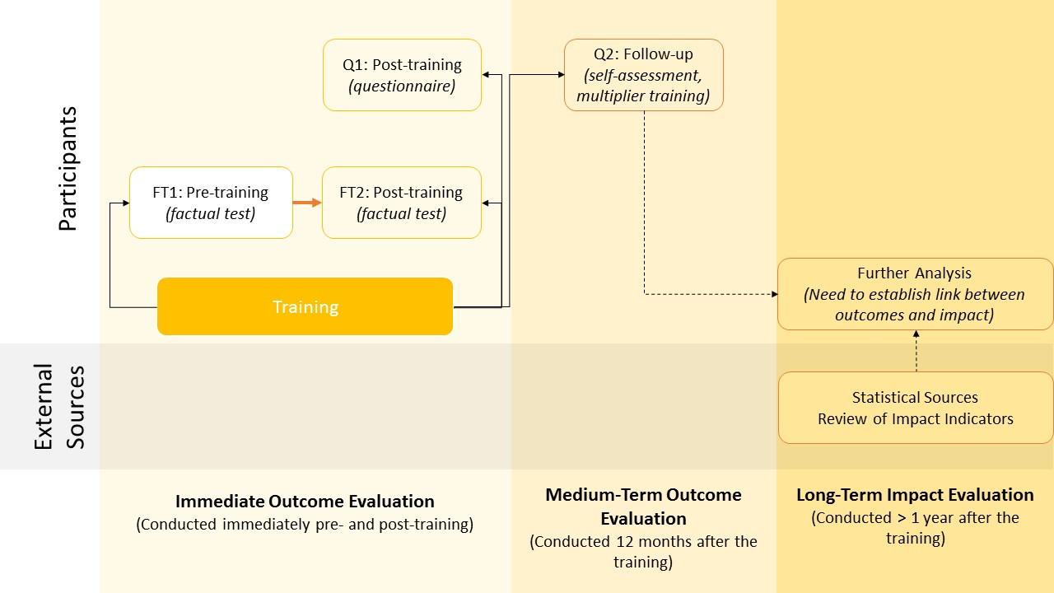
JIFSAN’s M&E Approach

Slide 9
Training efforts
FSMA – and international food safety capacity building
  Alliances – Preventive Controls, Produce Safety, FSVP, etc)
  JIFSAN (rolling out produce safety training with IICA in Latin America),
HACCP training via the GMA
GFSI trainings
Way forward

Slide 10
New Rules under FSMA
Preventive Controls rule for Food - requires a food facility to have and implement preventive controls to significantly minimize or prevent the occurrence of hazards that could affect food manufactured, processed, packed, or held by the facility.
Preventive Controls rule for Animals - establishes requirements for good manufacturing practices, and requires that certain facilities establish and implement hazard analysis and risk-based preventive controls for animal food, including ingredients and mixed animal feed.
Produce Safety rule - establishes the science-based minimum standards to reduce the risk of foodborne hazards associated with the production and harvesting of raw fruits and vegetables that are marketed as raw agricultural commodities.
Foreign Supplier Verification Programs rule - describes what a food importer must do to verify that its foreign suppliers produce food that is as safe as food produced in the United States.
Accreditation of Third-Party Certification rule - establishes a voluntary program for the accreditation of third-party certification bodies to conduct food-safety audits and issue certifications of foreign facilities and the foods they produce.
Sanitary Transportation of Human and Animal Food rule - establishes requirements for shippers, loaders, carriers by motor vehicle and rail vehicle, and receivers engaged in the transportation of food, including food for animals, to use sanitary transportation practices to ensure the safety of the food they transport.
Intentional Adulteration rule - requires facilities to implement a food defense plan to prevent actions intended to cause large-scale public harm

Slide 11
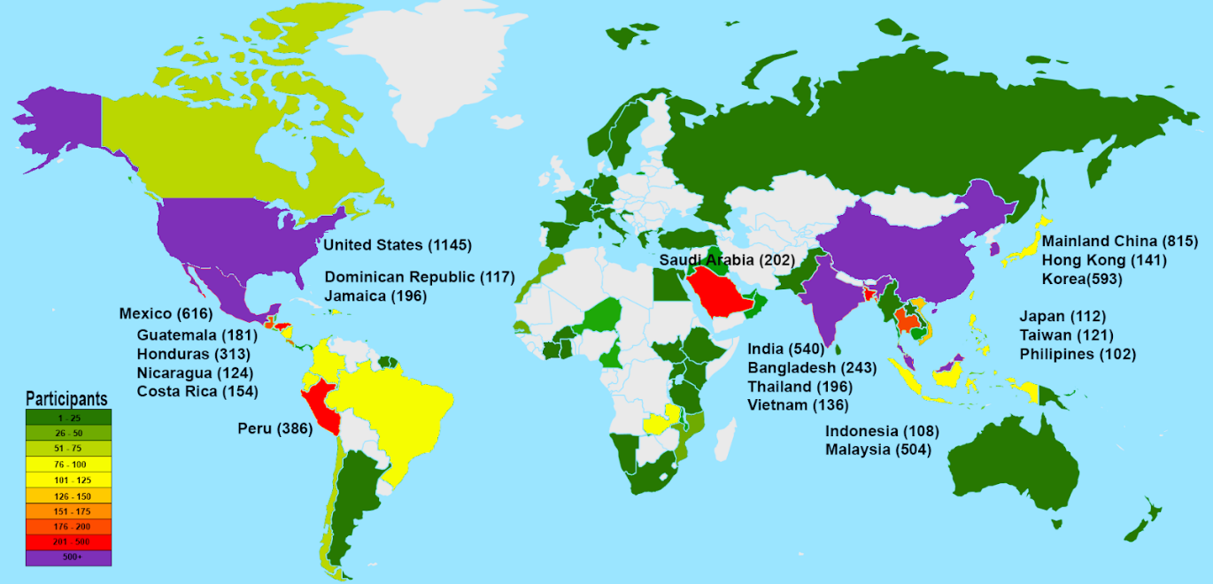
JIFSAN
Created in 1996, is a public private partnership between FDA, the University of Maryland, and the private sector.
Mission is to advance sound strategies that improve public health, food safety, and applied nutrition using risk analysis principles through cooperative research, education, and outreach programs internationally.
Since 2000 trained over 9000 individuals -much of the capacity-building is funded through a FDA cooperative agreement with support for specific country programs from the private sector, FDA, USDA- FAS, FSIS, USAID

Slide 13
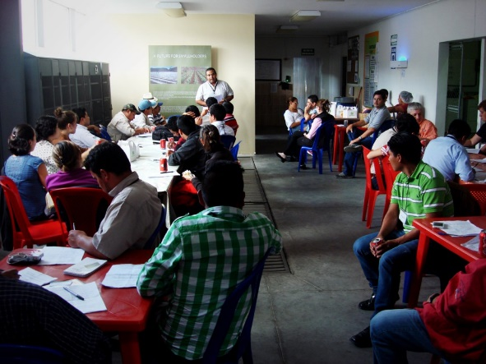
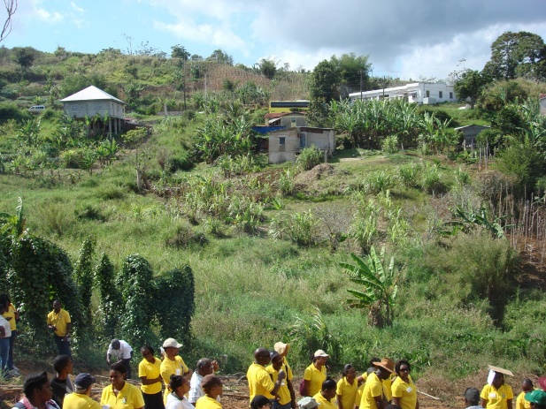
GAP trainings Typically Collaborative Efforts between JIFSAN, FDA, and Host Country
FDA identifies priority countries - JIFSAN reaches out to key local stakeholders to secure their buy-in.
  Try to do it within the fiscal year.
  Since 2002, host countries have been required to share the cost of the trainings with JIFSAN.
    JIFSAN funds the training up to the port of entry of the host country. ~$40 K (salary of trainers and flights).
    Host country and other partners provide funding for training activities inside the country. ~$30 K (travel, housing, training venue, and logistical support)
Governments directly reach out to JIFSAN
  Governments self-fund the trainings (Malaysia) or seek funding from donor agencies like the World Bank, IDB, USDA/FAS, etc. (Jamaica)
Guatemala
Jamaica
  Note: While the shared funding policy was implemented before FSMA, it is based on several of the
  principles in the FDA International Capacity Building Plan

Slide 14
GAPs Training
Host countries are responsible for identifying the participants who will become future lead trainers in GAP
2000 -2017, the course was held 46 times throughout the world and 2,192 individuals were trained.
2013-2017(M&E implemented in all trainings) all of JIFSAN’s GAP capacity building took place in Latin America/ Caribbean
2017 – moved to produce safety rule training
2017 | Managua, Nicaragua (PSA GT) | August 7-11, 2017 | 45
2017 | Kingston, Jamaica (PSA TTT) | August 22-25, 2017 | 42
2017 | Santo Domingo, Dominican Republic (PSA TTT) | October 16-20, 2017 | 32
2017 | Guatemala City, Guatemala (PSA TTT) | October 24-27, 2017 | 30
2017 | Lima, Peru (PSA TTT) | November 7-10, 2017 | 36
2018 | Tegucigalpa, Honduras (PSA TTT) | March 6-9, 2018
2018 | San Luis Potosi, Mexico | May 31 - June 3 (2 individuals from each state)
2018 | San José, Costa Rica | August 6-10 (4-5 individuals from 16 countries)

Slide 15
Measures of Immediate Impact of GAP trainings (Process)
95% satisfied with the training
Participants earned higher average scores in post-tests than in pre-tests
  indicates an overall improvement in factual knowledge
Post score standard deviation was also lower than that of the pre score
  indicates participants’ factual knowledge became more aligned between the two groups after the training
Statistical analysis of the test scores and score improvements after training addressed some of the concerns about adapting trainings to international participants and points to potential improvement and training emphasis in the future

Slide 16
Caveats of Analysis
Sample size is small
  Going forward focus is on Alliance training associated with the Produce Rule
We are using test results and changes as a metric
  Test taking is not the only measure of learning
  Continual monitoring and evaluation are needed to provide more evidence to the initial results and to answer questions
    Do different country selection mechanisms affect training effectiveness through trainee motivation?
Medium-term effects - need to strengthen relationship with country partners so as to get better response rates on following up surveys
  ~35-50% response rate with help of instructors; higher response rate from those whose funding is outside the Cooperative Agreement
  Suggest the helping with the follow-up M&E becomes a requirement of having training
Long term impacts - gathering secondary data to estimate long-term impacts are

Slide 17
What Makes a Collaborative Training Initiative?
Agreements (JIFSAN and country partners) to provide a sustainable partnership that will result in scaled up food safety training in virtual centers housed within the partner institute
  JIFSAN works with countries to identify and obtain support from local partners (government, industry, academia, and local institutions)
  Local partners are responsible for utilizing existing resources and developing a business plan that includes fundraising with other entities
    Responsible for identifying individuals to become lead trainers
    Lead trainers adapt training material to the needs of their countries supply chains and help disseminate it throughout the country via ‘multiplier’ trainings
    After lead trainers are trained, JIFSAN instructors may return to the country to assist in the delivery of multiplier trainings, but the goal is for the country to take ownership
    Over time, the role of JIFSAN declines and JIFSAN serves in more of an advisory capacity role

Slide 18
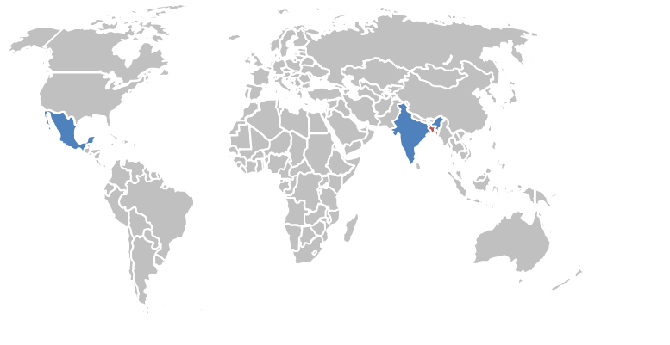
Global Food Safety Collaborative Training Initiatives
Bangladesh (GAqP)
  Bangladesh Shrimp and Fish Foundation
India (Supply Chain Management for Spices and Botanical Ingredients)
  CII Jubilant Bhartia Food and Agriculture Centre of Excellence
  Spice Board
Thailand (CSPF)
  King Mongkut’s University of Technology Thonburi (KMUTT)
  Chulalongkom University
Mexico (Produce Safety Training)
  SENASICA
  Universidad Nacional Autónoma de México (September 2018)
IICA/regional training Center (September, 2018)
To provide a vehicle and framework to sustain in-country regional training and capacity building thereby leveraging JIFSAN and FDA training resources.
Notes:
Flexibility
Country/market sector ownership and involvement
Program aligns with country partners’ agenda and using country partners’ systems
Country partners set the agenda based on needs of the country’s food safety system/market sector
Country partner identifies/obtains the resources to develop and sustain the program (working for India -Spices, Bangladesh Aquaculture)

Slide 19

Three Phase Approach
Phase I - JIFSAN goes to the host country to train a group of potential lead trainers
  In-country partner identifies eight to ten individuals from that group to become future lead trainers
Phase II - the selected individuals come to JIFSAN to participate in an intensive two-week internship
  Tailor training to meet countries needs
  develop an action plan on how to promulgate the training to industry, government, primary producers, and other value chain actors
  Action plan also includes an M&E plan to measure the impact of future trainings
Phase III - lead trainers develop country- or region-specific training materials that they use to train local food market players
Notes:
Handouts avaialbe

Slide 20
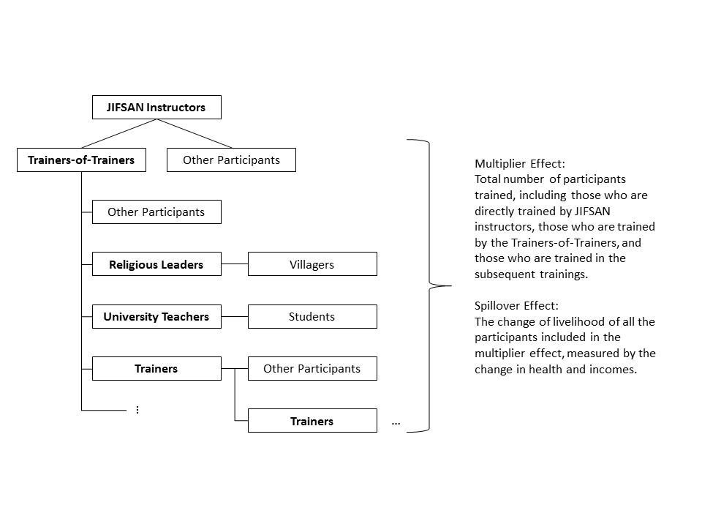

Slide 21
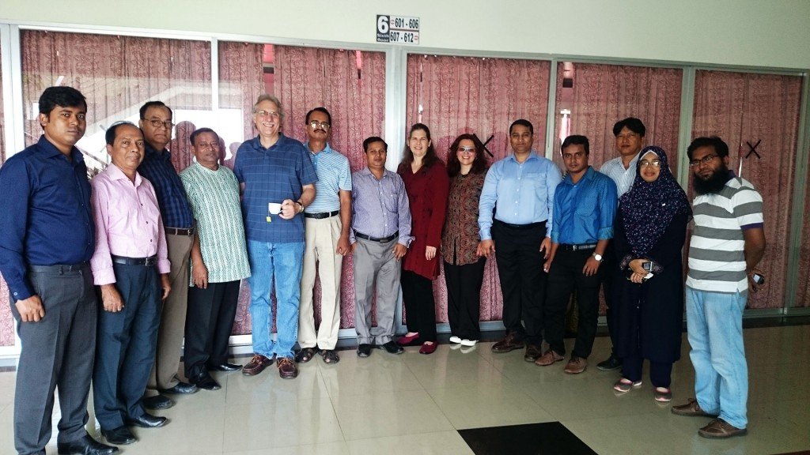
Bangladesh’s Aquatic and Aquaculture Food Safety Center
Phase I – 2009 JIFSAN delivered GAqP training program in Kuhlna, from which potential lead trainers were selected
Phase II - lead trainers came to JIFSAN and Virginia Tech for training.
Participants worked with JIFSAN instructors to identify components of the existing GAqP program that they could use in their trainings and additional areas that were specifically relevant to the Bangladesh industry
Phase III, Dec 2011 -JIFSAN’s GAqP program held in Bangladesh with a third of the program presented by the Bangladesh AAFSC lead trainers
2014, the curriculum extended to include a two-day HACCP training
2016, JIFSAN delivered the Association of Food and Drug Officials / Alliance Training on Seafood HACCP.
  Some difficulty in certification due problems in accessing the online course and the funding in US dollars to pay for the certification process
  BSFF have been discussing with JIFSAN instructors about more practical ways to getting AFDO certification
close to 20 thousand Bangladeshi individuals have been trained to
help ensure the safety of Bangladesh fish and aquaculture products

Slide 22
Trainings at Bangladesh’s AAFSC Directly Involving JIFSAN
 | Year | Location | Number of Participants | Funding
Phase I | 2009 | Khulna, Bangladesh- GAqP | 47 | Cooperative Agreement - BSFF & Dept. of Fisheries - USAID/Price - Katalyst
Phase II | 2010 | Bangladesh (in Maryland) - GAqP | 9 | Cooperative Agreement - BSFF
Phase III | 2010 | Cox's Bazar, Bangladesh - GAqP | 38 | Cooperative Agreement - BSFF & Dept. of Fisheries
 | 2011 | Khulna, Bangladesh - GAqP | 20 | Cooperative Agreement - BSFF & Dept. of Fisheries
 | 2014 | Khulna, Bangladesh, GAqP | 36 | Cooperative Agreement - USDA FAS - BSFF & Dept. of Fisheries
 | 2015 | Bangladesh - GFVP + HACCP | 38 | Cooperative Agreement - USDA FAS - BSFF & Dept. of Fisheries
 | 2016 | Bangladesh - HACCP ToT | 25 | Cooperative Agreement - USDA FAS - GFSP, Responsible Aquaculture Foundation and AFDO
 |  | Total | 213

Slide 23
Additional AAFSC Phase III trainings
Name of the topic | Events | Participants trained | Institutions | Districts covered
AAFSC accomplishments in food security, 2009 - 2014
Organized ToT on GAqP (Development of Core Trainers) | 17 | 600 | 15 | 24
Organized field-level training on GAqP, Code of Conducts and Codex, Seafood HACCP | 54 | 2120 |  | 32
Training diversification to reach mass community
GAqP to school teacher & Imam (Head Priest of Mosques) | 4 | 200 | 65 | 4
GAqP to field-level government officials | 3 | 100 | 9 | 3
GAqP to university teachers | 5 | 160 | 16
GFVP | 1 | 40 | 16
Seafood HACCP by SHA (Seafood HACCP AFDO) and Cornell University | 1 | 30 | 7
GAqP on dry fish | 1 | 50 | 26 | 1
List of training programs conducted by BSFF with support from JIFSAN, 2014 - 2016
HACCP | 16 | 800
GAqP | 18 | 900
GAqP + HACCP | 1 | 50
GAqP + HACCP + CODEX | 1 | 50
CODEX | 6 | 300
GFVP | 1 | 50
Risk Management | 1 | 50
HACCP/CODEX | 1 | 50
Total |  | 5500
Data provided by the Bangladesh Shrimp and Fish Foundation, 2017

Slide 24
Additional Food Safety Capacity Building Trainings Collaborating with BSFF (raised over $72 million additional funds)
Training/Program | No. of Training | Total No. of Participants | Projects
CODEX | 44 | 2200 | BEGP, BPC
Farmers Field Program | 3 | 120 | FAO Food Safety Project
Food Control Guideline | 3 | 87 | FAO Food Safety Project
Food Control Guidelines in Fish Value chain | 1 | 32 | FAO Food Safety Project
Good Aquaculture Practices (GAqP) | 86 | 4300 | FAO Food Safety Project
HACCP | 24 | 1200 | BEGP, BPC
Safe Fish Production | 192 | 6278 | FAO Food Safety Project and Agri-Business for Trade Competitiveness (ACT-P)
Food Control Guidelines in Aquaculture Value chain | 3 | 72 | FAO Food Safety Project
Grand Total | 356 | 14,289

Slide 25
Number of Refusals of Selected Food Import Categories (2007-2017)

Slide 26
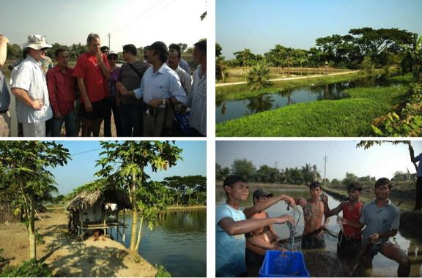
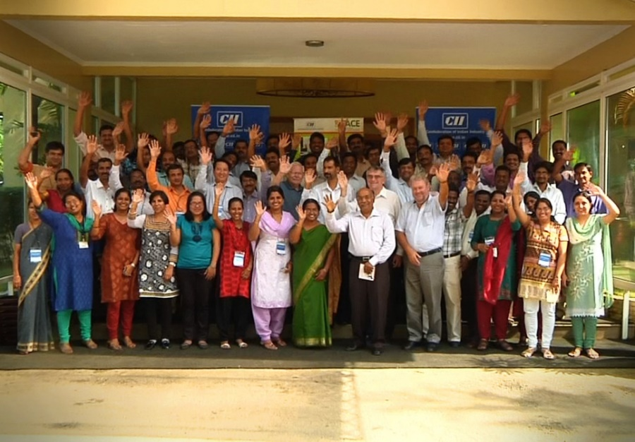
Lessons Learned from Centers
~20 k individuals trained in Bangladesh; ~8 k in India
Lead trainers tailor JIFSAN training material to local supply chains and create local language training material
Partner institutions worked to improve national laboratory infrastructure
Sustainability of Initiatives due to partnerships (industry groups and involving national and local governments)
Recognized from the start that initial training was the base from which additional work could be done. With external funds
With third party certifications some difficulties in producers accessing online courses and funds in US dollars to complete certification requirements.

Slide 27
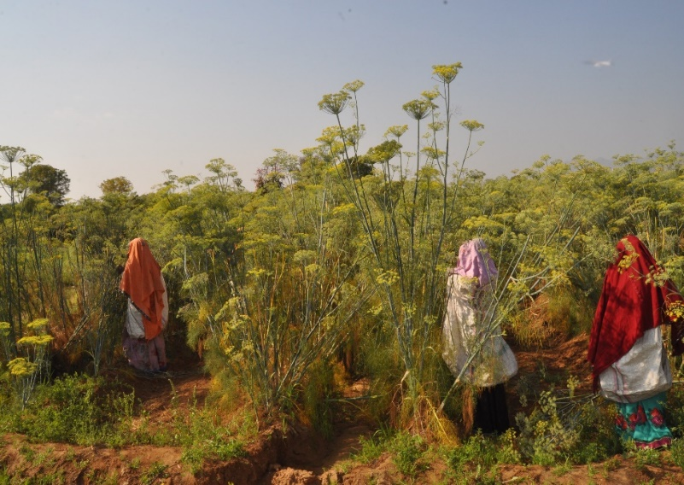
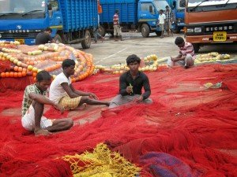
Lessons Learned from Center’s in terms of M&E
Existing approach focuses on examining the immediate learning outcome based on participant satisfaction and factual test scores
Approach needs to be altered to capture the impact of the expanding curricula, locations, and forms as they experiment with the best way to reach smallholders such trainings in rural communities using cluster farms
  shift the focus of M&E work to examining also the spillover effect
Ability to measure domestic benefit will paint a clearer picture of the importance of food safety, raises the awareness of governments in both developing and developed countries, and points to where resources should be directed to in the future.

Slide 28


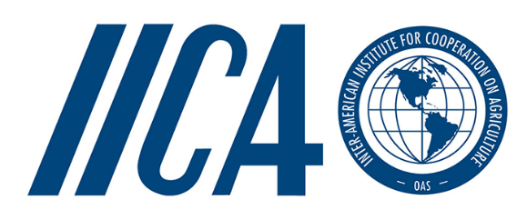
HACCP training in the Caribbean
Inter-American Institute for Cooperation on Agriculture (IICA) and the Grocery Manufactures Association(GMA) - Science and Education Foundation was awarded funding through EU to build the capacity of both public sector professionals and private sector stakeholders in CARIFORUM countries on Hazard Analysis and Critical Control Points (HACCP) preventive approaches to food safety, and the Joint Institute for Food Safety and Applied Nutrition (JIFSAN) to conduct monitoring and evaluation work
Train-the-trainer program aimed at developing a cadre of qualified HACCP trainers in the Caribbean that can subsequently deliver trainings region-wide.
Project aimed to increase the level of HACCP compliance and implementation among the private sector in the CARIFORUM.

Slide 29
Involvement in Exports & Training Activities
Involvement in Exports and Inspection & Regulation of Exports
Length of Involvement in Training Activities
HACCP Sessions Trained in Last Year
Other Non-HACCP Training Provided?*
Notes:
* Good Manufacturing Practices; Food Safety; Veterinary Public Health Lecturer; Disaster Risk Reduction and Management in Livestock Sector; Standard Operating Procedures; Post Harvest Horticulture; Health and safety, labor law, induction of new employees, all training related to social compliance more in the apparel sector; Food handling; Basic food safety & ServSafe; Prerequisites; Food Safety and Processing, Sampling Techniques; ASYCUDA, Business Plan Writing, Canadian Market Entry, Grant Proposal Writing; Professional development, business mentoring and life coaching; Laboratory/Quality Assurance; Capacity Building; Food Safety and Quality

Slide 30
6-Month Follow-Up Questionnaire (November, 2016)
All nine (9) of the participants from Phase I employed by a food manufacturing facility had either reviewed or are in the process of reviewing their company’s HACCP plan as a direct result of programme participation.
Seven of the nine had at least written a preliminary HACCP Plan and one company has since passed a third party food safety certification audit.
Since completion of Phase I, a total of 71 HACCP trainings have been delivered within the first six months, leading to an additional 336 people trained in HACCP throughout the Caribbean.
64% of participants have already received or are actively pursuing HACCP trainer certification from the International HACCP Alliance since completion of training.
Almost all participants from the regulatory agencies from Phase I indicated that the training helped them to do their jobs better by improving their ability to conduct inspections and explain how to take corrective actions.

Slide 31
Key recommendations for future training
Additional Trainings for the Private Sector Employees needed
Throughout both phases of the project, senior trainers noted the need for participants to receive basic training in GMPs and food safety prior to receiving HACCP training. Indeed, a lack of foundational knowledge is cited as one of the main barriers to HACCP implementation by program participants.
  This was especially true of participants from small to medium sized businesses.
Lack of time for completion of online training also resulted in poor performance among some participants. This was especially true of Phase II participants due to the short time between final participant selection and trainings.
Many of the participants from the private sector cited lack of buy-in or awareness from other employees within their companies as a barrier to HACCP implementation. Participants should receive coaching on how to talk to upper management within their companies in order to obtain management’s commitment to implementing HACCP and food safety systems.

Slide 32
Way forward – Creating PPP’s to Measure the Impact
Difficulties using secondary data to measure long term impact
Hard to attribute to specific training done by any one group
  Some cases many players
  Harmonized trade data doesn't match FDA refusal data
Exploring working with private sector to obtain additional indicators
  # of companies with third party certification/GFSI certification
  Financial measures (improved or maintain first pass quality, reduction in number of rejected products, increased market access and trade)
  Internal control measures (Audit sores, facility/operation externally certified records)
Partnering with the private sector and forming such partnerships for data sharing to achieve improved public health outcomes.
USDA Branded Food Products Database is the result of a successful PPP with USDA/ARS, International Life Science Institute (ILSI), GS1 US., 1WorldSync, Label Insight, and University of Maryland’s JIFSAN. .
  Goal - enhance public health and the sharing of open data by complementing the USDA National Nutrient Database for Standard Reference with nutrient composition of branded foods and private label data provided by the food industry.

