Slide 1
Effectiveness of International Food Safety Train-The Trainer Programs in
Good Agricultural and Aqua cultural Practices: Evidence from Survey Instruments
Clare Narrod, Mark Miller, Tarik Chfadi Joint Institute for Food Safety and Applied Nutrition, University of Maryland
Selected Poster prepared for presentation at the 2016 Agricultural & Applied Economics Association Annual Meeting,
Boston, MA, July 31 – Aug. 2.
Copyright 2016 by Clare Narrod,Mark Miller, and Tarik Chfadi All rights reserved. Readers may make verbatim copies of this document for non-commercial purposes

Slide 2

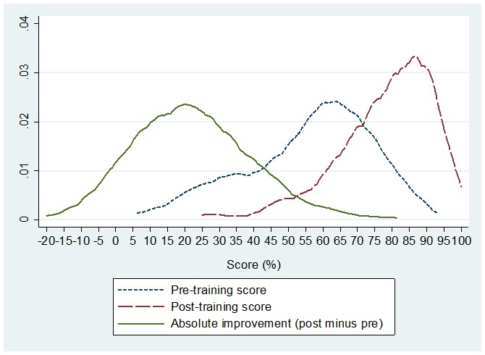
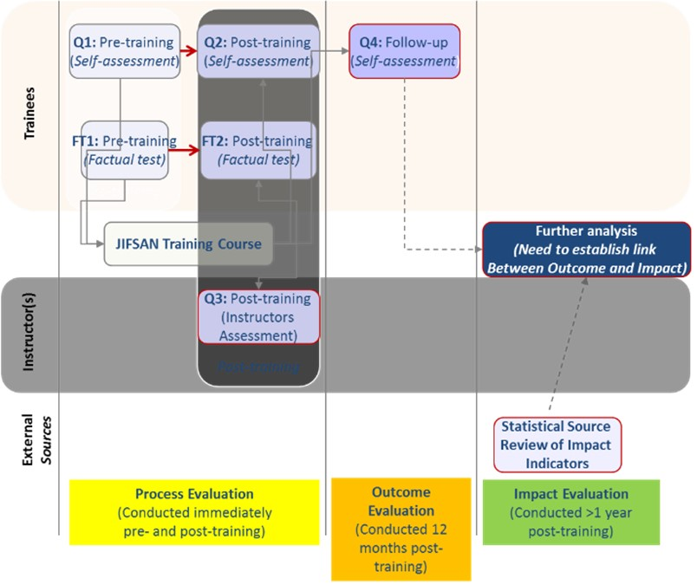
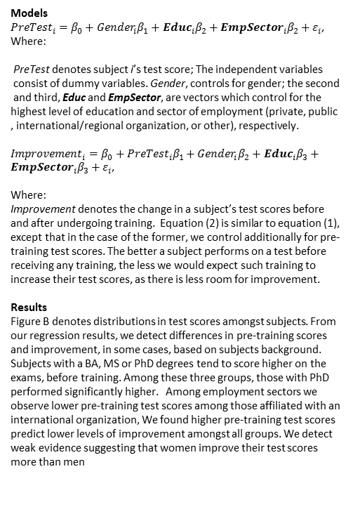
Effectiveness of International Food Safety Train-The Trainer Programs in Good Agricultural and Aqua cultural Practices: Evidence from Survey Instruments Clare Narrod, Mark Miller, Tarik Chfadi Joint Institute for Food Safety and Applied Nutrition, University of Maryland
Background
The US Food Safety Modernization Act, implemented in 2011, includes new regulations for farms growing produce and for facilities processing food. The Act also charged the FDA to develop a comprehensive plan to expand the technical, scientific and regulatory capacity of foreign governments exporting foods to the US, and their respective food industries. To that end, the Joint Institute for Food Safety and Applied Nutrition, FDA’s international food safety trainings center, developed a monitoring and impact approach that has been in place for all their international train the trainer programs.
Figure b
Objective
To develop a framework for evaluating the impact of food safety capacity building efforts. To develop a set of evaluation tools/instruments to identity socio-economic factors that may affect changes in participants factual test scores.
Models
${PreTest}_{i}={β_{0}+Gender}_{i}β_{1}+{Educ}_{i}β_{2}+{EmpSector}_{i}β_{2}+ε_{i}$,
Where:
PreTest denotes subject i’s test score; The independent variables
consist of dummy variables. Gender, controls for gender; the second
and third, Educ and EmpSector, are vectors which control for the
highest level of education and sector of employment (private, public
, international/regional organization, or other), respectively.
${Improvement}_{i}=β_{0}+{PreTest}_{i}β_{1}+{Gender}_{i}β_{2}+{Educ}_{i}β_{3}+{EmpSector}_{i}β_{3}+ε_{i}$,
Where:
Improvement denotes the change in a subject’s test scores before and after undergoing training. Equation (2) is similar to equation (1), except that in the case of the former, we control additionally for pre-training test scores. The better a subject performs on a test before receiving any training, the less we would expect such training to increase their test scores, as there is less room for improvement.
Results
Figure B denotes distributions in test scores amongst subjects. From our regression results, we detect differences in pre-training scores and improvement, in some cases, based on subjects background. Subjects with a BA, MS or PhD degrees tend to score higher on the exams, before training. Among these three groups, those with PhD performed significantly higher. Among employment sectors we observe lower pre-training test scores among those affiliated with an international organization, We found higher pre-training test scores predict lower levels of improvement amongst all groups. We detect weak evidence suggesting that women improve their test scores more than men
Conceptual model
Conclusion
Overall we do not observe a significant difference in test score
improvement across employment sectors. The only trainings for
which differences are detected are those for GAqPs. Improvement for those in the private sector is the lowest, followed by local and federal public workers, among these groups, differences are not significant, suggesting comparable outcomes after controlling for other factors. It is possible that the those in the private sector are less used to taking tests.
Data:
Our data includes the results from 286 participants over 11 distinct training sessions from eight countries (Bangladesh, India, Ecuador, Guatemala, Indonesia, Jamaica, Mexico, and Vietnam). Subjects were included which 1) did not include missing data on any of the variables, and 2) had nonzero scores for both the pre-training and post-training factual test, respectively. Summary statistics characterizing the sample are displayed in Table 1 and the change in test score figure 2.

