Slide 1

Why Consider GAqPs?
<Enter Instructor Name and Title Here>
45 minutes
Notes:
Why Use GAqPs?
Instructor Guide
CC BY-NC 4.0
45 minutes

Slide 2
What Do You Remember?
Ensure food safety; more demand, more money, less problems
Food Safety
Biosecurity
Best Management Practices (BMPs)
GAqP
Program
Prevent diseases; save money and help the environment
Maintain health; ensure a harvest, make money
Notes:
What Do You Remember?
INSTRUCTOR NOTE: Before class enter the name of the instructor on the cover slide.
Ask: What is the benefit of including BMPs in your GAqP program?
<Select Enter to advance the slide build.>
Debrief using answer shown on the slide.
Ask: What is the benefit of including Biosecurity in your GAqP program?
<Select Enter to advance the slide build.>
Debrief using answer shown on the slide.
Ask: What is the benefit of including a Food Safety Plan in your GAqP program?
<Select Enter to advance the slide build.>
Debrief using answer shown on the slide.

Slide 3
How GAqPs Help
Do you have:
Documentation?
Evidence?
Records?
Transparency?
Can you show and tell your story to:
Bankers?
Importers?
Buyers?
Consumers?
Can you traceback to correct problems?
Food Safety
Biosecurity
Best Management Practices (BMPs)
GAqP
Program
Notes:
How GAqPs Help
Say: In this lesson we will discuss how GAqPs can help seafood producers and what a GAqP program should include.
<Select Enter to advance the slide build.>
Say: A GAqP Food Safety Plan makes a difference, even if you are already following best practices. Do you have documentation? Evidence? Records? Transparency?
<Select Enter to advance the slide build.>
Say: Can you show and tell your story to bankers? Importers? Buyers? Consumers?
<Select Enter to advance the slide build.>
Say: Can you traceback to correct problems?

Slide 4
A Virtuous Cycle
Export product
Farm/Producers
Prevent diseases and get a harvest
Produce food that is safe for human consumption while adhering to domestic and international regulations and standards
Feed the World
The U.S. and many countries must import seafood
17% of the world’s animal protein intake comes from seafood
Make a profit
Build trust in your brand
Benefit the industry
Notes:
A Virtuous Cycle
Say: Here is why it is important that farms, countries, industry organizations, and third-party certification groups consider having a GAqP program.
Read each part of the diagram as it appears. <Select Enter to advance the slide build.>
Say: Let’s begin by looking at how you, a producer, can benefit from using Good Aquaculture Practices?

Slide 5

Why Are GAqPs Important to Farms/Producers?
Increased demand
Food security
Nutrition
Improved perception
3 billion people rely on seafood
40% of the world’s population—3 billion people—rely on seafood as their primary protein source
Notes:
Why Are GAqPs Important to Farms/Producers?
Ask: Why are GAqPs important to aquaculture-producing countries?
<Select Enter to advance the slide build.>
Debrief one-by-one:
Increase Demand
Food security
Nutritional
Perception
Say: We will look at each of these in more detail during this lesson.
<Select Enter to advance the slide build.>
Read the facts on the slide.

Slide 6

Increased Demand Is an Opportunity for Seafood
Global Seafood Consumption
2012
2030
Farm Raised
Wild Caught
Sources: FAO FIPS (2014)//Fish to 2030 (2013)
Notes:
Increased Demand Is an Opportunity for Seafood
Say: This chart shows the global demand for seafood in the past and in the future. This forecasts a major impact on food security and trade.
Point out the expected demand for seafood and the deficit in the supply. The need to satisfy the deficit is an opportunity for the aquaculture industry.
Say: Factors that will increase demand include:
Population growth: As the world’s population grows, so does the demand for food.
Lifestyle changes: People are cooking more at home and looking for healthy, fast options.
Income growth: As incomes rise, so does the demand for nutritious food.
Culture: People may eat fish for a variety of reasons, including taste, health, and sustainability.
Factors that may limit supply include:
Overfishing: In many parts of the world, fish are being harvested faster than they can reproduce.
Restrictions on fish farming: Restrictions on fish farming can limit the amount of seafood that can be produced.
Fisheries pushed to their limits: More than 85% of the world’s fisheries are currently pushed to or beyond their limits.

Slide 7
Food Security Is an Opportunity for Aquaculture
Human population growth is expected to increase from 6.8 billion to over 9.2 billion by 2050.
95% prediction interval
Median Variant
© 2024 United Nations, DESA, Population Division. Licensed under Creative Commons license CC by 3.0 IGO. United Nations, DESA, Population Division. World Population Prospects 2024 http://population.un.org/wpp/
Notes:
Food Security Is an Opportunity for Aquaculture
Say: What makes aquaculture important for food security worldwide and an opportunity for growth as the population increases?
<Select Enter to advance the slide build.>
Say: Aquaculture is important for food security by providing high-quality protein for the world. Human population growth is expected to go from 6.8 billion to 9.2 billion in 2050.
An important common thread occurs when countries go through the steps of economic development. They start to consume more protein.

Slide 8
Food Security Is an Opportunity for Aquaculture
Human population growth is expected to increase from 6.8 billion to over 9.2 billion by 2050.
Which means the 9.2 billion people in 2050 will eat as much as 13 billion people eat because of the increase meat consumption!
More meat means more use of water, feed, land use, and more environmental effects, etc.
Notes:
Food Security Is an Opportunity for Aquaculture, continued
Say: That’s why in 2050, 9.2 billion people will eat as much as 13 billion people.
Where is the food going to come from? The earth is 2/3 water. Let’s farm it like the land…..but responsibly. This provides a wonderful opportunity for aquaculture growth and to have a successful aquaculture industry.

Slide 9
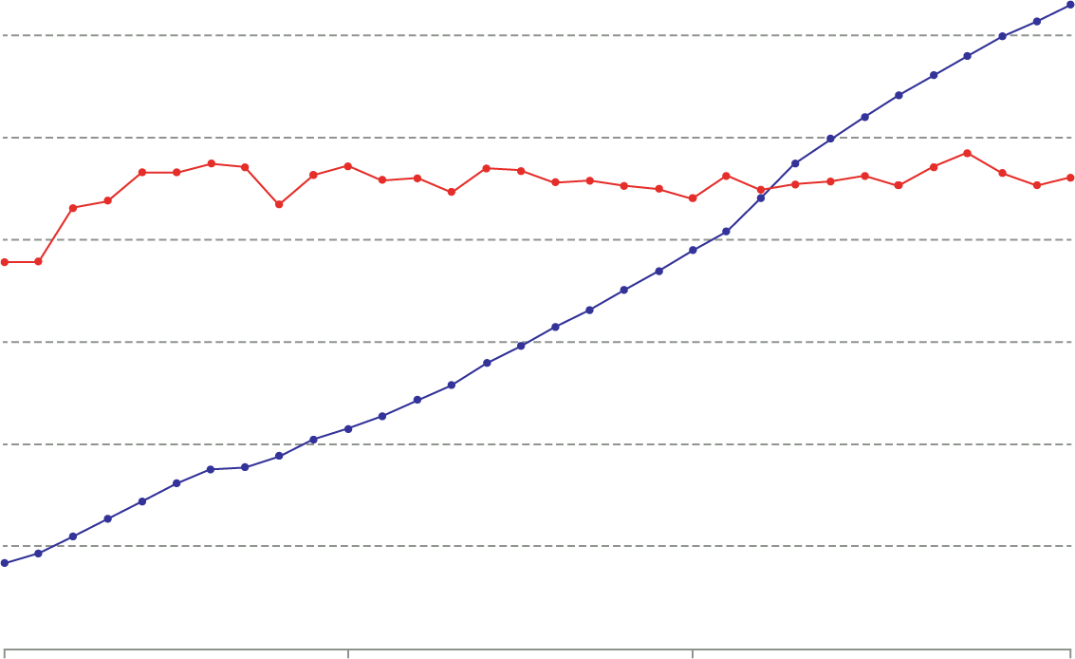
Producing Seafood: Wild Catch vs. Aquaculture
Aquaculture
120 million tons
100 million tons
Wild Catch
80 million tons
60 million tons
40 million tons
20 million tons
0 t
1990
2000
2010
2021
Notes:
Producing Seafood: Wild Catch vs. Aquaculture
Say: The additional supply must come from aquaculture producers like you.
Here is an example. Capture or wild-caught seafood has been flat for many years while aquaculture has grown dramatically over the past 20 to 30 years.
Aquaculture needs to follow best practices and GAqPs are one option for ensuring the safety and quality of your product.

Slide 10




Nutrition Is an Opportunity for Aquaculture
Feed Conversion Rates
Estimated feed required to gain one pound of body mass
Farm-raised Seafood
Broiler Chicken
Hogs
Cattle
1.1
POUNDS
1.7
POUNDS
2.9
POUNDS
6.8
POUNDS
Notes:
Nutrition Is an Opportunity for Aquaculture
Say: Feed conversion is the amount of feed that it takes to produce one pound of body mass for animals. As shown here 1.1 pounds of feed is needed to produce one pound of shrimp or other farm-raised seafood while, in contrast, it takes 6.8 pounds of feed to produce a single pound of beef.
This is another opportunity for growth in aquaculture using GAqPs.
In terms of the effect, more meat will require much more water and land to grow the feed necessary for animal feed,
One good reason for countries to encourage aquaculture as a protein source is that aquaculture, done correctly, is the most efficient use of feed for meat protein. This slide shows the 1.1 feed conversion rate for aquaculture products. However, this can vary. In Norway, for example, salmon can be grown with a feed conversion of less than 1.0.

Slide 11
Improved Perception Is an Opportunity for Aquaculture
GAqPs help to improve perception by offering:
Transparency: Explaining what you are doing step-by-step
Evidence: Documenting your process proves your story
Storytelling: Use these details to show and tell your story
Building trust and demand for your product(s)
Do you have:
Documentation?
Evidence?
Records?
Transparency?
Can you show and tell your story to:
Bankers?
Importers?
Buyers?
Consumers?
Can you traceback to correct problems?
Notes:
Improved Perception Is an Opportunity for Aquaculture
Read the slide.
Say: Modern aquaculture is less than 40 years old whereas agriculture is 1000s years old. The fact is when you clear-cut trees and plow virgin land for agriculture, it probably will never come back to its original natural state. Aquaculture has a minimal impact at the beginning and if you move it from place to place using a fallow method, there is no or very little impact over time.
Improving the perception of aquaculture is also an opportunity for growth in aquaculture-producing countries. Improving perception can mean additional consumption of a product because people trust its quality and safety. They will decide to buy it.
<Select Enter to advance the slide build.>
Say: GAqPs can help improve the perception of aquaculture by providing evidence of what you are doing. You can show and tell your story to NGOs, the public, banks, buyers, and consumers. This builds trust in aquaculture products which is good for public health, the aquaculture industry, and your country.
Again, you may already be practicing biosecurity, BMPs, and food safety but do you have documentation and evidence to show and prove what you are doing? Can you tell your story to others?
Pause to allow for individual comments or questions.

Slide 12
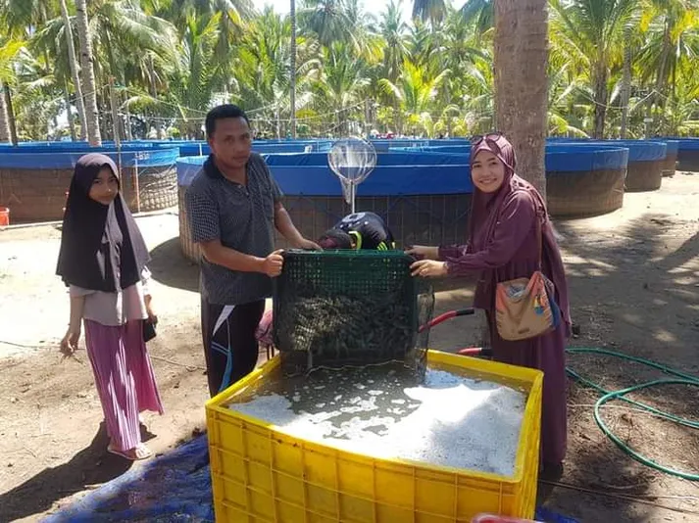
Become Well-Known and Trusted for Aquaculture
Feed the planet and provide food security
Use GAqPs to improve perception and demand for aquaculture
Conduct corrective actions
Create transparency with your banks, buyers, and consumers as a way to build trust
Notes:
Become Well-Known and Trusted for Aquaculture
Read the bullets on the slide.
Ask: When you think of a country known for a product brand, what comes to mind?
Debrief accepting all answers as correct. Emphasize the point that GAqPs can help to improve the reputation of a country and its industry, government, and academia. It can be helpful to collaborate and build common standards and a culture of quality, safe aquacultured seafood.

Slide 13
Why Are GAqPs Important to the U.S.?
What Food Is Most Traded In the World?
Cocoa?
Coffee?
Bananas?
Rice?
Seafood?
Tea?
The U.S. imports 90-94% of seafood
Most is from aquaculture operations
Food safety risks or hazards can occur and impact U.S. consumers
We have limited regulatory control of farms and producers
Seafood
Notes:
Why Are GAqPs Important to the U.S.?
Ask: What food in most traded in the world?
<Select Enter to advance the slide build.>
Debrief: Seafood. By far, more than coffee, rice, and sugar combined. (By value not volume.)
Ask: Why GAqPs are important to the United States?
<Select Enter to advance the slide build.>
Debrief: The U.S. imports 90-94 percent of all seafood, most from aquaculture operations. However, food safety risks or hazards can occur and the U.S. FDA does not have regulatory control or oversight of seafood farms and producers around the world. That’s why we developed GAqPs.

Slide 14
U.S. Seafood Imports
Imported Shrimp – 95%
Notes:
U.S. Seafood Imports
Say: Imported seafood is very important to the U.S. That’s where we get the vast majority of our seafood. As you can see, in 2006, the U.S. imported 83% of our seafood. We now import 94% of all seafood…
<Select Enter to advance the slide build.>
Say: …and 95% of the shrimp we eat.

Slide 15

U.S. Consumption of Imported Seafood
SEAFOOD
Shrimp
Salmon
Canned Tuna
Tilapia
Pangasius
Alaska Polluck
Cod
Catfish
Crab
Oysters
Point of Sale (retail)
Producer
Processing
Consumer
Notes:
U.S. Consumption of Imported Seafood
Say: Here is a list of the seafood most consumed in the U.S.
<Select Enter to advance the slide build.>
Say: These are mostly produced using aquaculture.
<Select Enter to advance the slide build.>
Say: Food safety hazards and risks are still associated with aquaculture seafood products.
Ask: Which of these is the weakest link in the food safety chain?
Debrief ensuring the following is mentioned:
In aquaculture products, it is the producer or the farm. This is because there is less regulatory oversight.

Slide 16
GAqPs Prevent Food Safety Issues
Food Safety
Food Safety Issues:
Drug Residues
Salmonella
Filth
Decomposition
Pesticides
Heavy Metals
Best Management Practices (BMPs)
Biosecurity
Notes:
GAqPs Prevent Food Safety Issues
Say: As we have learned in this course, there are food safety hazards and risks associated with aquaculture – just like there are with all foods.
Briefly read through the examples. Add a story or two about where hazards may occur at farms.
Say: Even though most seafood comes from farms, the U.S. FDA and many other importing countries do not have regulatory programs at farms. The U.S. FDA collaborated with JIFSAN and several universities to develop Good Aquaculture Practices.
GAqP is a voluntary program that helps aquaculture producers or farmers avoid food safety problems domestically and at the border.
Over time the U.S. FDA and JIFSAN have collaborated with many countries, including India, Indonesia, Ecuador, Vietnam, Thailand, Peru, and others. This has encouraged farms and countries to develop and implement their own GAqP-type program.

Slide 17
U.S. FDA Tests for Salmonella in Shrimp/Prawns
71
19
https://datadashboard.fda.gov/ora/index.htm
Notes:
U.S FDA Tests for Salmonella in Shrimp/Prawns
Say: Regarding safety problems, this slide shows the number of times shipments of shrimp and prawns have been refused, that is they have not been allowed to enter the U.S. due to salmonella discovered in the shipment. It shows 2003-2023 – a twenty-year period.
Notice that in 2005, the U.S. FDA found salmonella in 71 shipments. And in 2023 U.S. FDA found salmonella in 19 shipments of shrimp and or prawns. Every year some seafood product is refused, the chart shows how more is refused in some years, less in other years.
Refused shipments due to salmonella or other biohazards can be very costly and can be the reason for bad publicity and a loss of market share.
The data for this chart came from the FDA website. It’s free and publicly available and you can access it to see all of the regulatory actions the U.S. FDA has taken.
Demonstrate pulling up the website using the link shown on the slide, as time allows.

Slide 18
What Should a GAqP Program Include?
Food Safety
Biosecurity
Best Management Practices (BMPs)
Notes:
What Should a GAqP Program Include?
Ask: Using everything we’ve talked about in this course, what should a GAqP program include?
Debrief accepting all answers as correct and using the following set of slides to reinforce key points.
INSTRUCTOR NOTE: Allow participants to do most of the talking and guide the conversation and coverage of key points.

Slide 19
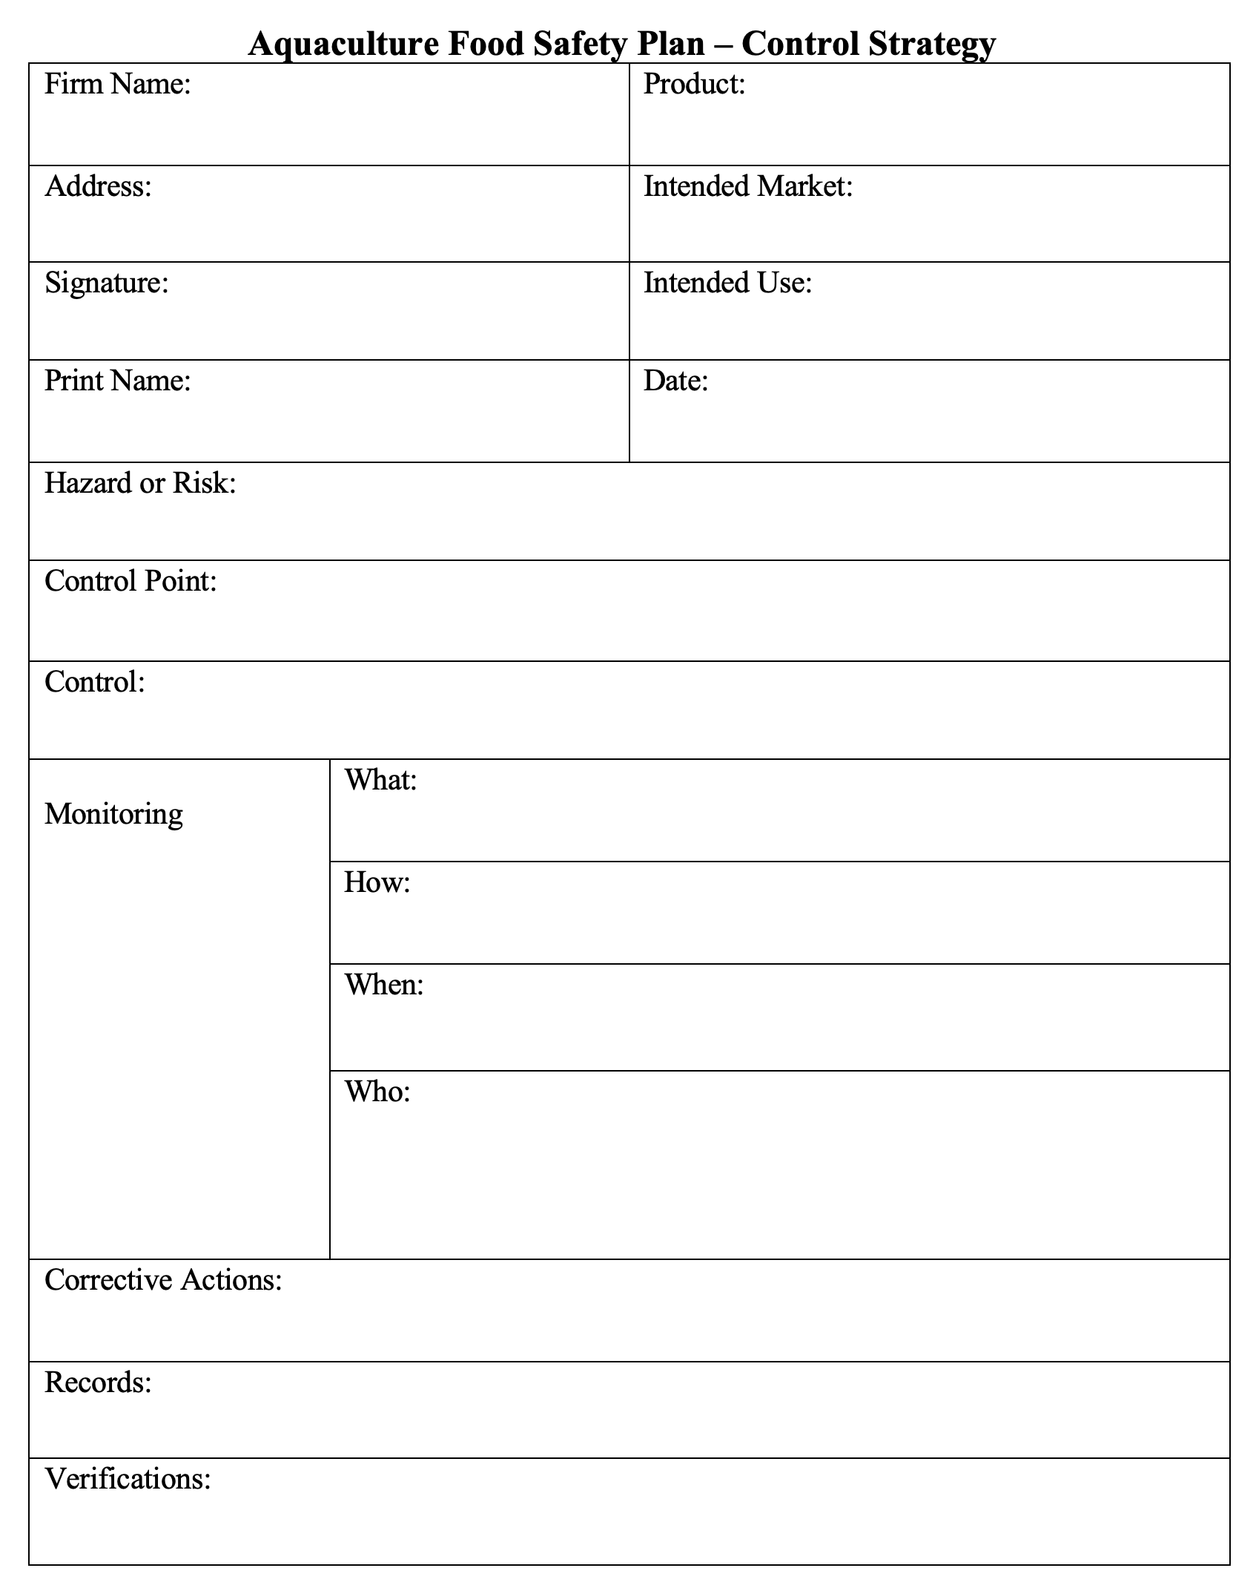
Food Safety Plans
Notes:
Food Safety Plans
Say: Use this form, SOPs, or something else. Whichever plan design you use, ensure it has the elements we have previously described.

Slide 20
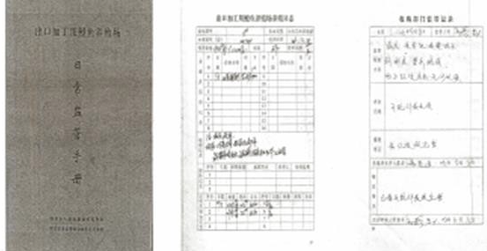
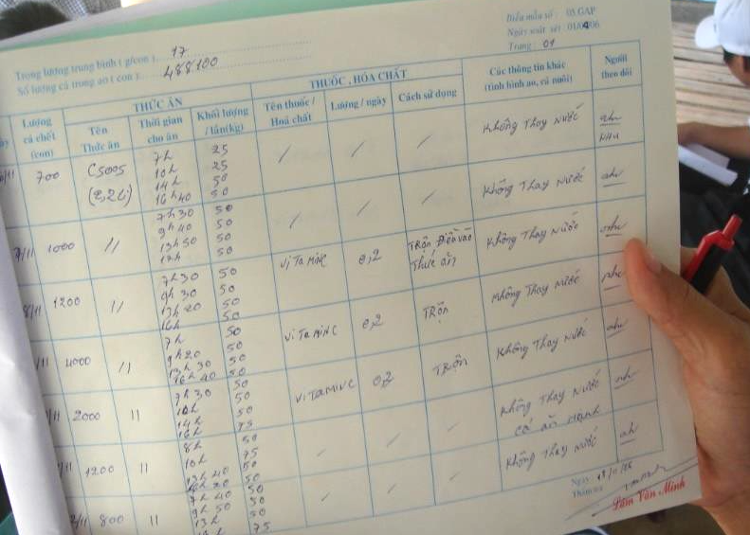
Records and Documentation
Keep written records of all medications used:
Name of drug
Date started
Date stopped
How much used
Calculated withdrawal times
Why it was used
Prescription
Notes:
Records and Documentation
Say: Keep records, this is your documentation, your evidence. Include important decisions as you make them such as why you included a certain disease as a likely risk vs. another disease. Document your “risk or hazard” analysis.
Maintain any guidance documents, SOPs, instructions for employees, written procedures, etc. For example, consider including an SOP describing how to make the sanitizing solution used for your dip nets, or how to collect water samples, etc.
Ensure your policies and procedures identify practices such as not going from one farm to another unless you have changed clothes, showered, or waited 24 hours in between visits.
Maintain the “One step forward, one step back principle”. This means document who you bought from and who you sold to. You should be able to identify the source of products as well as who you sold them to.
Keep written records of all medications used as follows:
Name of drug
Date started
Date stopped
How much used
Calculated withdrawal times
Why it was used
Prescription

Slide 21
Verification Testing
Notes:
Verification Testing
Say: Producers can spend millions of dollars on testing including testing the same lot of product many times. With a GAqP or other preventive program, millions of dollars can be saved by only testing for verification.
For example, sometimes the same product is tested for residues at the farm, again at the processor, before shipment, and again at the import stage. The same lot is tested several times. Not an efficient use of money or time.
As we mentioned earlier, verification is an important part of a Food Safety Plan. However, testing alone is not a preventive, proactive program.
Using a GAqP program verifies the complete Food Safely Plan is in place. A producer should be able to explain what and why a plan is in place and show proof via written plans and documents. Your verification step can be through a self audit you do on your own, a qualified third-party program, the government, and so on. You should use whatever method works for you and your situation.

Slide 22
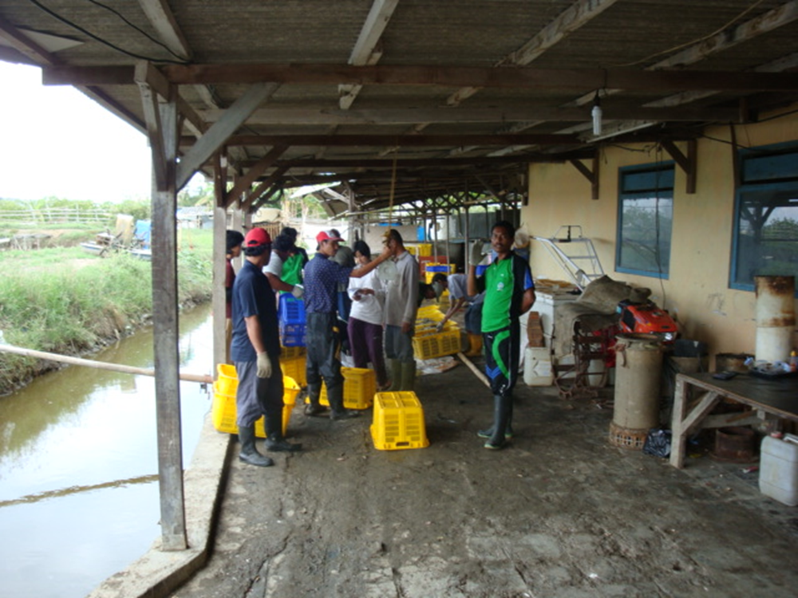
Training for Farm Workers
Notes:
Training for Farm Workers
Say: Training is very important in GAqPs, from what drugs and how to use them to identify disease symptoms in your animals.
The next few slides tell a story about the importance of employee training, which is an important element of GAqPs.
Just like this GAqP course, a team from JIFSAN was conducting a visit at a farm. The farm was expecting the group to come. This picture shows the participants in the class at the farm visit.

Slide 23
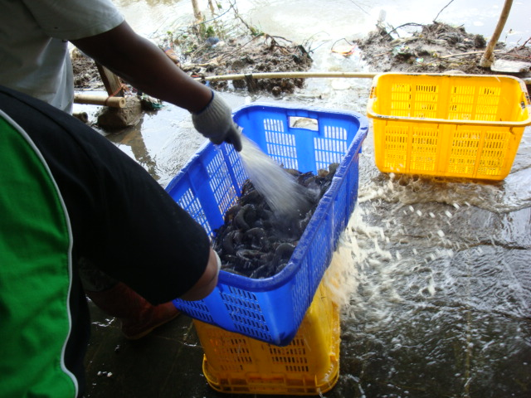
Training for Farm Workers
Notes:
Training for Farm Workers
Say: In this photo the farmer is washing fresh caught shrimp. Looks pretty good, right? The plastic totes appear to be clean and are up off the ground.

Slide 24
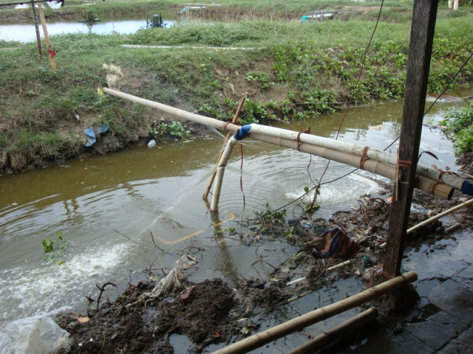
Training for Farm Workers
Notes:
Training for Farm Workers
Say: But where is the water coming from that the farmer is using to wash the shrimp?

Slide 25
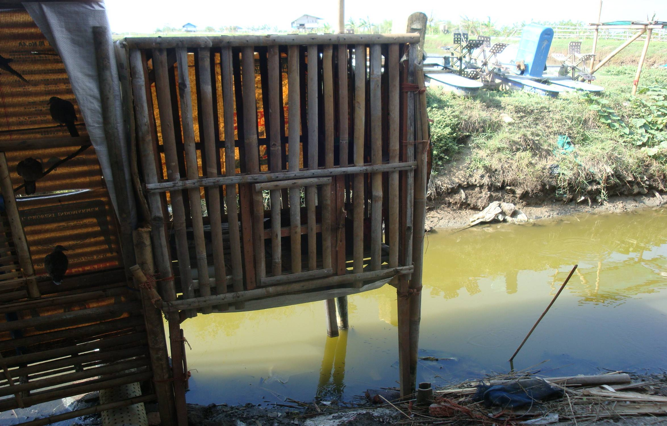
Training for Farm Workers
Notes:
Training for Farm Workers
Say: The water the farmer was using to wash the product came from here.
Birds and a pig are housed over the water that was used to wash the shrimp.
This problem could be solved by employee training. The employees knew we were coming for a farm visit. They needed to be trained to know that birds and other animals living above a water source used to wash shrimp is a huge potential risk of salmonella and other human pathogens.
They were able to improve their food safety practices as a result of the site visit.

Slide 26
Key Takeaways from the GAqP Course
Reduces trade disruptions due to food safety issues.
Reduces human and animal illnesses.
Decreases liability due to food safety issues.
Creates transparency. You have the data and documentation to show what you are doing.
Can save money.
Builds your brand and trust.
Reduces regulatory actions.
Notes:
Key Takeaways from the GAqP Course
Lead a group discussion using the key takeaways listed on the screen. Ensure everyone participates and that each of the items is covered in detail.
Conclude with a brief introduction to the next lesson about what to expect on the site visit.

Slide 27
?
Notes:
Ask: What questions do you have at this time?
Transition to discussing the details of the farm visit using the remaining slides.

Slide 28

Farm Visit
8hrs
Observe ‘good’ and ‘not so good’ practices on the farm using what you have learned in this course:
BMPs
Biosecurity
Food Safety
Take notes and pictures to support your observations (if authorized).
Always practice biosecurity while at the farm.
Avoid touching the animals, feed, water, or equipment.
Wear clothes and shoes that have not been to a farm within 48 hours.
Wash and sanitize hands.
Be courteous and kind to the farmer and other workers.
(Time permitting) After observing, meet in your small group to prepare a 10-minute presentation. You will have additional time to work on the presentation.
Notes:
Farm Visit
Divide participants into 4 groups.
Say: This farm visit will be an opportunity to observe ‘good’ and ‘not so good’ aquaculture practices on the farm using what you have learned in this course. It is a good idea to take photos and notes to support your observations and use them in your presentation. Practice biosecurity while at the farm using the tips shown here. Be courteous and kind to the farmer and other workers.
You and your group will use your observations to make a presentation to the whole group.
Describe the time and place the group will meet to travel together to the farm, explain lunch plans, and estimate the time of return. Suggest any additional items they should bring such as water, snacks, etc.
Read the bulleted items on the slide. Add additional details about the trip as they are available:
Time of departure
Place of departure
Estimated time of travel
Estimated time at the farm
Time of return
Classroom time after return?
Food provided?
Food to bring
What to wear
Take a camera and notebook
INSTRUCTOR NOTE: If time allows, give groups time to work on their presentation upon returning from the farm visit.

Slide 29
Group Presentations
Your Presentation Should Include:
Slides
Photo(s) and remarks about ‘good’ practices
Photo(s) and remarks about ‘not so good’ practices
Ensure each group member contributes
Prepare a 10-minute presentation.
Notes:
Your Presentation Should Include:
Review what the presentations should include so they are prepared to take photos and notes while on the farm visit.

