Slide 1

U.S. FDA Traceability Rule for Seafood
<Enter Instructor Name and Title Here>
30 minutes
Notes:
U.S. FDA Traceability Rule
for Seafood
Instructor Guide
CC BY-NC 4.0
30 minutes

Slide 2
Introductions
<Instructor Name, Title, Organization>
<Instructor Name, Title, Organization>
Notes:
Introductions
INSTRUCTOR NOTE: Before class enter the name of the instructor on the cover slide.
Present your experience, name, affiliation (where you work) and describe your main role(s).
Offer background on how you got into aquaculture and what you have done in the field of aquaculture.

Slide 3

What Does the Food Traceability Rule Require?
Persons who manufacture, process, pack, or hold foods on the Food Traceability List
Covers the entire food supply chain
Includes both foreign and domestic entities
Notes:
What Does the Food Traceability Rule Require?
Say: The Food Traceability Rule establishes new recordkeeping requirements for persons who manufacture, process, pack, or hold certain foods – those which are on a list called the Food Traceability List (FTL). The additional recordkeeping requirements are necessary to help U.S. FDA rapidly and effectively identify and remove potentially contaminated food.
The rule covers the entire food supply chain, including retail food establishments, restaurants, and farms, and applies to domestic firms as well as foreign firms producing food for U.S. consumption.

Slide 4
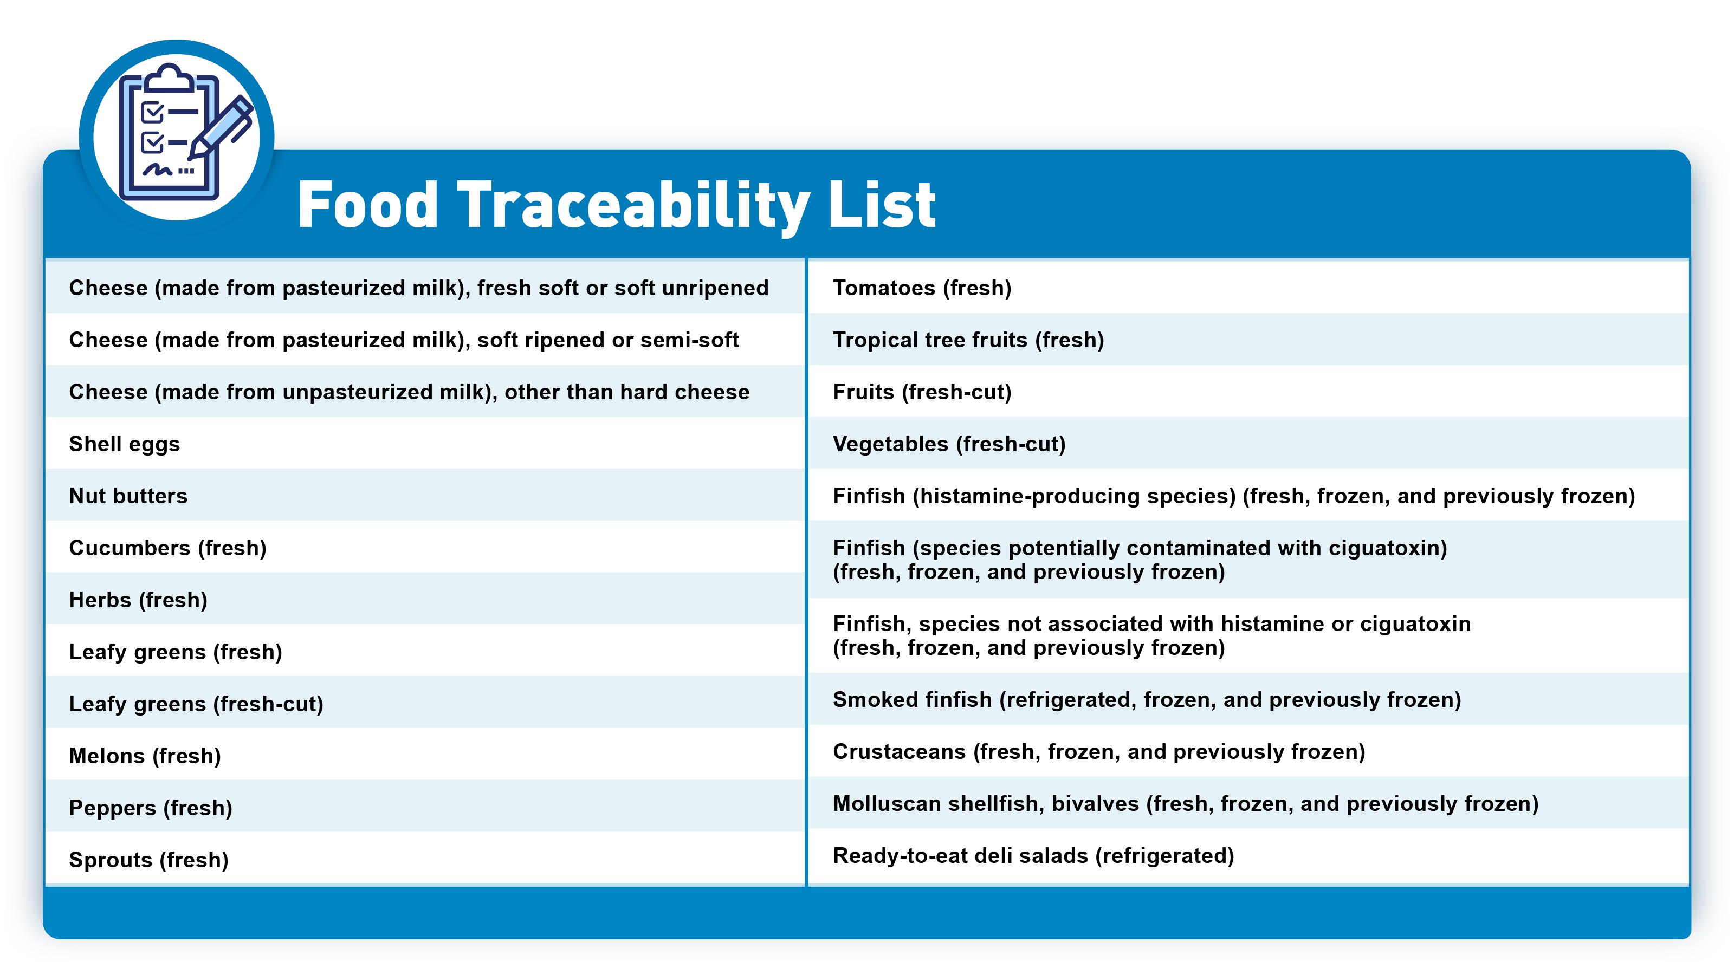
Food Traceability List
Notes:
Food Traceability List
Say: This is the FT — the Food Traceability List. The rule applies only to foods on the FTL, including foods containing listed foods as ingredients (as long as the ingredient is in the same form as what appears on the list).
<Select Enter to advance the slide build.>
Say: For example, fresh. The slide highlights the seafood products covered by the rule.
There is a link in your participant guide that will take you to the U.S. FDA website. There you’ll see descriptions for each commodity, including examples of foods that are and are not considered part of certain commodity designations on the FTL.
Ask: Do you think dried anchovies would be considered on the FTL?
Debrief ensuring the following answer is mentioned:
If a food, designated as fresh, frozen or previously frozen on the FTL, has been changed through drying, etc., and is no longer “fresh, frozen or previously frozen” then the food would no longer be on the list.

Slide 5
The Foundational Framework of the Rule
The role of the entity in the supply chain defines the data it must keep and share.
Key Data Elements (KDE)
Required records need to contain specific Key Data Elements (KDEs). The KDEs depend on the CTE being performed.
Critical Tracking Events (CTE)
Harvesting, cooling, initial packing, first land-based receiving, shipping, receiving, and transforming are Critical Tracking Events (CTEs) for which records are required.
Notes:
The Foundational Framework of the Rule
Say: Persons on the Food Traceability List must maintain and provide specific information to their supply chain partners. The information is called Key Data Elements or KDEs.
<Select Enter to advance the slide build.>
Say: KDEs are required for certain Critical Tracking Events or CTEs in the food’s supply chain. This framework forms the foundation for effective and efficient tracing of food.
<Select Enter to advance the slide build.>
Say: The information or data that firms must keep and send forward varies depending on the type of supply chain activities they perform, from harvesting or production of the food through processing, distribution, and receipt at retail.

Slide 6


Traceability Lot Code (TLC)
Traceability Lot Code (TLC)
TLCs can only be assigned or changed when the following occurs:
Initial packing of a Raw Agricultural Commodity (RAC)
First land-based receiving of a food from a fishing vessel
Transformation of a food
The role of the entity in the supply chain defines the data it must keep and share.
Traceability Lot Code Source (TLC Source)
Notes:
Traceability Lot Code (TLC)
Say: The Traceability Lot Code is an important component of the traceability requirements. Requiring Traceability Lot Codes to be kept and shared along the supply chain is critical to be able to track the movement of food by lot code. This can help enable U.S. FDA to avoid issuing overly-broad recalls as has sometimes been done in the past, which can help limit the adverse impacts on industry sectors affected by these outbreaks.
<Select Enter to advance the slide build.>
Say: TLCs can only be assigned or changed when the following occurs:
Initial packing of a RAC
First land-based receiving from a fishing vessel
Transformation of a food
<Select Enter to advance the slide build.>
Say: The TLC links to the other Key Data Elements required, including the TLC Source which provides the physical location where the Traceability Lot Code for a FTL food was assigned.
Once a TLC is assigned, the TLC must remain unchanged and passed thru the supply chain (unless a transformation event occurs).
Obtaining the Traceability Lot Code and Traceability Lot Code Source enables U.S. FDA to get to the source faster – going to those points in the chain that handle the product and assign a Traceability Lot Code – in order to get to the possible source of contamination more efficiently.

Slide 7

Traceability Plan
A description of internal procedures used to maintain records under the rule.
Intended to help U.S. FDA more quickly review and understand the traceability information provided by a firm involving a food on the FTL.
For aquaculture, the traceability plan must include a farm map with the location, name, and geographic coordinates of each unit.
Traceability plan must be updated as needed to reflect your current practices and ensure compliance with the Food Traceability Rule.
Notes:
Traceability Plan
Say: All covered entities must maintain a traceability plan. The plan would be intended to help U.S. FDA understand a firm’s recordkeeping process which is significantly valuable especially in foodborne illness outbreak investigations. All firms that would be covered by the rule would be required to maintain a traceability plan.
Traceability information is maintained in varying ways and forms across the food industry. As a result, there can be a significant impact on the time needed to analyze tracing data collected from each firm during a traceback investigation. Obtaining as much detail as possible from firms regarding interpretation of their records can assist in alleviating time delays that result from a lack of understanding. The Food Traceability Rule rule would require every person who manufactures, processes, packs or holds foods on the FTL to establish and maintain a traceability plan.
For aquaculture farms, the traceability plan must include a farm map with the location and name of each unit such as pond, pool, tank, or cage in which you raise seafood and geographic coordinates in which you raise seafood on the FTL.
Traceability plan must be updated as needed to reflect your current practices and ensure compliance with the Food Traceability Rule.
The traceability plan is required to be maintained for 2 years following any update. Having a record of these changes would be helpful during retrospective outbreak investigations where historical cases were associated with an ongoing outbreak investigation.

Slide 8
Example of a Traceability Plan for an Aquaculture Farm
Traceability Plan | Page 1 of 2
BUSINESS NAME: Swimmy’s FishFarm | ISSUE DATE | 01/15/2028
ADDRESS: 1608 Aquapond Road, Leland, MS 38756 | SUPERSEDES | 01/20/2026
Procedures to Maintain the Records
Paper records are maintained in file folders in the main office. Records are maintained for two years.
Hard copies of invoices for when shrimp are sent for processing are provided to subsequent recipients and contain all required Key Data Elements (KDEs).
Procedures to Identify Food Traceability List (FTL) Foods
All products on this farm are on the FTL.
Assigning Traceability Lot Codes
We do not assign lot codes to the shrimp.
Point of Contact
Tina James, Food Safety Coordinator 222-555-3333
Farm Map
See Appendix.
Traceability Plan Updates
This plan is reviewed annually as part of our management review of our food safety system, as well as whenever something changes in our traceability procedures. Each previous traceability plan is kept in a folder on the Traceability Manager’s laptop for at least two years after it is updated.
Notes:
Example of a Traceability Plan for an Aquaculture Farm
Read the text on the slide.

Slide 9
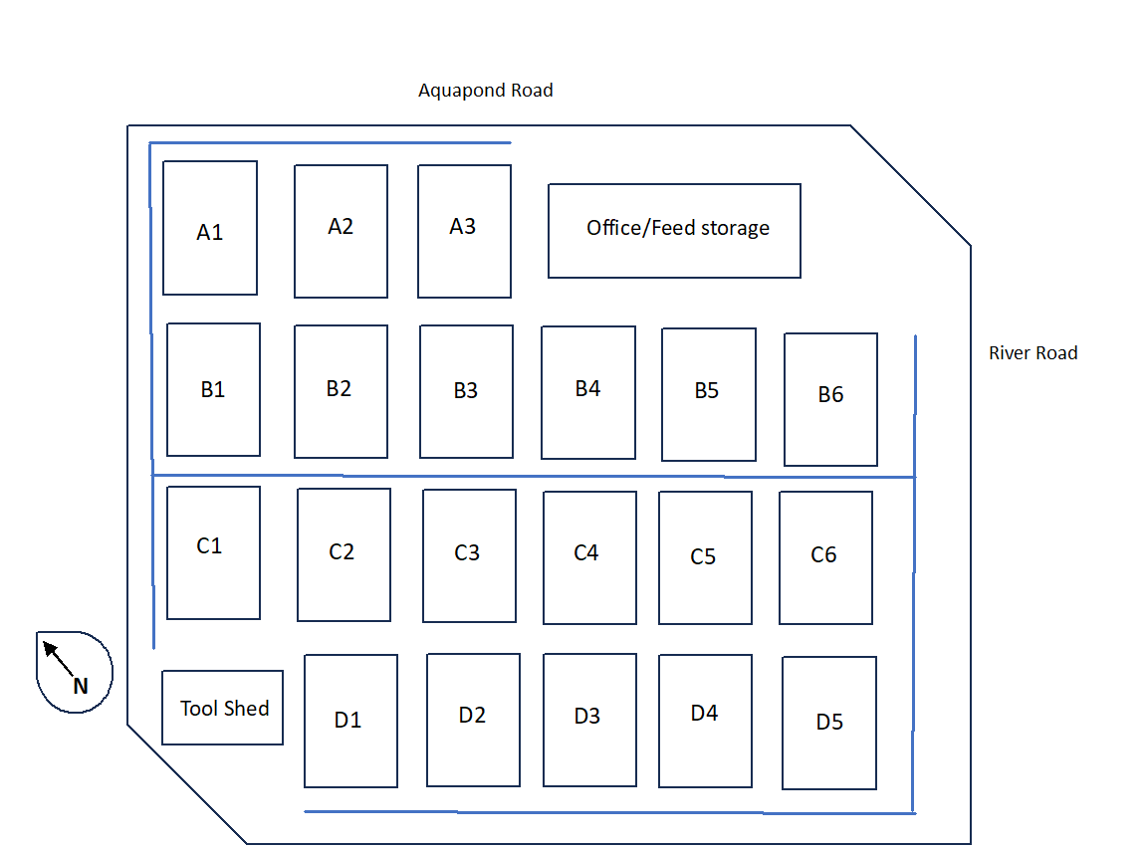
Example of a Traceability Plan for an Aquaculture Farm
Traceability Plan | Page 2 of 2
BUSINESS NAME: Swimmy’s FishFarm | ISSUE DATE | 01/15/2028
ADDRESS: 1608 Aquapond Road, Leland, MS 38756 | SUPERSEDES | 01/20/2026
Appendix:
Swimmy’s FishFarm
1608 Aquapond Road
Leland, MS 38756
GPS coordinates: 33.343806, -91.149742
Notes:
Example of a Traceability Plan for an Aquaculture Farm, continued
Read the text on the slide.

Slide 10




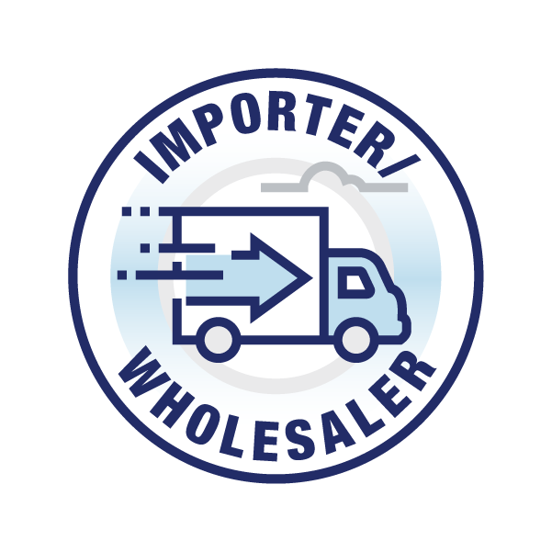


Supply Chain Example: Aquaculture Shrimp
Harvesting KDEs
Initial Packing KDEs
Receiving KDEs
Receiving KDEs
Receiving KDEs
Shipping
KDEs
Shipping
KDEs
Shipping
KDEs
Transformation KDEs
Traceability Plan
Notes:
Supply Chain Example: Aquaculture Shrimp
Say: A firm’s role and activities in the supply chain will determine which KDEs they must keep and share.
In this scenario, aquacultured shrimp is packed and sent to an exporter for export to the U.S. In this case, the exporter physically handles the product. Key Data Elements are required for the fresh shrimp at the points indicated in the graphic.
For example, the initial packer of the shrimp would be required to keep pieces of information pertaining to that initial packing event. Since that same entity most likely ships the food to the next point in the supply chain, that entity would also keep KDEs required under the Shipping CTE.
All entities in blue are covered by the Food Traceability Rule and must maintain a Traceability Plan, in addition to the KDEs.

Slide 11

Supply Chain Example: Aquaculture Tilapia
Harvesting KDEs
Initial Packing KDEs
Receiving KDEs
Receiving KDEs
Shipping
KDEs
Shipping
KDEs
Transformation KDEs
Traceability Plan
Notes:
Supply Chain Example: Aquaculture Tilapia
Say: In this scenario, aquaculture tilapia is transformed from live fish into filets by the seafood processor for sale at retail. Key Data Elements (KDEs) are required for the fresh tilapia at the points indicated in the graphic. All entities in blue are covered by the Food Traceability Rule and must maintain a Traceability Plan, in addition to the KDEs.
Ask: Does the Food Traceability Rule apply to importers?
Debrief ensuing the following is mentioned:
The final rule applies to importers who physically possess the food offered for import and are engaged in “holding” of food within the meaning of the rule.
This means that some persons who are part of the importation process may not be subject to the rule if they do not “hold” the food.
For example, a person who coordinates the importation of a food on the FTL but never takes physical possession of the food would not be subject to the rule, while a person who imports a listed food and physically possesses the food would be subject to the rule.
The FDA encourages U.S. importers to work with their foreign suppliers to ensure there is an understanding of the traceability requirements for foods exported to the U.S.

Slide 12




Records Maintenance and Availability
Legible original paper, electronic, or true copies. Stored to prevent deterioration or loss. May include electronic links.
Records must be kept for 2 years.
Available within 24 hours (or reasonable time if U.S. FDA agrees). May be stored offsite or by another entity.
During an outbreak – electronic sortable spreadsheet available within 24 hours of a request (including a phone request).
Notes:
Records Maintenance and Availability
<Select Enter to advance the slide build.>
Say: Records can be maintained either as original paper records, electronic records, or true copies.
Ask: Does FDA require a specific application or technology for keeping records?
Debrief ensuring the following is mentioned:
No. The final rule does not require specific technologies for the maintenance of records. Records may be kept as original paper or electronic records or true copies (such as photocopies, pictures, scanned copies, or other accurate reproductions of the original records). Records must be legible and stored to prevent deterioration or loss.
<Select Enter to advance the slide build.>
Say: Records must be maintained for 2 years. Records need to be made available to U.S. FDA…
<Select Enter to advance the slide build.>
Say: …within 24 hours of a request, or within some reasonable time to which U.S FDA has agreed; During an outbreak or other threat to public health, an electronic sortable spreadsheet must be provided within 24 hours of request (or some reasonable time to which U.S. FDA has agreed), which could include a request by phone.
<Select Enter to advance the slide build.>
Say: In certain circumstances, U.S. FDA can require that the records be provided to us in an electronic sortable spreadsheet. These situations would include when it is necessary to help prevent or mitigate a foodborne illness outbreak; to assist in the implementation of a recall; or to otherwise address a threat to public health. The electronic sortable spreadsheet would not be requested during a routine inspection.

Slide 13
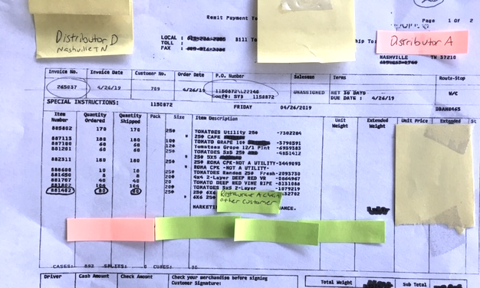
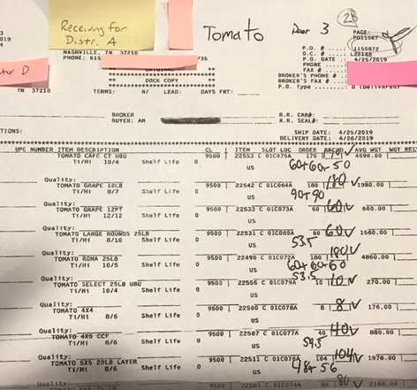
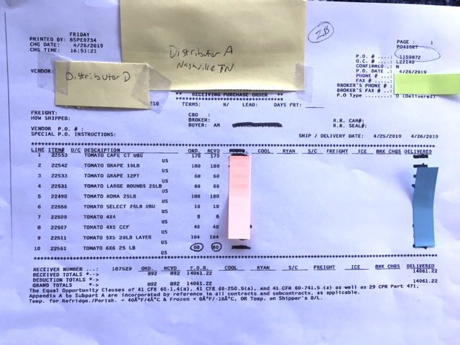
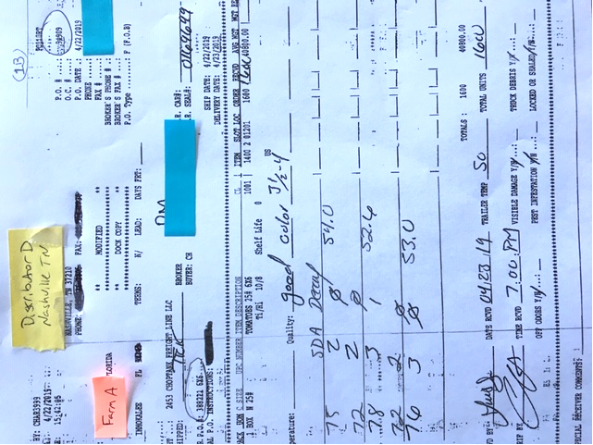
Rationale Behind the Traceability Rule
Notes:
Rationale Behind the Traceability Rule
Ask: What do you think the U.S. FDA came up with the Traceability Rule?
Say: These are examples of the types of records U.S. FDA can sometimes receive when conducing outbreak investigations.
Information on the forms is inconsistent and not standardized and often lacks a deliberate method to connect records.
Piecing together information from several types of documents to extract useful tracing data at each point in the supply chain is laborious and time-consuming, significantly slowing the tracing process and potentially putting more consumers at risk during an outbreak. The U.S. FDA uses the new Traceability Rule to more efficiently investigate an outbreak and get to the source of the problem.

Slide 14

In Effect From 20 January 2026
Applies to all firms
U.S. FDA educates before and while it regulates
Questions: Technical Assistance Network (TAN) https://www.fda.gov/food/food-safety-modernization-act-fsma/fsma-technical-assistance-network-tan
For U.S. FDA Food Traceability Rule Resources
Notes:
In Effect From 20 January 2026
Say: Records can be maintained either as original paper records, electronic records, or true copies.
Records must be maintained for 2 years; Records need to be made available to U.S. FDA within 24 hours of a request, or within some reasonable time to which U.S. FDA has agreed; During an outbreak or other threat to public health, an electronic sortable spreadsheet must be provided within 24 hours of request (or some reasonable time to which U.S. FDA has agreed), which could include a request by phone.
In certain circumstances, U.S. FDA can require that the records be provided to us in an electronic sortable spreadsheet. These situations would include when it is necessary to help prevent or mitigate a foodborne illness outbreak; to assist in the implementation of a recall; or to otherwise address a threat to public health. The electronic sortable spreadsheet would not be requested during a routine inspection.
Play video as time allows: https://youtu.be/4A8UMBSloms

Slide 15
Summary
Persons who manufacture, process, pack, or hold foods on the Food Traceability List.
Covers the entire food supply chain.
Critical Tracking Events (CTEs) require record keeping.
Key Data Elements (KDEs) describe what information needs to be tracked in your records.
KDEs vary depending on the CTE that is being performed.
Records must be:
Legible, original paper or electronic
Available within 24 hours
Kept for 2 years
In electronic sortable spreadsheet format during an outbreak
Notes:
Summary
Review each point on the slide one-by-one.

Slide 16
?
Notes:
Ask: What questions do you have at this point?

