Slide 1

U.S. FDA Import Operations
<Enter Instructor Name and Title Here>
45 minutes
Notes:
U.S. FDA Import Operations
Instructor Guide
CC BY-NC 4.0
45 minutes

Slide 2
In this lesson…
U.S. FDA Regulatory Authority
Imported Seafood Safety Process
The Import Process
Import Verification
Food Facility Registration and Prior Notice
Detention, Refusal, and Import Alert
Food
Safety
Notes:
In this lesson…
INSTRUCTOR NOTE: Before class enter the name of the instructor on the cover slide. Also, this presentation includes links to source references for your use as needed.
Say: These are the topics that we will discuss in this lesson. We will be covering each of them in depth.
Read: the slide.

Slide 3
U.S. FDA Regulatory Authority
All products regulated by the U.S. FDA must meet the same requirements, whether imported or produced domestically.
“If it appears from the examination of such samples or otherwise that:
Such article has been manufactured, processed, or packed under insanitary conditions… or
Such article is forbidden or restricted in sale in the country in which it was produced … or
Such article is adulterated, misbranded, or in violation of section 505 (Unapproved New Drugs)
…then such article shall be refused admission…”
https://www.fda.gov/industry/import-program-food-and-drug-administration-fda/import-basics
Notes:
U.S. FDA Regulatory Authority
Say: All products regulated by the U.S. FDA must meet the same requirements, whether imported or produced domestically. There are links provided in your Participant Guide that provide additional details regarding these requirements.
Also in your Participant Guide is the text from the Federal Food, Drug, and Cosmetic Act (FD&C Act) Section 801(a) that sets out the requirements for imports and exports of products regulated by FDA as shown here.
Read the text on the slide emphasizing the words in bold text.
Provide a brief example of these terms for clarity and understanding:
Adulterated: for example, presence of any contaminants or unapproved food additive in a product is a violation.
Misbranded: for example, the substitution of less expensive rockfish (Sebastes spp.) for more expensive red snapper (Lutjanus campechanus) is a violation.
Unapproved drugs: for example, use of antibiotics such as chloramphenicol or nitrofurans in aquaculture production is a violation.
Point out the following paragraph on the same page in the Participant Guide and read it aloud.
“The Secretary of the Treasury shall deliver to the Secretary of Health and Human Services, upon his request, samples of food, drugs, devices, and cosmetics which are being imported or offered for import into the United States, giving notice thereof to the owner or consignee, who may appear before the Secretary of Health and Human Services and have the right to introduce testimony……”
Emphasize that sample collections are delegated to the U.S. FDA as well as Customs and Border Protection.

Slide 4
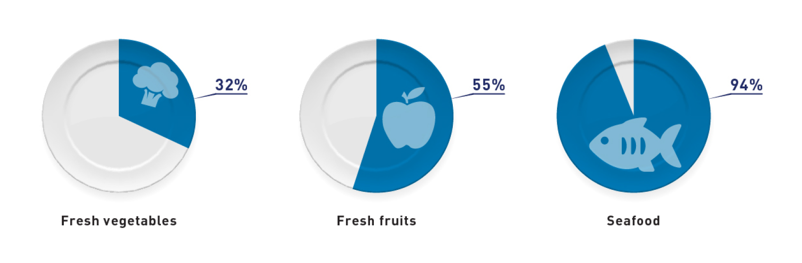
U.S. Imported Foods
Approximately 94% of seafood consumed in the U.S. is imported
https://www.fda.gov/food/importing-food-products-united-states/fda-strategy-safety-imported-food
Notes:
U.S. Imported Foods
Say: The U.S. imports about 32% of its fresh vegetables.
More than half, 55% of its fresh fruits.
<Select Enter to advance the slide build.>
Say: And the U.S. imports approximately 94% of the seafood consumed in the country.

Slide 5
Top 5 Reasons for Seafood Detentions
Filth
Salmonella
Listeria monocytogenes
Animal Drug Residues
Unsafe Food Additives
Notes:
Top 5 Reasons for Seafood Detentions
Read the bullets as displayed.
<Select Enter to advance the slide build for each.>
Define filth as any objectionable matter contributed by animals to a food product, such as insect parts, animal hair, grit, or extraneous material that would not knowingly be eaten.
Mention examples of Animal Drug Residues like chloramphenicol and nitrofurans and Unsafe Food Additives such as sulfites.

Slide 6
Imported Seafood Safety Process
1
Assessing seafood product
2
Conducting inspections
3
Conducting Importer verification inspections
4
Conducting examinations and collecting samples
5
Conducting filers evaluations
6
Conducting country program assessments
7
Receiving information from partners and FDA foreign offices
Notes:
Imported Seafood Safety Process
Say: The U.S. FDA ensures the safety of fish and fishery products in many ways. Here is a summary of our process.
<Select Enter to advance the slide build for each.>
Say:
Assessing seafood product and processing types
Conducting inspections of foreign processing facilities
Conducting Importer Verification inspections to verify that importers are adequately verifying the safety of the food they import from foreign suppliers.
Conducting examinations and collecting samples of seafood offered for import
Conducting evaluations of filers of seafood products
Conducting country program assessments
Receiving relevant information from our partners and FDA foreign offices

Slide 7
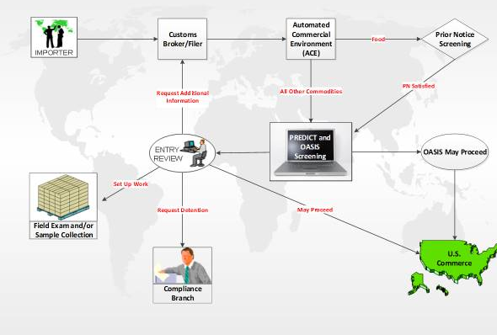


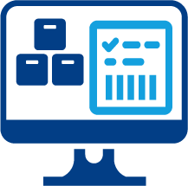
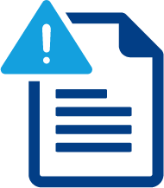
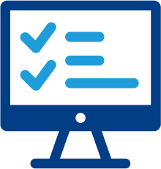

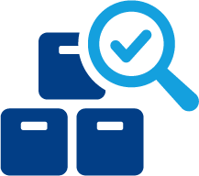
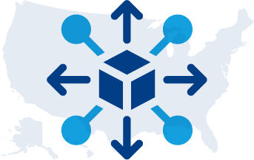
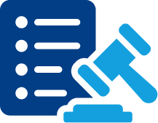
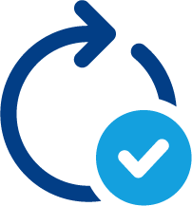
How Seafood Enters the U.S.
Importer
Customs Broker/Filer
Automated Commercial Environment (ACE)
Prior Notice
Entry Review
PREDICT Screening
Field Exam and/or Sample Collection
Compliance Branch
U.S. Commerce
May Proceed
Notes:
How Seafood Enters the U.S.
Say: We will start by illustrating how an imported entry such as seafood is processed for a U.S. FDA admissibility decision. First, the importer will contact the Customs Broker or Filer.
<Select Enter to advance the slide build.>
Say: The Customs Broker or Filer will submit the entry information on behalf of the importer through the
<Select Enter to advance the slide build.>
Say: Automated Commercial Environment (ACE) system.
<Select Enter to advance the slide build.>
Say: If the product is food, Prior Notice must be submitted.
<Select Enter to advance the slide build.>
Say: The entry will undergo electronic screening through PREDICT, or Predictive Risk- based Evaluation for Dynamic Import Compliance Targeting. The entry will either pass through with a “May Proceed” designation or …
<Select Enter to advance the slide build.>
Say: it will undergo further review by a U.S. FDA staff member.
The U.S. FDA entry reviewer will have several admissibility options, including requesting a field exam and/or sample collection, requesting additional information from the broker or filer, requesting detention through the Compliance Branch, or may proceed and be released to the U.S. Commerce. We will explore these pathways during this session, starting with the U.S. FDA’s requirements.
<Select Enter to advance the slide build.>
Say: But first let’s look at where it all starts, with importers.

Slide 8
Importer Verification Inspections
Importer must either obtain products from a processor located in a country that has a Memorandum of Understanding (MOU) detailing U.S. equivalency OR implement written verification procedures.
21 CFR Part 123.12
HACCP and monitoring records for lots being imported
Lot-by-lot certification
Regular inspections
Periodic testing of the product
Processor’s HACCP plan and written guarantee
https://www.fda.gov/food/guidance-regulation-food-and-dietary-supplements/registration-food-facilities-and-other-submissions
Notes:
Importer Verification Inspections
Say: Importer inspections are in part based on Hazard Analysis Critical Control Point (HACCP) regulations. The excerpt is in your Participant Guide. It reads:
“Importer must either obtain products from a processor located in a country that has a Memorandum of Understanding (MOU) detailing U.S. equivalency or implement written verification procedures.” the latter (Importer verification is the most common one.
Basically, this means that the importer, is required to buy from countries with an MOU.
Or importers must have written procedures:
To ensure the fish and fishery products imported to the U.S. are processed in accordance with the requirements of 21 CFR Part 123
To list the product specifications which ensures that the product is not injurious to health or processed under insanitary conditions
<Select Enter to advance the slide build of each bullet.>
Say: Importers must affirm product safety by any of these activities:
Obtaining HACCP and monitoring records for lots being imported
Obtaining lot-by-lot certification
Conducting regular inspections
Periodically testing the product
Most often the importer obtains a copy of the processor’s HACCP plan and written guarantee

Slide 9
U.S. Agent and Customs Broker
The Broker/Filer (agent) acts as a communication link between U.S. FDA and the exporter
U.S. FDA will contact a facility’s U.S. agent if an emergency occurs
Importer
Customs Broker/Filer
Automated Commercial Environment (ACE)
Prior Notice
Entry Review
PREDICT Screening
Field Exam and/or Sample Collection
Compliance Branch
U.S. Commerce
May Proceed
https://www.fda.gov/food/guidance-regulation-food-and-dietary-supplements/registration-food-facilities-and-other-submissions
Notes:
U.S. Agent and Customs Broker
Say: Food facilities shipping products to the U.S. are required to have an agent in the U.S..
<Select Enter to advance the slide build.>
Say: The U.S. agent acts as a communication link for both routine and emergency communications between U.S. FDA and the exporter. U.S. FDA will contact a facility’s U.S. agent if an emergency occurs, unless the facility opts to designate a different emergency contact.

Slide 10
Food Facility Registration and Prior Notice
Food Facility Registration applies to each firm location, not to firms and companies as a whole.
Importer
Customs Broker/Filer
Automated Commercial Environment (ACE)
Prior Notice
Entry Review
PREDICT Screening
Field Exam and/or Sample Collection
U.S. Commerce
Compliance Branch
May Proceed
https://www.fda.gov/food/guidance-regulation-food-and-dietary-supplements/registration-food-facilities-and-other-submissions
Notes:
Food Facility Registration and Prior Notice
Say: Facilities that manufacture, process, pack, distribute, receive, or hold food for consumption by humans or animals in the United States must register with the U.S. FDA. Also, the U.S. FDA must receive advance notice of each shipment of food into the U.S.
<Select Enter to advance the slide build.>
Say: Food Facility Registration applies to each firm location, not to firms and companies as a whole.

Slide 11

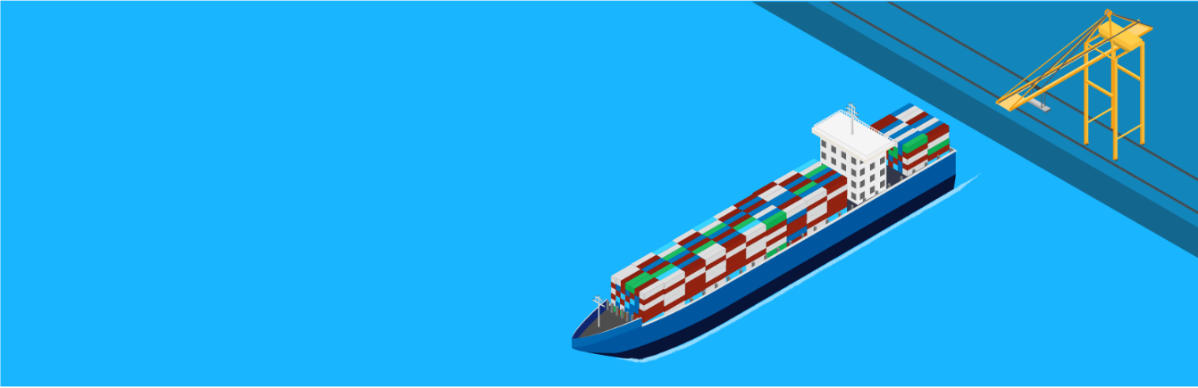
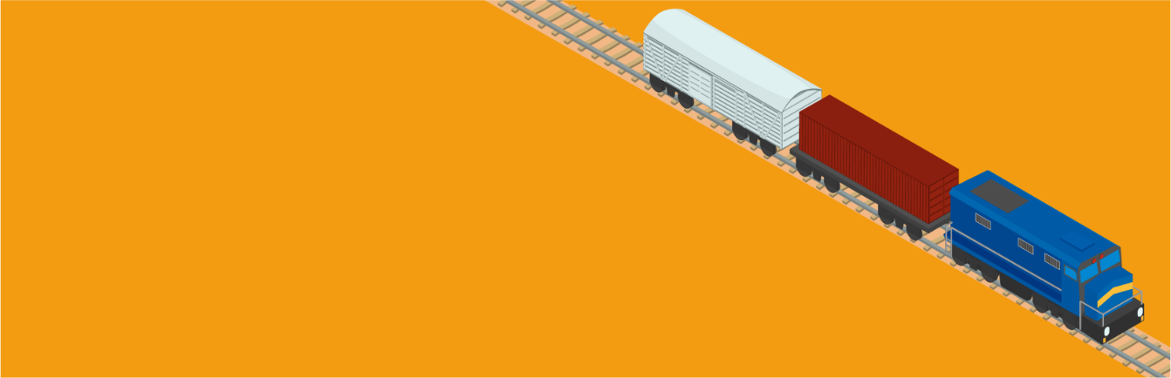



Prior Notice Submission
Time Requirement by Mode of Shipping
By land via road
By water
(shipping)
≥2h
≥8h
before port of arrival
before port of arrival
By rail
By international mail
≥4h
before port of arrival
Before the food is sent
By air
Carried by or otherwise accompanying an individual
≥4h
Within the timeframe for the applicable mode of transportation
before port of arrival
https://www.fda.gov/industry/fda-import-process/prior-notice-imported-foods
Notes:
Prior Notice Submission
Say: Can be submitted via:
Customs and Border Protection Automated Broker Interface of the Automated Commercial Environment (ABI/ACE)
The Prior Notice System Interface (PNSI) for individuals or companies who cannot or choose not to file through Customs and Border Protection
<Select Enter to advance the slide build.>
Read each row of the table one-by-one.

Slide 12
The Screening Process
xx
Importer
Customs Broker/Filer
Automated Commercial Environment (ACE)
Prior Notice
Entry Review
PREDICT Screening
Field Exam and/or Sample Collection
U.S. Commerce
Compliance Branch
May Proceed
Notes:
The Screening Process
Say: U.S. FDA screens all imported shipments of U.S. FDA-regulated products. The review of entries is largely an automated process and is a 100% electronic screening. All entries are initially evaluated by the Predictive Risk-based Evaluation for Dynamic Import Compliance Targeting (PREDICT) system.

Slide 13
Entry Review
xx
Importer
Customs Broker/Filer
Automated Commercial Environment (ACE)
Prior Notice
Entry Review
PREDICT Screening
Field Exam and/or Sample Collection
U.S. Commerce
Compliance Branch
May Proceed
https://www.fda.gov/food/guidance-regulation-food-and-dietary-supplements/registration-food-facilities-and-other-submissions
Notes:
Entry Review
Say: If an entry has been designated during PREDICT screening to undergo further review, the entry is reviewed for compliance with regulatory requirements. Admissibility decisions are made after assessing information from multiple sources, including databases, compliance history, work plans, assignments, import alerts, and PREDICT screening results.

Slide 14
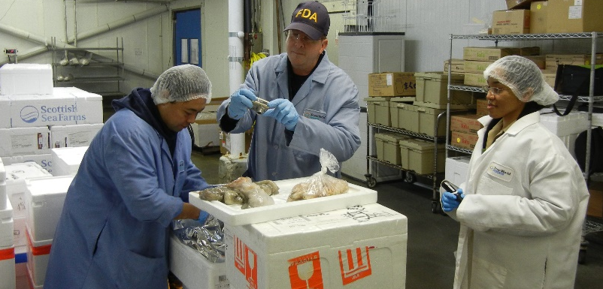
Examination and Sampling
Filth | Pathogens | Decomposition | Labeling issues | Residues | Economic fraud
Notes:
Examination and Sampling
Say: U.S. FDA field personnel are trained in examination, sampling techniques, and laboratory analysis. They are looking for non-compliance with regulations, including:
Filth
Pathogens, including Salmonella
Decomposition
Package labeling issues
Residues of animal drugs (from either use of unapproved drugs or misuse of approved drugs), food additives, pesticides and environmental chemicals
Economic fraud, including species substitutions and product short weighting
Provide additional examples as needed.

Slide 15
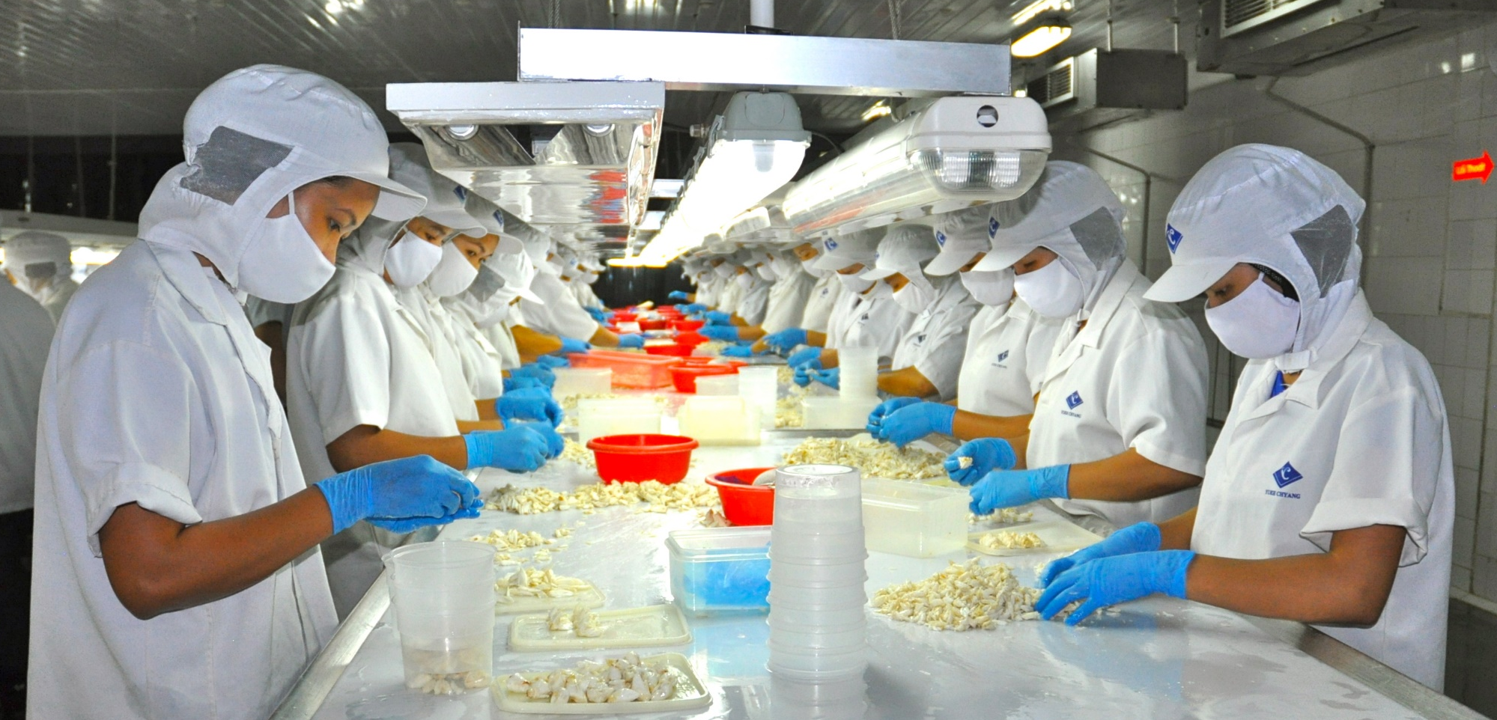
Shared Responsibility
Processors and importers share the responsibility for the safety of the seafood offered to the U.S. market.
Notes:
Shared Responsibility
Read the statement on the slide and elicit discussion from the group about what it means to share responsibility.

Slide 16
Product Detention and Import Refusal
Importer
Customs Broker/Filer
Automated Commercial Environment (ACE)
Prior Notice
Entry Review
PREDICT Screening
Field Exam and/or Sample Collection
U.S. Commerce
Compliance Branch
May Proceed
https://www.fda.gov/food/guidance-regulation-food-and-dietary-supplements/registration-food-facilities-and-other-submissions
16
Notes:
Product Detention and Import Refusal
Say: When entry reviewers forward requests for detention to the U.S. FDA Compliance Branch the product goes through further review.
The Federal Food, Drug, & Cosmetic Act gives FDA the authority to refuse products that appear to be in violation of FDA laws and regulations. This is known as the “appearance standard”.
If products in the shipment violate or appear to violate U.S. FDA laws and regulations, based on the results from examination, or sampling and testing, U.S. FDA detains the shipment. Notice of U.S. FDA Action is sent to importer, consignee, and filer:
Indicates U.S. FDA's assertion that the articles are subject to refusal
Reason(s) why
Right to provide testimony (evidence)
Timeframe for response
Contact name/number
Importer has the right to submit an application to FDA requesting permission to re-label or recondition the product in an attempt to bring it into compliance. The reconditioning plan should include a detailed summary of how the product will be brought into compliance to give the FDA confidence that the identified issues has been resolved.
For example, if the application is denied or if the issue is not resolved, the imported entry will be refused. Notice of U.S. FDA Action and Refusal of Admission is issued to importer. Refused product must be destroyed unless exported back within 90 days.
U.S. FDA has authority to seize product if certain criteria have been met.
The purpose of product detention and import refusal is to prevent potential violative products from being distributed into the United States. The responsibility is on the importer to prove the product is in compliance before it can be released.

Slide 17

Import Alerts
Country-wide Import Alerts
Firm-specific Import Alerts
Red List
Firms, products are subject to Detention Without Physical Examination under an import alert.
Yellow List
Firms, products are subject to Detention Without Physical Examination under an import alert and require an intermediate level of surveillance such as demonstration of compliance.
Green List
Firms, products that have met criteria for exemption from Detention Without Physical Examination under an import alert.
https://www.fda.gov/industry/actions-enforcement/import-alerts
Notes:
Import Alerts
Say: If the product is refused due to violation of FDA laws and regulations, the firm and its product are placed on an import alert.
See the U.S. FDA website Import Alerts for lots of information.
Say: Each import alert includes a listing section that provides specific firm and product combinations that are either subject to or exempt from Detention Without Physical Examination. There are three Listing categories:
<Select Enter to advance the slide build.>
Read the information for the Red List
<Select Enter to advance the slide build.>
Read the information for the Yellow List
Say: Currently, there are no Import Alerts for seafood products with the Yellow List.
<Select Enter to advance the slide build.>
Read the information for the Green List
<Select Enter to advance the slide build.>
Say: There are 2 types of Import Alerts:
Country-wide may include the entire country or a region in the country. These import alerts are implemented when there is a recurring and unresolved issue with product from a specific country.
Firm alert is for a specific manufacturer and product. These import alerts are often related to a refused entry.
Demonstrate opening the Import Alerts | FDA website as time allows.

Slide 18
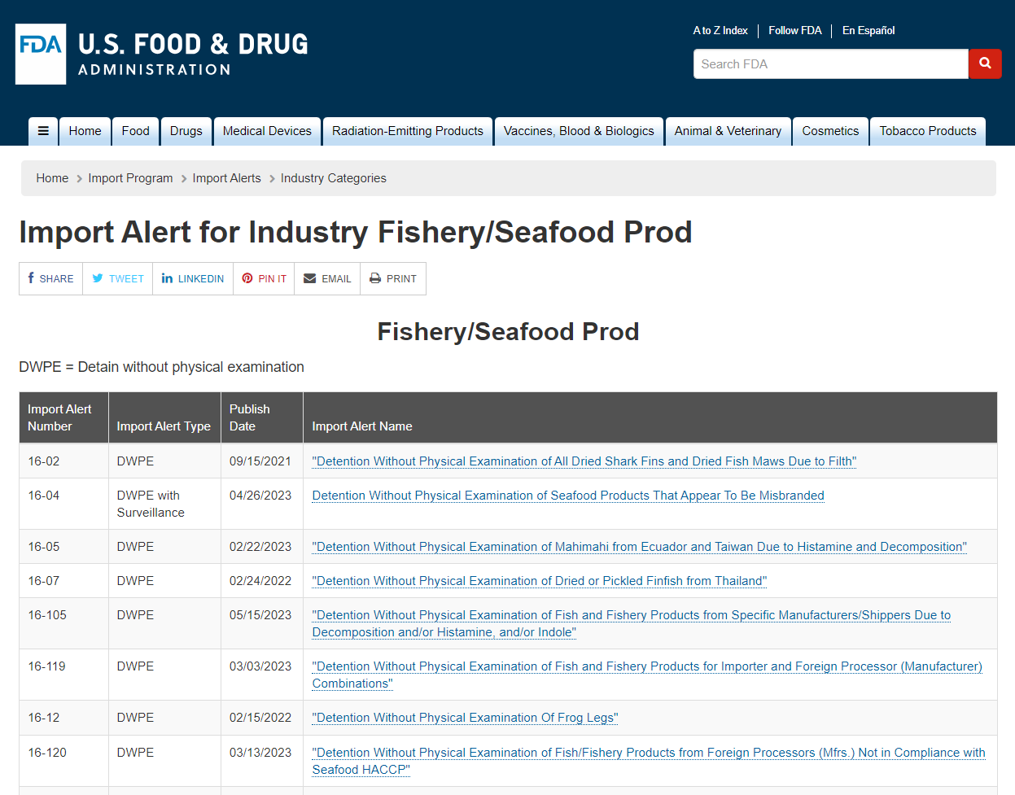
Fishery and Seafood Import Alerts
https://www.accessdata.fda.gov/cms_ia/industry_16.html
Notes:
Fishery and Seafood Import Alerts
Say: This is the U.S. FDA website for Import Alerts.
Point out relevant parts of the website on the screen or alternatively, demonstrate bringing up the website here: https://www.accessdata.fda.gov/cms_ia/industry_16.html to show the latest version.
As time allows, direct attention to some of the more common Import Alerts for Aquaculture Products:
DWPE 16-124 – This applies to firms when an entry is found adulterated with residues of unapproved animal drugs or residues of approved animal drugs that exceed established tolerances.
DWPE 16-127 – This import alert was developed for chloramphenicol, a commonly detected unapproved animal drug. Chloramphenicol is a broad-spectrum antibiotic that is not approved for use in food-producing animals and prohibited from extra-label uses in food producing animals.
DWPE 16-129 – This is another import alert that was developed for nitrofurans, another commonly detected unapproved animal drug. Drugs from Nitrofuran class are a broad-spectrum antibiotic that is not approved for use in food-producing animals and can be used to fight bacterial infections in humans and animals.
DWPE 16-18 – This applies to product that appears to be contaminated with Salmonella, decomposition, and filth in imported raw shrimp. This is a country-wide import alert applying to Bangladesh, Hong Kong, Indonesia, Taiwan, and Thailand. It means that the products from these countries are detained unless it’s from a firm on the Green List.
DWPE 16-131 – This is a country-wide import alert for specific aquaculture products from China
DWPE 16-136 – This is another country-wide import alert for shrimp from Peninsular Malaysia.

Slide 19
Release of Shipments/Removal from Import Alerts
For specific product from individual manufacturer:
Submit a petition for removal that includes information related to five (5) consecutive non-violative shipments.
U.S. FDA may request additional information: root cause analysis, corrective actions, firm’s HACCP plan, and monitoring records.
U.S. FDA must be confident that the firm has resolved the conditions that gave rise to the violation and that future entries will be non-violative.
Notes:
Release of Shipments/Removal from Import Alerts
Say: To be removed from an import alert, a minimum of 5 consecutive commercial shipments must be found to be non-violative or clean. The process is:
Firm or importer must submit a petition for removal.
Each of the 5 shipments is sampled by an importer and analyzed by a private third-party laboratory in the United States.
U.S. FDA reviews the lab worksheets and approves them.
U.S. FDA may require additional information, such as a root cause analysis identifying the source of the issue, corrective actions taken to prevent future problems, the firm’s current HACCP plan, and monitoring records associated with clean entries (all information has to be in English).
U.S. FDA must be confident that the firm has resolved the conditions that gave rise to the violation and that future entries will be non-violative.

Slide 20
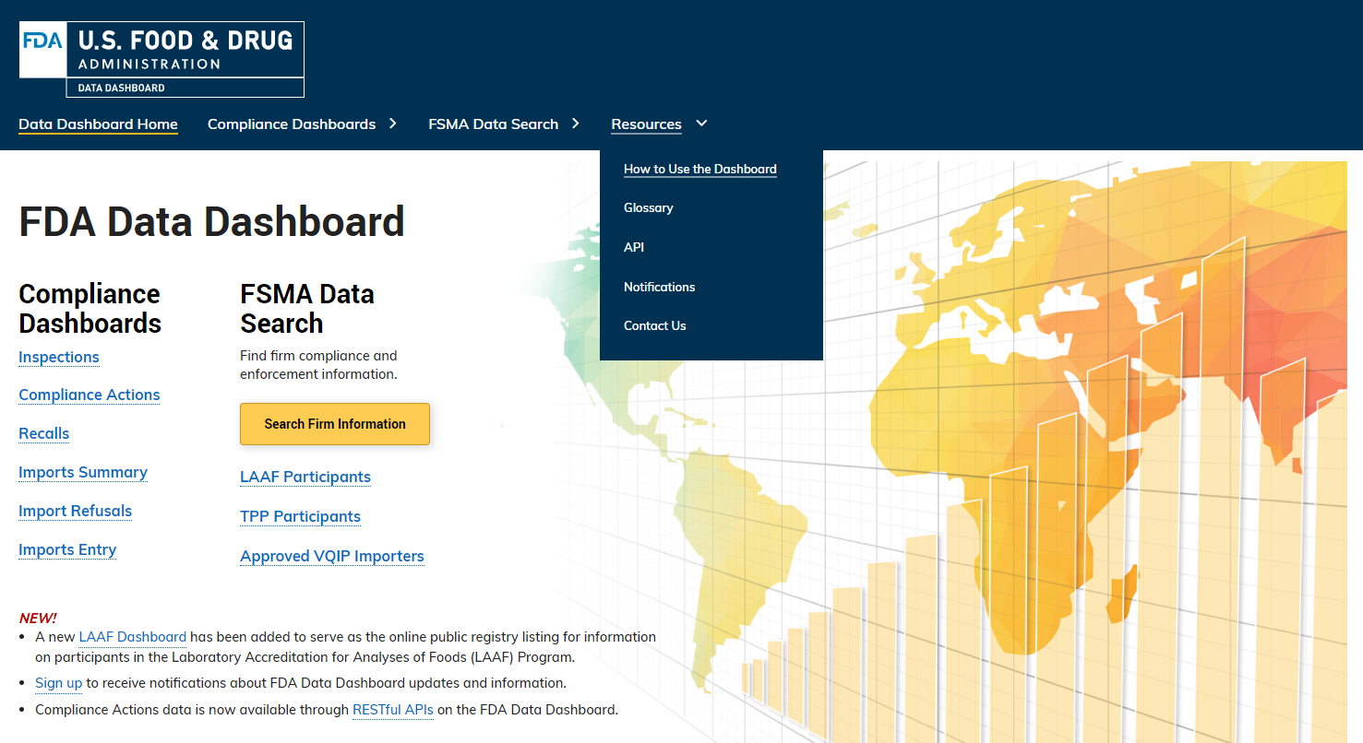
U.S. FDA Data Dashboard—Home Page
https://datadashboard.fda.gov/ora/index.htm
Notes:
U.S. FDA Data Dashboard—Home Page
Say: The U.S. FDA Data Dashboard provides information on inspection, compliance, and enforcement-related data in a graphic format. This tool allows users to get detail and underlying data as well as import graphs.
Demonstrate pulling up the website using the link on the screen and navigating to each page as you describe them.

Slide 21
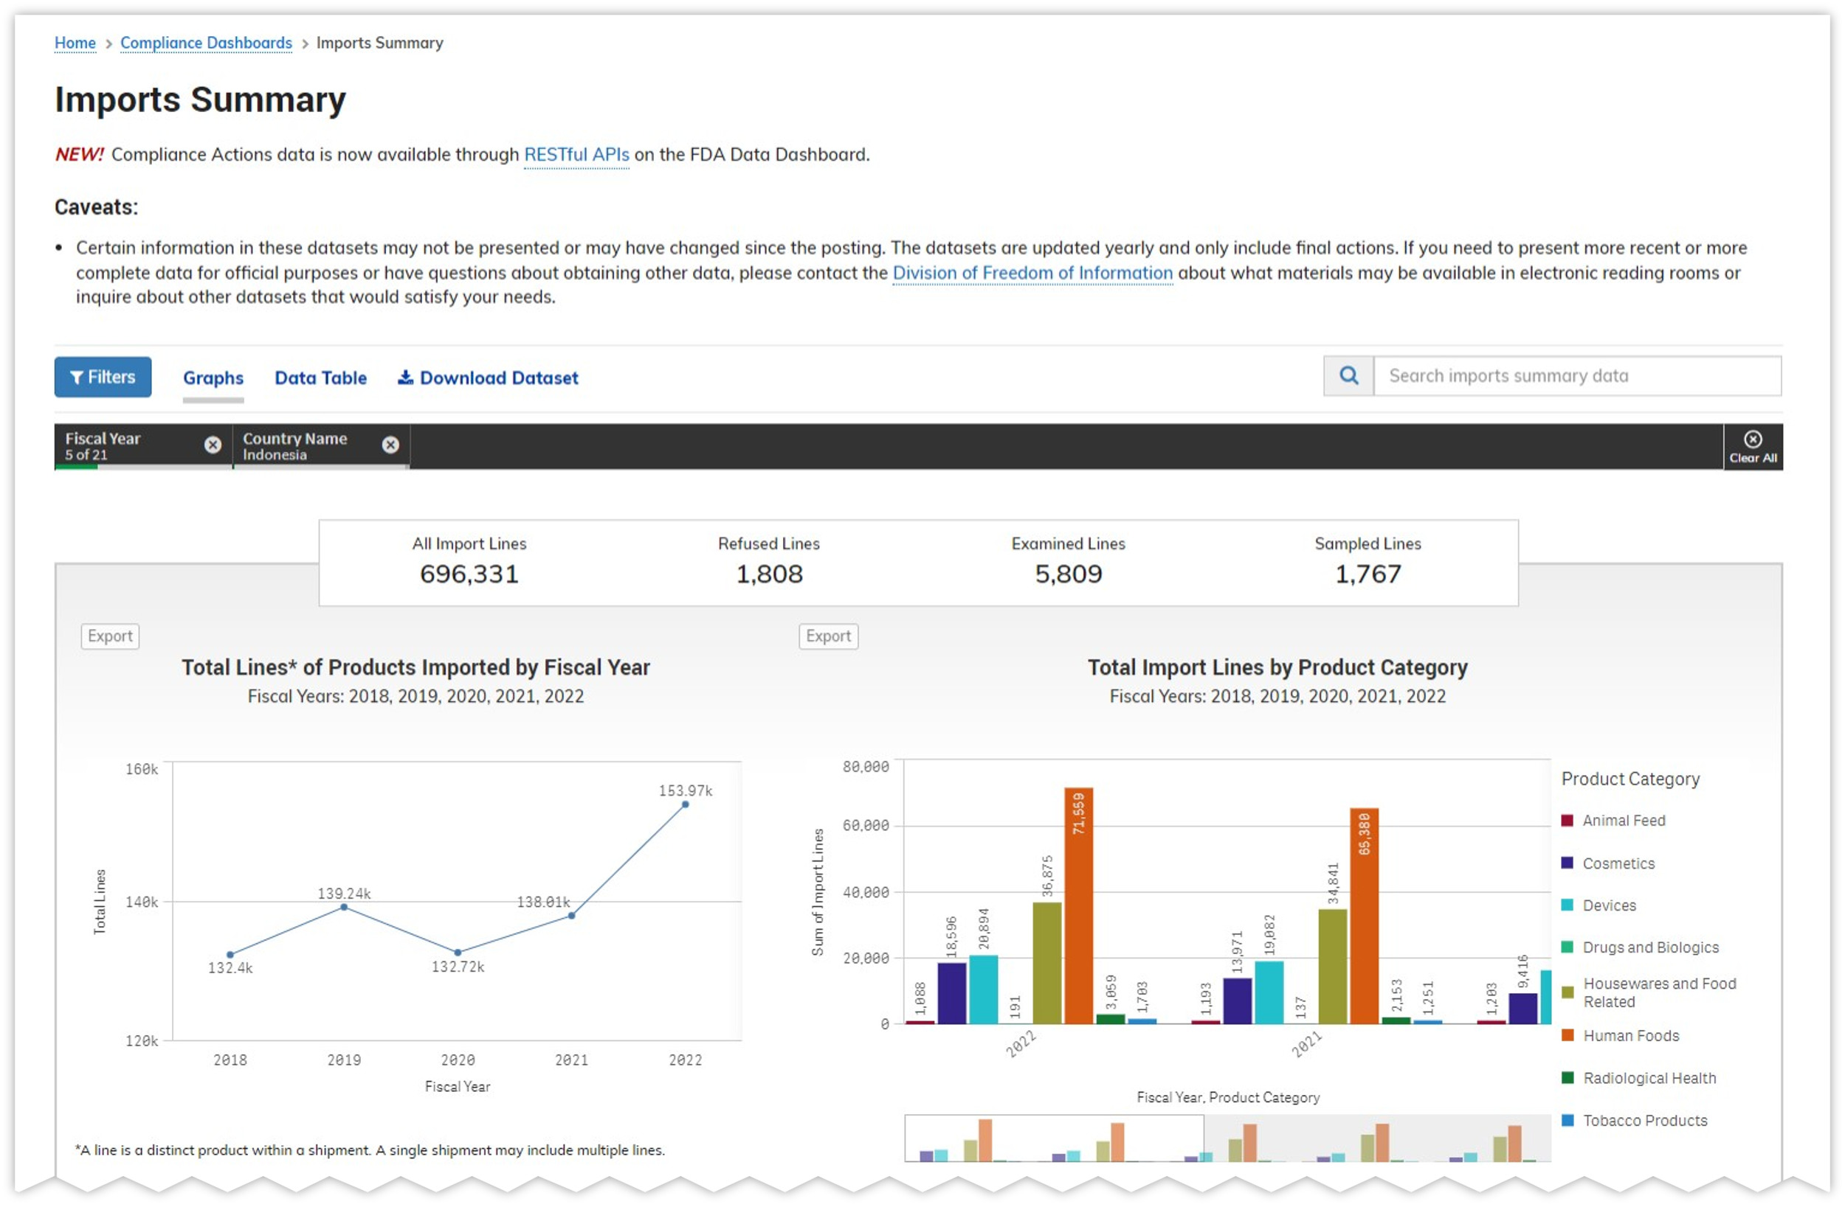
U.S. FDA Data Dashboard—Imports Summary
https://datadashboard.fda.gov/ora/index.htm
Notes:
U.S. FDA Data Dashboard—Imports Summary
Demonstrate pulling up the website using the link on the screen.

Slide 22
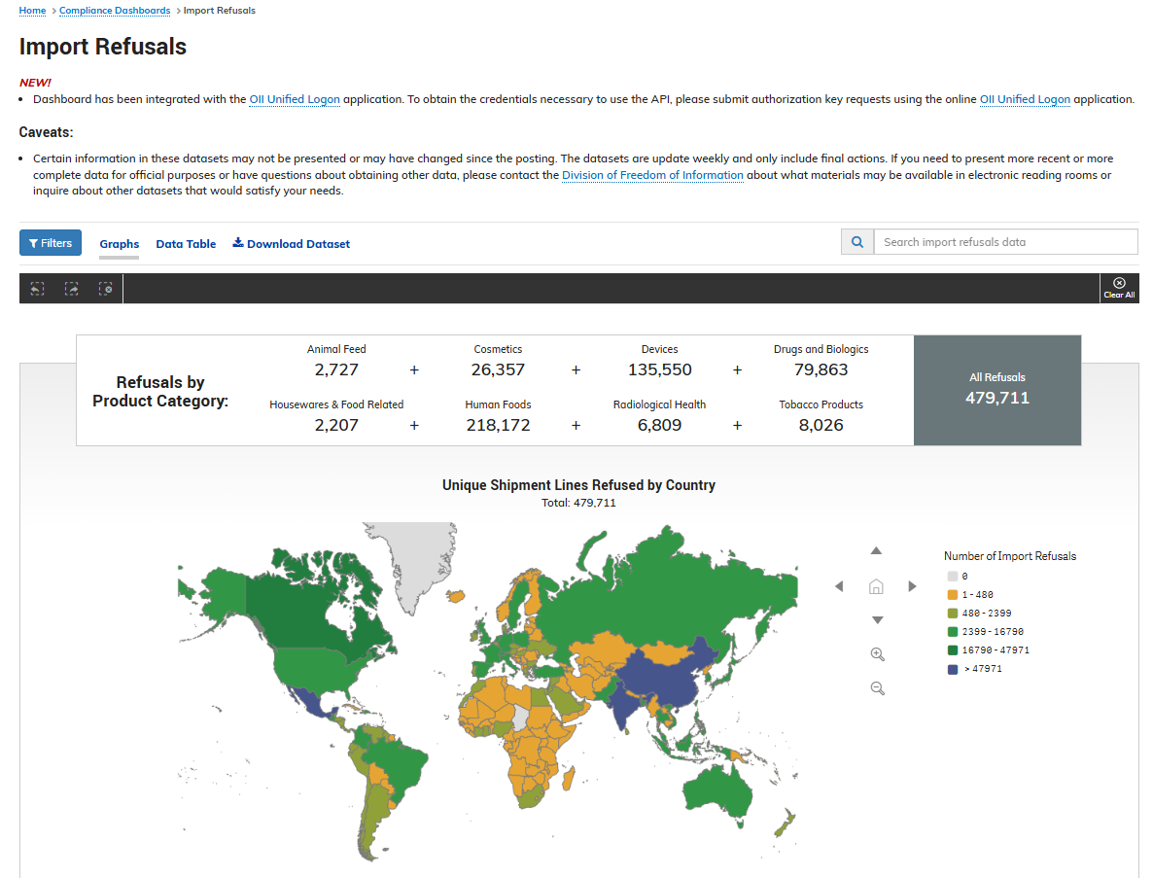
U.S. FDA Data Dashboard—Refusals
https://datadashboard.fda.gov/ora/index.htm
Notes:
U.S. FDA Data Dashboard--Refusals
Demonstrate pulling up the website using the link on the screen.
Say: Let’s take a moment now to review the Resources provided in your Participant Guide.

Slide 23
Summary
All products regulated by the U.S. FDA, whether imported or produced domestically, must meet FDA’s laws and regulations.
The U.S. FDA ensures the safety of imported seafood products through import processes including:
Import Verification
Food Facility Registration and Prior Notice
Screening
Entry Review
Examination and Sampling
Detention, Refusals and Import Alerts
Notes:
Summary
Review each point on the slide one-by-one.

Slide 24
?
Notes:
Say: What questions do you have?

Slide 25
This publication is supported by the Food and Drug Administration (FDA) of the U.S. Department of Health and Human Services (HHS) as part of a financial assistance award U01FD001418 with 100% funded by FDA/HHS. The contents are those of the author(s) and do not necessarily represent the official views of, nor an endorsement by FDA/HHS, or the U.S. Government.

