Slide 1

Introduction to
Good Aquaculture Practices
<Enter Instructor Name and Title Here>
75 minutes
Notes:
Welcome to Good Aquaculture Practices Training
Instructor Guide
CC BY-NC 4.0
75 minutes

Slide 2


Background
BMPs
GAqPs
Best Management Practices
Good Aquaculture Practices
2006
Present
Notes:
Background
INSTRUCTOR NOTE: Before class enter the name of the instructor on the cover slide.
Direct participants to the Glossary in their Participant Guide and define:
BMPs: Best Management Practices
GAqPs: Good Aquaculture Practices
Say: All of these are related to ensuring your products are of the highest quality and safety. As we’ve said, GAqPs were developed in collaboration with governments, universities, and industry representatives.
<Select Enter to advance the slide build.>
GAqPs were originally developed in 2006 and have gone through many iterations.
<Select Enter to advance the slide build.>
This course has been conducted many times in many different countries.
GAqPs are closely related to Best Management Practices (BMPs) and Good Agricultural Practices (GAPs).
Each time the course is conducted we learn things from each country and use it to improve the course.

Slide 3
What You Will Learn in This Course
BMPs
Biosecurity
Food Safety
Notes:
What You Will Learn in This Course
Say: GAqPs is a strategic approach to prevent or minimize the likelihood of animal disease outbreaks and address food safety risks.
BMPs are the practices that will help keep the animals and employees healthy and minimize the risk of introducing animal and human pathogens.
Biosecurity includes disease prevention, monitoring, and treatment such as identifying pathogen introduction pathways and developing mitigation strategies to minimize pathogen introduction and exposure.
Food Safety ensures safe products for human consumption and lowers the risk of problems during trade.
Ask: Are you familiar with these concepts? Do you already practice some of them, but call them by another name?
Debrief using this key point to summarize: There are many different terms that mean the same thing as these words. Feel free to use terms that are familiar to you during this class, the specific words are not important, the concepts are important to us during this class. Remember, you have a Glossary in your Participant Guide with full definitions for all of the terms we will be using.

Slide 4
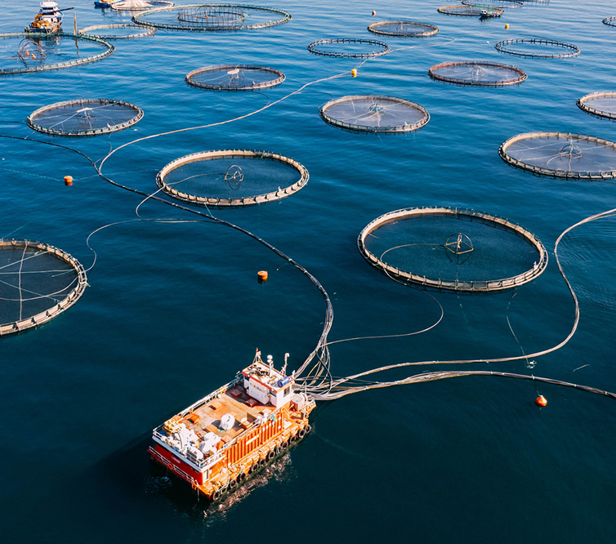
What You Will Learn in This Session
What Are GAqPs?
One Health Approach
Food Safety Plans (FSP)
GAqPs in Action
Notes:
What You Will Learn in This Session
Review the session agenda from the slide.
Highlight these points:
What are GAqPs?
GAqP uses a One Health approach which we will talk about shortly
How to develop an aquaculture food safety plan
GAqPs provide documentation or evidence about your practices that you can share with buyers, government regulators, consumers, NGOs
Say: All of these, together, can help you lower the disease risk on your farms and make certain your hard work results in the ability to sell and trade your product and ensure profits.

Slide 5
What are GAqPs?
GAqPs are:
Voluntary program based on prevention.
Strategic approach to preventing or minimizing:
  Risk of animal diseases
  Food safety risk
Not a certification program or scheme, but can be used or integrated into standards.
Flexible and adaptable.
Notes:
What are GAqPs?
Say: What are GAqPs? GAqPs is a strategic approach to preventing or minimizing two risks:
The risk of animal and human diseases and
The food safety risk we just spoke about.
Review the additional points on the slide one-by-one.
Ask: Different diseases affect different areas. What seafood diseases are common in <country name>? For example, <relevant example such as White spot>?
Accept all answers as correct and/or offer other examples to demonstrate the point.

Slide 6




One Health Approach
Prevent outbreaks of zoonotic disease in animals and people
Improve food safety and security and economies reliant on livestock production
Reduce antibiotic-resistant infections and improve human and animal health
And protect global health security
Notes:
One Health Approach
.
Say: GAqPs use a One Health approach. The goal of the One Health approach is achieving optimal health outcomes recognizing the interconnection between people, animals, plants, and their shared environment. A One Health approach includes animal diseases, human diseases, and the environment as interconnected with each other. Many health organizations use the One Health approach. The idea is that the health of people is connected to the health of animals within the framework of a shared environment. Here are some specifics about the concept of One Health.
<Select Enter to advance the slide build.>
Say: Prevent zoonotic diseases which are diseases shared by both animals and people.
<Select Enter to advance the slide build.>
Say: Improve food safety and security.
<Select Enter to advance the slide build.>
Say: Reduce antibiotic resistance infections and improve human and animal health.
<Select Enter to advance the slide build.>
Say: Protect global health security overall. The way to practice the One Health approach is by bringing together experts across fields, such as human health experts, farm experts, and veterinarians. What is an example of this? This GAqP course!

Slide 7

Good Aquaculture Practices Lead to
Safe Food for Human Consumption
Food
Safety
Biosecurity
Best Management Practices (BMPs)
Food
Safety
Notes:
Good Aquaculture Practices Lead to Safe Food for Human Consumption
Say: Let’s begin with the Basics: How GAqPs work. We use a layered preventive control approach. We use a pyramid to illustrate the three blocks of GAqPs.
<Select Enter to advance the slide build.>
Say: The base of the pyramid are BMPs which refer to keeping your animals healthy and preventing pathogens such as salmonella.
<Select Enter to advance the slide build.>
Say: Next on our pyramid, Biosecurity includes identifying animal disease risks and eliminating, preventing or reducing them to a manageable level. This may include treating your grow out water and limiting wild animal and human farm access at entry.
<Select Enter to advance the slide build.>
Say: And, at the top of our pyramid, Food Safety focuses on food safety risk or hazards in order to prevent food safety problems. It may include how a farm prevents animal drug residues, environmental chemicals, and pathogens in their product. The goal is safe food for human consumption.
All of these are what governments like the U.S, FDA, consumers, your buyers, and importers want. We will go into each of these during the course.

Slide 8
What Do You Think?
  Why do you maintain your home?
  What is the main goal in GAqP and aquaculture food safety?
  The goal is…
Notes:
What Do You Think?
Ask: Why do we maintain our homes? Why do we paint, repair, and clean it?
Debrief, accepting all answers as correct.
Say: A reason is prevention. GAqPs is about preventing problems before they happen.
Ask: What is the main goal in GAqP and aquaculture food safety?
Debrief, same as above, it is prevention.
Say: The goal of GAqP, then, is prevention. Developing an aquaculture food safety plan allows us to control food safety risks. The way we will teach this is by using a form we have developed.

Slide 9
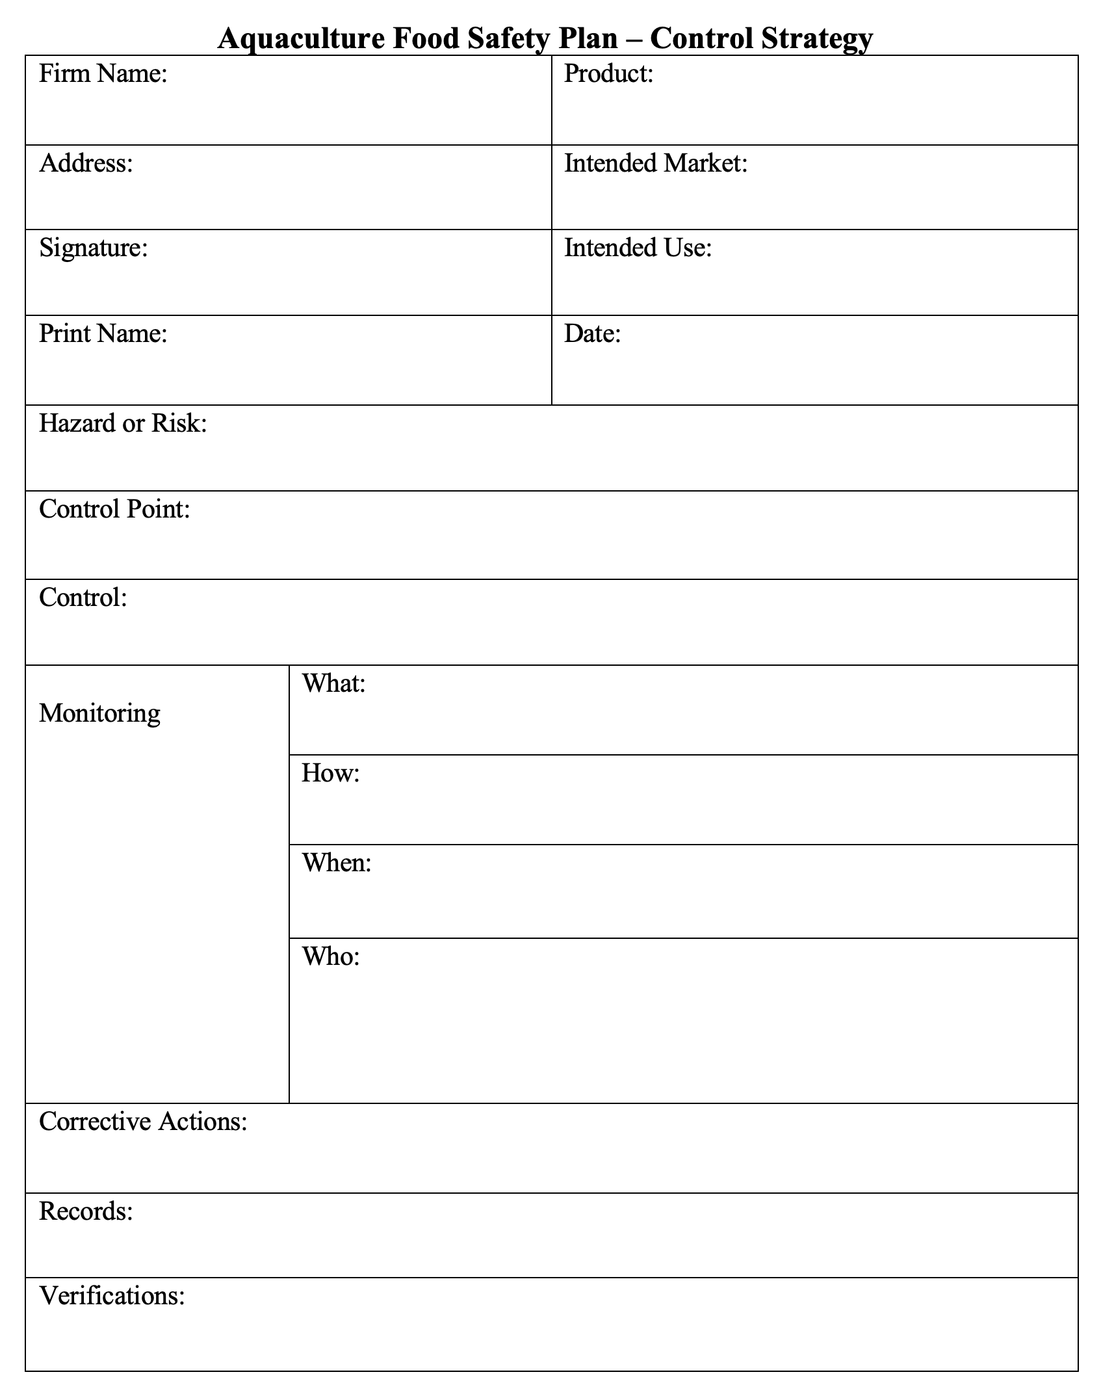
Food Safety Plan
Notes:
Food Safety Plan
Refer participants to the Food Safety Plan template in their Participant Guide.
Say: This is a template you can use to help you bring all these ideas together. We’ll walk through the template now, and later we will use it in activities.

Slide 10
Intended Market and Intended Use
Notes:
Intended Market and Intended Use
Say: There are two important elements to discuss next:
Intended Market and
Intended Use
Ask: Why do you think the Intended Market is important?
Debrief accepting all answers as correct and emphasizing this point:
Every country (and, therefore, market) has their own list of approved aquaculture drugs. This is important to know because you need to only use drugs approved in your intended market.
Say: For example, Japan has numerous drugs approved for aquaculture. The U.S. only has 10. So, if you use a drug that is approved in Japan but not the U.S. and your market is the U.S., you will be violating U.S. laws and regulations if you export your product to the U.S. because your product is considered adulterated in the U.S.
Why is Intended Use important? It is key to know if the product is intended to be cooked, partially cooked, or consumed raw because if it is intended to be used raw or partially cooked, you need to control human pathogens. The farm will want to be extra careful about pathogen contamination and will want to monitor the source water, ice, containers, etc.
Did you know? Most countries have dishes that use raw or partially cooked seafood. For example, Ceviche which is very popular in North and South America. Also, note that the U.S. FDA tests for salmonella in imported raw seafood. Salmonella is not part of the natural flora of shrimp ponds. It is introduced by birds, other animal waste, or contaminated water or ice. If salmonella is found in shrimp, the product is considered adulterated and in violation of U.S. laws and regulations.

Slide 11
Parts of a Food Safety Plan
Food
Safety
Biosecurity
Best Management Practices (BMPs)
Risks
Notes:
Parts of a Food Safety Plan
Say: The next step in developing a Food Safety Plan is to identify significant hazards or risks specific to your location, such as diseases in your area, water quality challenges, and so on.
You can identify significant hazards or risks in any or all of the three layers of preventive controls: BMPs, biosecurity, and food safety. Food Safety Plans are for significant hazards or risks, not every risk.

Slide 12
Parts of a Food Safety Plan
Food
Safety
Biosecurity
Best Management Practices (BMPs)
CPs
Notes:
Parts of a Food Safety Plan
Say: Then, determine the best and most appropriate location where a control can be applied to the identified hazard or risk.

Slide 13
Parts of a Food Safety Plan
Food
Safety
Biosecurity
Best Management Practices (BMPs)
Controls
Notes:
Parts of a Food Safety Plan
Say: Identify and apply a Control which is an action that when properly implemented eliminates, prevents, or reduces the significant risk you identified to a manageable level.

Slide 14
Parts of a Food Safety Plan
Food
Safety
Biosecurity
Best Management Practices (BMPs)
Monitor
Notes:
Parts of a Food Safety Plan
Say: Now, to monitoring the controls. How will you monitor that controls are being implemented? Here, describe actions that will be taken to ensure the controls are being adequately conducted including what will be monitored, how it will be monitored, when it will be monitored, and who will do the monitoring.

Slide 15
Parts of a Food Safety Plan
Food
Safety
Biosecurity
Best Management Practices (BMPs)
Corrective Actions
Notes:
Parts of a Food Safety Plan
Say: The next step is to describe what you would do, the Corrective Action you would take when the Control is not adequately met. How will you correct the problem, or make it right?

Slide 16
Parts of a Food Safety Plan
Food
Safety
Biosecurity
Best Management Practices (BMPs)
Records
Notes:
Parts of a Food Safety Plan
Say: Next, describe what Records you will need to document the food safety plan that is being applied or implemented.
You may be doing all the things on the plan, but do you have evidence to show that you are? Do you have proof?
<Relate a personal story to depict the idea of being able to show proof or evidence.>

Slide 17
Parts of a Food Safety Plan
Food
Safety
Biosecurity
Best Management Practices (BMPs)
Verification
Notes:
Parts of a Food Safety Plan
Say: In GAqP, Verification is based on the “Trust but Verify” principle.
For example, you may work with a trusted supplier and you trust that the feed you get from them does not have residues. That is fine. However, you should also get a Certificate of Analysis from the supplier or do a test yourself in order to verify the feed is residue-free. This is your written proof or evidence.

Slide 18
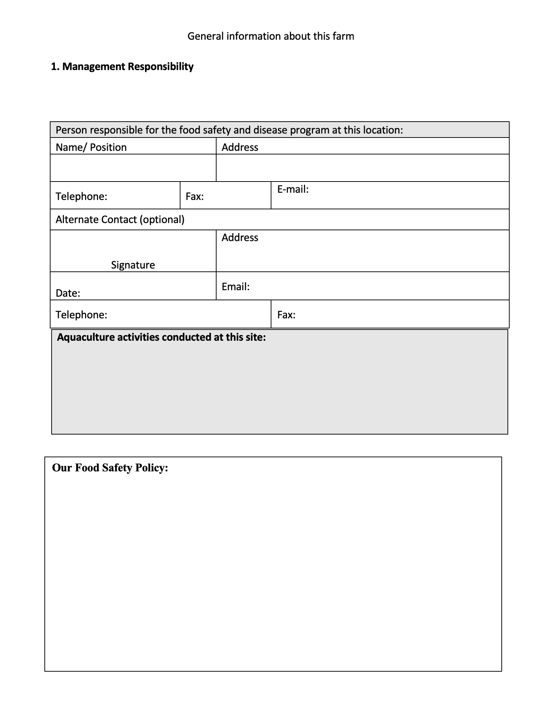
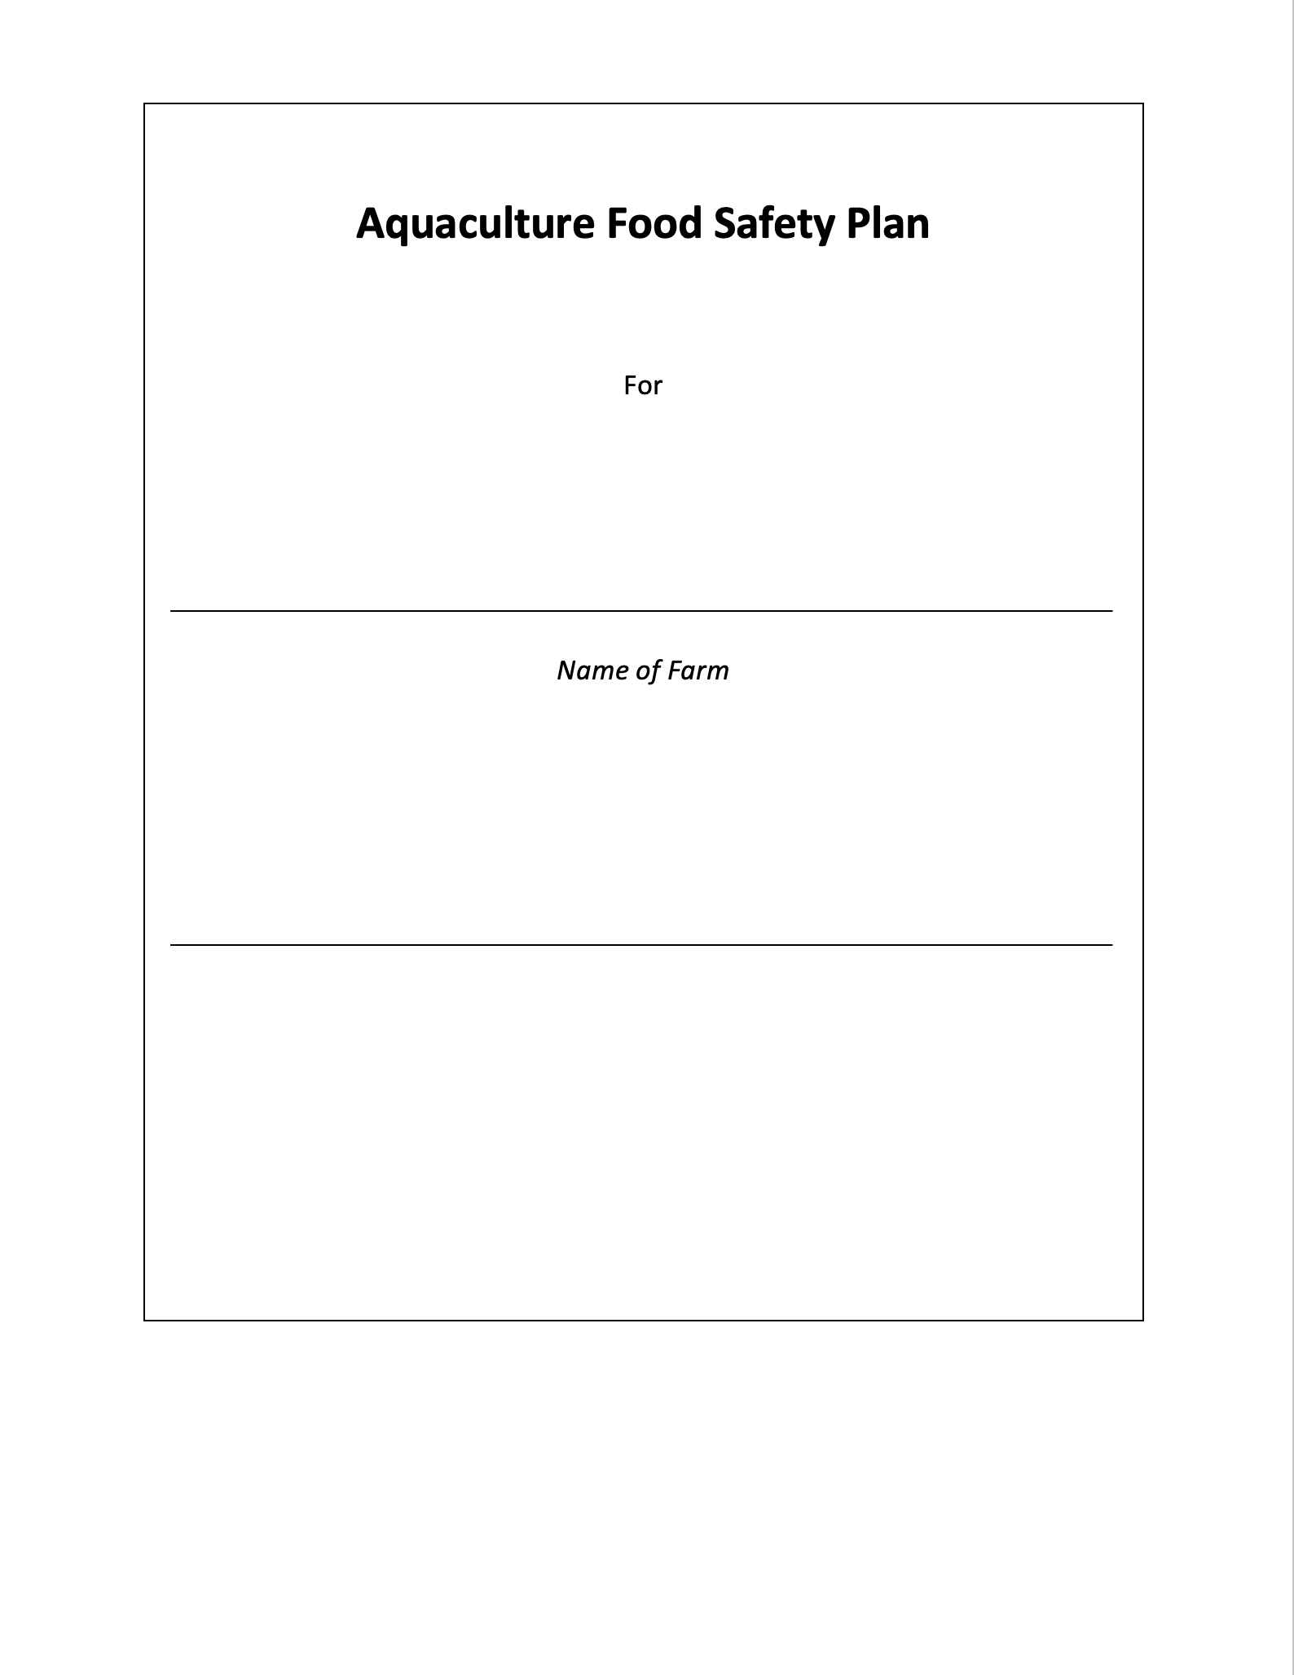
Put It All Together Into an Aquaculture Food Safety Plan
Notes:
Put It All Together Into an Aquaculture Food Safety Plan
Say: There are many different ways to document an Aquaculture Food Safety Plan. This is just one way. This form was developed based on HACCP principles which stands for Hazard Analysis and Critical Control Points. HACCP was developed by NASA to ensure safe food for astronauts.
A plan can be:
A written narrative,
Standard Operating Procedure, or
Whatever works for your farm and operation.

Slide 19
Significant Hazards or Risks
Food
Safety
Biosecurity
Best Management Practices (BMPs)
Risks
Food
Safety
Risks
Risks
Notes:
Significant Hazards or Risks
Say: Now we will have a whole group discussion about hazards or risks specific to your farms.
<Select Enter to advance the slide build.>
Ask: What are some of the hazards or risks in your location for each of the three layers of preventive controls? Let’s start with BMPs.
Debrief with examples of Hazards or Risks in BMPs such as:
Oxygen levels
pH
Feed management
<Select Enter to advance the slide build.>
Ask: What are some of the hazards or risks in your location related to Biosecurity?
Debrief with examples of Hazards or Risks related to biosecurity such as:
Whitespot or another virus
Crabs or vectors
Reusing dipnets
<Select Enter to advance the slide build.>
Ask: What are some of the hazards or risks in your location related to Food Safety?
Debrief with examples of Hazards or Risks in a food safety plan such as:
Drug residues
Environmental chemicals
Pathogens like salmonella

Slide 20
Where Do the Hazards or Risks Occur?
Where Do You Apply a Control?
Food
Safety
Biosecurity
Best Management Practices (BMPs)
Food
Safety
CPs
Notes:
Where Do the Hazards or Risks Occur? Where Do You Apply a Control?
Say: The Control Point is the location where you can apply a control to eliminate, prevent, or reduce the hazard or risk to an acceptable level. Examples include:
At the entries. Guards can apply controls.
At the tool shed. Only clean, sanitized, and properly stored tools are used.
At the reservoir source water. A trained technician can take a sample for testing.

Slide 21
How Does the Farm Eliminate, Prevent, or Reduce the Hazards or Risks to a Manageable Level?
Food
Safety
Biosecurity
Best Management Practices (BMPs)
Food
Safety
Food
Safety
Controls
Notes:
How Does the Farm Eliminate, Prevent, or Reduce the Hazards or Risks to a Manageable Level?
Say: The Control is the specific action you take to control to eliminate, prevent, or reduce the hazard or risk to an acceptable level. Here are examples:
For BMPs testing occurs for pH, ammonia, and water quality parameters.
For Biosecurity the source water in the reservoir must be chlorinated to 5 ppt to control white spot virus risk.
For Food Safety no drug can enter a farm unless it is on an approved list.

Slide 22
How Does the Farm Ensure the Control is Being Applied?
Food
Safety
Biosecurity
Best Management Practices (BMPs)
Food
Safety
Food
Safety
Monitor
Notes:
How Does the Farm Ensure the Control is Being Applied?
Say: Monitoring is the specific actions the farm takes to ensure the control is being applied. For example,
What is being monitored? This confirms that all drugs are on the farm’s approved list.
How is the monitoring happening? By checking the label and identifying the ingredients in each drug before entry.
When does monitoring occur? Monitoring occurs before any drugs can enter a farm.
Who does the monitoring? A trained gate entry guard is responsible for monitoring.

Slide 23
If the Control is Not Met, How Do You Correct the Problem?
Food
Safety
Biosecurity
Best Management Practices (BMPs)
Food
Safety
Food
Safety
Corrective Actions
Notes:
If the Control is Not Met, How Do You Correct the Problem?
Say: A Correction is an action. It identifies what the farm will do when a control is not met or is not met adequately enough to correct the deficiency. Examples include:
For Food Safety: If any drug is not on the approved list, it is rejected.
For Biosecurity: If the chlorine level in the source water (in a reservoir) is below 5 ppt, additional chlorine is added as needed and retested.

Slide 24
What Evidence or Documentation is Kept to Show the Control was Applied?
Food
Safety
Biosecurity
Best Management Practices (BMPs)
Food
Safety
Food
Safety
Records
Notes:
What Evidence or Documentation is Kept to Show the Control was Applied?
Say: Written plans record evidence or documentation that shows the control was applied. Examples of food safety hazard documentation include:
Drug delivery documentation. A guard maintains a daily record of all drug entries.
Environmental chemicals evidence. The farm permit is kept on file along with documentation that the farm location was tested and evaluated.

Slide 25
How Does the Farm Verify the Control is Working and Being Applied Correctly?
Food
Safety
Biosecurity
Best Management Practices (BMPs)
Food
Safety
Food
Safety
Verification
Notes:
How Does the Farm Verify the Control is Working and Being Applied Correctly?
Say: Verification is the action the farm takes to verify the food safety control plan for the identified risk or hazard is working. Verification examples for food safety include:
The farm manager reviews the guard’s daily records each week for compliance.
Copies of all Government or Competent authority farm and processor testing for unapproved drugs are kept on file.
Random testing of shrimp is done at least once a grow-out period from a representative number of ponds.

Slide 26
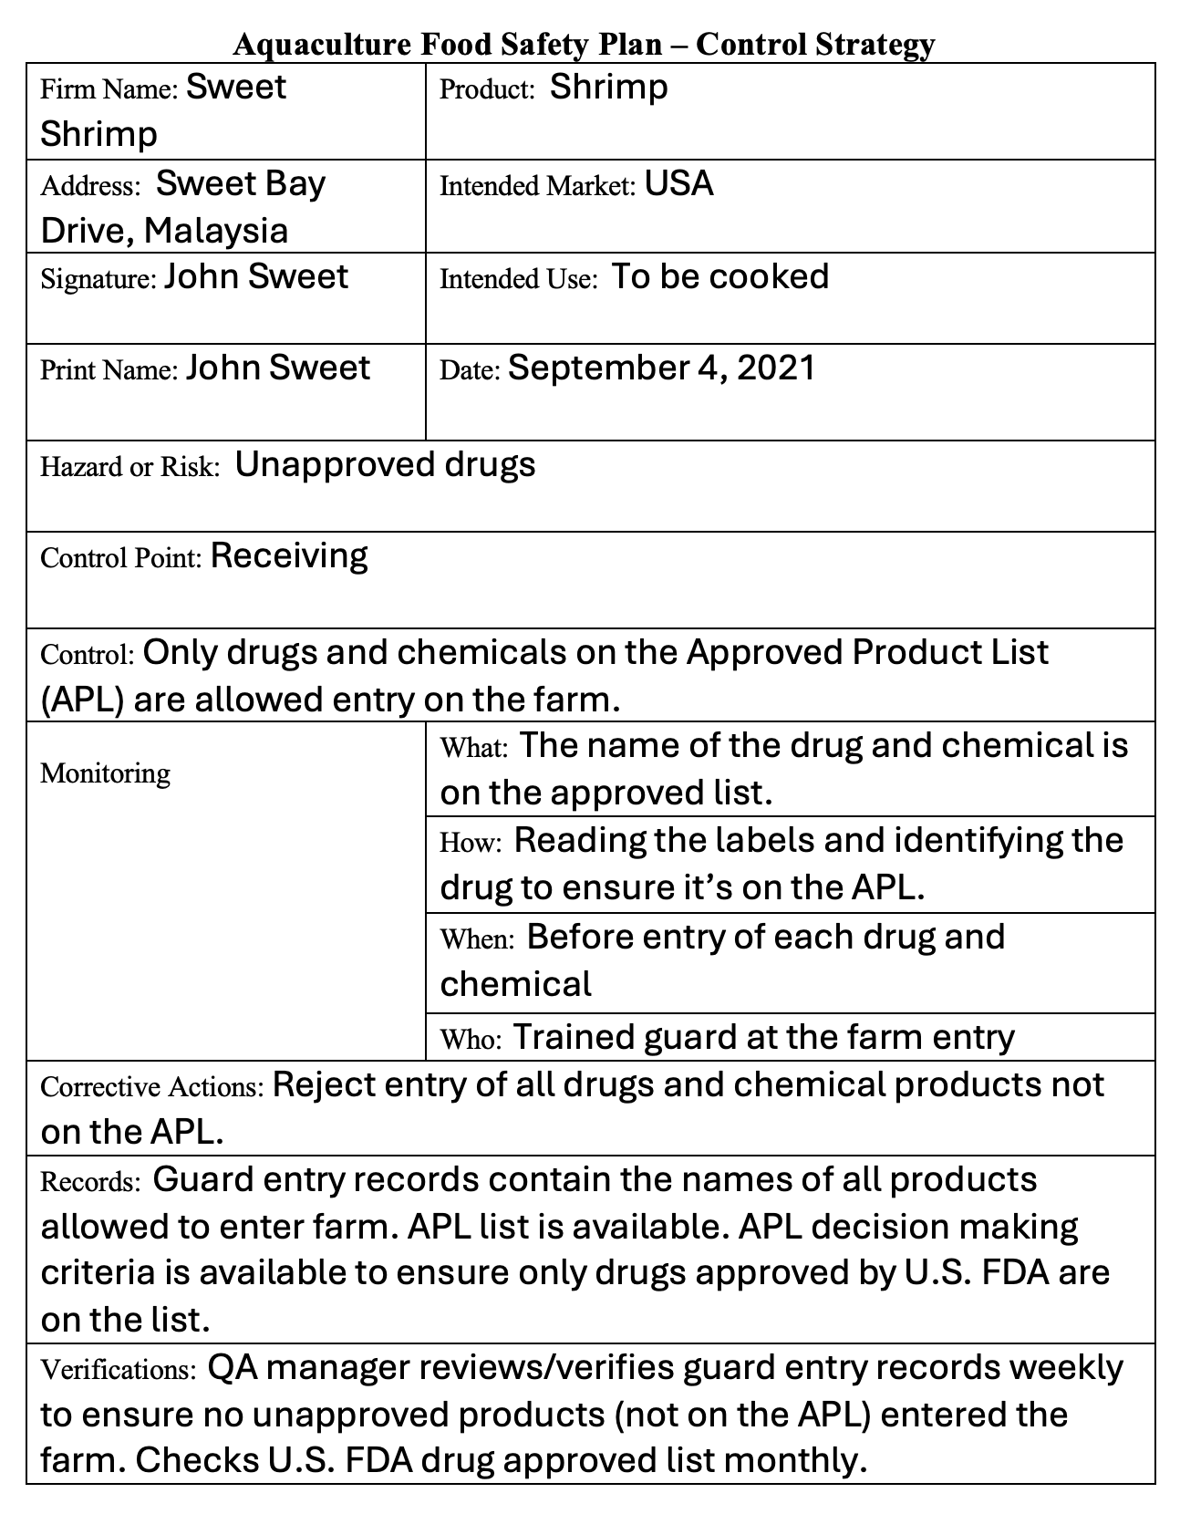
An Example
Written plan
Ongoing activities
Notes:
An Example
Say: Here is an example of a complete Food Safety Plan for an Unapproved Drug hazard. Food Safety Plans are ongoing plans. They should be consistently updated as you learn new things. This example is also in your Participant Guide.
<Select Enter to advance the slide build.>
Ask these questions to elicit a walkthrough of the example by the participants:
First, for the written portion of the plan, what is the farm name and address?
What is the product?
What is the intended market of this product?
Intended use?
What is the hazard risk documented in this plan?
What is the control point described in the plan?
The control?
How is the control being monitored?
<Select Enter to advance the slide build.>
Now for the ongoing activities, what is the correction?
Record?
How are the corrections verified?
Say: The key to a successful Food Safety Plan is that it controls the hazard or risk. Testing is part of the verification strategy. It demonstrates that the Food Safety Plan works!

Slide 27
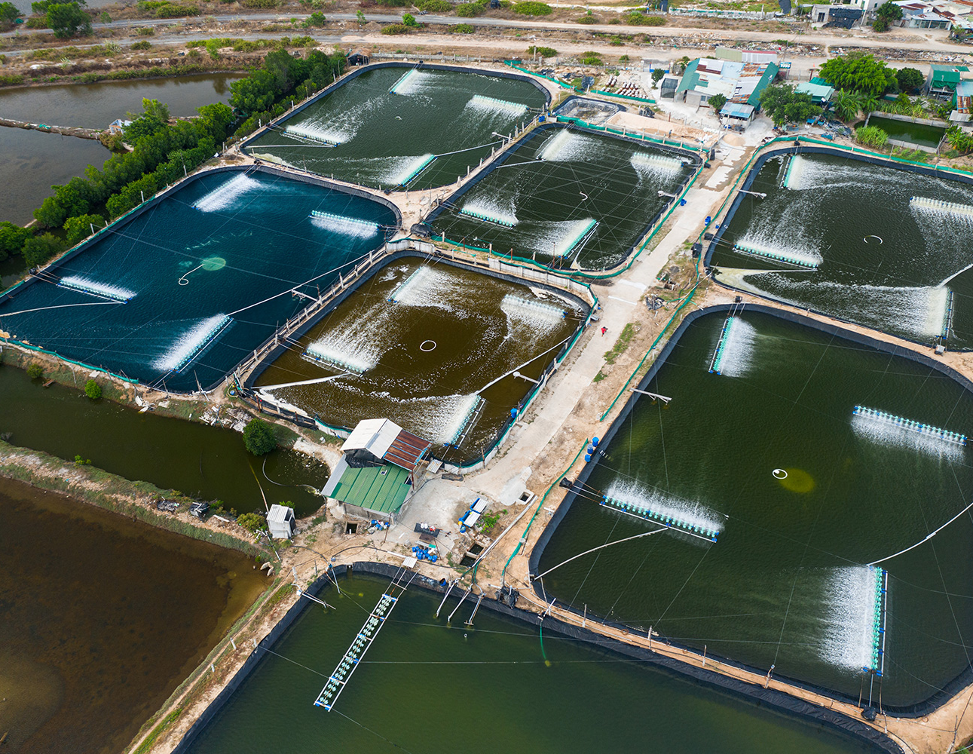
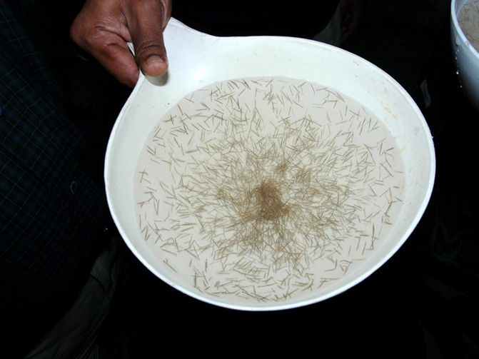
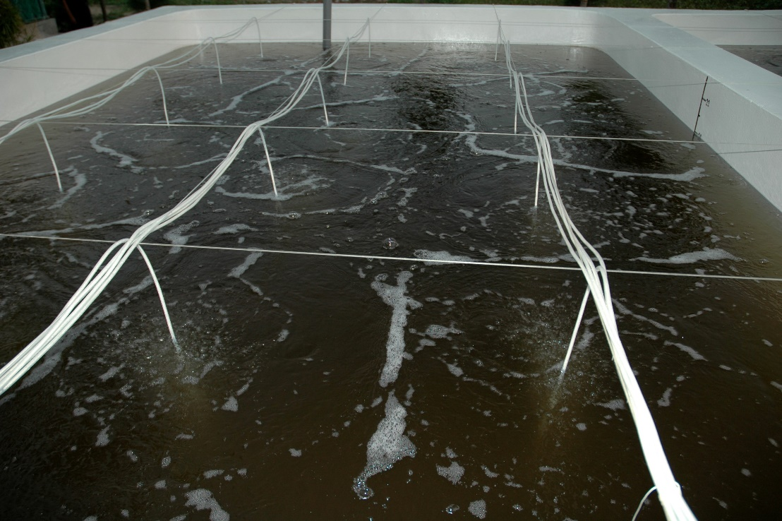
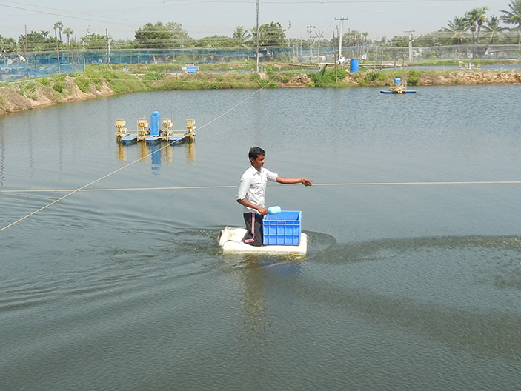
Good Aquaculture Practices (GAqP) for Various Operations
Grow Out
Hatchery
Nursery
Feed
Notes:
Good Aquaculture Practices (GAqP) for Various Operations
Say: While we are focused on grow out, the GAqP concepts and principles can be applied to hatchery, nursery, and feed mills.
Whether you put the risks and controls under BMPs, Biosecurity, or Food Safety is not the point. The key is to identify the critical risks, control those risks, keep written documentation, and verify that what you are doing is working.
Let’s use ice as an example. You can put the practice of clean, sanitary ice under BMPs or under Food Safety. It just matters that you are documenting your process and outcome using clean, sanitary ice.

Slide 28
GAqP Can:
Minimize Animal Diseases—Less diseases less need for interventions
Minimize Human Disease Outbreaks, Exposure to Drugs, Antimicrobial Resistance (AMR)
Minimize Violations at Import (Ex. U.S., EU)
Improve Poor Perception of Aquaculture
Save everyone time, money, and effort
Notes:
GAqP Can:
Review each of the bullet points on the slide.
Say: One perception held by some consumers is the belief that aquaculture products are full of drugs and chemicals. A well implemented Food Safety Plan resulting in the production of healthy animals without the use of unapproved drugs can help dispel this perception.

Slide 29
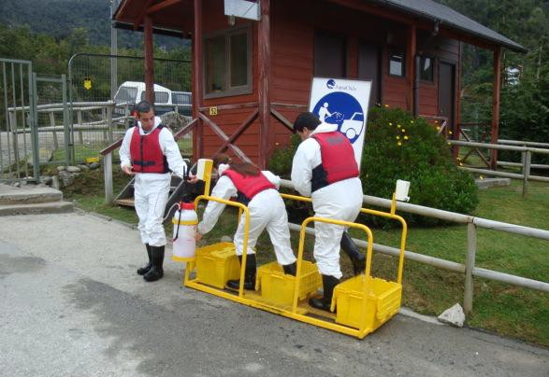
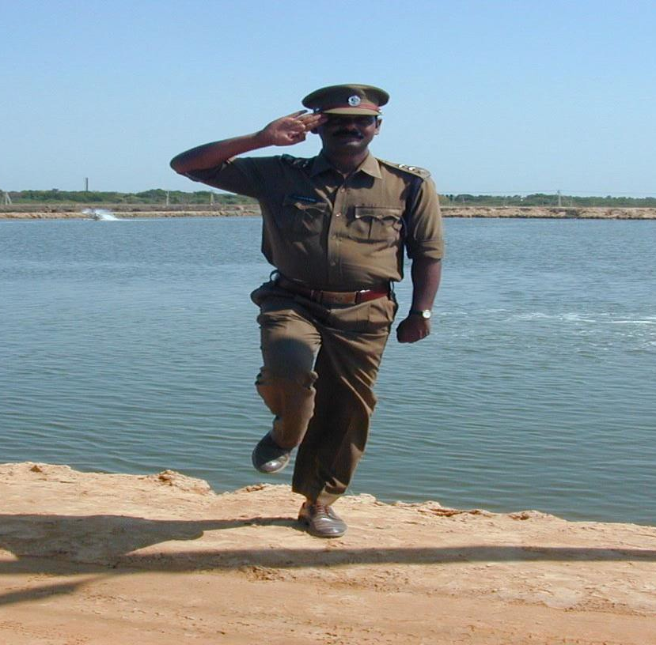
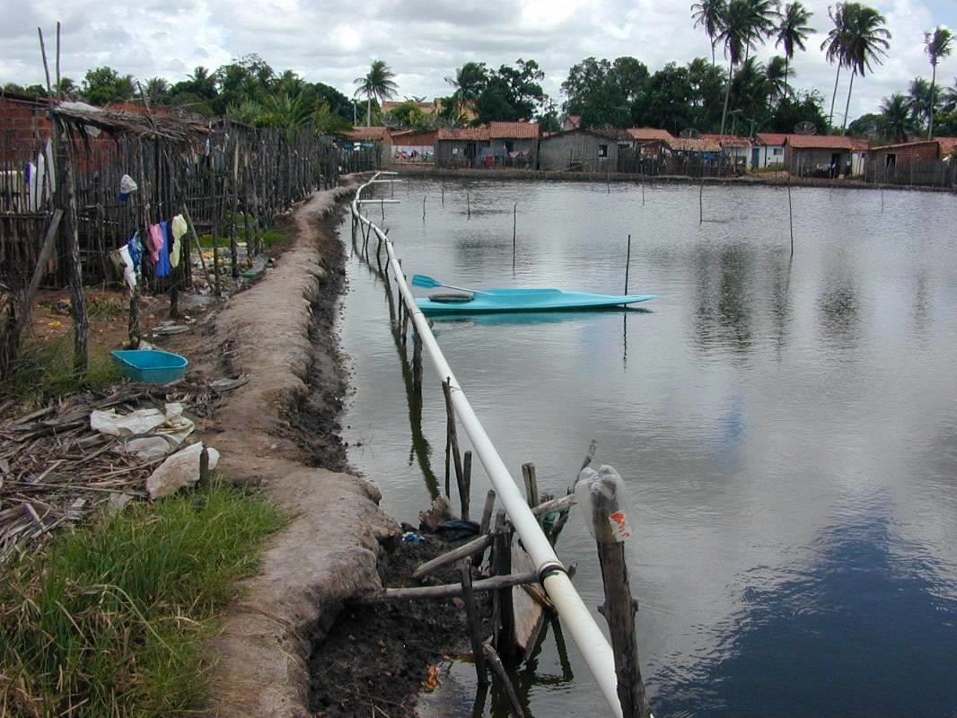
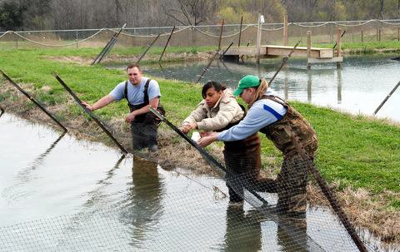
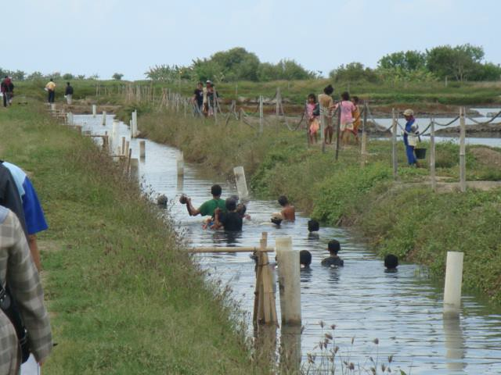
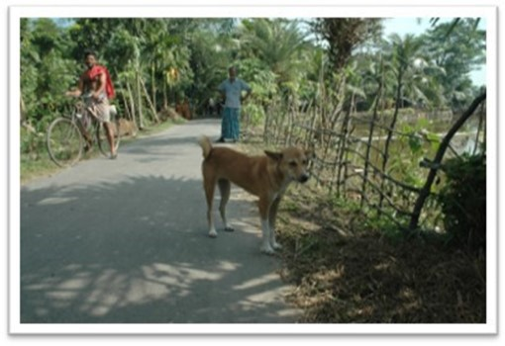
GAqPs in the Real World
Notes:
GAqPs In the Real World
INSTRUCTOR NOTE: This section is optional. It contains slides with photos to address examples related to the learning objective: Recognize the importance of GAqPs. Be sure to engage participants in conversation and ask/answer questions that arise to ensure an interactive experience for participants.
Site Selection: High Disease Risk – Site selection is a critical component if you have options. Ask the question, “Does this look like a high-risk area?”
<Select Enter to advance the slide build.>
Biosecurity Plan: Disinfecting Before Entry – Salmon farm disinfecting footwear. Three steps: wash, rinse, sanitize.
<Select Enter to advance the slide build.>
Security At The Aquaculture Site Is Critical – Site, entry security
<Select Enter to advance the slide build.>
Biosecurity…Visitors Can Bring In Disease – This is a slide of a farm that after harvest, allowed locals to catch anything that might have escaped into the canals. A nice social practice, but not bio-secure.
<Select Enter to advance the slide build.>
Keeping Vectors Out – Fencing to keep crabs out.
<Select Enter to advance the slide build.>
Keeping Animals Out – A simple way to keep animals and to some degree people from accessing a pond is this low-tech approach. The fence itself looks to be made from tree branches and vines. The effort to build the fence is exemplary and this barrier is better than no fence at all.
Continued on next slide

Slide 30
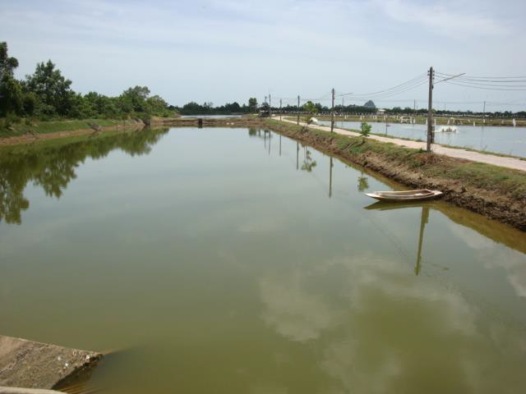
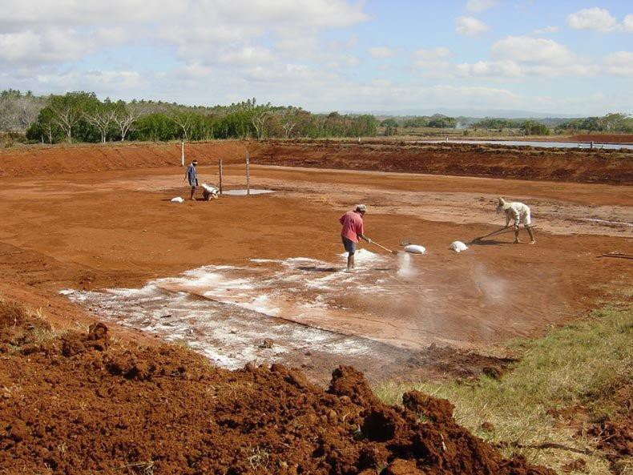
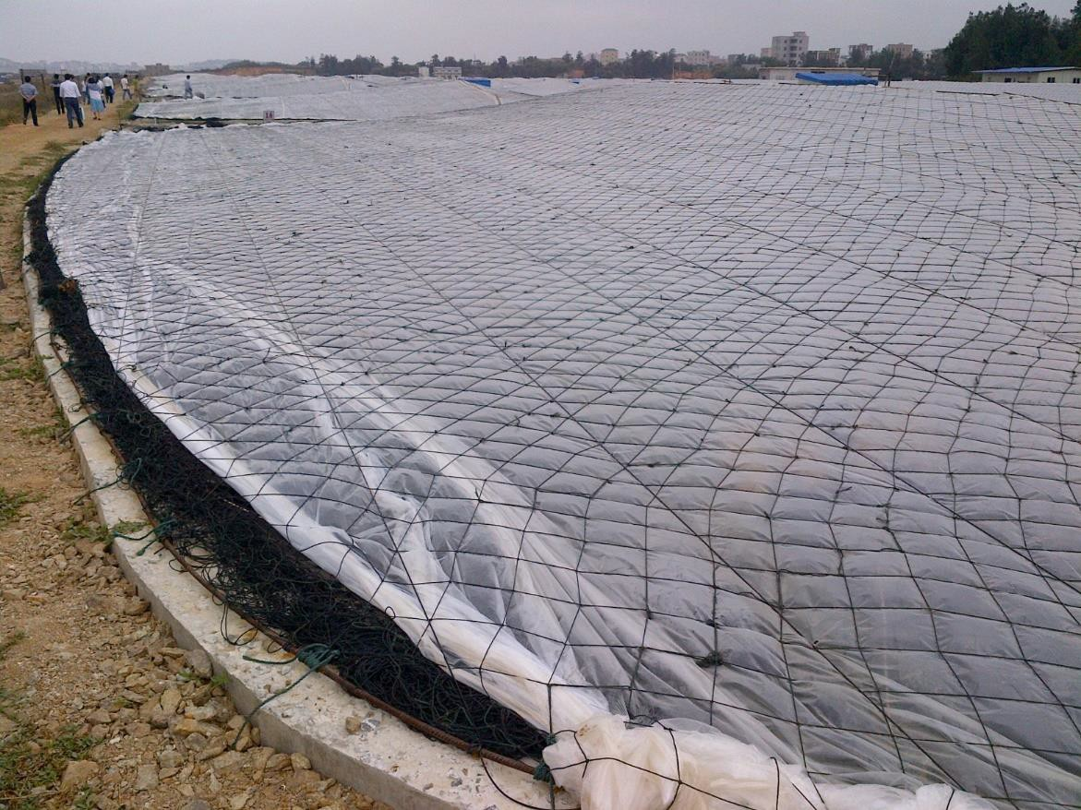
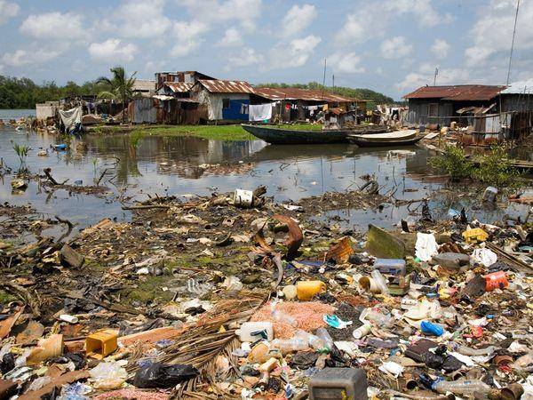
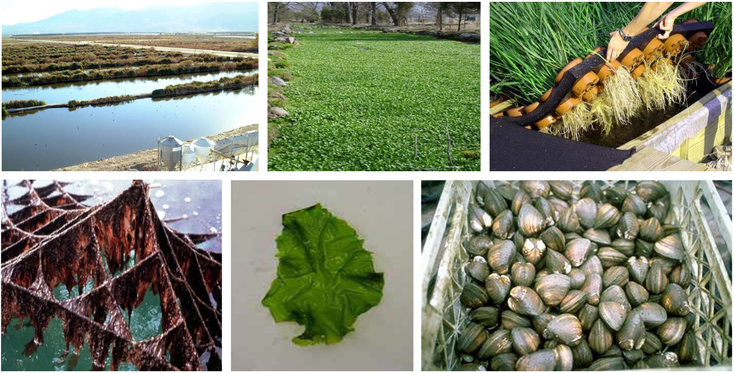
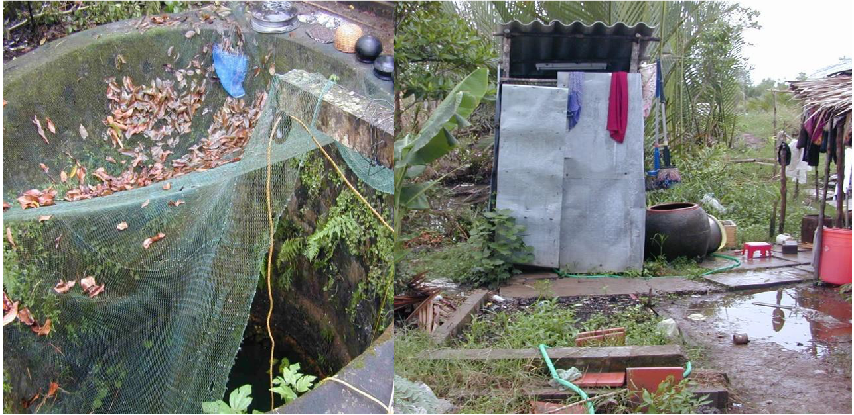
GAqPs in the Real World
Notes:
GAqPs in the Real World, continued
Holding Ponds: Significant – Holding or reservoir ponds are critical for many things, like improving water quality, and settling out detritus that microbes are attached to like salmonella, etc.
<Select Enter to advance the slide build.>
BMP: Pond Preparation – Pond preparation. In the middle of what’s called a shrimp toilet.
<Select Enter to advance the slide build.>
BMP: Pond Covers – Pond covers to protect the animals and the grow-out environment, maybe increase the temperature.
<Select Enter to advance the slide build.>
Personnel/ Worker Practices – Personnel and worker practices are important. The water they drink to not make them sick, the location, availability, and how well toilets function is important.
<Select Enter to advance the slide build.>
Farm Sanitation – Basic sanitation on a farm.
<Select Enter to advance the slide build.>
Discharge Water Treatment – Treating discharge water or recycling it is important. You want to be a good steward of the environment.
Continued on next slide

Slide 31
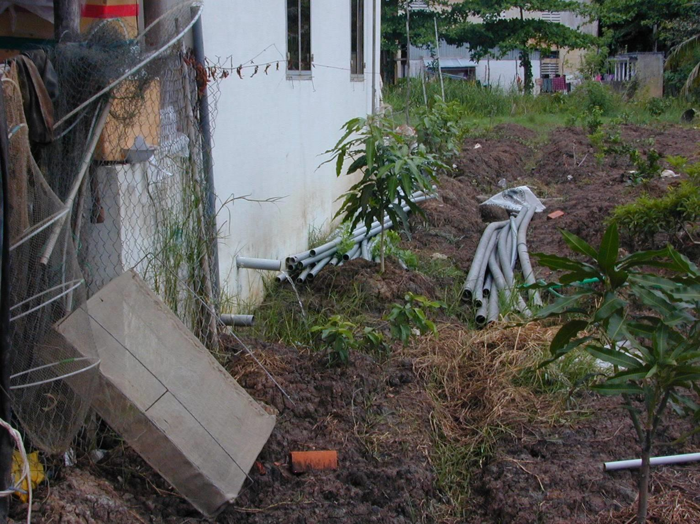
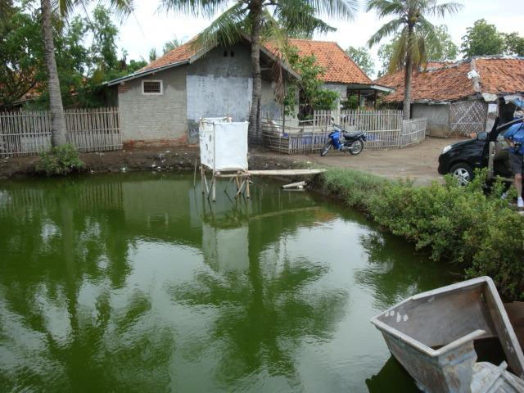
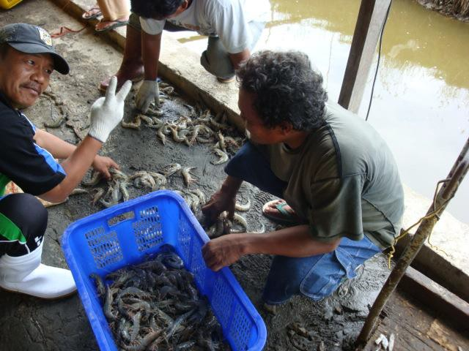
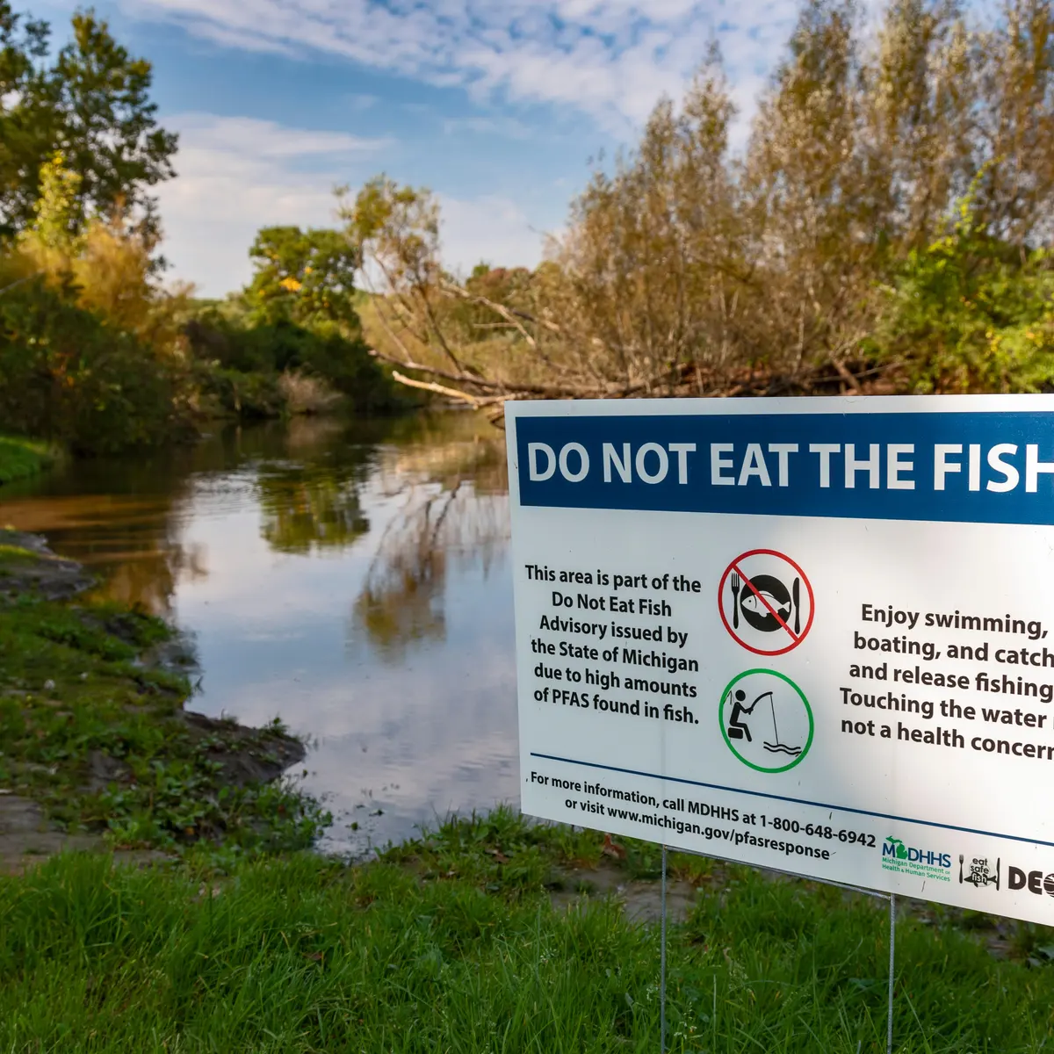
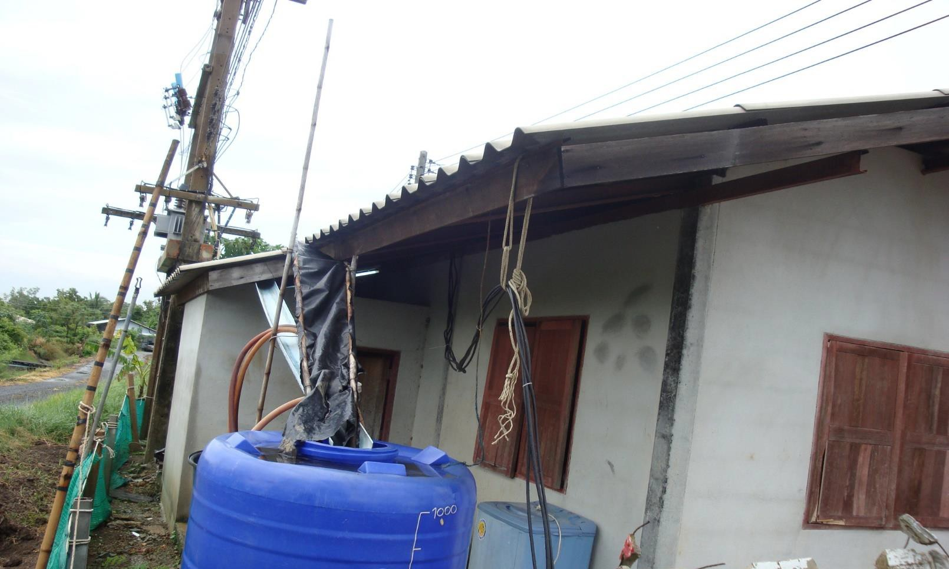
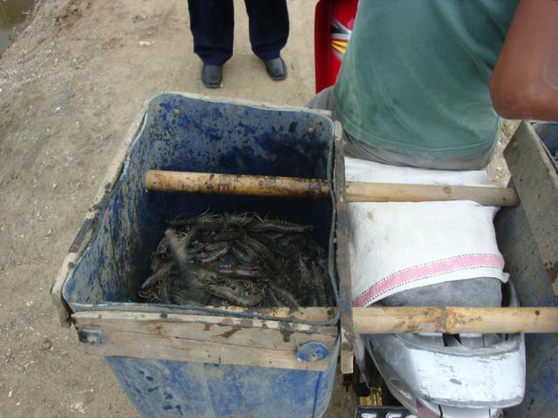
GAqPs in the Real World
Notes:
GAqPs in the Real World, continued
Sanitation: Shrimp in Mud, Sand, Dirt – Food safety examples.
<Select Enter to advance the slide build.>
Human Sewage Going Onto Ground Around Pond – Functioning, well-placed toilet. Here a person went into the bathroom, flushed, and the water can outside to the ground.
<Select Enter to advance the slide build.>
Sanitation: Human Pathogens – Toilet over the pond, a key cause of salmonella.
<Select Enter to advance the slide build.>
Employee Health: Drinking Water – There was a salmonella outbreak that we traced back to bird poop being washed off roofs into holding water.
<Select Enter to advance the slide build.>
Transportation – Bad holding conditions.
<Select Enter to advance the slide build.>
Environmental Chemicals – Location is important to prevent chemical contamination.
Continued on next slide

Slide 32
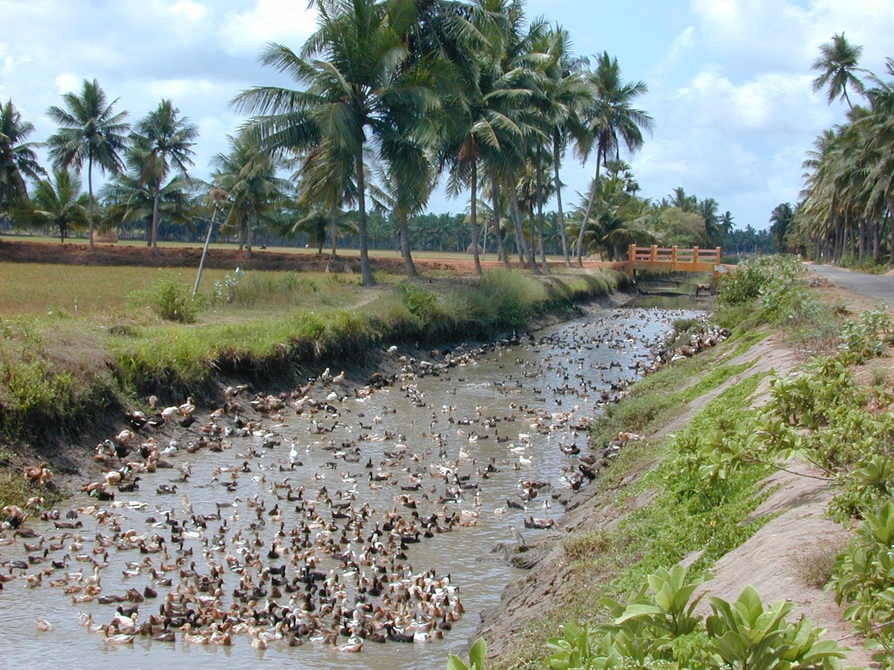
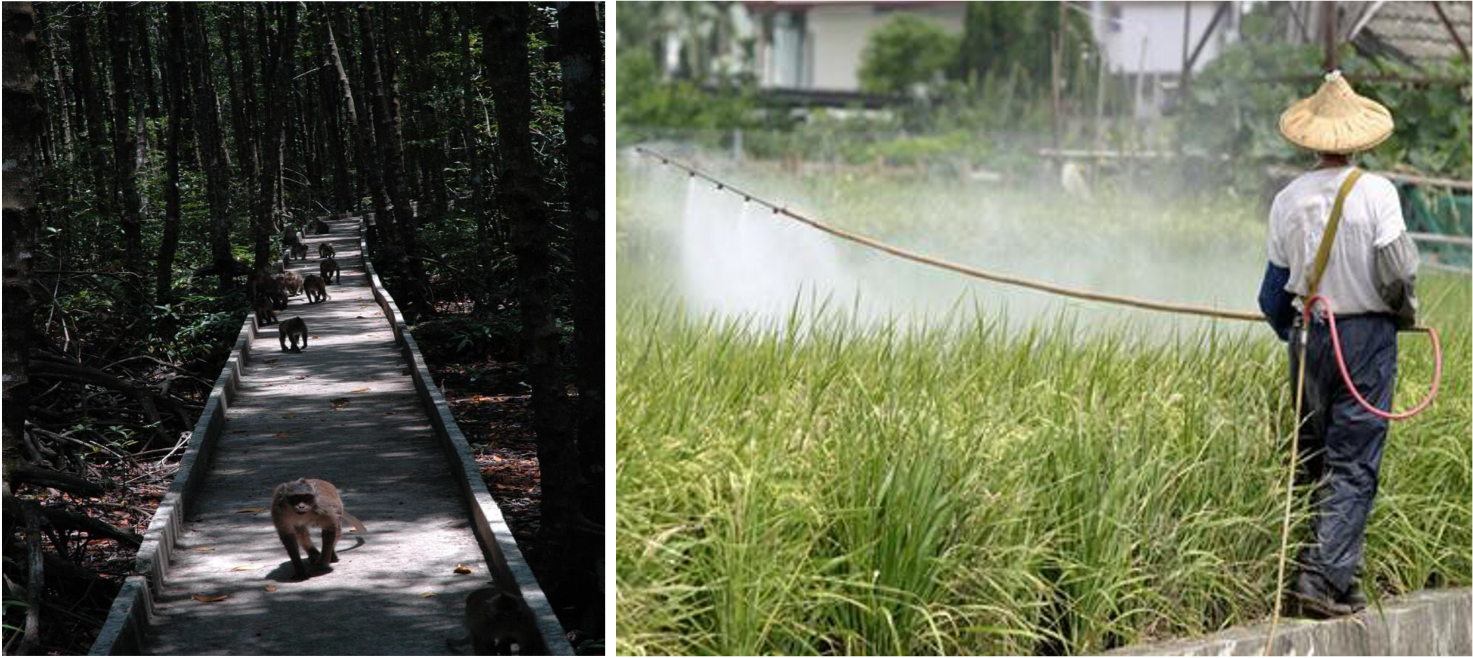
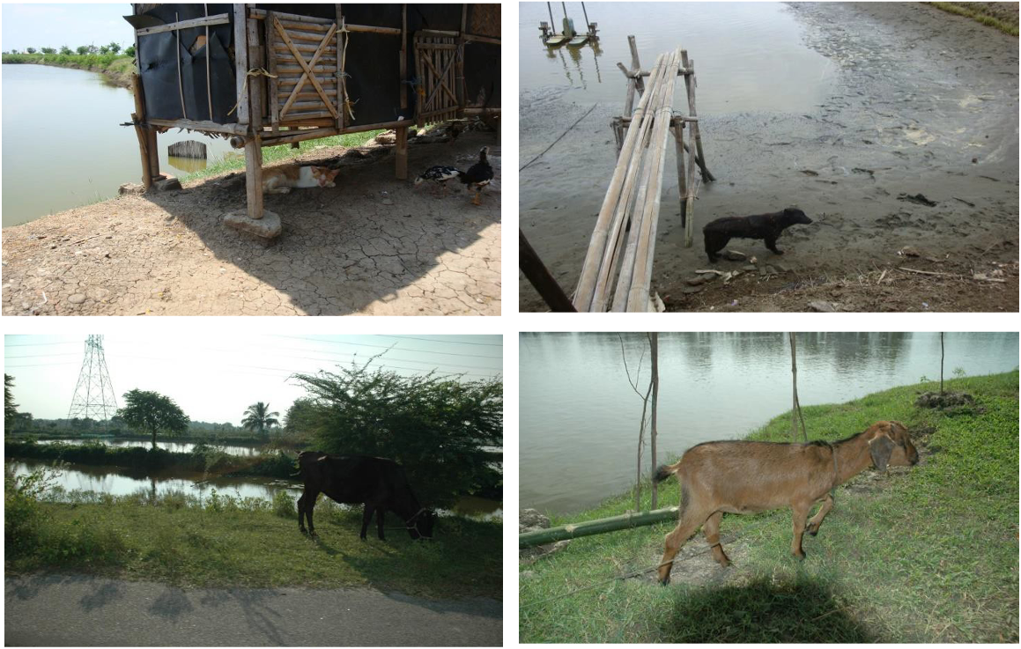
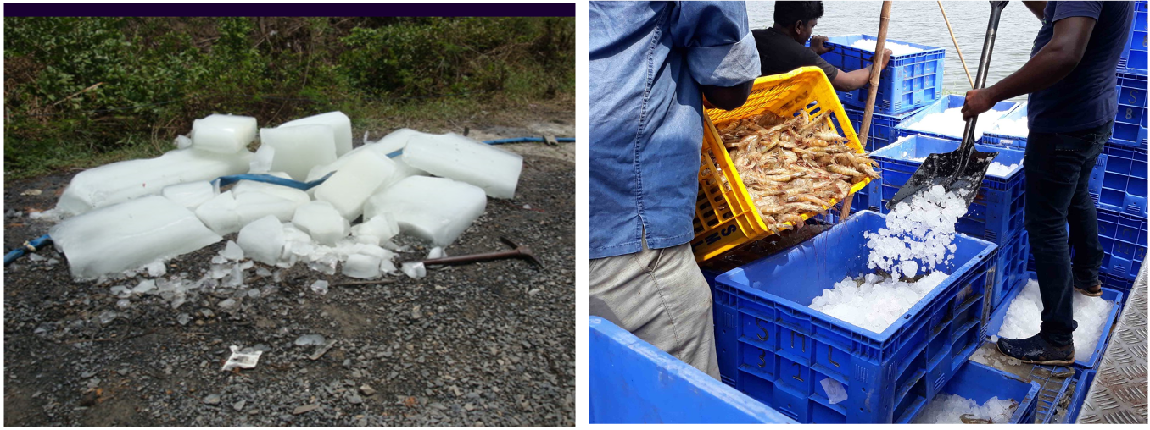
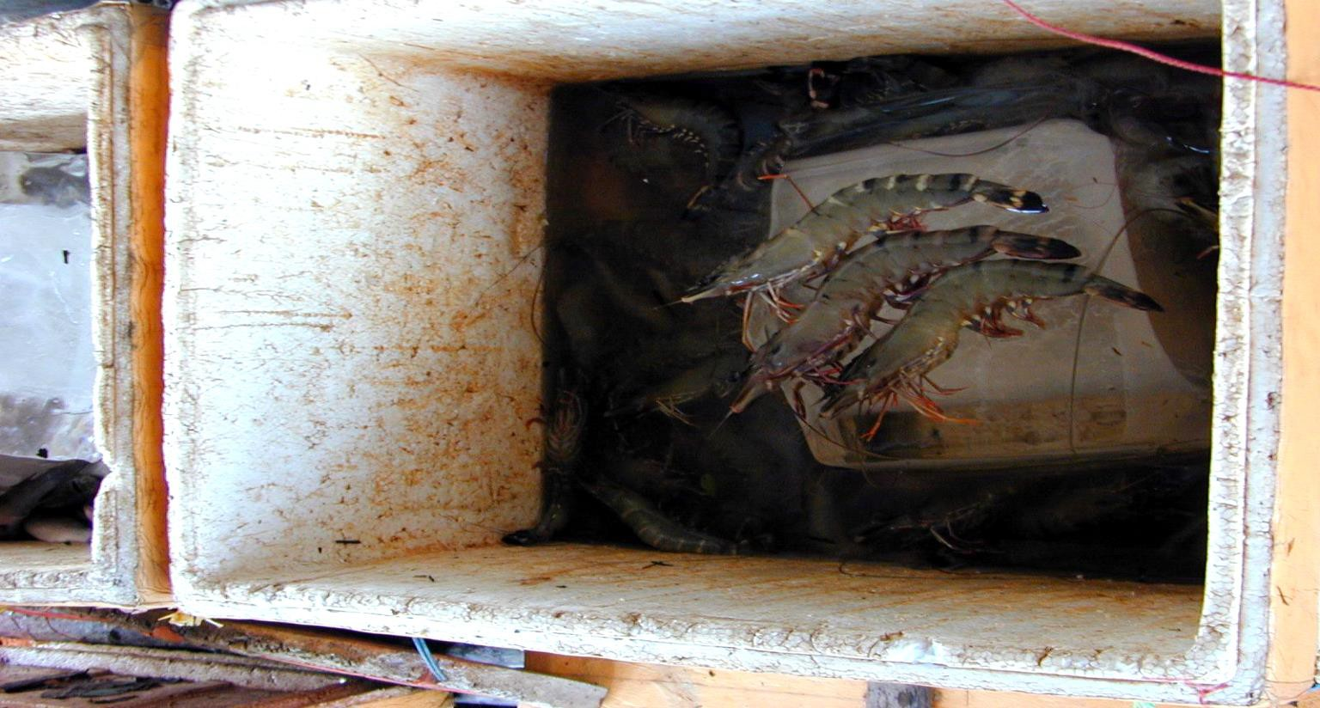
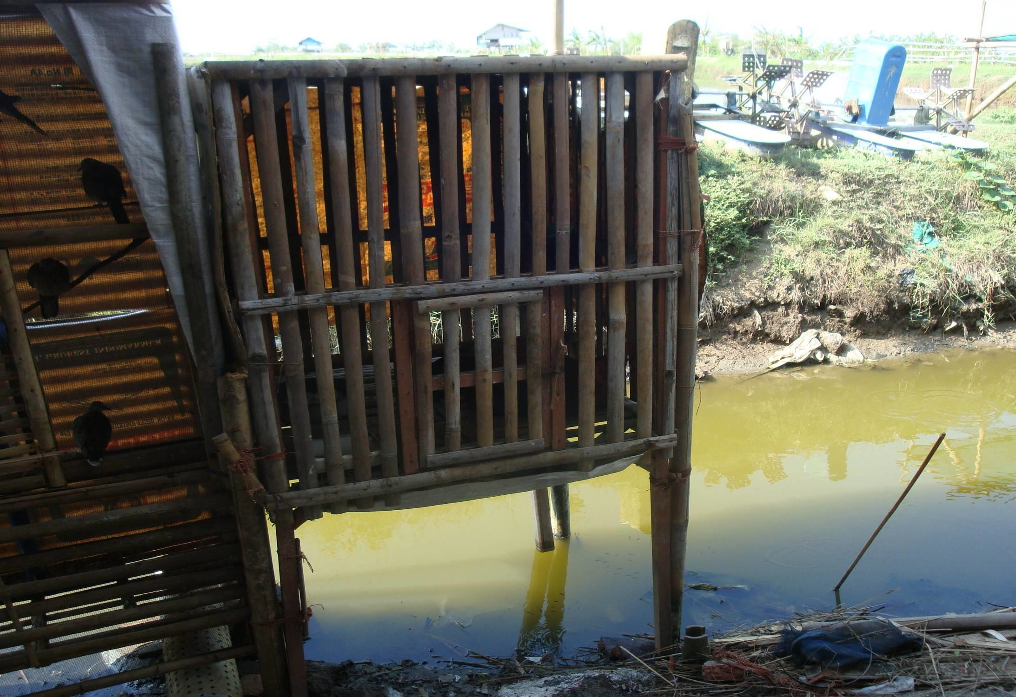
GAqPs in the Real World
Notes:
GAqPs in the Real World, continued
Site Selection: Previous Land Use or Neighbors – Notice who your neighbors are. Do they have animals? Or are they farmers using pesticides?
<Select Enter to advance the slide build.>
Human Pathogens: Source and Pond Water – What do you see here? What would be the risk of this as your source water? Yes, salmonella from the ducks.
<Select Enter to advance the slide build.>
Animals On Farm; Food Safety and Disease – Animals on the farm are a high risk as disease carriers and salmonella.
<Select Enter to advance the slide build.>
Animals On Farm; Food Safety and Disease – Again, animals directly above the source water.
<Select Enter to advance the slide build.>
Human Pathogens: Water and Ice – Clean ice and water are two important parts of seafood food safety.
<Select Enter to advance the slide build.>
Shrimp Being Contaminated By Dirty Ice, Dirty Container – Dirty containers. This is an example of a lack of training. The farmer was so proud of his black tiger shrimp he didn’t think about the dirty container or ice.

Slide 33
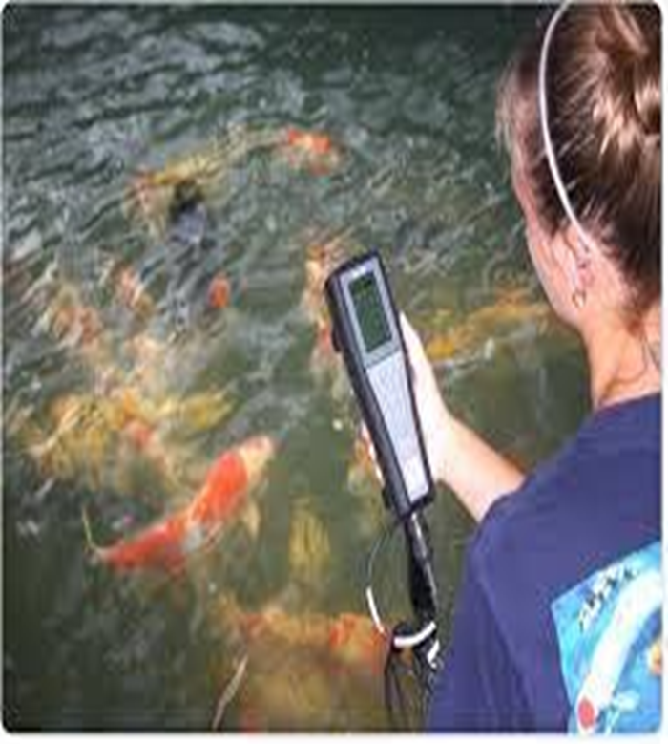
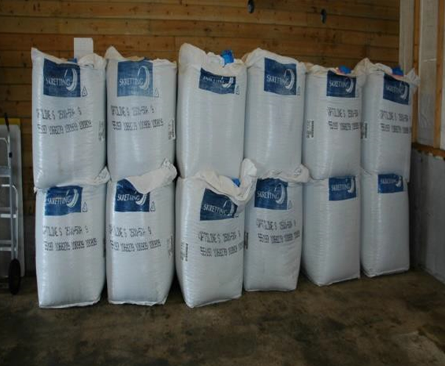
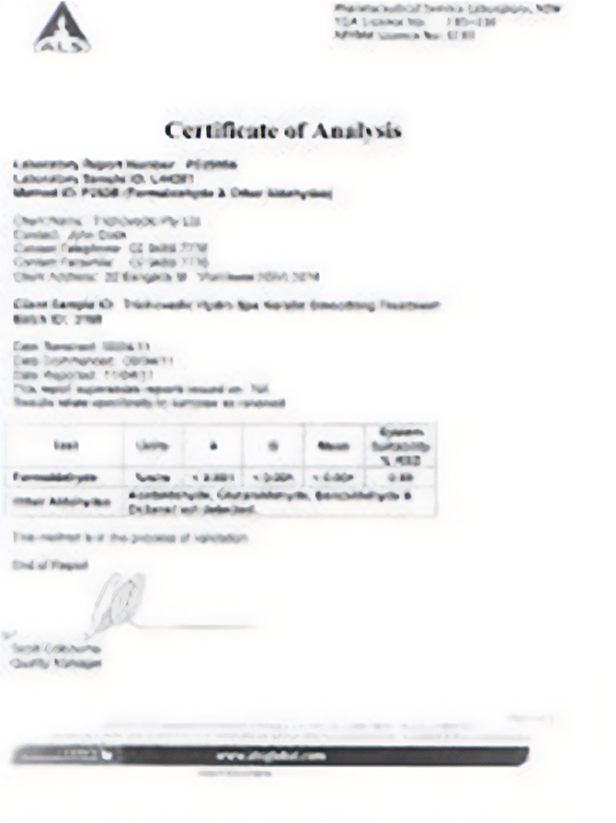
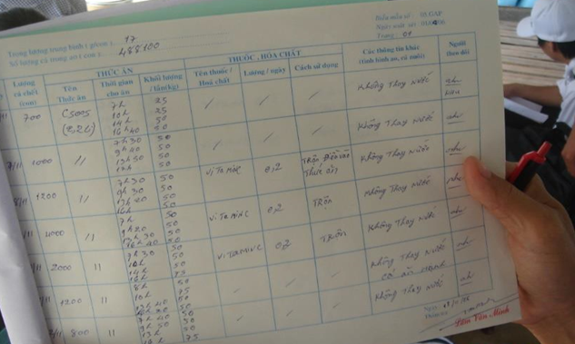
GAqPs in the Real World
Notes:
GAqPs in the Real World, continued
Feed Sourcing and Storage– Feed sourcing and feed storage is critical. This feed is stored on the ground.
<Select Enter to advance the slide build.>
Water Quality Testing
<Select Enter to advance the slide build.>
Certificate of Analysis – A Certificate of Analysis shows that feed is free of residues and/or has the proper nutrients.
<Select Enter to advance the slide build.>
Drug Records– It is important to use approved drugs and keep records including:
Name of drug
Date started
Date Stopped
How much used
Calculated withdrawal times
Why it was used
Prescription

Slide 34
Which of These Good Aquaculture Practices Are You Already Doing?
Can You Show &
Tell Your Story To:
Bankers
Importer
Buyer
Consumer
Can you traceback to correct problems?
Do You Have:
Documentation
Evidence
Records
Transparency
Notes:
Which of These Good Aquaculture Practices Are You Already Doing?
Group Discussion Activity
Ask: Consider your current efforts. Which of the good aquaculture practices are you already doing? You may already be doing biosecurity, BMPs, and addressing food safety.
But, do you have any or all of these? We are going to go around the room and “show and tell” your story about one or more of these.
Allow each person to choose one of the topics on the slide to share about.
Allow 2-4 minutes for each person to share.

Slide 35
GAqP Summary
A prevention-based strategy
Uses a One Health Approach
Includes layers of preventive controls:
  BMP
  Biosecurity
  Food Safety
Can save everyone time, money, and effort
Allows you to tell your story
Notes:
GAqP Summary
Review each point on the slide one-by-one.

Slide 36
?
Notes:
Say: What questions do you have?

Slide 37
This publication is supported by the Food and Drug Administration (FDA) of the U.S. Department of Health and Human Services (HHS) as part of a financial assistance award U01FD001418 with 100% funded by FDA/HHS. The contents are those of the author(s) and do not necessarily represent the official views of, nor an endorsement by FDA/HHS, or the U.S. Government.

