Slide 1

In Country Presentation
<Enter Instructor Name and Title Here>
30-45 minutes
Notes:
In Country Presentation
Instructor Guide
CC BY-NC 4.0
30-45 minutes

Slide 2
Introductions
<Instructor Name, Title, Organization>
<Instructor Name, Title, Organization>
Notes:
Introductions
INSTRUCTOR NOTE: Before class enter the name of the instructor on the cover slide.
INSTRUCTOR NOTE: The overall focus of today’s class is food safety and disease prevention at aquaculture farms for products exported to the United States (U.S.). Please prepare remarks for 5-30 minutes and allow 10 minutes for questions and answers with the group. Feel free to present what you think is most important to the students in this workshop about Good Aquaculture Practices with your knowledge and experience of your country in mind.
Present your experience, name, affiliation (where you work) and describe your main role(s).
Offer background on how you got into aquaculture and what you have done in the field of aquaculture.

Slide 3
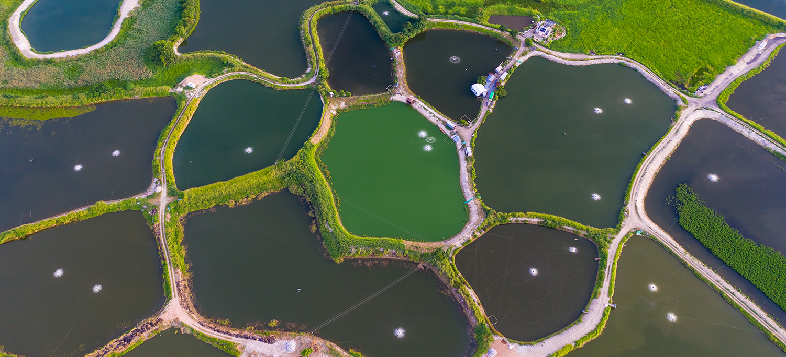
Aquaculture In Our Country
Notes:
Aquaculture In Our Country
INSTRUCTOR NOTE: Add images and slides, as needed, to this presentation as needed to present the following information in an interesting and engaging way.
Briefly describe the efforts of your country overall including regulatory or government requirements or standards, voluntary industry programs or standards, and other efforts underway to:
Prevent aquaculture diseases.
Ensure aquaculture products are safe for human consumption. (Please focus on products exported to the U.S. only.)
Ensure certification programs are in place at aquaculture farms related to disease prevention and or food safety.
Describe:
GAqP program(s) in place, if applicable.
Government farm inspections in place to monitor for diseases or to ensure food safety, if applicable.
The most challenging problem(s) with aquaculture in your country.
Solutions for each challenge above.
Present anything else you think is important about aquaculture in your country as time allows.

Slide 4
?
Notes:
Ask: What questions do you have at this point?

