Slide 1

Farm Visit and Presentations
<Enter Instructor Name and Title Here>
8 hours + 3.5 hours
Notes:
Farm Visit
Instructor Guide
CC BY-NC 4.0
8 hours + 3.5 hours

Slide 2

Group Presentations
60min
Your presentation should include:
Slides
Photo(s) and remarks about ‘good’ practices
Photo(s) and remarks about ‘not so good’ practices
Ensure each group member contributes
Prepare a 10-minute presentation.
Notes:
Group Presentations
INSTRUCTOR NOTE: Before class enter the name of the instructor on the cover slide.
Allow groups at least 45 minutes to work. Walk around monitoring the groups as they work and answering questions.
Notify the groups when there is 15 minutes remaining. Ask them to wrap up their work, take a quick break if necessary, and be prepared to share at the given time.
When 45 minutes has elapsed, call on each group to share, eliciting sharing from each member of the group when possible.
Allow each group approximately 10 minutes to share. There is a total of one hour allotted for this part of the activity.
At the conclusion of each group’s sharing, allow the whole group to ask questions about the presentation and give the presenters time to address each question.

Slide 3
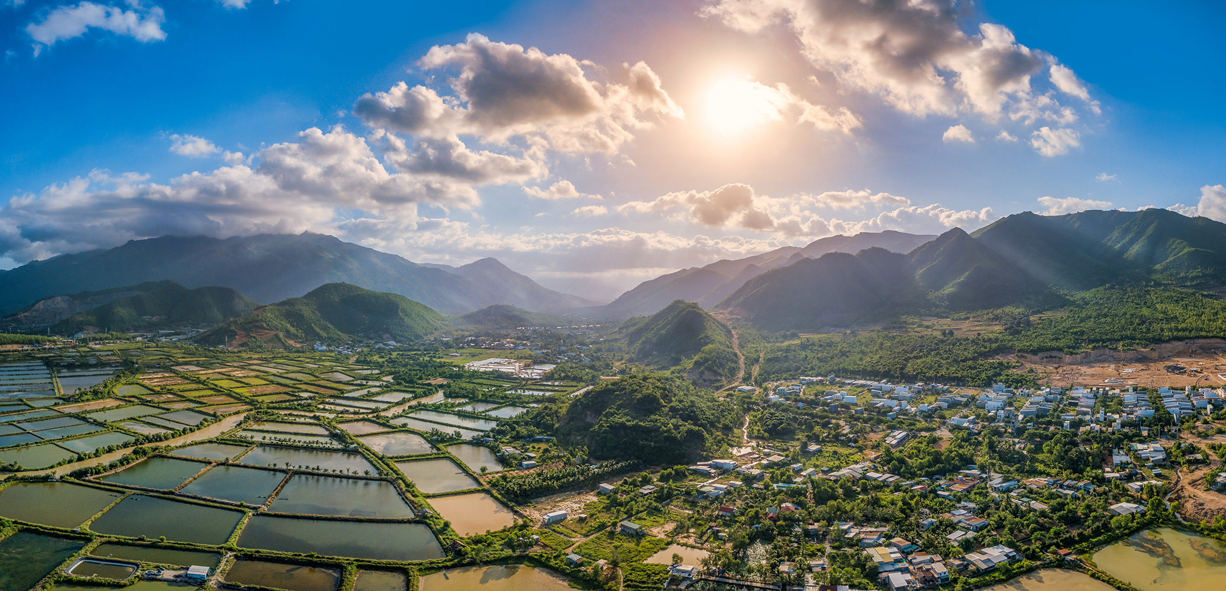
Complete Post-Test and Course Evaluation
30min
30 minutes
Notes:
Complete Post-Test and Course Evaluation
Hand out the test and course evaluation.
Allow 20 minutes. Let participants know when 2 minutes remain.
Collect tests and evaluations before reviewing responses. If participants need more time to complete course evaluations, allow for this.

Slide 4
Question 1
Which of the following are benefits of GAqPs?
(Choose all that apply.)
   Minimize animal diseases
   Minimize human diseases
   Reduce AntiMicrobial Resistance (AMR)
Notes:
Question 1
Review the test by reading each question aloud, engage students by asking them to raise their hand for their chosen answer (A, B, C), select Enter to show the correct answer, and then debrief each question with the feedback provided. Ask for questions frequently and answer them before progressing. Encourage fun and friendly competition.
Read the question aloud and ask participants to say the correct answer. Ask who agrees using raised hands.
<Select Enter to advance the slide build.>
Emphasize correct feedback as follows:
Say: The correct answer is all of these. Benefits of GAqPs include minimize animal diseases, minimize human diseases, and reduce antimicrobial resistance.

Slide 5
Question 2
In aquaculture biosecurity, a Control Point (CP) is:
   The point where the quality of the animals can be improved
   The location where a disease outbreak has already occurred
   The point where a control or mitigation can be applied
   The point where you use equipment most effectively and efficiently
   The point where you display your permits or licenses for official review
Notes:
Question 2
Read the question aloud and ask participants to say the correct answer. Ask who agrees using raised hands.
<Select Enter to advance the slide build.>
Emphasize correct feedback as follows:
Say: The correct answer is that a control point is the point where a control or mitigation can be applied to mitigate or eliminate a hazard or risk.

Slide 6
Question 3
With regards to pH in a shrimp pond, which one of the following is true:
   pH is stable over a 24-hour period
   Shrimp farming is unique, a pH reading of 5 is considered neutral
   Unlike dissolved oxygen, it is ok to check pond pH once a week
   Shrimp prefer a pH of 7- 8.5
Notes:
Question 3
Read the question aloud and ask participants to say the correct answer. Ask who agrees using raised hands.
<Select Enter to advance the slide build.>
Emphasize correct feedback as follows:
Say: The correct answer is that shrimp prefer a pH of 7-8.5. pH is not stable over a 24-hour period due to fluctuations in carbon dioxide in pond water. The CO₂ fluctuation is a result of microalgae production in the pond water during daylight hours and the reverse at the nighttime. CO₂ acts as an acid and increased at night. Neutral pH is 7.0, and typical pH for shrimp ponds ranges between 7.0 and 8.5. It’s important to check pH daily and at the same time each day for consistent pH values.

Slide 7
Question 4
If an aquaculture grow-out pond experiences a disease outbreak, which of these should the farm do immediately?
   Apply antibiotics to the infected pond
   Apply probiotics to all ponds
   Quarantine the infected pond
Notes:
Question 4
Read the question aloud and ask participants to say the correct answer. Ask who agrees using raised hands.
<Select Enter to advance the slide build.>
Emphasize correct feedback as follows:
Say: The correct answer is to quarantine the infected pond to prevent the spread of the disease and just as important, treat and effluent water from the pond to prevent spreading the pathogens to other farmers.

Slide 8
Question 5
Which of these potential disease vectors should be controlled on an aquaculture farm? (Choose all that apply.)
   Crabs
   Domestic animals
   Fish
   Mammals
Notes:
Question 5
Read the question aloud and ask participants to say the correct answer. Ask who agrees using raised hands.
<Select Enter to advance the slide build.>
Emphasize correct feedback as follows:
Say: The correct answer is all of these. Fish, crabs, mammals, and all animals, wild and domestic, are potential disease vectors.

Slide 9
Question 6
Which of these are true statements about site selection for an aquaculture farm? (Choose all that apply.)
   Adjacent land use is not a consideration in site selection
   Acidic soils, characteristic of mangrove areas, are considered ideal for shrimp ponds
   Being close to roads and transportation is important
   Source water for a farm directly impacts water quality
Notes:
Question 6
Read the question aloud and ask participants to say the correct answer. Ask who agrees using raised hands.
<Select Enter to advance the slide build.>
Emphasize correct feedback as follows:
Say: Two of these are true statements. Source water for a farm directly impacts water quality and being close to roads and transportation is important. Adjacent land use is a consideration in site selection and acidic soils are not ideal for shrimp ponds.

Slide 10
Question 7
Good Aquaculture Practices (GAqPs) are used to:
(Choose all that apply.)
   Prevent diseases
   Guarantee farms are profitable
   Ensure acceptable shipments to the U.S.
   Document your practices and tell your story
Notes:
Question 7
Read the question aloud and ask participants to say the correct answer. Ask who agrees using raised hands.
<Select Enter to advance the slide build.>
Emphasize correct feedback as follows:
Say: The correct answer is to prevent diseases and document your practices and tell your story. This is important for the daily farm operations. Through the use of Good Aquaculture Practices, a farm may be able to command a higher price for the farm product in the marketplace. Of course, there are never guarantees or assurances of profitability.

Slide 11
Question 8
What are the most common food safety hazards or risks related to consumption of aquaculture seafood?
   Drug residues, melamine, pesticides
   Heavy metals, pesticides, hormones
   Off flavors, drug residues, shrimp molting
   Environmental chemicals, unapproved drug residues, human pathogens
Notes:
Question 8
Read the question aloud and ask participants to say the correct answer. Ask who agrees using raised hands.
<Select Enter to advance the slide build.>
Emphasize correct feedback as follows:
Say: The correct answer is environmental chemicals, unapproved drug residues, and human pathogens.

Slide 12
Question 9
Where do most aquaculture food safety hazards or risks occur?
   At the processor
   During transportation and shipment
   At the production farm
   At retail or consumer level
Notes:
Question 9
Read the question aloud and ask participants to say the correct answer. Ask who agrees using raised hands.
<Select Enter to advance the slide build.>
Emphasize correct feedback as follows:
Say: Most aquaculture food safety hazards or risks occur at the production farm.

Slide 13
Question 10
Which of the following should an aquaculture Food Safety Plan include? (Choose all that apply.)
   All potential hazards or risks at the production farm
   Controls that prevent or eliminate the hazard or risk
   Verification that the controls implemented on the farm work
   Intended market/country of the seafood produced
Notes:
Question 10
Read the question aloud and ask participants to say the correct answer. Ask who agrees using raised hands.
<Select Enter to advance the slide build.>
Emphasize correct feedback as follows:
Say: An Aquaculture Food Safety Plan should include the intended market, use, and country; determine control points, monitor the control points, make corrective actions, keep records, and verify that the controls are working. It is critical to identify significant hazards or risks, not all hazards or risks, so that one statement is not correct.

Slide 14
?
Notes:
Ask: Before we conclude, what questions do you have at this time?

Slide 15

Certificates and Closing Ceremony
45min
Congratulations!
Notes:
Certificates and Closing Ceremony
Prepare a certificate for each participant in advance.
Present each participant with their certificate and have them step up to receive it creating an atmosphere of celebration.

