Slide 1

Best Management Practices
<Enter Instructor Name and Title Here>
4 hours
Notes:
Best Management Practices (BMPs)
Instructor Guide
CC BY-NC 4.0
4 hours

Slide 2
Elements of a BMP Plan for Aquaculture Farms
Permits and Site Selection
Design
Source Water and Effluent Treatment
Production Pond Management
Water Quality Management
Production Management
Feed and Feeding
Harvesting
Chemicals
Equipment
Personnel
Disease Prevention
Record Keeping
Food
Safety
Biosecurity
Best Management Practices (BMPs)
Food
Safety
Notes:
Elements of a BMP Plan for Aquaculture Farms
INSTRUCTOR NOTE: Before class enter the name of the instructor on the cover slide.
Say: These are the main elements for consideration in Best Management Practices for aquaculture farms. We will be covering each of them in depth in this presentation.
<Select Enter to advance the slide build.>
Ask: Before we jump into BMPs, what questions do you have so far?
Debrief by answering all questions thoroughly, ensuring plenty of time for follow up questions before beginning.

Slide 3
1. Permits and Site Selection
Environmental Permits
Water Intake/Discharge
Land Use
Impact
Depredation
Regulatory Permits
Aquaculture Operation
Import
Export
Production
Operating/Business Permits
Tax-related
Import
Export
Certifications
Notes:
1. Permits and Site Selection
Say: Permits and site selection are important aspects of Best Management Practices. It is important to clearly understand what permits are required to legally locate, operate, and maintain an aquaculture facility.
<Select Enter to advance the slide build.>
Say: Environmental permits are required for activities impacting the environment, including farm water intake and discharge, land use and impact, and control strategies to prevent predation by birds or animals.
<Select Enter to advance the slide build.>
Say: Examples of regulatory permits may include aquaculture operation permits, import/export permits, and production permits.
<Select Enter to advance the slide build.>
Say: Examples of operating or business permits may include tax related permits as well as import/export permits.
<Select Enter to advance the slide build.>
Say: In many cases certifications can act as permits. Participation in a voluntary certification program can influence decisions for the BMP considerations we discussed. These programs can create opportunities, including relationships with specific processing firms or importers and access to specific consumer markets. Different certification programs have different standards that address a variety of aspects, including worker and animal welfare and environmental sustainability. For example, some programs require a percentage of land to exist as mangroves.
Offer a story to illustrate this point.

Slide 4
Infrastructure and Support Needs
Infrastructure
Electrical Power
Transportation:
  Roads
  Airport
  Shipping port
  Railways
Support
Services
Operational supplies
Veterinarian Services
Disease Testing
Water Quality Labs
Feed and Equipment
Maintenance and Repair
Notes:
Infrastructure and Support Needs
Say: During Site Selection, it is important to consider the inputs, outputs, and infrastructure necessary to conduct the business efficiently. Infrastructure needs include access to electrical power, good roads, airports, shipping ports, or railways to transport products to and from the farm.
<Select Enter to advance the slide build.>
Say: Support services include operational supplies, veterinarian services, laboratory testing for diseases and water quality, feed and equipment, equipment and facility maintenance and repair, and much more.
Because aquaculture farms are often located far from urban areas, access to infrastructure and support services may be limited.

Slide 5
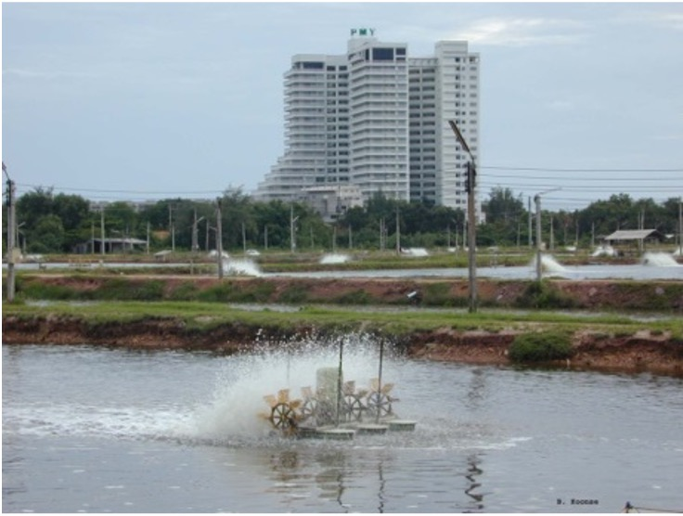
Site Considerations
Minimize risk coming FROM the surrounding area
Minimize risk going TO the surrounding area
Site
Proper site selection can reduce risk of poor water quality, aid in animal health and safety, and reduce the potential need for site remediation.
Notes:
Site Considerations
Say: During site selection, it is critical to consider what the property, as well as adjacent land has, or is being used for. These past or present uses could negatively impact soils, runoff, overspray of detrimental chemical pesticides, and so on.
<Select Enter to advance the slide build.>
Say: Primary considerations during site selection are to minimize risks coming FROM surrounding areas, as well as …
<Select Enter to advance the slide build.>
Say: Minimize risk going TO the surrounding area from the farm. During site selection it is also important to understand the characteristics of a good production site. This can include, but is not limited to soils, source water, infrastructure, supplies, and other activities in the area. This information will also assist in subsequent farm design as well as management strategies. In addition, it is also important to work with all relevant agencies to understand possible future development or conservation plans for the area/region.
<Select Enter to advance the slide build.>
Read the banner at the bottom of the slide.

Slide 6
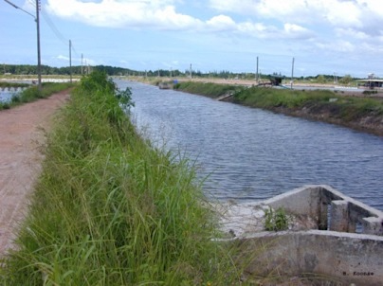
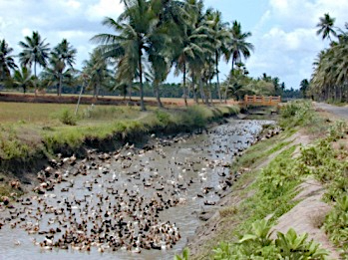
Source Water
Pumping locations of the source water should be separated from farm effluents and minimize exposure to animal wastes. Filtering the source water is essential to reduce introduction of predators.
Notes:
Source Water
Say: High organic loading in source water will increase nutrient and bacterial levels in aquaculture farms. This will directly increase the need for aeration and can lead to increased ammonia concentrations.
Filtration at the pump intake location, using a series of screens or mesh sizes, is essential to reducing risk of contaminants and introduction of potential predators. High organic loading of the source water will complicate screening as it will cause screening systems to clog more easily.
Using larger surface areas for screens or meshes will reduce the required frequency of cleaning, which is crucial for maintaining optimal performance in water filtration systems.
Locating the intake pump as far away from sources of nutrients, such as facility discharge sites or other agricultural production, will optimize water quality for the farm.
Farms should be located in areas:
Above tidal influence, which helps reduce the incidence of high organic soils, flooding potential, and allows for proper draining of farms through all tidal ranges. This is also an important consideration to maintain final animal quality during harvest.
Where no animal (human or livestock) wastes can enter ponds either directly, or through source water.

Slide 7
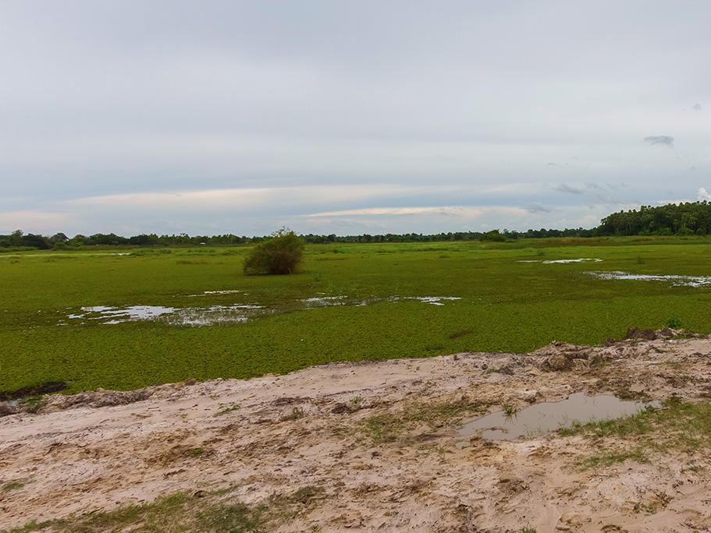
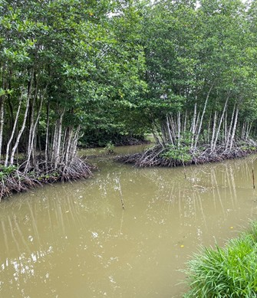
Protected Areas
Notes:
Protected Areas
Say: Choose sites outside of wetland or other protected areas.
Locating pond in wetlands and mangrove areas:
Negatively impacts important natural environments. Mangrove and other wetland areas have more value to humanity in their pristine conditions, rather than as aquaculture farm. It is critical to prevent the establishment of aquaculture farms in mangrove areas, or areas that at one time were mangrove areas.
Makes for bad public perceptions.
Increases pond soil and water quality management problems. Aside from the public perception and environmental degradation issues, mangrove areas have inherent poor soil conditions which are very problematic for aquaculture farm management.
May require farms to develop restoration sites. There have been instances recently where if a mangrove was disturbed to support aquaculture development, new areas of mangrove restoration were required.

Slide 8
Proper Soil Type
  Soil type has a direct impact on water quality.
  Soil pH should be 6-8.5.
  Water pH, alkalinity, and hardness are a direct result of soil type.
  Organic content of soil will influence oxygen demand and oxidation of animal wastes.
  Sufficient clay content to minimize seepage (~25%).
  Acid sulfate soils (as in mangrove areas) should be avoided and require special construction and management guidelines.
Notes:
Proper Soil Type
Read the bullet points on the slide. <Select Enter to advance the slide build to read each bullet.>
Say: Water quality is linked to source water as well as the type, composition, and chemical characteristics of soil. Soil permeability will influence water loss through seepage. Soil with 20% or more clay content can minimize seepage. Mineral content of the soil impacts water pH, hardness and alkalinity which in turn effect plankton productivity.
High organic content in soil increases oxygen demand as bacteria decompose organic matter. This may result in ammonia buildup which is toxic to animals.
Acid sulfate soils, common in areas that are or were mangroves, will leach acid and pyrites into the water which will reduce water pH and lead to conditions that are toxic to animals.
It is critical for pond construction that soil types be properly identified and improved as needed before pond construction.
Ask: For your specific area or region, what other considerations might you have related to site selection?
Debrief and discuss as needed.

Slide 9
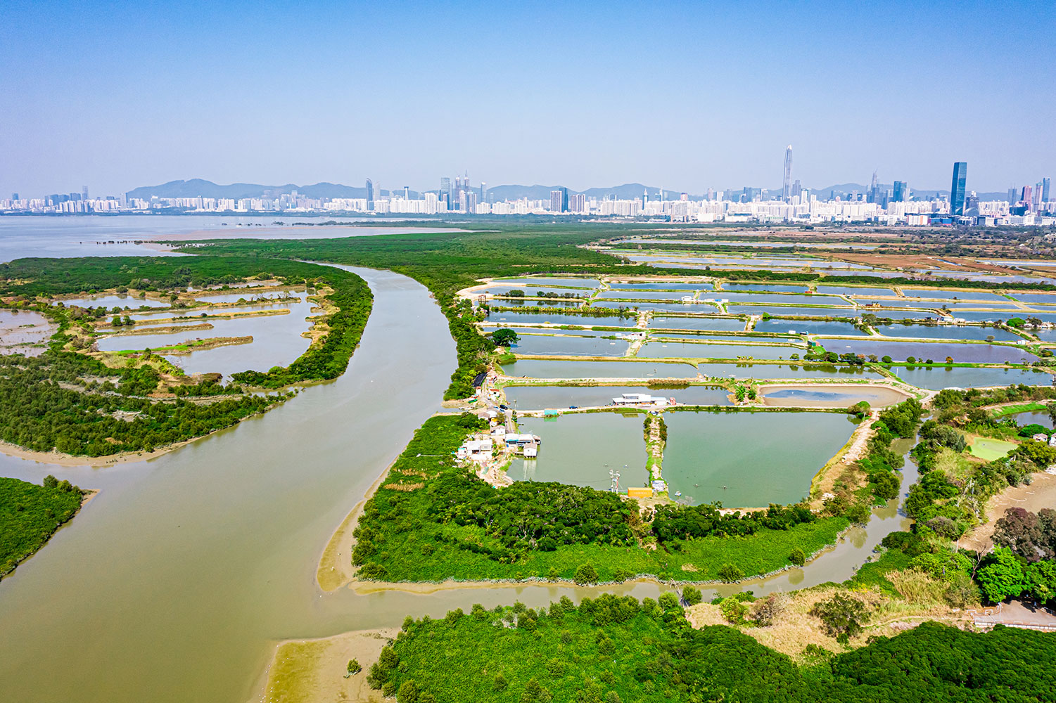
2. Design
Discharge
Water Flow
Intake
Notes:
2. Design
Say: Proper facility design will help support farm and water quality management, minimize disease occurrence and intensity, and support the production of high-quality product.
In the design phase, it is important to maximize the distance between pond water intake and discharge, as well as distance from adjacent farm discharge stations. Discharge location should be downstream from intake location.
This is a good time to ask for other possible contamination risks from adjacent properties.

Slide 10
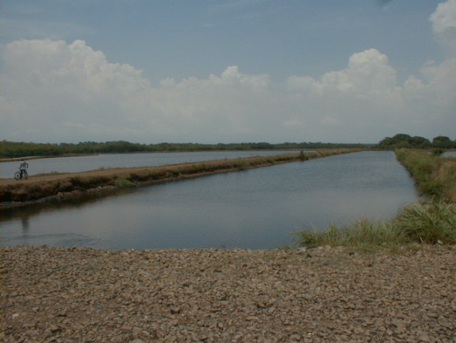
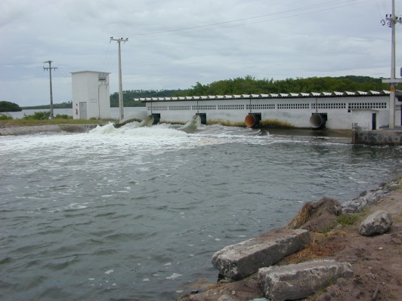
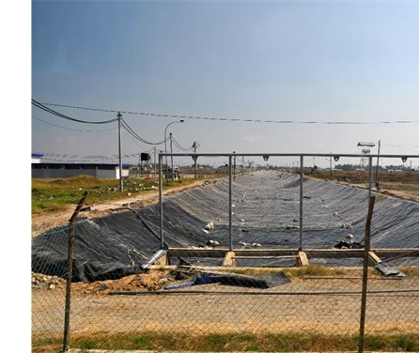
Fill Canal
Notes:
Fill Canal
Say: Fill canals, if designed and maintained properly, can serve as good secondary settling opportunities. Lining these fill canals will also make it easier to periodically remove the sediment and helps maintain canals by minimizing erosion of the levees.

Slide 11
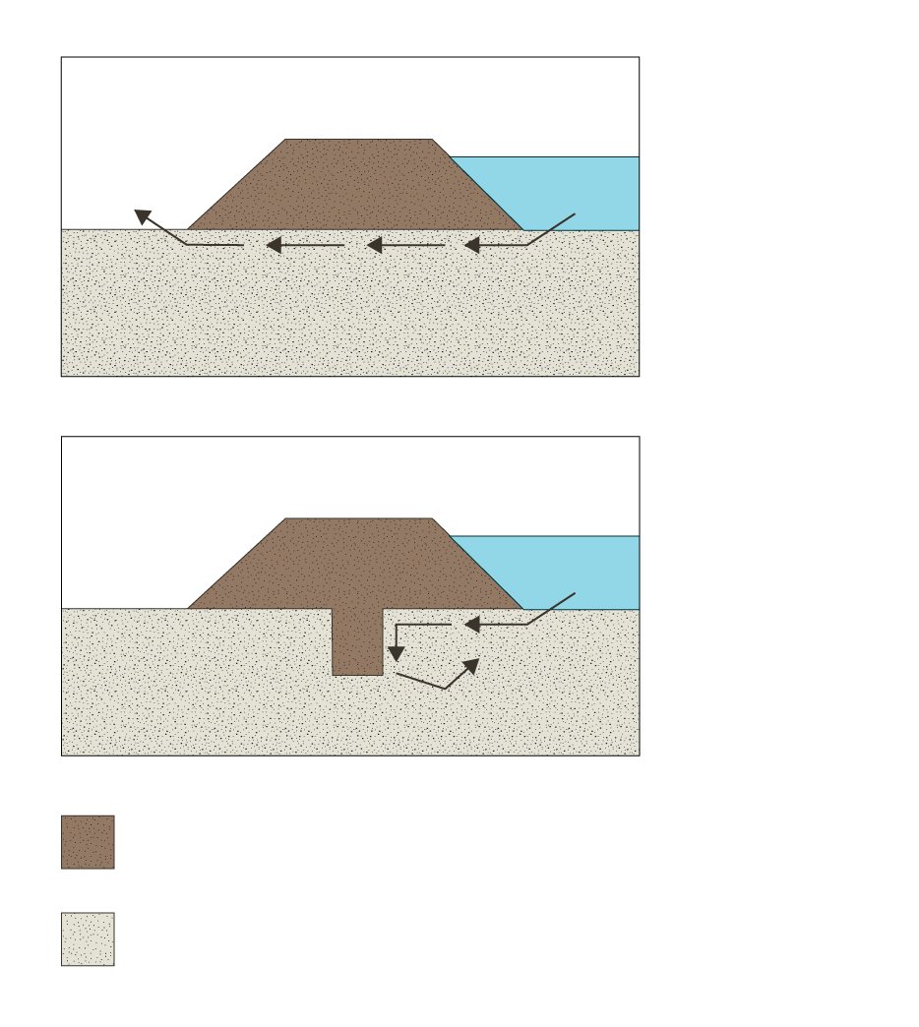
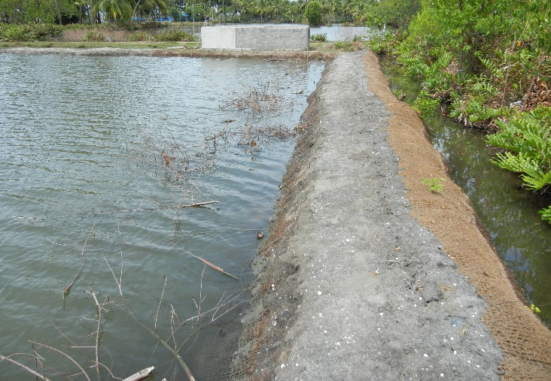
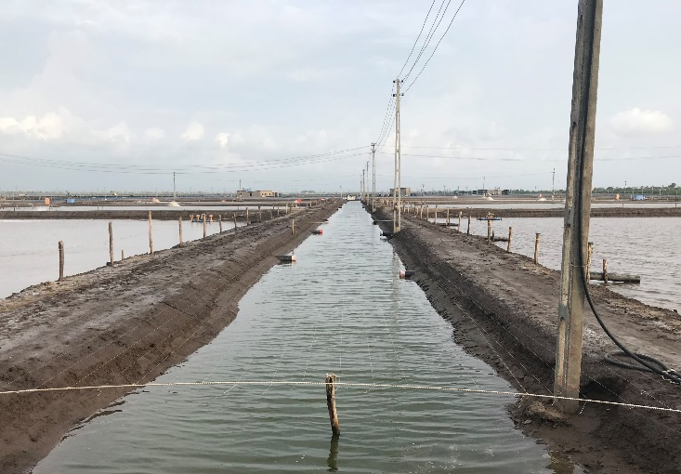
Elevation and Slopes
Water
Pond levee without core trench
Water
Pond levee with core trench
Material used to construct levee and core trench
Undisturbed soil
Notes:
Elevation and Slopes
Say: Locating ponds in low elevation areas such as mangrove swamps has created environmental and production problems. Ideally, ponds should be located inland from the coast with the pond bottom elevation being 1-2 meters above highest tides. A rectangular shape pond is less expensive to construct and reduces wind erosion damage to levees if pond length is perpendicular to prevailing winds. Levee slopes should be at least 1.5:1 to 2:1 to minimize levee erosion. This means that for every meter in elevation the levee should be at least 1.5 m in width; double this if there is a pond on each side of the levee. Here we see a comparison – a standard levee in the top illustration and a core levee in the bottom illustration. On a standard levee depending on soil composition, it is not uncommon for water from the pond to leak out under the levee resulting in problematic water loss from the pond. In the core levee you can see an additional excavation – that goes deeper and includes more of the levee material-which prevents water loss from the pond.
<Select Enter to advance the build.>
Say: This shows how water seepage occurs on a standard constructed levee. To maintain moderate water temperatures, it is best to have water depths of at least 0.8 meters, preferably 1-1.6 meters. If the selected site has acid sulfate soils which results in low pH and reduced growth, avoid disturbing soil with equipment and consider covering the bottom with new topsoil. Planting levees with a grass cover will reduce erosion, which will also help minimize total suspended solids. The photo shows a pond which requires re-sloping as the current side shape will strand large numbers of animals during harvesting.
<Select Enter to advance the slide build.>
Say: Here the harvest basin is not above the drainage canal, and we can see where supplemental pumping is required to further remove water from the pond during harvest. This lengthens the harvest process which compromises the final product quality and safety.

Slide 12
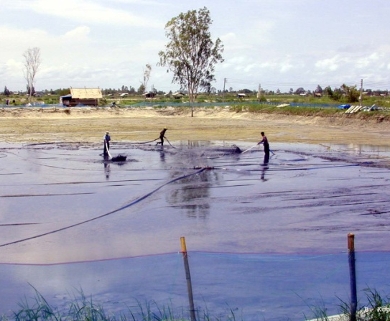
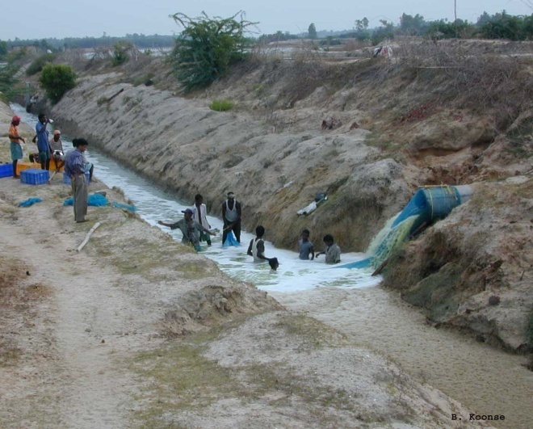
Building a Levee
Notes:
Building a Levee
Say: The top width of the levees depends on the levee height and slope, but at a minimum, the top should be wide enough to accommodate the largest harvest equipment used. Pond bottoms should be clean of debris and flat, with a gentle slope to the drain to facilitate draining and harvest.
The pond discharge should be at least 0.3 above the drainage canal water level to allow for harvest equipment and easy access for maintenance of the drainage canal. The water discharge structure should be carefully constructed to be durable and facilitate a quick harvest, which will ensure minimum time between harvest and icing. These factors will maintain the final product quality.

Slide 13
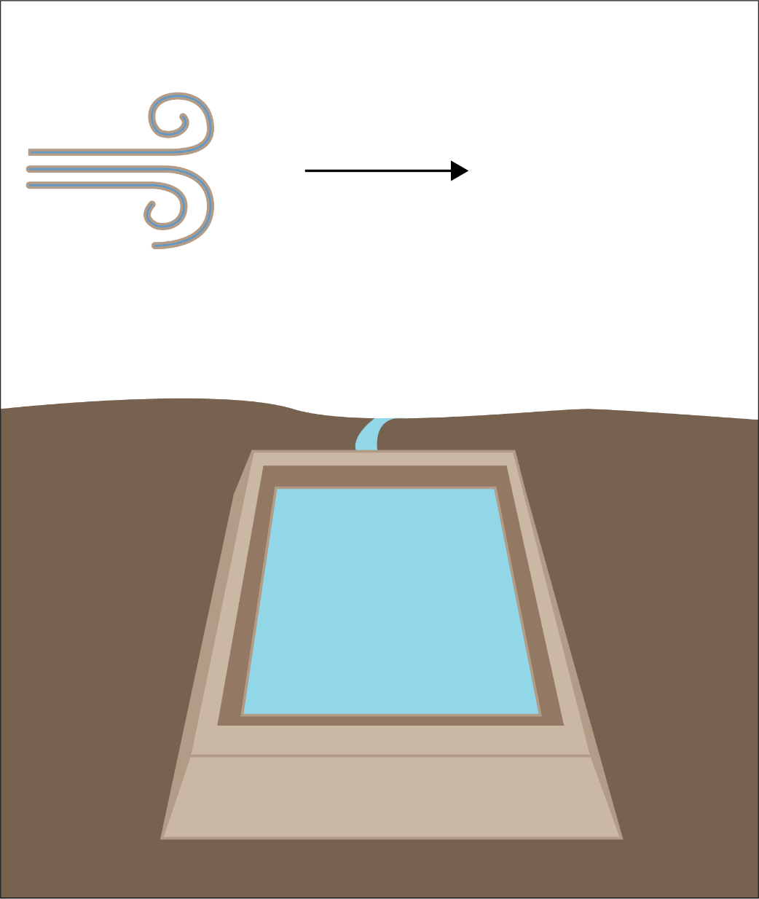
Building a Levee
Predominant
Wind Direction
Farm Pond
Notes:
Building a Levee
Say: Here are three things to know about building a levee:
Rectangular shaped ponds can aid in aeration and experience less wind erosion (when the length is perpendicular to prevailing wind). Constructing the long side of ponds perpendicular to the predominant wind directions maximizes the surface area interaction between the air and water, allowing more oxygen to dissolve into the water. This orientation can also minimize wave energy, which helps protect the levees from erosion caused by wind-driven waves. Reducing erosion is especially important if levees contain acid sulfate soils.
Save and reuse topsoil to promote healthy vegetation growth. Use native grasses, which are adapted to local conditions, to plant along levees. These strategies can help protect against soil erosion.
Limit disturbance of acid sulfate soils. If disturbance is unavoidable, treating the soil can help neutralize acids and covering the soil with topsoil can act as a physical barrier to minimize the interaction between the water and sulfate soils. These strategies can help mitigate the negative effects of acid release into a pond.

Slide 14
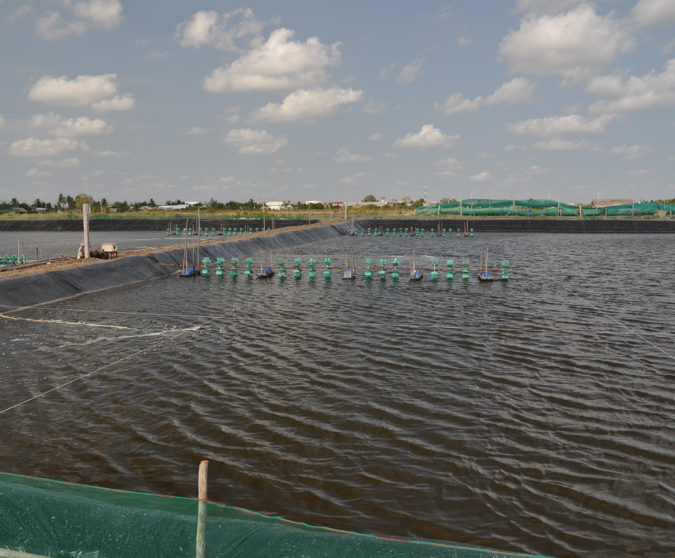
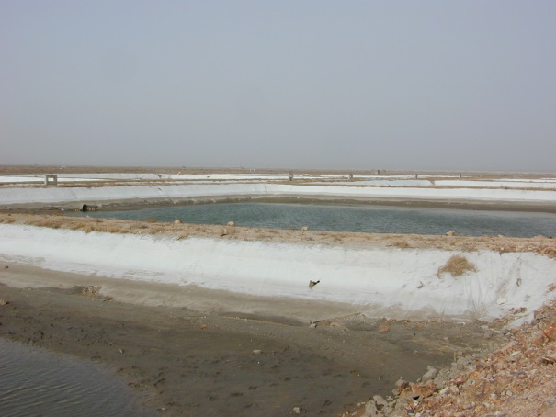
Lined Ponds
Notes:
Lined Ponds
Say: It is becoming a common practice in aquaculture to install liners into ponds. While this results in a higher initial capital investment cost, lined ponds help facilitate efficient harvesting, stabilize levees, minimize erosion, reduce habitats where animal vectors can live, and make pond cleaning and preparation between production runs more efficient and effective.
<Select Enter to advance the slide build.>
Say: Here we see the application of liners, but as you can see these liners are holding large amounts of sediment indicating the sediment was not removed between production runs.

Slide 15
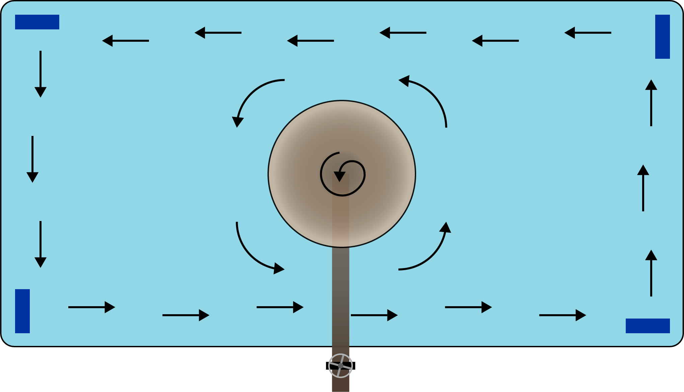
Organic Sedimentation Control
Notes:
Organic Sedimentation Control
Say: Organic sedimentation control in ponds is a very important component in aquaculture farming. To improve organic sedimentation control, “shrimp toilets” can be designed into the ponds.
Shrimp toilets can have features including a bottom drain and central waste pumping, allowing for the efficient management of wastes. Innovative aquaculture designs like this can play an important role in improving aquaculture production systems.

Slide 16
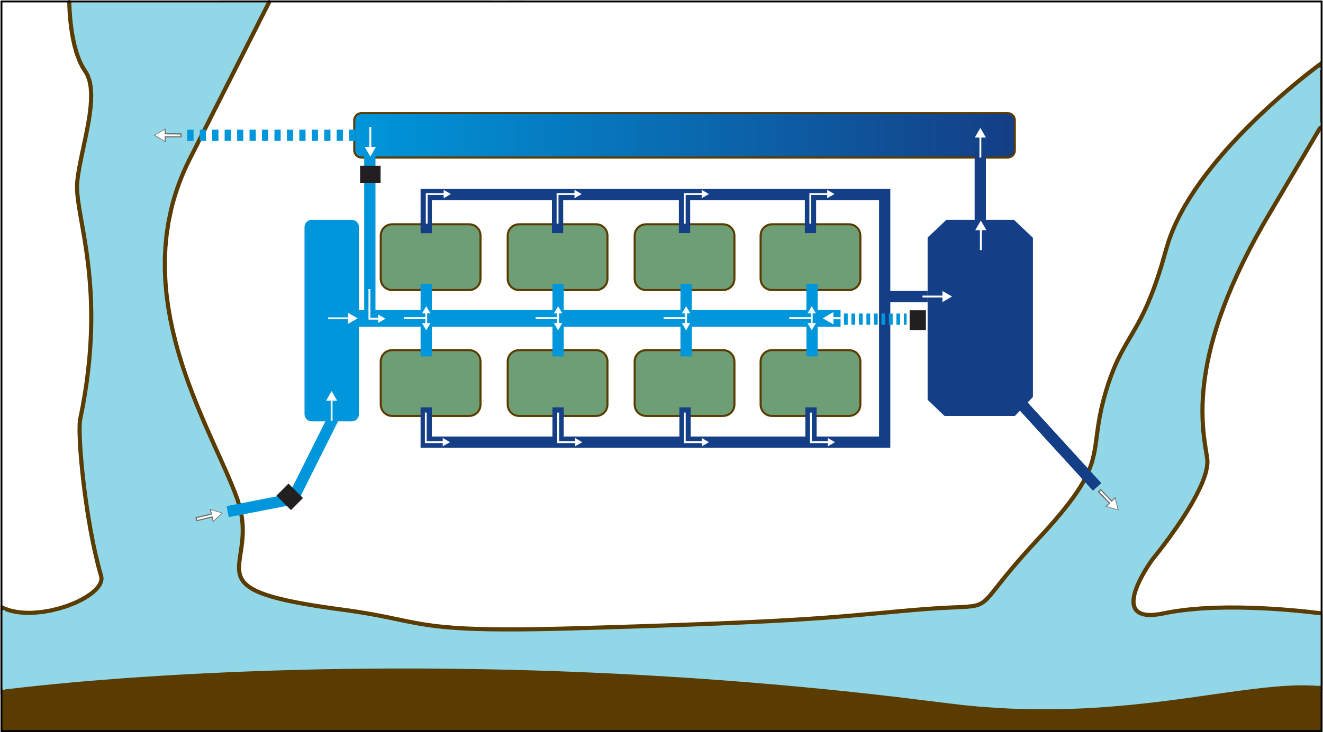
Recirculation
alternative discharge point
bioremediation
recycle pump
settlement
reservoir
recycle pump
drain
intake pump (estuary or coast)
aqueduct
discharge point
Notes:
Recirculation
Say: There are increasing trends in some countries for the implementation of recirculating farms. The basic design of these farms involves capturing of pond effluent in detention areas for sedimentation, then pumping the water higher into a series of biofiltration/remediation lagoons including aquatic plant production for nitrogen removal etc., and then the water is available to flow via gravity back into production ponds as needed.
Water quality management can also be applied in these steps to optimize water quality and chemistry.
The benefits of such systems include enhanced biosecurity, production when source water and ambient water quality in the area is poor, and minimizing negative impacts of the farm on the surrounding environment. This is another example of an innovative aquaculture design that can enhance production systems and improve sustainability, but it does require land and investment to establish.
Ask: For your particular area or region, what additional challenges or opportunities might this approach provide for your farmers?
Debrief and discuss as needed.

Slide 17
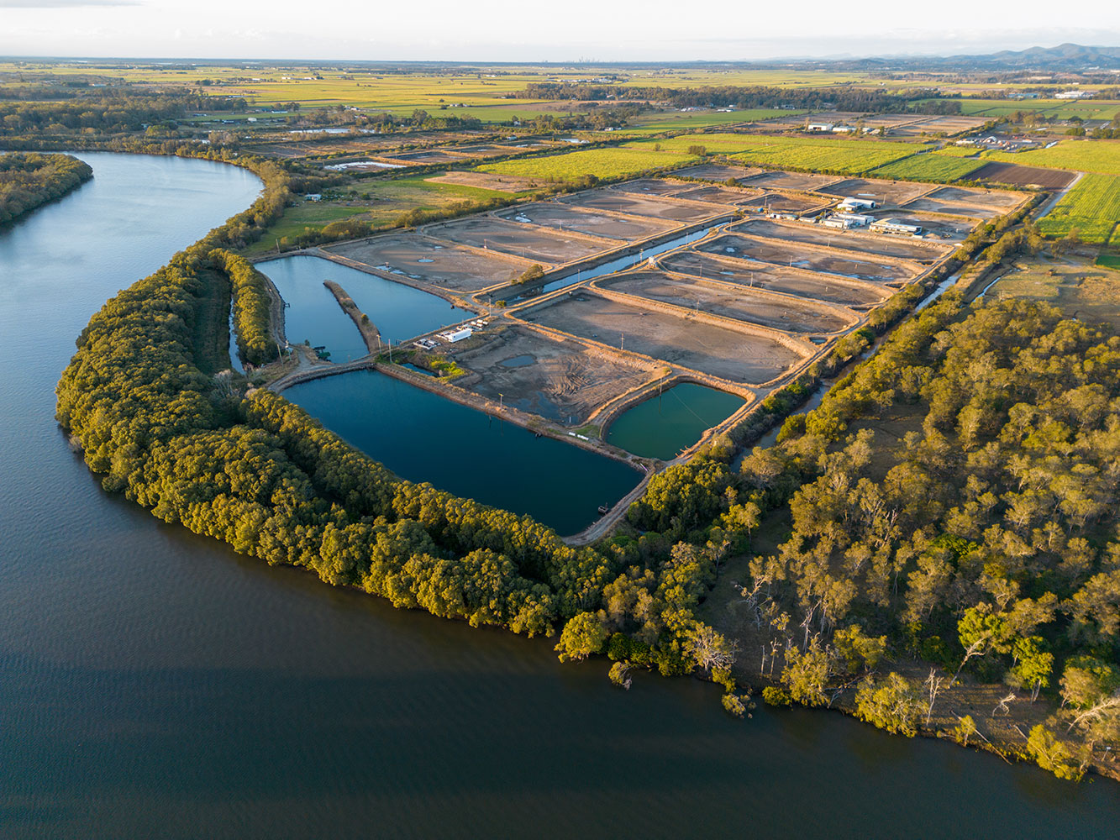
3. Source Water and Effluent Treatment
Settling ponds with baffles provide low velocity of flow allowing for solids to settle.
Aquatic plants increases solid settling, nutrient capture, and reduce organic loading.
Plants may also be sold as a secondary crop.
Settling ponds with baffles provide low velocity of flow allowing for solids to settle.
Aquatic plants increases solid settling, nutrient capture and reduce organic loading.
Plants may also be sold as a secondary crop.
Notes:
3. Source Water and Effluent Treatment
Say: Treating source water before use in production ponds with a settling pond is a cost-effective tool for improving water quality and biosecurity. The settling pond will provide time for organics and other suspended solids, which account for much of the nitrogen and bacterial loading. to settle to the pond bottom and not enter the production pond. Furthermore, many of the pathogenic viruses in aquaculture are associated with solids, so settling of these solids can reduce potential viruses from the water column.
The volume and size of the settling pond is based on production pond pumping requirements and time needing for settling. Settling solids or sedimentation is typically effective for particles sizes of 100 microns (1/10 of window screen) or larger. The optimal area of a settling pond can be calculated using area equals flow rate divided by the settling velocity, where settling velocity is the speed at which a particle settles in a still fluid. Typical settling pond area recommendations include: one square meter per 40 liters per minute of flow. Maximizing the length of a settling pond is recommended, as the longer the retention, the better the settling effects. Incorporating aquatic plants along shorelines or in settling ponds can aid in nutrient and solids reduction by absorbing pollutants, stabilizing shorelines, and trapping sediment. In some situations, the plants utilized in settling ponds can be sold, providing additional income for the farm. For example, mangrove seedlings and marsh grasses can be grown in pots and sold for restoration efforts.
Settling pond maintenance includes preventing erosion of levees, ensuring no animal waste is allowed to enter pond, and draining these settling ponds periodically to remove solids. Typically, after water depth is reduced by 20-25%, these settling ponds should be cleaned. When designing settling ponds, ensure access is available for equipment to periodically remove solids.

Slide 18
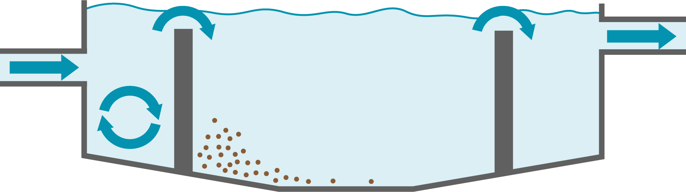
Settling Pond Design Considerations
Settling Area
Notes:
Settling Pond Design Considerations
Say: Settling ponds rely on reducing water velocity to allow particles to settle.
Velocity is reduced by providing a large surface area for water to move through. Phytoplankton and very small particles will not settle out of the water column, but removal of particles larger than 100 microns will improve water quality by reducing organic and nutrient loading, bacterial counts, and biological oxygen demand, which also improves oxygen concentrations.
The use of baffles at the inflow portion of the pond can increase settling efficiency. Effluent settling ponds often are designed to allow for a three-day water residence time to achieve maximum benefit. Use of aquatic plants can enhance nutrient uptake and reduce the residence time necessary for clean effluent.

Slide 19
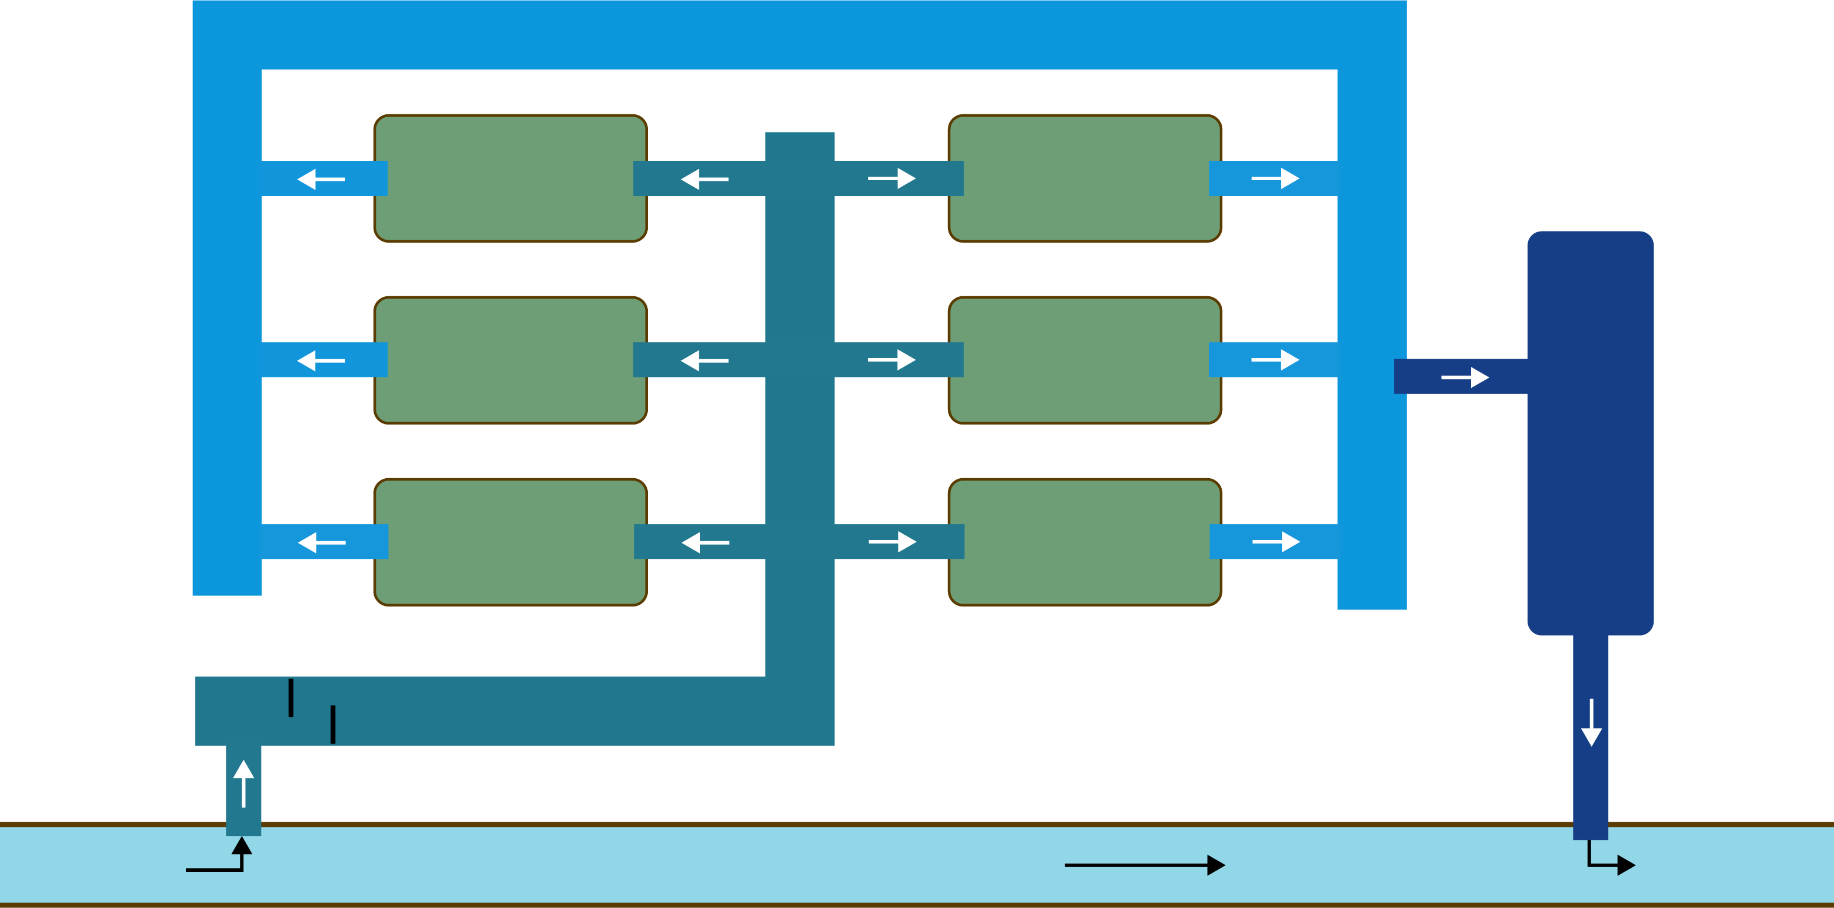
Simplified Aquaculture Farm Plan
Drainage/Harvest Canal
Aquaculture Ponds
Effluent Settling Pond
Source Water Settling Pond
Source Water Canal
Notes:
Simplified Aquaculture Farm Plan
Say: This diagram shows a simplified farm plan including both source water and effluent settling ponds. The source water settling pond supplies water, via gravity, to the production ponds. The effluent settling pond stores and settles solids prior to facility discharge. The goal is to allow sufficient settling time, using a sufficient settling area, and an appropriate flow rate.
For pre-existing farms designed without source water or effluent settling ponds, unless more land is acquired, part of the production area can be converted into settling ponds. While this reduces the production area by converting it into water treatment areas, it improves water quality entering the ponds and improves water quality of the farm effluent leaving the facility and possibly impacting the surrounding environment.
Such alterations in land use may become more common as regulations address environmental sustainability.

Slide 20
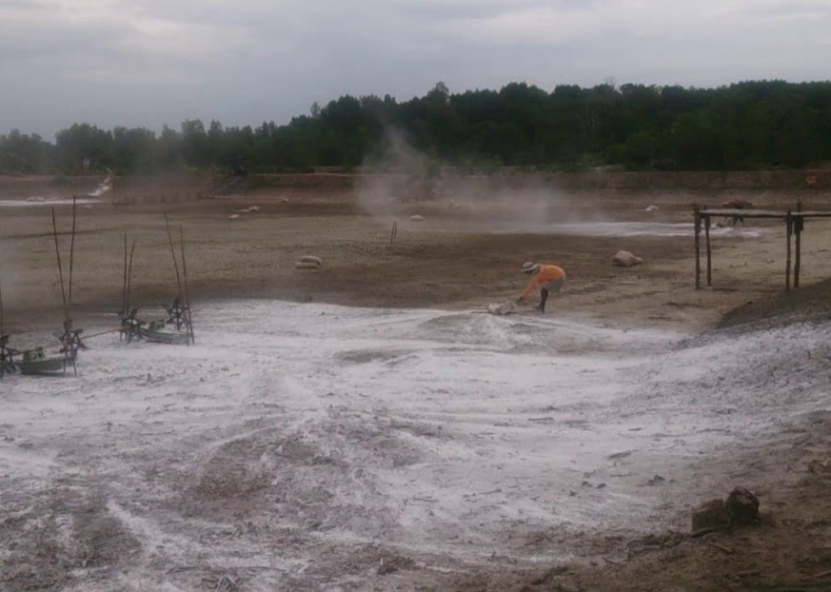
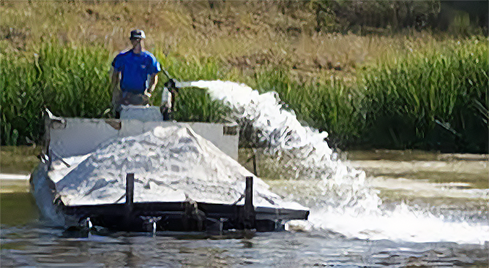
Chemical Treatments
Notes:
Chemical Treatments
Say: Source water treatments can reduce total suspended solids, improving solids settling and enabling the oxidation of organic matter and potential pathogens.
While chlorine is primarily known as a disinfectant it can also aid in flocculation. Flocculation involves making small particles in water clump together to form larger, heavier particles, known as flocs.
Hydrated lime is not only effective in raising pH, but also aids in solids flocculation, and depending on the dose can contribute to disinfection. Hydrated lime is also a fertilizer enhancer.
There are many other water additives on the market. Be sure to know what you are using, why you are using it, and how to use it properly as there are products on the market that are not effective.
Ask: In your area or region, what are some other common treatments used by intensive or extensive aquaculture ponds? Does anyone use Ozone or UV for example?
Debrief and discuss as needed.

Slide 21
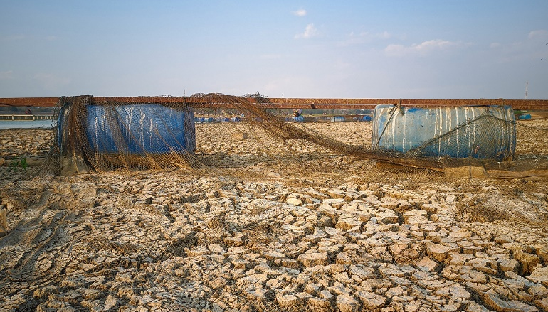
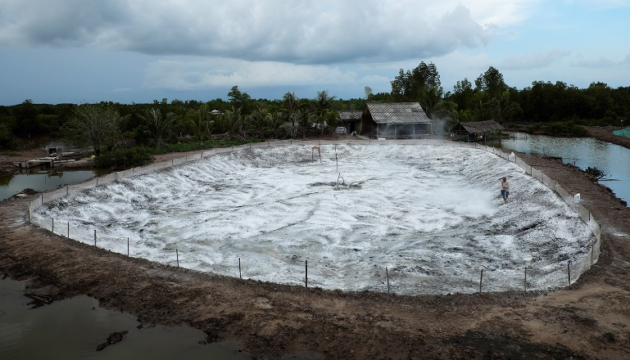
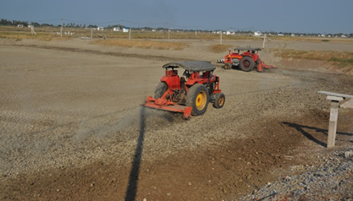
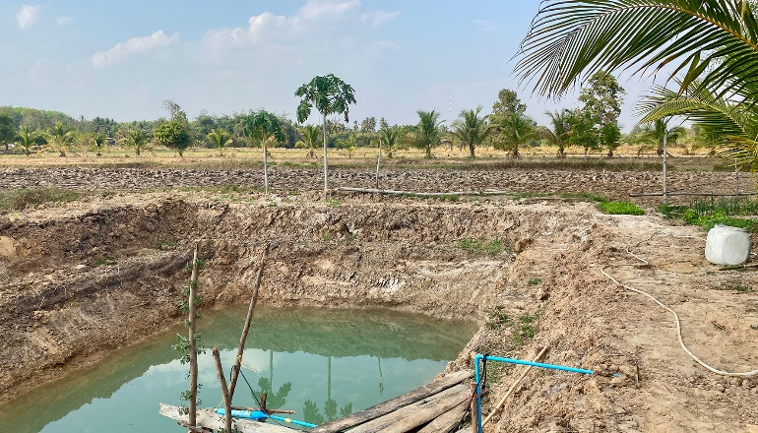
4. Production Pond Management
Remove rubbish.
Eradicate predators and vectors.
Thoroughly dry the pond bottom.
Lime the entire bottom.
Till the pond bottom.
Re-slope the bottom of the pond.
Notes:
4. Production Pond Management
Say: Maintenance of production ponds is critical to stabilize and optimize pond water quality as well as animal performance and health during production runs. The basics of pond bottom management include:
Removal of rubbish which can harbor pathogen vectors and impede harvest.
Eradicate predators and vectors physically and chemically.
Thoroughly dry the pond bottom to oxidize organics.
Treat the soil with the addition of hydrated or slaked lime to help disinfect the pond bottom, add alkalinity for increased pH, and lower bacteria levels. When adding lime, it is important to apply lime to the entire pond bottom, not just select areas. Once this is done…
The pond bottom should be tilled to aid the oxidation of organic matter between production runs.
IMPORTANT: If the ponds were constructed on acid sulfate soils, skip; this last step and DO NOT till the bottom because tilling will expose the pyrites and other detrimental aspects of these soils.
While the pond bottom is dry and being reworked, this is a good time to re-slope the bottom of the pond for harvest optimization, as well as rework the sides and levees as needed.
Ask: In your area or region, are there many farms that are unable to dry ponds out periodically? If so, why, and what are some other possible options for maintenance and treatment between production runs?
Debrief and discuss as needed.

Slide 22
5. Water Quality Management
Goal: To provide an optimal environment thereby reducing animal stress and optimizing animal health, growth, and quality.
Important water quality parameters:
  Hydrogen sulfide
  Phosphorus
  Salinity
  Biological oxygen demand
  Turbidity
  Dissolved oxygen
  pH
  Ammonia
  Nitrite
  Temperature
  Alkalinity/Hardness
  Hydrogen sulfide
  Phosphorus
  Salinity
  Biological oxygen demand
  Turbidity
Notes:
5. Water Quality Management
Say: Water quality management is important to reduce factors that contribute to animal stress and disease. The goal is to optimize conditions that lead to the production of healthy animals.
Pond water is directly affected by source water.
Water quality monitoring is a critical responsibility for each pond. The more intensive the animal production system the more frequently water quality samples should be taken. For measuring the water quality parameters listed here, equipment is needed, such as sensors and probes, chemical test kits or strips, and a dissolved oxygen meter. It is important to keep records of water quality monitoring. These can be useful to track the performance of the systems and identify issues when they begin.

Slide 23
Dissolved Oxygen
10 -
8 -
6 -
4 -
2 -
0 -
Dissolved Oxygen Concentration
(ppm)
12 am 6 am Noon 6 pm Midnight
Time of Day
Notes:
Dissolved Oxygen
Say: Dissolved oxygen levels are one of the most important water quality parameters to monitor in an aquaculture pond. Saturation levels dependent on water temperature and salinity. Maintaining good dissolved oxygen concentrations is essential to maintaining optimal health and performance of the animals being cultured. The dissolved oxygen levels in aquaculture production ponds fluctuate daily due to photosynthesis, causing oxygen levels to rise during the day and decline at night.
As you can see on this chart the highest oxygen levels are typically observed in the late afternoon due to the production of oxygen during the day by plants and microalgae in the pond. Oxygen in the pond is typically the lowest just before sunrise as respiration and the consumption of oxygen by plants and animals continues around the clock.
Test kits and handheld battery-operated electronic oxygen meters are very helpful to measuring and maintaining accurate oxygen readings. It is important to be aware that during cloudy or rainy days there is less oxygen produced by the microalgae in the pond. Therefore, oxygen levels at night will be lower. These conditions may require supplemental aeration beyond what is normally used.

Slide 24
Maintaining Dissolved Oxygen
Dissolved Oxygen Levels (mg/l) and Impacts on Aquatic Animals
0 1 2 3 4 5 6 7 8 9 10
Critical
May kill fish and aquatic animals
Poor
Stressful for fish and aquatic animals
Moderate
OK for fish and aquatic animals
Good
Best for fish and aquatic animals
Notes:
Maintaining Dissolved Oxygen
Say: Maintaining dissolved oxygens in production ponds above 5.0 milligrams per liter is important to facilitate good animal growth as well as reduce the occurrence of disease. Having oxygen levels below 5.0 milligrams per liter will compromise animal growth rate and their immune system and therefore increase the risk of diseases.
Many health-related issues in aquaculture production ponds around the world can be tied to low oxygen levels, especially in the early morning. It is not uncommon to find ponds operating in the two to four milligrams per liter range for dissolved oxygen. This is very detrimental and should be avoided. Maintaining higher oxygen levels during the night can result from proper pond bottom maintenance and good source water.

Slide 25
Pond Aerator Placement
Paddlewheel Aerator
Notes:
Pond Aerator Placement
Say: There are many aerators available in the market to add supplemental oxygen to aquaculture production ponds. However, paddle wheel aerators are the most cost effective in oxygen generation and also create beneficial currents for good water circulation throughout the pond if placed properly.
Placement of aerators in the corners of the ponds provides a clockwise circulation in northern hemisphere ponds and counterclockwise circulation in southern hemisphere ponds. This allows for good pond circulation and the accumulation of solids in the center of the pond.
This sedimentation in the middle of the pond can facilitate solids removal from the pond either through a center drain shrimp toilet or during drying of the pond. Depending upon pond size additional aerators can be placed closer to the middle of the pond that can support the same circulation pattern for additional oxygenation and circulation. Typically, 10 to 20 horsepower per hectare are used in high animal stocking densities and feeding rates.

Slide 26
Temperature
  Oxygen saturation in 34 ppt salt water at sea level:
    12º C = 11.3 ppm
    22º C = 8.9 ppm
    32º C = 7.3 ppm
Notes:
Temperature
Say: Temperature is another important water quality parameter to monitor as it directly affects animal metabolism as well as feeding and growth rates, Temperature also directly impacts biota respiration in the pond (bacteria and other), influences the solubility of oxygen in the water as well as the degree of ammonia toxicity. There is an inverse relationship between the temperature of water and dissolved oxygen saturation.
As shown here, the oxygen saturation of full-strength seawater decreases as the temperature goes up. In other words, warm water holds less oxygen than cool water. In addition to low oxygen saturation levels at temperatures above 32°C, prolonged exposure at these levels can also stress animals, reduce growth rate, and compromise immune systems. At the same temperatures, fresh or low salinity water has higher oxygen saturation levels than higher salinity water. Therefore, production in lower salinities can help mitigate oxygen levels in production ponds.

Slide 27
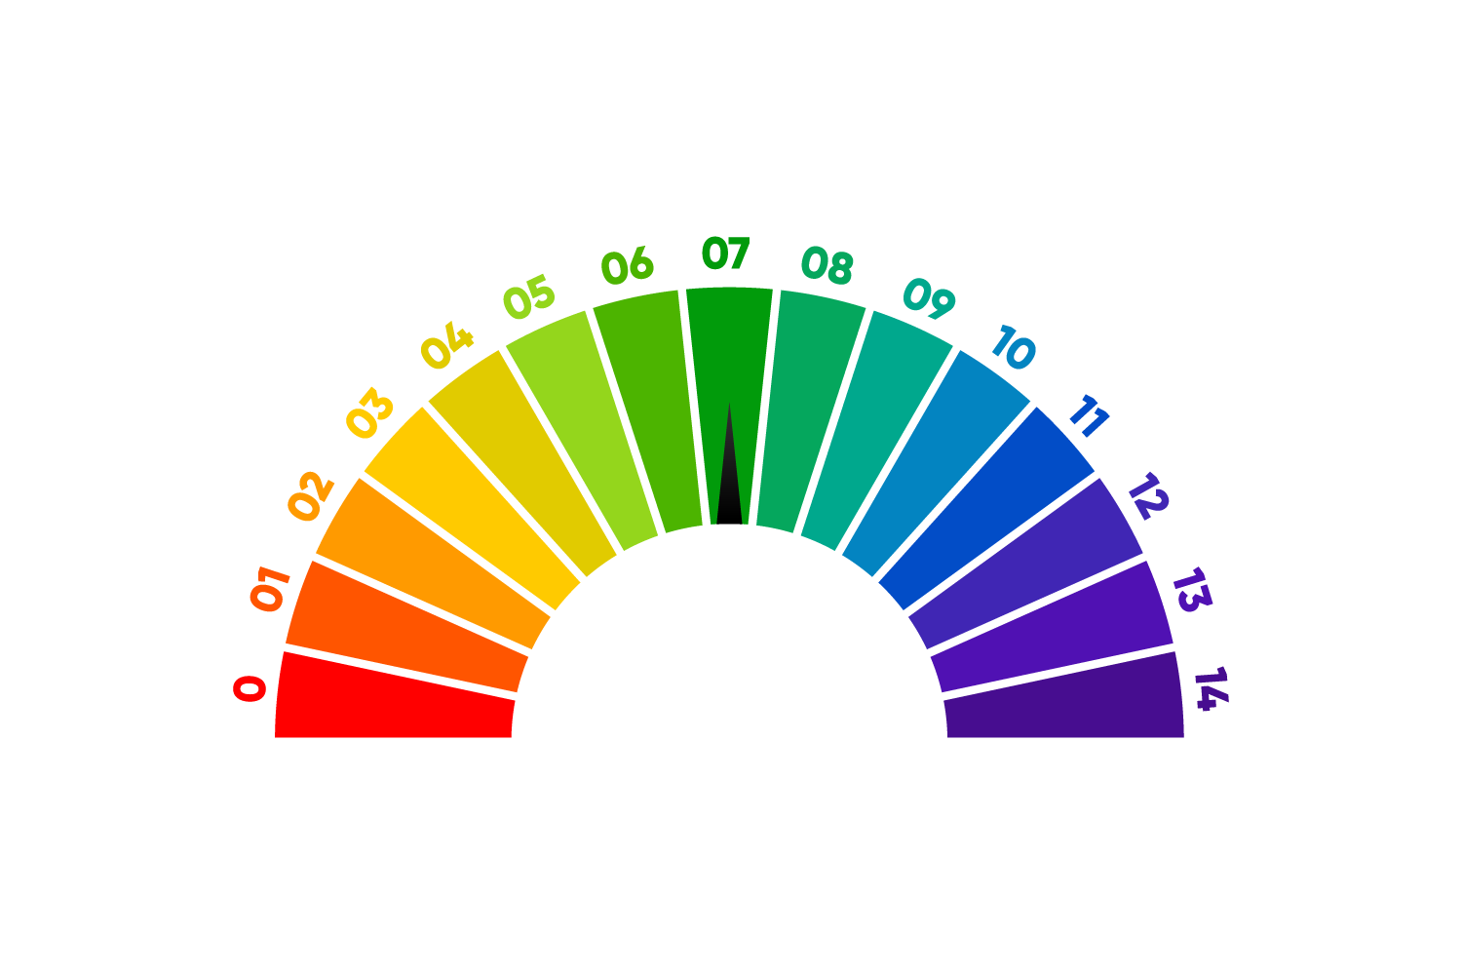
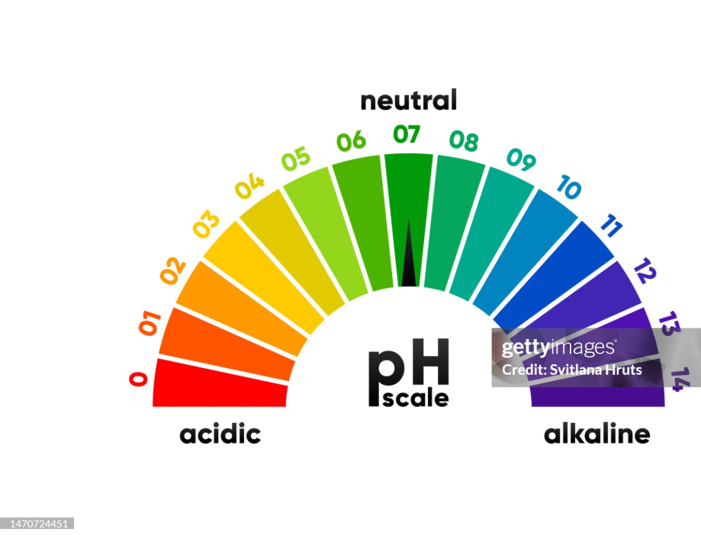
pH
neutral
pH
scale
acidic
alkaline
Notes:
pH
Say: In water quality, pH is a measure of the acid/base or alkaline relationship. pH is also known as the measure of hydrogen ion concentrations in water.
<Select Enter to advance the slide build.>
Say: A pH of 7 is considered neutral,…
<Select Enter to advance the slide build.>
Say: …below 7 is acidic, and…
<Select Enter to advance the slide build.>
Say: …above 7 is basic or alkaline.
<Select Enter to advance the slide build.>
Say: Animals typically do best when the pH ranges between 7.0 and 8.5, and it is important to keep in mind that animals do not like large changes in pH during a 24-hour cycle.
pH in an aquaculture production pond typically increases during daylight hours when photosynthesis converts carbon dioxide to oxygen, and goes down at night due to reverse photosynthesis, respiration and increased carbon dioxide levels. Large daily changes in pH can be minimized by buffering the water with alkalinity (carbonate system). It is important to keep in mind that pH is a logarithmic scale. All living organisms have optimal ranges of pH where health and performance is optimal. Soil and water pH is easily tested and low pH can be improved by adding lime. Because pH fluctuates naturally during the day it is important to be consistent in the time of day when pH is measured to be able to better compare changes in pH from day-to-day.

Slide 28
Daily pH Fluctuations
Notes:
Daily pH Fluctuations
Say: pH naturally fluctuates during the day due to consumption of carbon dioxide (which acts as an acid) by photosynthesis from microalgae. It is generally lowest at sunrise (due to accumulation of carbon dioxide during the night) and highest at afternoon when algae consumption of carbon dioxide, and conversion into oxygen, is at its greatest. The graph shows two identical ponds, one with low alkalinity the line in green and one with moderate alkalinity the line in blue. This demonstrates the importance of good pond bottom management as soil alkalinity is a primary driver of water alkalinity.

Slide 29
pH Effects on Animals
14
11
8.5
7
5
0
Acid death point
Slow growth
Desirable range for production
pH
Slow growth
Alkaline death point
Notes:
pH Effects on Animals
Say: In this chart we can see the effects of pH on animals and aquaculture ponds. As stated earlier, animals typically grow best in a neutral to slightly basic water quality meaning a range from 7 to 8.5. Waters above or below this optimal pH range negatively affect health and growth of the animals and in extremes cause death. It is not uncommon to find aquaculture ponds running pH below 7 early morning and above 9 late in the afternoon.
This chart shows that water quality parameters lower animal immunocompetence and can result in more disease episodes. Good source water, good pond bottom management, and proper stocking and feeding rates help control this water quality parameter. Similar to the oxygen level chart, it is common in production ponds around the world, to find daily pH swinging to dangerous levels, thereby being primary factors contributing to disease outbreaks during production.

Slide 30
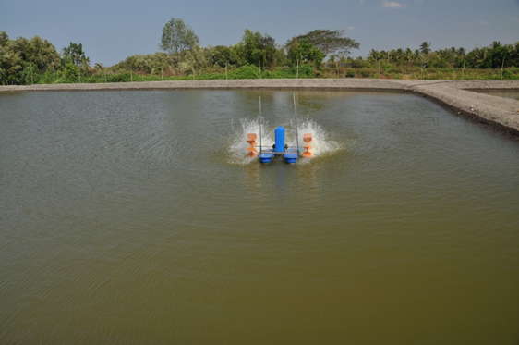
Fertilizers
Notes:
Fertilizers
Say: Fertilizers both natural or synthetic are added to aquaculture ponds to help increase and stabilize primary productivity, which is composed of phytoplankton and zooplankton.
Examples of common organic fertilizers are rice bran or cotton seed meal.
Examples of inorganic fertilizers include NPK or nitrogen phosphorus and potassium. Typical rates of 20 to 30kg of nitrogen per hectare and one to two kilograms of phosphorus per hectare are common in aquaculture ponds. It is common for new aquaculture ponds for ponds which have been recently renovated to add organic fertilizers directly to the pond bottom before the pond is filled. This provides a head start for the production of phytoplankton and zoo plankton in the pond before animals are stocked.
Do not overfertilize with organic or inorganic additives. Overfertilization quickly elevates primary productivity in the pond resulting in considerable water quality and water chemistry problems which will negatively impact production performance and health over time.

Slide 31
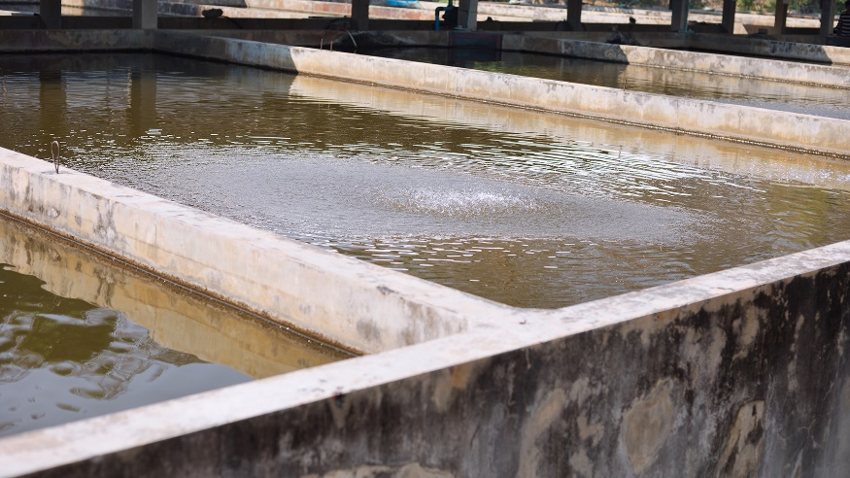
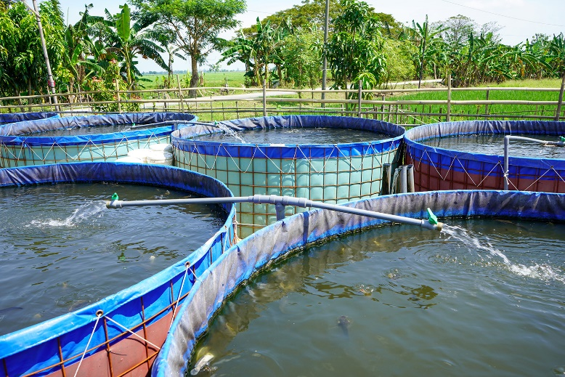
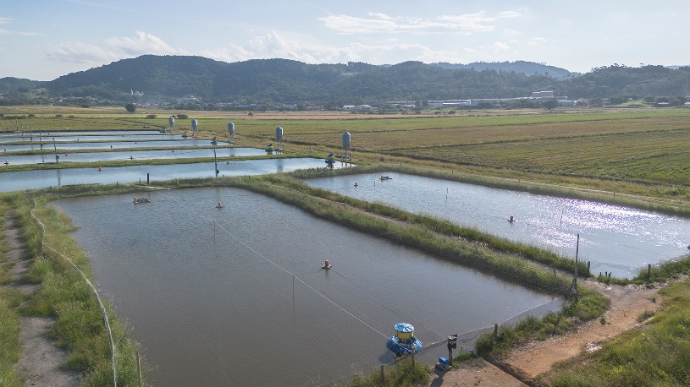
6. Production Management
Follow stocking densities adequate to system.
Ensure stocking of good quality post larvae.
Do not use wild caught larvae.
Properly acclimate post larvae to pond temperature and pH.
Notes:
6. Production Management
Say: In animal production management, it is important to follow proper stocking densities designed for the system. Always purchase and stock high quality post larvae and never use wild caught larvae. It is also very important to properly acclimate the post larvae to the pond, especially in relation to water temperature and pH.
Here we can see on-farm nursery systems. On-farm nursery systems are increasing in popularity throughout the world. In these systems instead of stocking Post larvae directly into the pond, the post larvae are stocked into holding tanks which receive water from the pond. This allows for better water quality monitoring and control, better feed management, and allows the post larvae to grow larger before being released into the larger, extensive pond. This is not a complicated addition to the production system.
Also applies to fin fish and other production animals.

Slide 32
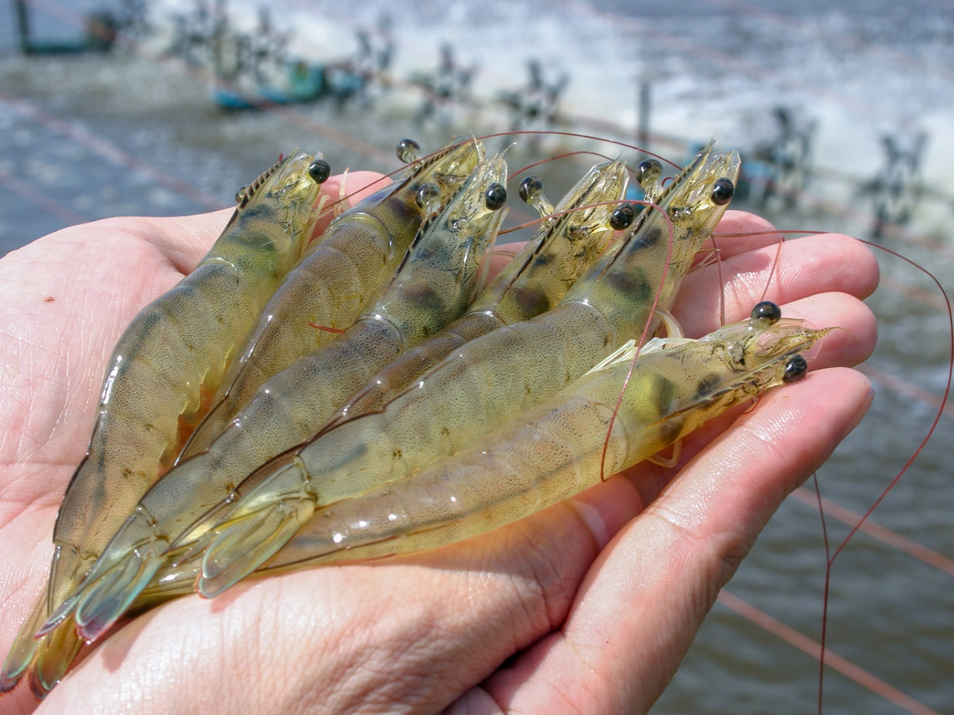
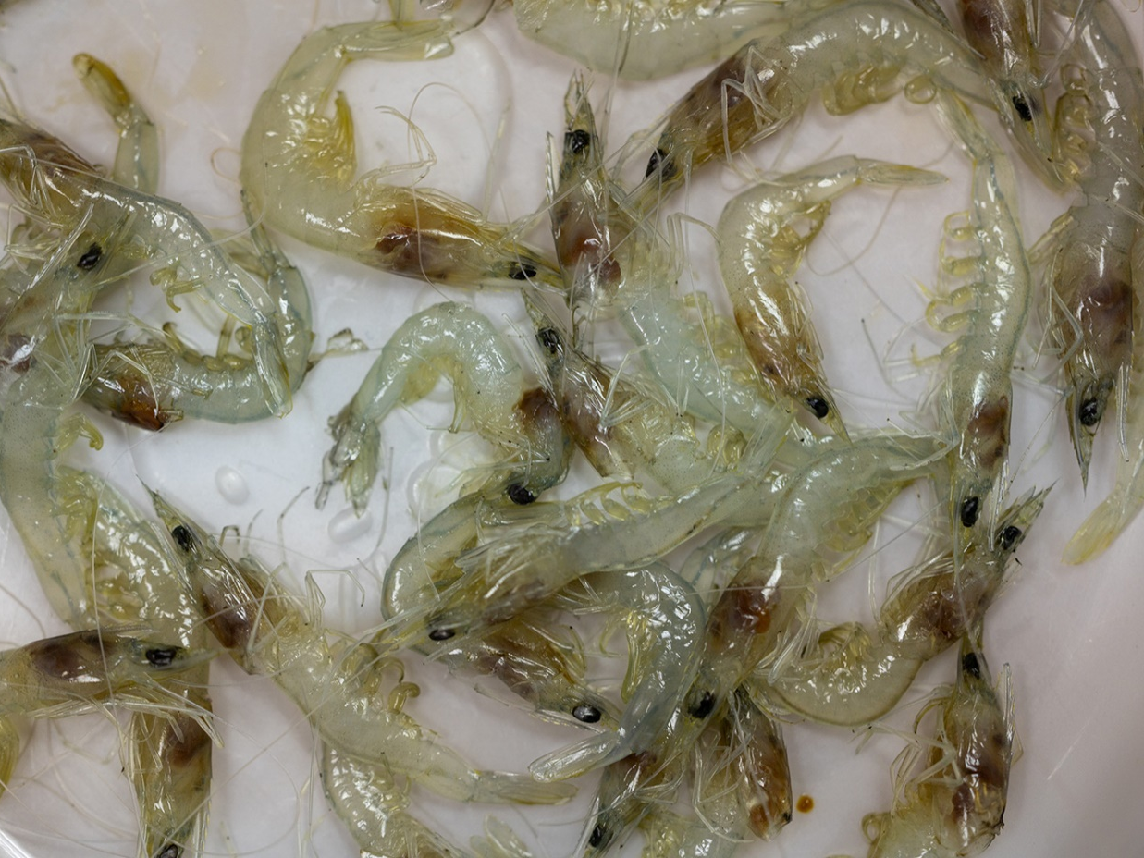
Shrimp Production Management
  Healthy animal
  Diseased animal
Notes:
Shrimp Production Management
Say: For example, in shrimp production management, it is very important to focus on preventing or reducing shrimp stressors during the production cycle. Stress management practices directly impact shrimp health, growth and disease resistance. During the shrimp production cycle any monitoring of shrimp behavior and visual observations are critical management strategies. Healthy shrimp are indicated by size, color, long antennae, a good colored hepatopancreas and gut as well as fecal strands.
Shrimp health should be monitored daily and recorded. In addition to maintaining optimal water quality, it is also important to use high quality feed and good feeding practices to optimize animal health and reduce stress. Remove and properly dispose of dead shrimp. These practices will significantly reduce the potential for disease and optimize shrimp health.
The left shrimp shows a healthy colored GI tract and Hepatopancreas. Unhealthy or diseased shrimp may show discolored Hepatopancreas, empty GI tract, and so on.

Slide 33
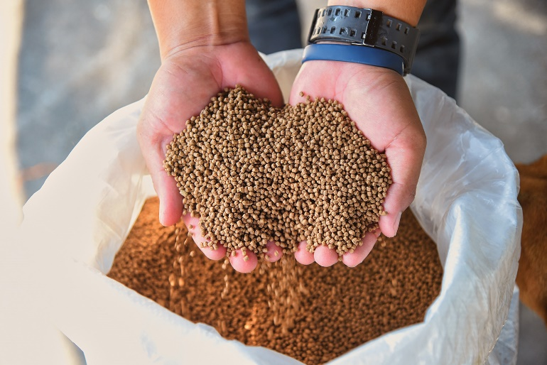
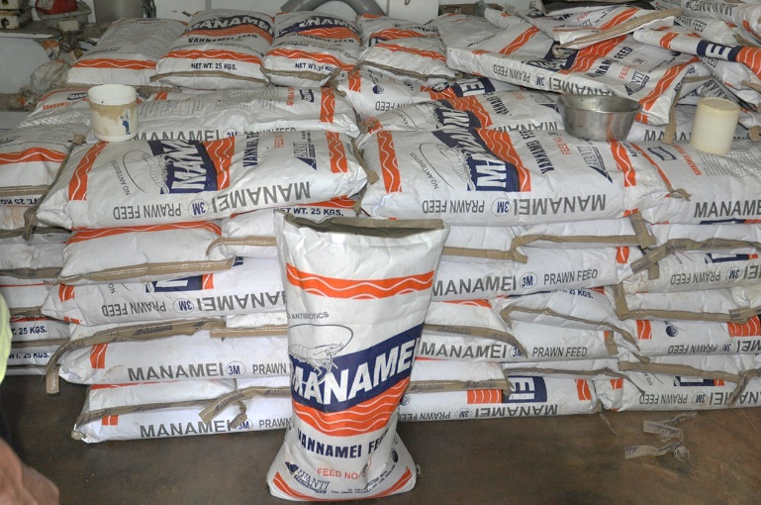
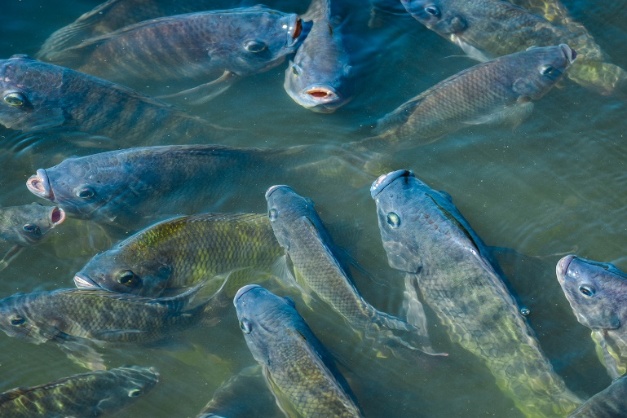
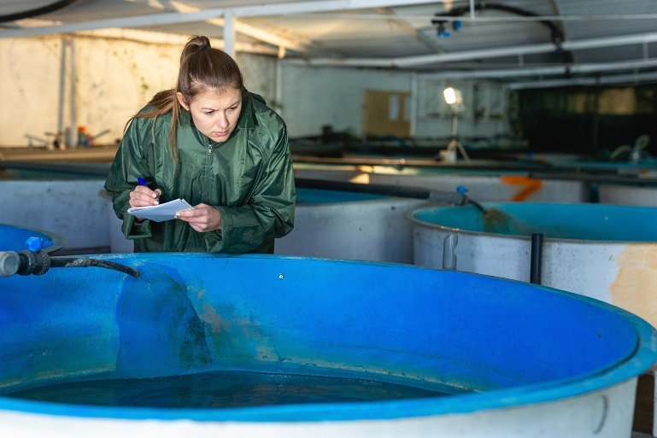
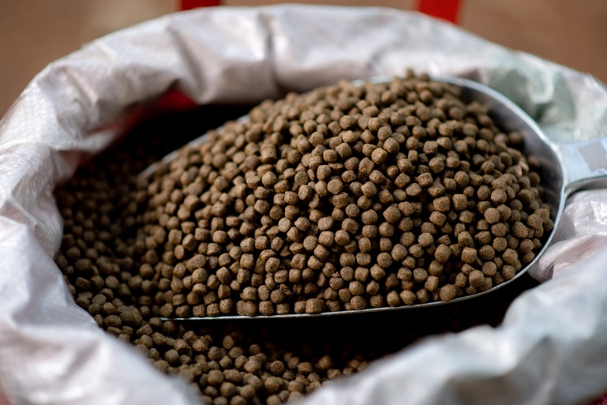
7. Feed and Feeding
Notes:
7. Feed and Feeding
Say: Feed management is another very important factor in the good production of animals. Feed is the number one operating cost in aquaculture production and is a very important contributing factor to water quality.
Know the nutritional requirements of species, and life stages.
Feed the proper nutrition, form and size.
Request letters of quality guarantee and test feed periodically.
If feeds get contaminated or spoiled reject or destroy.
All feed should arrive from supplier with tags. Keep good records to include:
Ingredients, date of manufacture, feed mill ID, lot #.
If medicated, properly labeled, specific use, application rate (just like medicine).
Over feeding aquaculture ponds wastes money and negatively impacts water quality. It is important to understand the nutritional requirements of the species, the nutritional requirements at the various life stages, thereby feeding the proper nutrition, form, and size of the feed pellets. In addition to requesting letters of feed quality and nutrition, it is important to verify these guarantees with an in-house or third-party laboratory.
If, at any time, feed gets contaminated or is spoiled, reject or destroy the feed lot immediately. All feed should arrive from feed suppliers with tags that document the feed ingredients, the date of manufacture, the feed mill identification number as well as feed lot number. If feed is medicated it should likewise be properly labeled designed for a specific use and have an appropriate application rate no different than your own personal medicine.

Slide 34
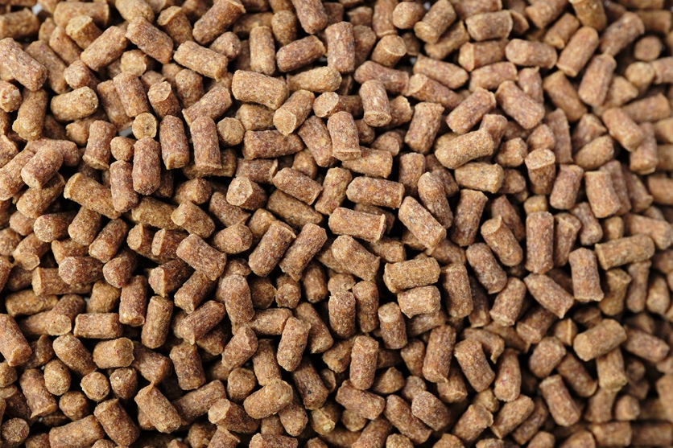
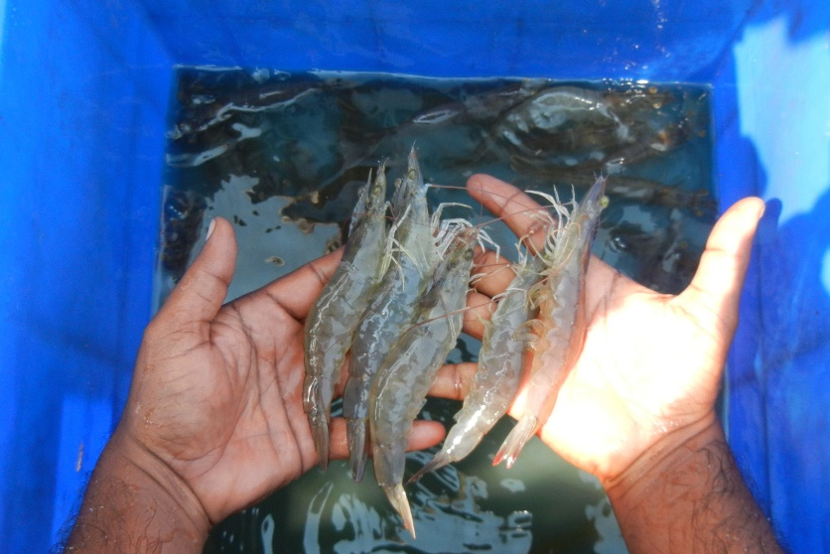
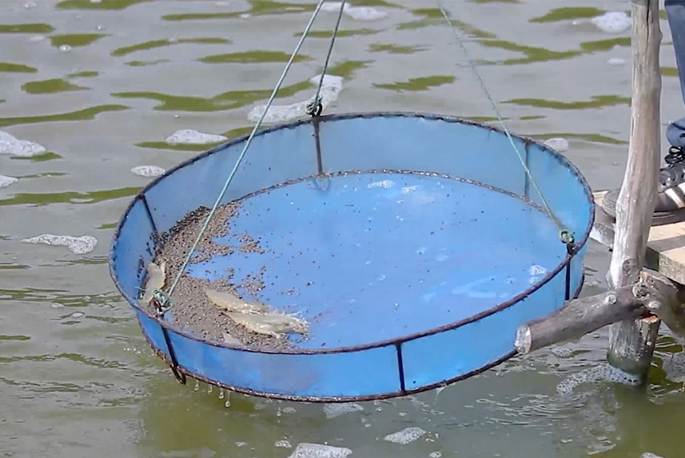
Proper Nutrition
Notes:
Proper Nutrition
Say: Selecting and using the appropriate feed quality and protein level is essential to maximizing animal growth and health. Use feeds of proper nutritional value, for animals this is typically 35 to 40% protein depending upon the animal size. Typically, juveniles receive higher protein levels than final growout diets. It is important to verify that the feed being used has the proper vitamin A, vitamin C, and astaxanthin content for increased immunocompetence of the animals. Also, select feeds with good water stability. This can easily be tested by putting some feed pellets into a beaker of water and seeing how long the pellets remain intact with occasional swirling or water agitation before the pellets dissolve. As a general rule, extruded feeds exhibit increased digestibility, reduced anti-nutritional compounds and reduced potentially harmful microorganisms.
Some farmers compromise on feed protein-quality/content during financial difficulties and/or lower market prices for shrimp. This can quickly result in negative secondary production issues. Do not do this.
Ask: What might some of these negatives be?
Debrief and discuss as needed.

Slide 35
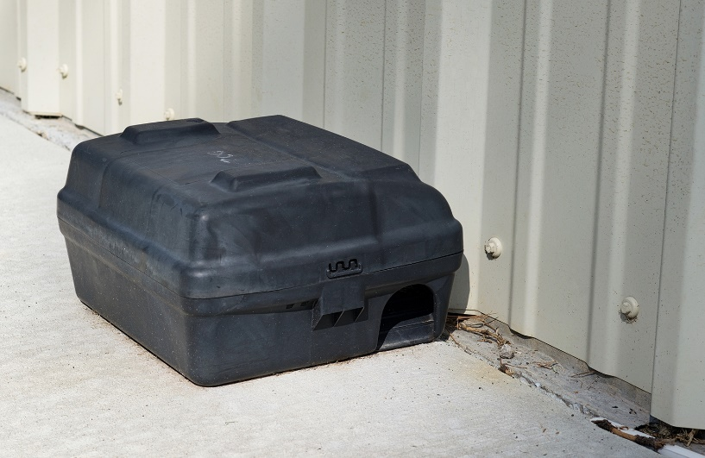
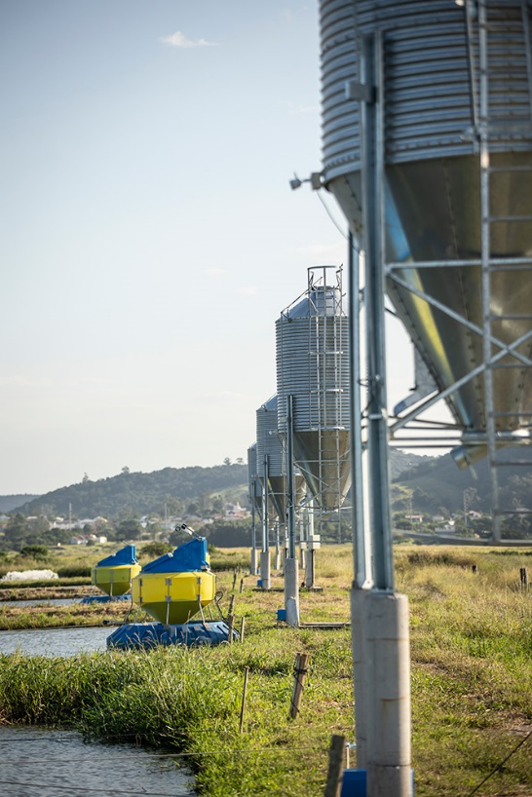
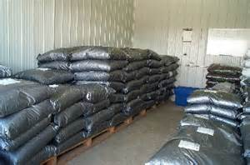
Feed Storage
  Keep dry, cool, and pest-free (use baits/traps)
    Off the floor
    Away from walls
    Space between pallets
    Do not stack too high
    Rotate inventory back-to-front
    Retain all labels
Notes:
Proper Nutrition
Say: Feed storage is a critical management aspect on aquaculture farms. Feed is very expensive has a relatively short shelf life, and poor or improperly stored feed can quickly degrade thereby negatively impacting animal health and performance.
Feed should be stored in a cool dry low moisture, and pest free environment. Aquaculture feeds attract many types of animals, rodents and insects so it is very important to implement and maintain proper bait stations and traps to protect the feed from contamination and possible disease vectors. Feed bags should be stored on pallets off the floor and away from the walls to minimize moisture accumulation.
Space should be maintained between feed pallets to facilitate air circulation, and the feed bags should not be stored too high on pallets. If the bags are stacked too high on the pallets, the pellets in the lower bags will be crushed into powder, and the potential of the upper bags falling off and injuring workers increases. While it takes extra effort, rotate inventory. This means remove old feed from the storage facility and store new feed in the back of the room. This way old feed is used before newer feed.
Retain all labels from feedlots in case there are subsequent issues with quality or safety.

Slide 36
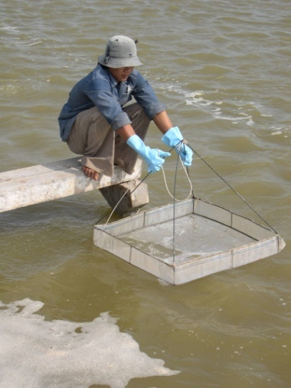
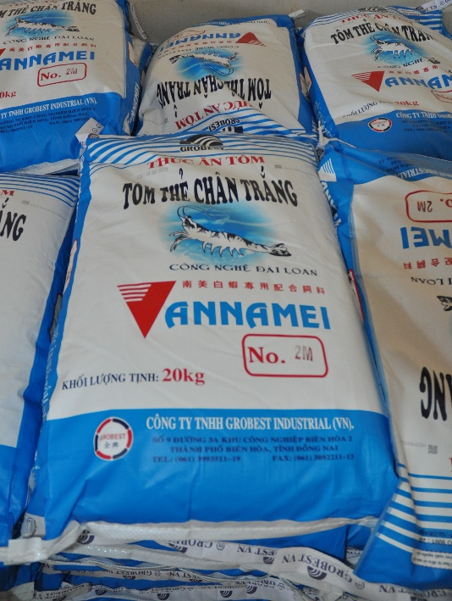
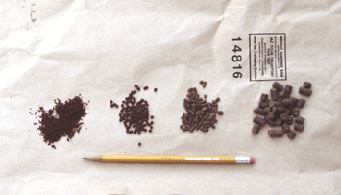
Good Feed Management Practices
Notes:
Good Feed Management Practices
Say: Good feed management practices maximize efficient feed utilization by animals, optimize growth and the feed conversion ratio, as well as minimize feed waste. As previously discussed, feed quality can be reduced if stored improperly. Heat and high humidity can reduce the vitamin content of feeds and cause mold which can cause toxins. Keeping feed cool and dry is important to maintain feed quality be sure to only purchase feed that has been recently manufactured and only store an appropriate quantity of feed that can be used within a few weeks to several months on the farm.
Never use expired or moldy feed.
When feeding ponds, distribute feed over large areas not just in certain areas or corners.
It is also common to feed numerous times per day to ensure that all animals have access to feed for proper growth and the ability to maintain good health. Wide feed distribution as well as multiple feedings per day helps maintain a steady breakdown of organic wastes by beneficial bacteria, thereby directly minimizing spikes in water quality problems such as ammonia and oxygen during day and nighttime hours.
Daily observations of feed consumption by the use of feeding trays as pictured is a valuable tool in managing feed application rates, good feed efficiency, and food conversion ratios, as well as optimizing water quality and daily assessment of animal health and performance. While inspecting the shrimp on the feeding trays it is good to verify shrimp hepatopancreas and gut and color and fecal strands. If uneaten feed is seen on the trays feeding rates should be reduced and shrimp health should be checked more thoroughly as should water quality.
Demand feeders have revolutionized the industry in many places.
For example, because shrimp feed on the bottom, feeding trays are an important tool to know how much feed shrimp are eating. Feeding should be monitored daily.

Slide 37


Record Daily Feeding
Notes:
Record Daily Feeding
Say: Recording feeding rates and animal feeding behavior carefully is a critically important daily management tool for farmers. It shows how their animals are performing. If shrimp are not feeding well, it may be an indication of some underlying stress, disease, or pathogen. I animals are not feeding well or mortality is observed, feeding rates should be reduced or stopped to prevent feed waste and its negative impact on water quality. At this time every effort needs to be made to understand the cause of the poor feeding behavior and remediate.
Record daily feeding rate and animal behavior.
Monitor animal growth and adjust rate accordingly.
Promote natural food productivity.
It is critical to monitor the Food Conversion Ratio (FCR).
Ask: In your area or region, how common is FCR recording/reporting from small and large farms, and if so, what are some targeted FCR’s to help evaluate good production practices?
Debrief and discuss as needed.

Slide 38




Feeding Techniques
Notes:
Feeding Techniques
Say: Different feeding techniques work better in different farm environments and situations. The important factor when applying fee to the pond, is to spread the feed over as large of an area as possible. The intent is to bring the feed to the animals and not the other way around. Increased feeding events can improve food conversion ratios as well as subsequent size variation at the time of harvest.
Ask: What do you think are the pluses and minuses of the first photo?
Debrief each photo emphasizing these points:
Timed feeders are good, but they only feed some of the animals in the pond.
<Select Enter to advance the slide build.>
This food spreader on a domestica catfish farm requires you to have infrastructure and only feeds half of the animals.
<Select Enter to advance the slide build.>
A man in a canoe works well to spread feeding around the pond to access most of the animals.
<Select Enter to advance the slide build.>
A man with a bag only feeds a small area at a time.
Say: A combination of these is ideal.

Slide 39

Emerging Technologies
Feeding Control and Environmental Monitoring
Internet
Radio Base Station
Controller
Feeder
Control Office
D.O./Temp. Probe
Hydrophone
Notes:
Emerging Technologies
Say: This shows the application of emerging technologies in the feeding of aquaculture animals. Shown here is an automatic feeding system that is computer controlled, incorporates real time monitoring of dissolved oxygen and temperature to adjust feeding rates, as well as acoustic hydrophones that identify when shrimp are feeding, when feeding slows, and when they have stopped feeding or are not feeding at all.
This real time data can also be transmitted directly to the cell phone of the farm or feed manager or to the computer for subsequent informing of feed inventory feed orders, animal health, and even market trajectories for the pond and other analytical opportunities. Such systems have been demonstrated in proper farming applications and uses to minimize feed waste, optimize food conversion ratio, animal health and growth, as well as pond water quality.
Again, in these examples we have shown different techniques and technologies for feeding aquaculture ponds. As a general rule, the more intensive an aquaculture production facility is, the more reliant it is on advanced technologies and automation to optimize production and minimize environmental impact.
Ask: In your area or region, are any such emerging technologies in development/implementation, and what might be some ways to help advance implementation of these or perhaps other technologies to help advance production efficiencies?
Debrief or discuss as needed.

Slide 40


8. Harvesting
Harvesting should be timely, efficient, and completed as soon as possible
Use of ice is important to maintain animal quality at harvest, however, using clean and safe water and ice in the harvest tanks is critical.
Notes:
8. Harvesting
Say: Harvesting of an aquaculture pond is a critical and final step in maintaining final animal product quality as well as safety before transfer to the processing facility. Prior to harvesting, good water quality should be verified as well as animal size, condition, and pond biomass. In addition, all paperwork, documentation, and labelling should be complete.
The draining process for the pond should be coordinated to accommodate harvest of the animals early in the morning before the sun gets too high. Prior to the actual harvest all equipment should be verified clean, staged, on location, personnel organized, as well as all materials and equipment needed. When the harvesting begins efforts should be made to keep the harvest timely, efficient, and completed as soon as possible. During the entire harvest process all animals should be handled in a clean and sanitary manner.
Animals should be iced immediately upon harvest from the pond in order to quickly reduce the core temperature of the product. This is the beginning of the cold chain process for the product going to market. It is important to use adequate ice during harvest to cool the seafood to maintain quality and to use clean water in the harvesting tanks.
Pond discharge or discharge canal water should never be used as this water will increase bacterial counts and reduce seafood quality and safety.

Slide 41




9. Chemicals
Store in a special cool, dry, and safe place.
Separate accelerants and combustibles.
Retain all labeling.
Rotate inventory.
Monitor expiration dates.
Rotate inventory
Monitor expiration dates
Notes:
9. Chemicals
Say: There are many chemicals these days which can be used on aquaculture farms for different purposes. All chemicals must be properly stored, used as labeled, documented, and disposed of properly when expired. It is important to note that Formalin used to treat certain protozoan parasites in shrimp farming, is the only chemical approved for production by the U.S. FDA. With regard to shrimp farming and the potential use of chemicals, it is critical to always be aware of the final country of destination for the product, as different countries have different laws and regulations regarding the use of chemicals in aquaculture products.
All chemicals should be stored in separate climate controlled, dry, and secure areas. Chemical accelerants and combustibles must always be stored separately. Chemical labels should remain on all containers and be retained for records as documentation. As with feed inventory all chemical inventory should be rotated first in, first out. Expiration dates should be closely monitored and followed. Expired chemicals should be properly disposed of.
<Select Enter to advance the slide build.>
This shows the danger of improperly stored chemicals which in this case can seep into the ground and through the levee into the aquaculture pond, not to mention negatively impacting worker safety.
<Select Enter to advance the slide build.>
Say: Here is well-designed fuel storage with fuel spill barriers to prevent fuels from entering the production environment.
<Select Enter to advance the slide build.>
Say: And these pictures show properly stored chemicals.
Ask: For growers in your region, what might be some ways to help communicate these principles to growers, and more importantly communicate the importance of vigilant monitoring?
Debrief and discuss as needed.

Slide 42

10. Equipment
Clean, disinfect, and maintain equipment prior to storage.
Keep storage areas clean.
Keep equipment for product handling separated from other machinery.
Equipment such as nets, feeding trays, harvest bags or tubs should be disinfected before using in a different pond.
Notes:
10. Equipment
Say: Equipment storage is a very important BMP for aquaculture farms, as it directly impacts final product quality and safety. Equipment should be cleaned and disinfected after each use prior to storage. Equipment storage areas should be maintained clean, dry, and free from rodents, pests, or other pathogen vectors. Also, equipment for product handling should be kept separate from other machinery and equipment storage on the farm. These harvest bins have been cleaned, but not all have lids which are important to maintain cleanliness.
Also notice that the roof and back wall were previously damaged. Upon further inspection it was apparent that birds were entering the storage building in the rafters and there were bird feces on and in these cleaned storage bins. Bird feces are a direct vector for salmonella in the final product. In addition, equipment used in the ponds such as nets, feeding trays, harvest bags, and so on should always be cleaned and disinfected before use in a different pond or area of the farm.

Slide 43


11. Personnel
Notes:
11. Personnel
Say: All farm workers should be properly trained in their areas of responsibility, understand the fundamentals of animal production, and know their workers’ rights. Workers should be trained on all relevant equipment they will be using, as well as standard operating procedures. All workers responsible for chemical use must be aware of each chemical’s potential dangers, proper use, proper storage, proper disposal, and documentation of use. All production personnel on the farm should understand aquaculture pond production management fundamentals, biosecurity basics, as well as cleanliness and sanitation basics. All workers should be treated fairly and equitably. It is a very good idea for companies to maintain and provide employee handbooks describing these rights, responsibilities, and expectations.
Personal hygiene for all farm workers is important as it not only effects their health and safety, but also directly impacts animal health as well as final product quality and safety. Management should always maintain and keep up to date all worker health records. Workers should always use appropriately designed and maintained restroom facilities in designated areas on the farm. When workers come to the farm they should change into clean work clothes upon arrival. Proper health, safety, and cleanliness must be continually communicated and reinforced on a regular basis.

Slide 44


Safe Working Environment
Notes:
Safe Working Environment
Ask: What do you notice is wrong in this picture?
Say: This photo shows electrical wiring that is not properly terminated and secured. Maintaining a safe working environment is a very important aspect at all levels of farm production and requires daily vigilance, management, and observation. Aquaculture is one of the most dangerous working environments because it incorporates heavy machinery, electricity, and water.
<Select Enter to advance the slide build.>
Say: This is an electric motor connected with a belt to a pump. The safety shroud or covering is missing, which can be extremely dangerous when the motor is in operation. Warnings and reminders across the farm to take proper care and precaution can go a long way to remind workers about worker safety.
Ask: What are some additional and common safety concerns/issues on aquaculture farms?
Debrief and discuss as needed.

Slide 45


12. Disease Prevention
Typical propane powered canon which operates on a timer. Hand-held scare pistols fire shells with different noises to scare birds.
Bird or predator netting can be placed around the pond levees blocking access to pond. This can reduce predation as well as manure input.
Notes:
12. Disease Prevention
Say: Reducing pests can reduce disease occurrence and increase production. Common disease vectors on farms include fish, crustaceans, birds, and mammals all of which are potential sources of disease as well as predation. Prevention is the best approach. Examples of prevention include screening incoming water down to 0.3mm or treating ponds prior to stocking with Saponin or TCK at 1.5 parts per million or Rotenone at 0.5 to 1 part per million, which are effective at reducing oxygen and killing aquatic vector animals. Pests that affect animal health are those that can transmit disease such as wading birds which can carry organisms on legs and feathers, and rodents which can contaminate feed. The use of barriers such as netting along pond banks can reduce use of ponds by birds and animals. Pyrotechnics, such as propane powered cannon or hand scaring devices can be an effective tool in reducing bird predation. These should be used consistently and varied to keep birds from getting accustomed to the noise.
<Select Enter to advance the slide build.>
Say: Here we can see crab and bird netting which has been installed to keep crustaceans and birds from entering the pond and transferring pathogens.

Slide 46
Disease Contingency Plan
Quarantine infected ponds/treat effluent.
Optimize environmental parameters.
Identify the disease.
  Pre-established procedures and points of contact.
Determine quarantine or de-population, then proceed as per pre-established procedures.
Follow subsequent disinfection procedures prior to restocking.
Notes:
Disease Contingency Plan
Say: While everything possible should be done to keep diseases out of the aquaculture farm, there was always the potential for a disease to enter the farm and create a problem. A disease contingency plan is critical to knowing what to do, when, and by whom, should a disease incident occur. Some examples in a disease contingency plan may include:
Quarantining the infected pond and treating its effluent. During a disease outbreak one must immediately implement all actions possible to optimize environmental parameters and subsequent animal health in the pond.
Once there is a disease event proper identification of disease as soon as possible through pre-established procedures and points of contact is crucial.
Once this information has been determined, options may be to continue pond quarantine. Depending on pathogen depopulation, proceeding with these management strategies via pre-established procedures Is critical. It ensures that no time is wasted.
A final management strategy would be to follow appropriate disinfection procedures of the pond prior to refilling and restocking for a subsequent production run.

Slide 47

Identifying, Characterizing and Managing Disease Risks
Notes:
Identifying, Characterizing and Managing Disease Risks
Say: This example of a Food Safety Plan addresses disease prevention. In a disease prevention plan we identify, characterize, and manage disease risks on the farm. Here, we identify a hazard or risk as pathogens can enter the farm via ice and water used for harvesting.
Where is the control point: at the pond during harvest.
What is the control for this hazard or risk: all water and ice used during harvest comes from a source on the farm’s approved source list.
How do we monitor this? The farm harvest logbook records the source of water and ice before being used for harvest.
When do we do this? Before water and ice are used for each harvest.
Who does this? The trained harvest technician.
For this identified harvest or risk, What would be the corrective action for this hazard or risk? Reject any ice or water that is not on the farms approved source list.
And which records should be maintained for this disease prevention plan? The farm logbook, the name of all approved ice and water suppliers, the farm's criteria for approving water and ice, and the approval documentation for each supplier.
What is the verification step in this plan? The quality assurance manager reviews the farm’s logbook to ensure only ice and water from approved sources were used every week. The water and ice from approved sources are tested for fecal coliforms and E coli once a year. In addition, every supplier of ice and water gets reinspected once every year.
Ask: What benefits can you think of that come from the implementation and use of such a Control Strategy?
Debrief and discuss as needed.

Slide 48



13. Records
Production Management
Facility Management
Personnel
Safety
Procedures
Compliance
Equipment
Performance
Inputs
Growth
Projections
Notes:
13. Records
Say: Record keeping is an important aspect of aquaculture production, business management, certifications, as well as requirements from buyers.
<Select Enter to advance the slide build.>
Say: The records for production management include the personnel and their specific functions on the farm,
<Select Enter to advance the slide build.>
Say: all standard operating procedures for all aspects of production,
<Select Enter to advance the slide build.>
Say: identification of all equipment maintenance, operation, care, use;
<Select Enter to advance the slide build.>
Say: all production inputs to the farm;
<Select Enter to advance the slide build.>
Say: all aspects of growth management;
<Select Enter to advance the slide build.>
Say: and finally, projections to inform management and sales.
The records for facility management include all files for
<Select Enter to advance the slide build.>
Say: safety,
<Select Enter to advance the slide build.>
Say: compliance,
<Select Enter to advance the slide build.>
Say: and performance.
Records should always include the name and date of the responsible individual making the record. In addition to hard copies, it is highly advisable to have all records scanned electronically, not only for safekeeping but also for easy access by other responsible individuals and business entities.

Slide 49
Summary
Permits and Site Selection
Design
Source Water and Effluent Treatment
Production Pond Management
Water Quality Management
Production Management
Feed and Feeding
Harvesting
Chemicals
Equipment
Personnel
Disease Prevention
Record Keeping
Food
Safety
Biosecurity
Best Management Practices (BMPs)
Notes:
Summary
Review each point on the slide one-by-one. Elicit conversation from participants as time allows and encourage reflection and questions at this point.

Slide 50

Describe Your Farm
30min
Describe the size, number of workers, water source used for growout, harvest technique, disease risk, etc.
You will use this farm for all of the exercises.
Be creative when describing your farms and the potential risk or hazards, controls, monitoring etc. Do not just do what is required or done now in your country.
Groups 1 and 3
Describe a typical large commercial seafood farm in your country that exports shrimp to the U.S.
Groups 2 and 4
Describe a small seafood farm in your country that only sells shrimp locally.
Notes:
Describe Your Farm
Read the instructions line-by-line.
Divide participants into groups and allow them 30 minutes to work. Walk around monitoring the groups as they work and answering questions.

Slide 51
Developing Best Management Practices for the Food Safety Plan
90min
Identify at least two BMP risks for your farm.
Document the controls, monitoring, corrective actions, verification, records, etc. on the template for each risk.
Be prepared to share with the group and discuss.
Some examples:
There are problems with dissolved oxygen in your ponds during the rainy season.
A red tide occurs during the winter.
pH drops after putting post larvae into the farm.
The farm gets post larvae from various hatcheries without verification.
The farm makes their own feed using local fauna.
Notes:
Developing Best Management Practices for the Food Safety Plan
Say: For this activity, identify at least two BMPs risks for your farm. Again, use the Food Safety Plan template to report these BMPs. Identify the controls, how you will monitor the controls, records to keep, corrective actions, and how you will verify the Food Safety Plan is working to control the identified BMP risks. Be prepared to share with the group and discuss.
<Select Enter to advance the slide build.>
Say: Some examples of BMP risks to consider for your farm may include:
There are problems with dissolved oxygen in your farms during the rainy season
A red tide occurs during the winter
pH drops after putting post larvae into the farm
The farm gets post larvae from various hatcheries without verification
The farm makes their own feed using local fauna
Again, include in your presentation how you would go about conveying the plan to the farm owners and how you would persuade them to adopt your plan to manage BMPs on the farm.
Divide participants into 4 groups and allow them 90 minutes to work. Walk around monitoring the groups as they work and answering questions.
Notify the groups when there is 15 minutes remaining. Ask them to wrap up their work, take a quick break if necessary, and be prepared to share at the given time.

Slide 52
Developing BMPs Presentations
60min
Share the BMP risks you identified.
Identify the controls, how you will monitor the controls, records to keep, corrective actions, and how you will verify the plan is working to control the identified BMP risks.
Ensure each member of your group speaks during your sharing.
Notes:
Developing BMPs Presentations
Call on each group to share, eliciting sharing from each member of the group when possible.
Allow each group approximately 10 minutes to share. There is a total of one hour allotted for this part of the activity.
At the conclusion of each group’s sharing, allow the whole group to ask questions about the presentation and give the presenters time to address each question.

Slide 53

Summary
Permits and Site Selection
Design
Source Water and Effluent Treatment
Production Pond Management
Water Quality Management
Production Management
Feed and Feeding
Harvesting
Chemicals
Equipment
Personnel
Disease Prevention
Record Keeping
Notes:
Summary
Use the points on the slide to elicit summary reflections and questions from the group.

Slide 54
?
Notes:
Ask: What questions do you have at this time?

Slide 55
This publication is supported by the Food and Drug Administration (FDA) of the U.S. Department of Health and Human Services (HHS) as part of a financial assistance award U01FD001418 with 100% funded by FDA/HHS. The contents are those of the author(s) and do not necessarily represent the official views of, nor an endorsement by FDA/HHS, or the U.S. Government.

