Slide 1

Aquaculture Drugs Overview
<Enter Instructor Name and Title Here>
30 minutes
Notes:
Aquaculture Drugs Overview
Instructor Guide
CC BY-NC 4.0
30 minutes

Slide 2
What Is a Drug?
an article intended for use in the diagnosis, cure, mitigation, treatment or prevention of disease in man or other animals and articles (other than food) intended to affect the structure of any function of the body of man or any animal.
FD&C Act section 201(g)(1)(B)(C)
Notes:
What Is a Drug?
Say: This is how the U.S. FDA defines a drug in the Food Drug and Cosmetic Act.
Read the definition from the slide. As appropriate, invite a participant to read the definition in their language.

Slide 3
Animal Drug Regulations in the U.S.
Whether a chemical compound is regulated as a drug depends on its intended use.
All animal drugs, whether used as a direct medication or for addition to feed or water, must be approved by the U.S. FDA’s Center for Veterinary Medicine.
All animal drugs should be used judiciously, particularly “medically important” antibiotics.
Antibiotics should not be used to enhance growth or improve feeding efficiency.
Use of unapproved drugs or misuse of approved drugs is a violation.
https://www.fda.gov/animal-veterinary/development-approval-process/aquaculture
Notes:
Animal Drug Regulations in the U.S.
Say: Animal drug regulations that apply to food consumed in the U.S. are as follows:
Read each bullet point as displayed. <Select Enter to advance the slide build.>
Say: A link is provided on this slide to the U.S. FDA Center for Veterinary Medicine website where you can learn more about aquaculture drugs regulations in the U.S.
Medically important antibiotics being used to treat animal disease runs the risk that these antibiotics may develop antimicrobial resistance in humans. U.S. FDA will not approve antibiotics to enhance growth in animals. Approved animal drugs are only for treating diseases.

Slide 4
U.S. FDA Animal Drug Approval Process
Animal drug approval process includes evaluation for:
Effectiveness
Target Animal Safety
Environmental Impact
Human Food Safety
Chemistry, Manufacturing, and Controls
Animal drugs are approved for a specific:
Route of administration
Species
Indication for use
Dosage regimen
Frequency
Withdrawal time
Tolerance levels may be established
The goal is to ensure that the product is safe and effective for its intended use.
Notes:
U.S. FDA Animal Drug Approval Process
Read each bullet as displayed. <Select Enter to advance the slide build.>
.

Slide 5

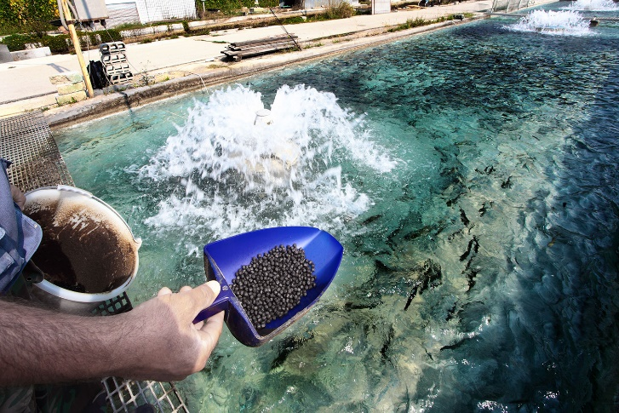
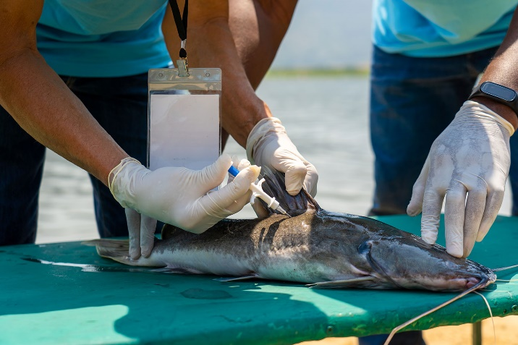
Animal Drugs Approved by U.S. FDA for Aquaculture
Immersion Drugs
Formalin
Hydrogen peroxide
Oxytetracycline hydrochloride
Tricaine methanesulfonate
Chloramine T
Medicated Feed
Florfenicol
Oxytetracycline dihydrate
Sulfadimethoxine/Ormetoprim
Sulfamerazine
Injectable Drugs
Chorionic gonadotropin
Notes:
Animal Drugs Approved by U.S. FDA for Aquaculture
Say: This is the list of approved animal drugs. Refer to your participant guide for additional details.
Animal drugs are categorized according to their route of administration. Immersion Drugs use a bath treatment where a concentration of medication is mixed into the water and animals are submerged for a certain length of time, to absorb the medication through their skin or gills. Medicated Feed includes medications that are mixed into the food given to animals. And Injectable Drugs are injected into each animal individually.

Slide 6
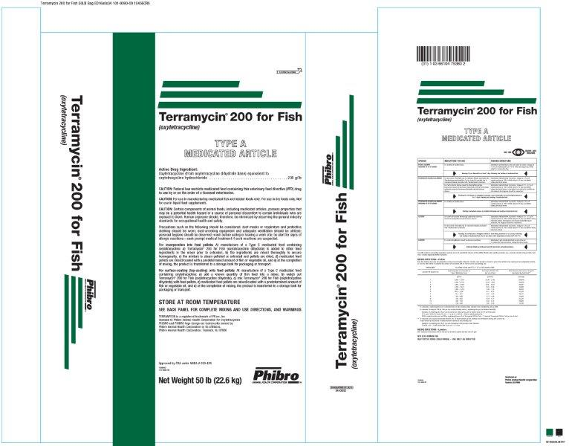
How to Read a Drug Label
Notes:
How to Read a Drug Label
Say: Since misuse of approved drugs is a violation, it is important to know how to read a drug label to prevent misusing an approved drug.
Step through each part of the drug label shown. <Select Enter to advance the slide build.>
Route of administration is the method or process used to administer the drug. Can be administered via feed, immersion (bath/dip), or injection. Appropriate route depends on the species, disease, and drug formulation. Misuse or off-label administration can lead to ineffective treatment and/or regulatory violations
Species describes the animals that may be given the medication. Each drug may be approved for a specific species. Always verify the species listed on the label prior to use. Using a drug for an unlisted species can lead to ineffective treatment and/or regulatory violations.
Frequency specifies how often the drug should be given. Overuse can lead to residues in animal tissues, contribute to the development of antimicrobial resistance in pathogens and negatively impact the environment. Follow prescribed treatment schedule to ensure therapeutic effectiveness, safeguard public health, and maintain regulatory compliance.
Indication for use describes what a drug may be used for. Drugs are approved for specific diseases or conditions (bacterial infections, parasite control, etc.). Using a drug for an unapproved purpose can lead to safety concerns and regulatory action. Off-label use requires a veterinarian’s prescription under extra-label drug use regulations (Title 21 Code of Federal Regulations Part 530.3).
Dosage regimen is how much of the medication may be used at a time. Overdosing can cause toxicity, while underdosing may lead to antimicrobial resistance. Always measure accurately and adhere to recommended concentrations.
Withdrawal time refers to the mandatory interval between last drug administration and harvest. This period ensures the drug has sufficient time to metabolize, reducing residues to safe levels and preventing potential public health hazards. Since withdrawal periods vary by drug, always verify the specific timeframe before harvesting.

Slide 7
Animal Drugs Not Approved by U.S. FDA (Unapproved Drugs)
Potential acute and chronic human health consequences.
Development of the prevalence of antibiotic-resistant microorganisms.
Any use of unapproved drugs or misuse of approved drugs is considered a violation.
Any detection of residues of unapproved drugs through U.S. FDA foreign facilities inspection or testing program is a violation.
Imported aquaculture product treated with an unapproved drug would be denied entry into the U.S. even if the level of residues is considered safe by a country where the animal drug is lawfully used.
Notes:
Animal Drugs Not Approved by U.S. FDA (Unapproved Drugs)
Say: Drugs not approved by U.S. FDA are considered unapproved drugs which have not been evaluated and are not recognized as safe under any condition of intended use. Unapproved drugs do not meet U.S. FDA standards for safety and effectiveness. There are public health concerns with the unapproved drugs. These include…
Read the next two bullets on the slide. <Select Enter to advance the slide build.>
Say: If a drug is not listed on the Approved Drug list, it should be considered Unapproved.
Read Any use of unapproved drugs or misuse of approved drugs is considered a violation.
<Select Enter to advance the slide build.>
Read Any detection of residues of unapproved drugs through U.S. FDA foreign facilities inspection or U.S. FDA testing program is a violation.
<Select Enter to advance the slide build.>
Read Imported aquaculture product treated with an unapproved drug would be denied entry into the U.S. even if the level of residues is considered safe by a country where the animal drug is lawfully used

Slide 8
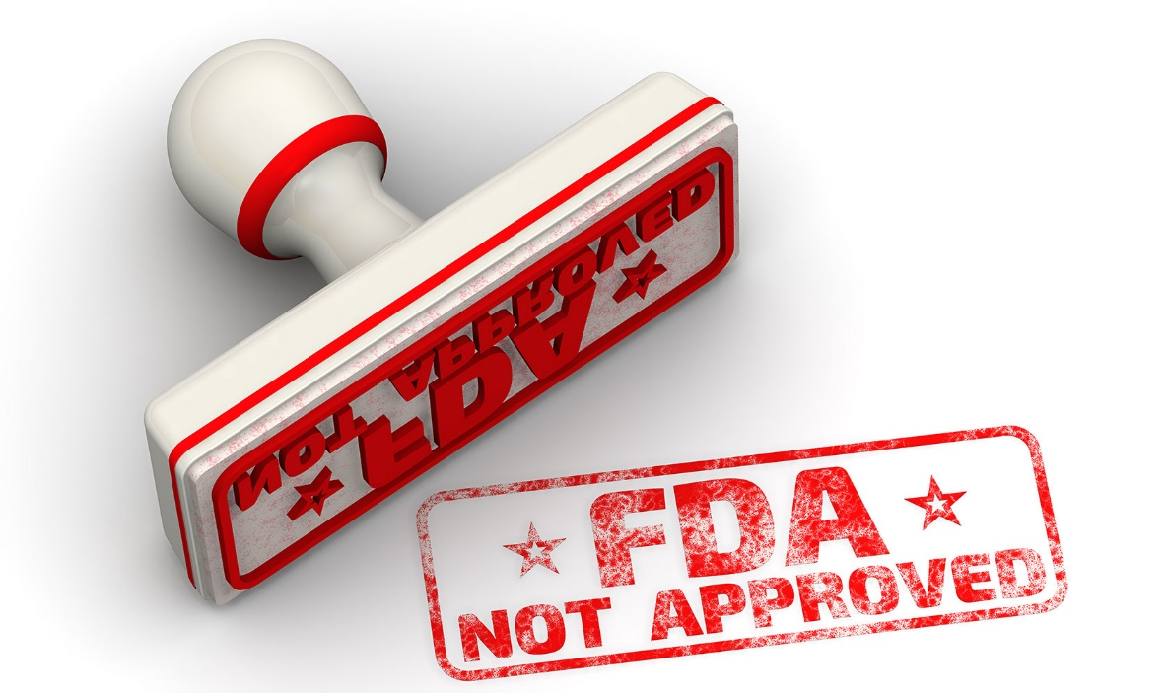
Unapproved Animal Drugs Commonly Detected
Chloramphenicol
Nitrofurans
Triphenylmethane Dyes
Quinolones
Fluoroquinolones
Tetracyclines
Sulfonamides
Notes:
Unapproved Animal Drugs Commonly Detected
Say: The FDA prioritizes enforcement actions based on the potential harm to public health, focusing on unapproved drugs, those with serious health risk concerns. This is a list of unapproved drugs that the U.S. FDA commonly detects through our testing program. When residues of these drugs are found in seafood products, it constitutes a serious violation resulting in denial of product entry into the country and addition of the manufacturer to an import alert.
The list includes:
Chloramphenicol
Nitrofurans including Furazolidone, Furaltadone, Nitrofurazone, Nitrofurantoin
Triphenylmethane Dyes including Malachite Green and Gentian (Crystal) Violet
Quinolones including Flumequine, Oxolinic Acid and Nalidixic Acid
Fluoroquinolones including Ciprofloxacin, Enrofloxacin, Sarafloxacin, and Difloxacin
Tetracyclines including Oxytetracycline, Tetracycline, Chlortetracycline
Sulfonamides
This list is also found in your participant guide.

Slide 9
Your Role in Ensuring Residue Free Products
2
Choose an accredited laboratory
1
Conduct periodic testing
3
Ensure and document the quality procedures of the lab
4
Maintain records
Notes:
Your Role in Ensuring Residue Free Products
Ask: Why does the U.S. FDA test for drug residue in aquaculture products?
Debrief all answers as acceptable.
Say: Here are the things you need to do in order to ensure you are producing healthy product without violative drug residue.
<Select Enter to advance the slide build.>
Conduct periodic testing as a verification tool to ensure your farm’s preventive control measures are working, confirm that no prohibited or unapproved drug and/or chemical compounds were used, and verify that approved drugs were used according to the label instructions, including withdrawal periods.
<Select Enter to advance the slide build.>
Choose an accredited laboratory to test your product before export. Ensure the lab is ISO/IEC 17025: 2005 accredited. This means they adhere to the global quality standard for testing and calibration.
<Select Enter to advance the slide build.>
Ensure and document the quality procedures of the laboratory:
-The lab should have a quality management system (including Quality Control and Quality Assurance Program) in place that defines Standard Operating Procedures and laboratory protocols.
-They should use Good Laboratory Practices to ensure quality and integrity of safety and efficacy data.
-Check to see that their procedures were followed. This includes data audits of equipment and personnel as well as proficiency testing.
<Select Enter to advance the slide build.>
Maintain records about the sample collection protocol, information on analytical method with method’s sensitivity level, and test results.

Slide 10
What Type of Testing Method Should Be Used?
Screening methods are used for detecting the presence of specific target drug residues.
A method that fits the intended purpose.
Throughput
Sensitivity
Specificity
Accuracy
Confirmatory methods verify screening results, are highly specific, and identify what drug residue is present and how much is present with high precision and accuracy.
Notes:
What Type of Testing Method Should Be Used?
Say: What type of testing method should you use? A method that fits the intended purpose.
Discuss the bullet points on the screen, ensuring participants add their thoughts and questions.
Say: There are two types of testing methods.
<Select Enter to advance the slide build.>
Say: Screening methods used for detecting the presence of specific target drug residues.
<Select Enter to advance the slide build.>
Say: Confirmatory methods verify screening results, are highly specific and identify what drug residue is present and how much is present with high precision and accuracy.

Slide 11
Screening Methods (Qualitative)-ELISA
PROS
Is inexpensive, quick and has simple procedures
Provides high efficiency analysis of a large number of samples
Does not require sophisticated instrumentation and highly trained personnel
ELISA test kits are commercially available
CONS
Has lower specificity and sensitivity in targeting and detecting analytes
May have cross-reactivity issues, leading to false positive/negative results
Provides information about the presence of analyte not concentration. Results should be reported as positive or negative – not as below sensitivity of the kit
Can be used for preliminary screening but may require confirmatory testing
Proper storage conditions are required for test kits and reagents
https://www.fda.gov/food/guidance-regulation-food-and-dietary-supplements/registration-food-facilities-and-other-submissions
Notes:
Screening Methods
Say: ELISA Rapid Screening Methods is a commercially available, widely used method as a preliminary screening for residues in seafood. It provides a quick visual detection of residues with high-throughput screening that allows for testing numerous samples simultaneously.
Read the remaining Pros shown on the slide.
<Select Enter to advance the slide build.>
Say: However, screening methods may not be as sensitive or specific (not able to distinguish between closely related compounds) and can be prone to false negative/positive results. For regulatory compliance and accurate quantification, ELISA results should be confirmed with more sensitive and specific techniques like LC-MS/MS. Accurate residue detection helps ensure the safety of seafood product.
When using commercially available kits, it’s important not to use expired test kits or deteriorated reagents and solutions. Pay attention to the expiration date on screening test kits.

Slide 12
Confirmatory Methods (Quantitative)
Interpreting Results
For drugs on the Approved Drug List:
Residue is less than tolerance or Maximum Residue Level = Safe
Residue is more than tolerance or Maximum Residue Level = Violation
For Unapproved Drugs:
No safe level is established. Any level detected is a violation.
Only use validated methods
Run replicate analyses.
Measure appropriate analytes
Target the right species
Demonstrate precision and accuracy
Notes:
Confirmatory Drug Residue Testing
Say: When choosing a lab, they must:
Be accredited
Use internationally recognized and validated methods
Run replicate analyses, at least duplicate samples
Measure appropriate analytes (residue marker, parent drug, metabolite)
Target the right species and tissue
Demonstrate precision and accuracy
Keep in mind the idea of Limit of Detection or LOD. This is not a safety number, it only reflects the sensitivity of the equipment used for testing. You should make sure the LOD is less than the allowable limit for a drug so that you can trust the test results.
<Select Enter to advance the slide build.>
Read the bullets under Interpreting Results.

Slide 13
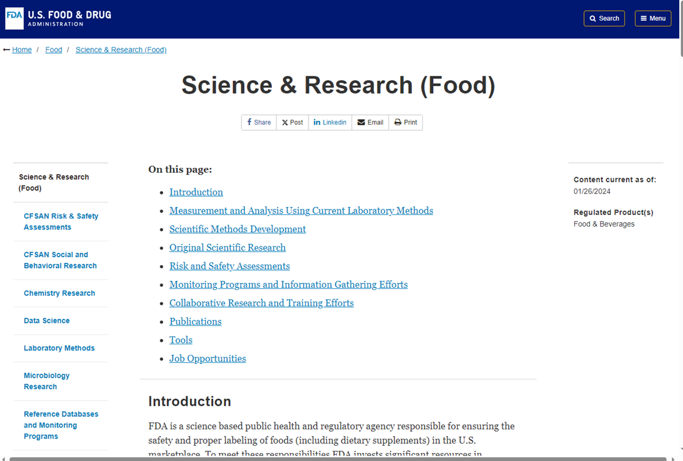
Food Science and Research
https://www.fda.gov/food/science-research-food
Notes:
Food Science and Research
Say: A link is provided on this slide to the U.S. FDA Food Science and Research website. Here you can learn more about laboratory methods used for testing food products.

Slide 14
Summary
All animal drugs, whether used as a direct medication or for addition to feed or water, must be approved by U.S. FDA for production of seafood intended for U.S. consumers.
Use of unapproved drugs or misuse of approved drugs is a violation.
There are two types of methods for testing animal drug residues in products:
Screening Methods
Confirmatory Methods
Notes:
Summary
Review each point on the slide one-by-one.

Slide 15
?
Notes:
Ask: What questions do you have?

Slide 16
This publication is supported by the Food and Drug Administration (FDA) of the U.S. Department of Health and Human Services (HHS) as part of a financial assistance award U01FD001418 with 100% funded by FDA/HHS. The contents are those of the author(s) and do not necessarily represent the official views of, nor an endorsement by FDA/HHS, or the U.S. Government.

