Slide 1

Aquaculture Food Safety
<Enter Instructor Name and Title Here>
4 hours
Notes:
Welcome to Aquaculture Food Safety
Instructor Guide
CC BY-NC 4.0
4 hours

Slide 2
Good Aquaculture Practices Lead to Safe Food
Food Safety
Control Aquaculture Food Safety Hazards
Introduce Traceability
GAqPs
Food
Safety
Biosecurity
Best Management Practices (BMPs)
Notes:
Good Aquaculture Practices Lead to Safe Food
INSTRUCTOR NOTE: Before class enter the name of the instructor on the cover slide.
Say: This session is specific to the top part of the pyramid, Food Safety, and how it is addressed in the GAqP Food Safety Plan concept and program. In it, we will bring together everything we have talked about related to Biosecurity and BMPs.
<Select Enter to advance the slide build.>
Say: In this session, we will discuss how good aquaculture practices lead to safe food including:
Aquaculture food safety hazards. Most aquaculture food safety hazards occur at the farm including drug residues, chemicals, and biological hazards.
Traceability and why a lot number is important. It’s the system and the ability to get data that’s important, not just collecting data.
And, how GAqPs make a difference.

Slide 3
What are GAqPs?
PROACTIVE PRACTICES HAVE A WRITTEN PLAN
Identifies risk
Determines controls
Requires documentation
Includes method of verification
GAqPs prevent or minimize
Risk of animal diseases
Risk of foodborne illnesses
Proactive
NOT
Reactive
Notes:
What are GAqPs?
Say: Let’s revisit what we have discussed so far and add some new understanding as we go. What are GAqPs?
<Select Enter to advance the slide build.>
Say: GAqPs is a strategic approach to preventing or minimizing hazards and risks:
The risk of animal diseases and
The risk of foodborne illnesses.
<Select Enter to advance the slide build.>
Say: GAqPs are proactive, not reactive.
<Select Enter to advance the slide build.>
Say: Proactive practices require that you have a written plan. The plan identifies risks, determines the necessary controls, and requires documentation as well as a method of verification.
<Select Enter to advance the slide build.>
Go to the next slide to continue reading the Notes section.

Slide 4
What are GAqPs?
PROACTIVE PRACTICES HAVE A WRITTEN PLAN
Identifies risk
Determines controls
Requires documentation
Includes method of verification
GAqPs prevent or minimize
Risk of animal diseases
Risk of foodborne illnesses
Proactive
NOT
REACTIVE PRACTICES
Border checks
Product testing
Inspections
Reactive
Notes:
What are GAqPs? (continued)
Say: Reactive practices include border checks, product testing, and inspections. Important to do, but they catch issues after the fact. GAqPs are about being proactive instead.
Offer a story to illustrate this point.
INSTRUCTOR NOTE: Use your own story or the following example story:
When you forget to close a barn door and it is left open, the horse gets out of the barn. Then you have to react and go get the horse. That’s reactive. How is proactive different? To be proactive you would need to have a plan for verifying that the door is closed. For example, a barn has a clicking sound when the door closes. Every time it is closed, you proactively listen to hear the click. Or some barns have pins that must be slid into place. Every time it is closed you can proactively look and ensure the pin is in, the door is closed and secure, so the horse is unable to get out.

Slide 5
BMPs: Examples of Risks and Controls
Food Safety
Biosecurity
Best Management Practices (BMPs)
Appropriate BMPs: region, species, history
Farm feed source, quality, safety, storage
Routine monitoring of water, animals, ‘early warning indicators’ including periodic diagnosis
Harvesting plan
Safe ice and water
Drug and chemical storage
Notes:
BMPs: Examples of Risks and Controls
<Select Enter to advance the slide build.>
Say: Appropriate BMPs depend on your region and area. Every region is different and species need different water quality parameters. The history and conditions are different, such as seasonal changes with water quality issues.
<Select Enter to advance the slide build.>
Say: Ensure your feed comes from a known, tested, high quality feed supplier.
< Select Enter to advance the slide build.>
Say: Routine monitoring uses records to reveal trends in water quality, salinity, and signs of diseases.
<Select Enter to advance the slide build.>
Say: Know where your water is coming from and ensure biosecurity controls such as ensuring there is not cross-contamination during harvesting. For example, contractors who help with harvesting can carry contaminants from farm to farm.
< Select Enter to advance the slide build.>
Say: Ensure ice and water come from a known source and are not contaminated.
< Select Enter to advance the slide build.>
Say: Proper storage of drug and chemicals prevents cross-contamination.

Slide 6
Biosecurity: Examples of Risks and Controls
Food Safety
Biosecurity
Best Management Practices (BMPs)
Appropriate farm location and controlled surrounding
Source water treatment, testing, control
Controlled access to people, animals, vectors, and activities
Disinfection at farm entry points for vehicles, people, equipment, etc.
Use of specific disease-free, resistant, or tolerant post-larva.
Notes:
Biosecurity: Examples of Risks and Controls
Say: As we have discussed, biosecurity requires a written biosecurity plan and training. Recall that we discussed these biosecurity risks as well.
Ask: Who can remind us about details of one of these biosecurity risks and controls? Repeat calling upon participants until a summary including the following key points is accomplished.
<Select Enter to advance the slide build.>
Debrief ensuring these key points are emphasized:
Farm location, surroundings, neighbors
Source water treatment, testing, control
Control access to people, animals, vectors, activities
Disinfection at farm entry points for vehicles, people, equipment, etc.
Use specific disease-free, resistant, or tolerant post-larva. What works best for your environment, practices, etc.
Say: Now that we have refreshed our memories about biosecurity risks and controls and examples, we will add one more piece of information. In addition to written biosecurity plans it is important to document disease contingency plans in written form as well. This allows you to act quickly if a problem arises.

Slide 7
Food Safety: Examples of Risks and Controls
Food Safety
Biosecurity
Best Management Practices (BMPs)
Written description of how your farm prevents:
Unapproved or prohibited drug residue
Environmental chemicals (HMs, pesticides)
Pathogens
Written verification procedures
Written records
Know what drugs and chemicals are used
Safe water and ice at harvest
Notes:
Food Safety: Examples of Food Safety Risks and Controls
Read through each of the points on the slide to emphasize the main points related to Food Safety risks and controls.
Say: Keep in mind that it doesn’t really matter where you categorize the elements, some belong in more than one category. Ice and water, for example, can be a food safety risk or a BMP risk. The task of using robust PLs can be BMP or biosecurity.

Slide 8
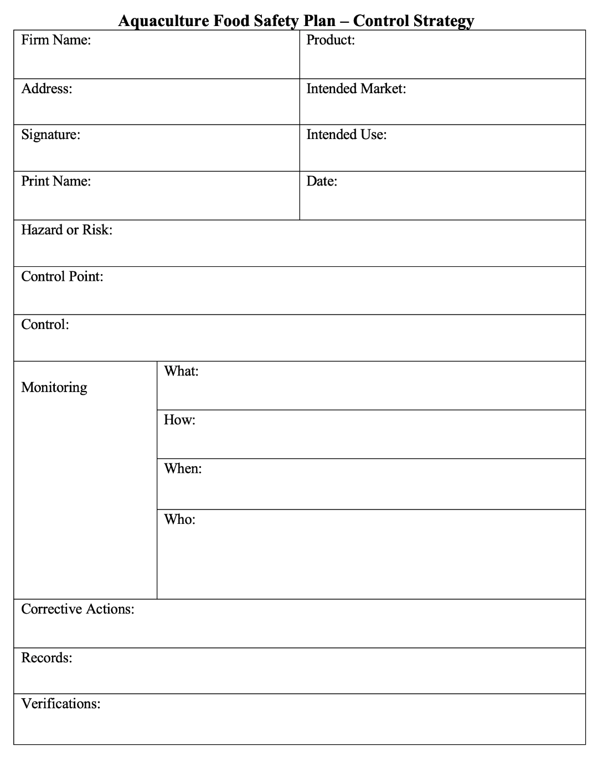
Parts of a Food Safety Plan
Notes:
Parts of a Food Safety Plan
Say: Now, let’s review the parts of a Food Safety Plan. You may want to look at the Food Safety Plan template in your Participant Guide.
<Select Enter to advance the slide build.>
Say: Remember, the first step in writing one is to identify significant hazards or risks specific to the location, diseases, markets, etc.
Ask: What are some hazards or risks?
Debrief ensuring some of the following are mentioned: Specific disease in your area, low oxygen during certain conditions, use of unapproved drugs, overspray from neighbor farms, cross contamination of equipment, visitors/animals on farm.

Slide 9
Parts of a Food Safety Plan
Notes:
Parts of a Food Safety Plan
Say: The second step is to determine the pathways where the risks occur or can enter or impact your farms so you can determine where to apply a control (the control point) to eliminate, prevent, or reduce to a manageable level, the significant risks you previously identified.
<Select Enter to advance the slide build.>
Say: These Control Points (CPs) determine where you can apply controls.
Ask: What are some examples of control points?
Debrief answers ensuring some of the following are mentioned: Farm entry, source water, reservoir or holding ponds, storage and use equipment, pond or net pens for testing, post larva or fry entry, etc.

Slide 10
Parts of a Food Safety Plan
Notes:
Parts of a Food Safety Plan
Say: The third step,
<Select Enter to advance the slide build.>
Say: apply Controls to eliminate, prevent, or reduce the significant risks you previously identified to a manageable level.
Ask: What are some examples of controls?
Debrief answers ensuring some of the following are mentioned: Preventing entry of animals or visitors, put in perimeter fencing, getting a Certificate of Analysis, water quality testing, having approved list of PLs, fry, feed, drugs, chemicals, etc.

Slide 11
Parts of a Food Safety Plan
Notes:
Parts of a Food Safety Plan
Say: And then, fourth,
<Select Enter to advance the slide build.>
Say: Monitor the Controls. This section is about the actions taken to describe and ensure the controls are being adequately conducted.
Ask: What are some examples of monitoring the controls?
Debrief answers ensuring some of the following are mentioned: Guard at gate, pond, or farm managers taking specific actions like observing entry registration or preventing entry, surveying the adequacy of fencing, observing sanitizing equipment.

Slide 12
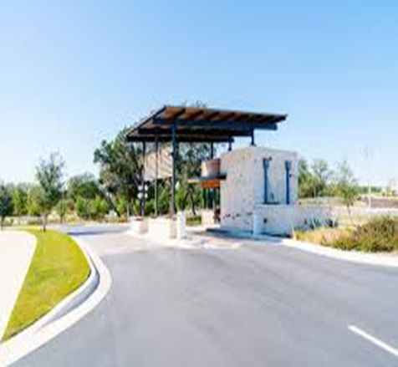
What to Monitor
Trucks and visitors do not have direct access to the farm.
Only approved post-larva are allowed entry.
All equipment and utensils are cleaned and sanitized.
Nets are in place and not torn.
Perimeter fencing is in place and not broken or down.
Notes:
What to Monitor
Say: The monitoring portion of the Food Safety Plan is when you make sure that the action identified as a control for the hazard or risk is being implemented. Let’s walk through some examples of control actions now.
Read through the examples on the screen adding description where possible.

Slide 13
Other Steps of Monitoring
How
Observation? Document review? Inspection? Audit?
Who
Entry gate guard
Quality Assurance, farm, or grow-out manager
Maintenance manager
Third party
When
Every vehicle or guest entering farm
After and before utensil use
Before grow-out
Notes:
Other Steps of Monitoring
Say: There are three other steps to monitor in addition to monitoring the controls. They are:
<Select Enter to advance the slide build.>
Say: How monitoring is conducted. Is it by observation, document receipt or review, an audit or inspection?
<Select Enter to advance the slide build.>
Say: Who is doing the monitoring action; at the entry gate guard, a manager, a third party?
<Select Enter to advance the slide build.>
Say: When is the time, the occasion when the monitoring action is taken; at entry, after use of equipment, before animals are put in the grow-out pond or pen.

Slide 14
Parts of a Food Safety Plan
Notes:
Parts of a Food Safety Plan
Say: The fifth step is to describe what you would do if a problem occurs…
<Select Enter to advance the slide build.>
Say: the corrective action you would take. How will you correct the problem, or make it right?
Ask: What are some examples of corrective actions?
Debrief answers ensuring some of the following are mentioned: Reject the entry of any drug or chemical not on the approved list, fixing or correcting any down perimeter fencing, guard at gate, pond, or farm managers taking specific actions like preventing entry, surveying the adequacy of fencing, sanitizing equipment.

Slide 15
Parts of a Food Safety Plan
Notes:
Parts of a Food Safety Plan
Say: The sixth step is to describe what …
<Select Enter to advance the slide build.>
Say: records you will need to document the food safety plan that is being applied or implemented.
Ask: You may be doing all of the things on the plan, but do you have evidence to show that you are? Do you have proof?
Debrief allowing everyone to offer a perspective who wants to share.
Ask: What are some examples of records?
Debrief answers ensuring some of the following are mentioned: Test results including any from the government or the processor, logbooks like those at entry, cleaning sanitizing records, survey or observation records like conducting weekly inspections of fences, monitoring for fish health.

Slide 16
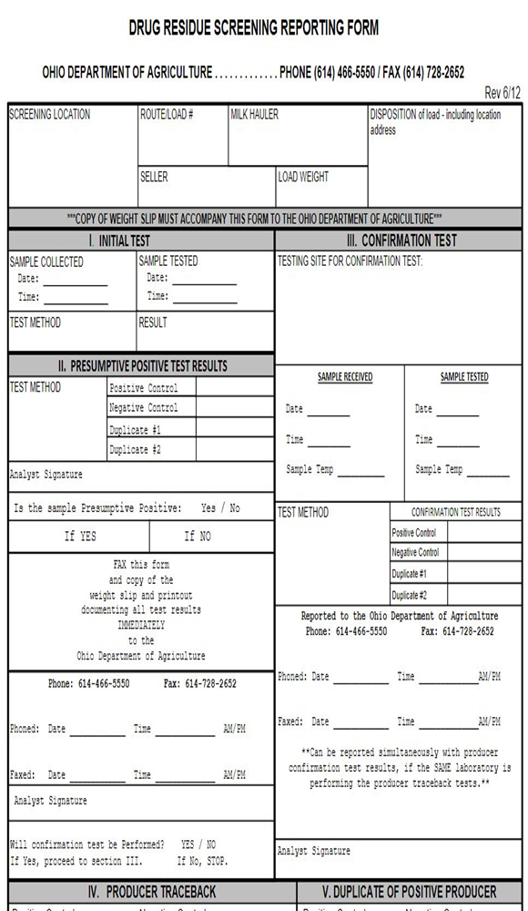
Documenting and Keeping Records
Monitoring
Verification
Critical Decisions
Products Used (for example, drugs)
Problems (diseases)
Corrective Actions
Drug Residue Testing Report
Notes:
Documenting and Keeping Records
Say: What specific records should be kept for documentation and transparency? Here are some broad examples. Records include actions taken and results.
Read through the list on the slide offering explanation where possible.

Slide 17

Parts of a Food Safety Plan
The Food Safety Plan controls the hazard or risk.
Testing is used to verify that the plan is working.
Notes:
Parts of a Food Safety Plan
Say: In GAqP, …
<Select Enter to advance the slide build.>
Say: verification is based on the “Trust but Verify” principle.
For example, you may work with a trusted supplier and you trust that the feed you get from them does not have residues. That is fine. However, you should also get a Certificate of Analysis from the supplier or do a test yourself in order to verify the feed is residue-free. This is your written proof or evidence.
Our final point in this GAqP review is very important:
<Select Enter to advance the slide build.>
Say: It is the Food Safety Plan that controls the hazard or risk. And testing is used to verify that the plan is working.
Ask: What questions do you have about a Food Safety Plan or anything else we have covered so far?
Debrief by answering all questions that arise and making note of any that you cannot answer at this time.

Slide 18
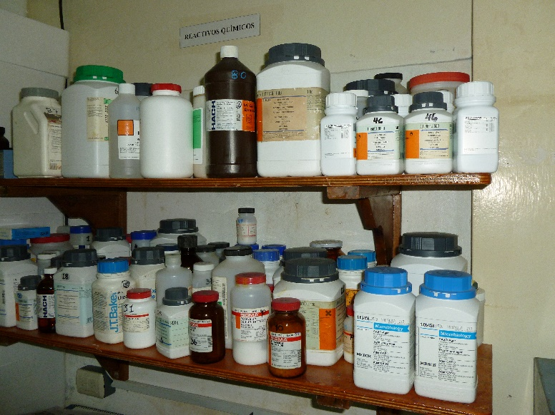
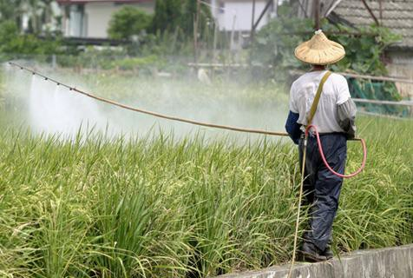
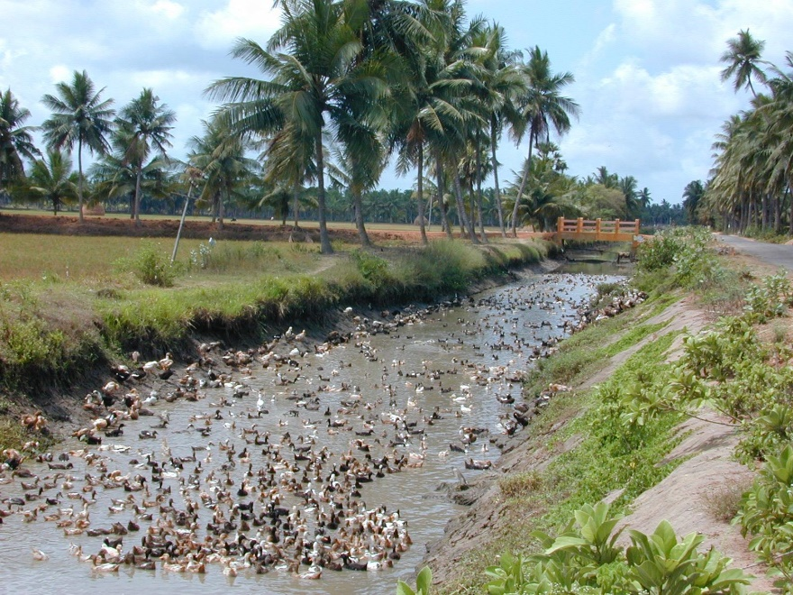
Aquaculture Food Safety Plan—At the Farm
Notes:
Aquaculture Food Safety Plan—At the Farm
Say: Three of the most common Food Safety risks with aquaculture products occur at the farm.
First, the use of unapproved drugs or chemicals. Some are known or suspected to be carcinogens, others such as Chloramphenicol can cause serious allergic responses, and the use or misuse of antimicrobials can contribute to antimicrobial resistance which is a primary public health problem worldwide.
<Select Enter to advance the slide build.>
Say: Second, chemical, pesticide, or heavy metal contamination including locating your farm where chemical contamination is present.
<Select Enter to advance the slide build.>
Say: And, third, pathogens, such as human bacterial pathogens and salmonella.

Slide 19
Chemical and Drug Control Considerations
Every country has a different approved drug list.
Use approved drugs according to the label.
Ensure drugs are approved for use in your intended market.
Administer all drugs correctly (i.e., proper withdrawal times, and documentation).
Document how, when, and why the drug is administered.
Know the names and active ingredients of all drugs and chemicals entering the farm.
Make a list of drugs that can and cannot enter the farm. Train the guard at the entry about this list.
Notes:
Chemical and Drug Control Considerations
Review each of the points on the slide in detail.
<Select Enter to advance the slide build for each bullet point.>
Say: Keep in mind that any drugs you use must be approved by the intended country and every country has its own unique list of approved drugs.
Pause to ask for questions at this time.

Slide 20
Example of Unapproved Drug Residue Samples
Country X (Name Deleted)
5. 11% Positive | 3 Crab samples for Chloramphenicol 2 Shrimp samples for Nitrofurans
6.
7. | 1 Shrimp sample for Chloramphenicol
8. 22% Positive | 6 Catfish samples for Malachite Green 4 Channel Catfish samples for Malachite Green 26 Eel samples for Malachite Green 2 Grouper samples for Malachite Green 4 Shrimp samples for Nitrofurans 3 Tilapia samples for Malachite Green
9. 21% Positive | 3 Eel samples for Malachite Green 1 Clarius sample for Malachite Green
10. 17% Positive | 3 Crab samples for Chloramphenicol 1 Grouper sample (both Malachite Green and Fluoroquinolones) 1 Shrimp sample for Chloramphenicol
Example
Notes:
Example of Unapproved Drug Residue Samples
Say: This is an example of an actual U.S. FDA Aquaculture Unapproved Drug Residue Sample for one year. We removed the name of the country for privacy. The example reiterates the criticality of Food Safety.
In the year shown, Country X made shipments of exported seafood that was destroyed or sent back due to the drug residues shown here.
The chart shows the percentage of positive tests for specific products.
<Select Enter to advance the slide build.>
Say: For example, row 8 shows that 22 percent of the samples were positive for drug residues.
As you can imagine, this was expensive in terms of money and time to everyone in the chain including the U.S. FDA and the vendor, including its workers. And it resulted in a lack of product for consumers.

Slide 21
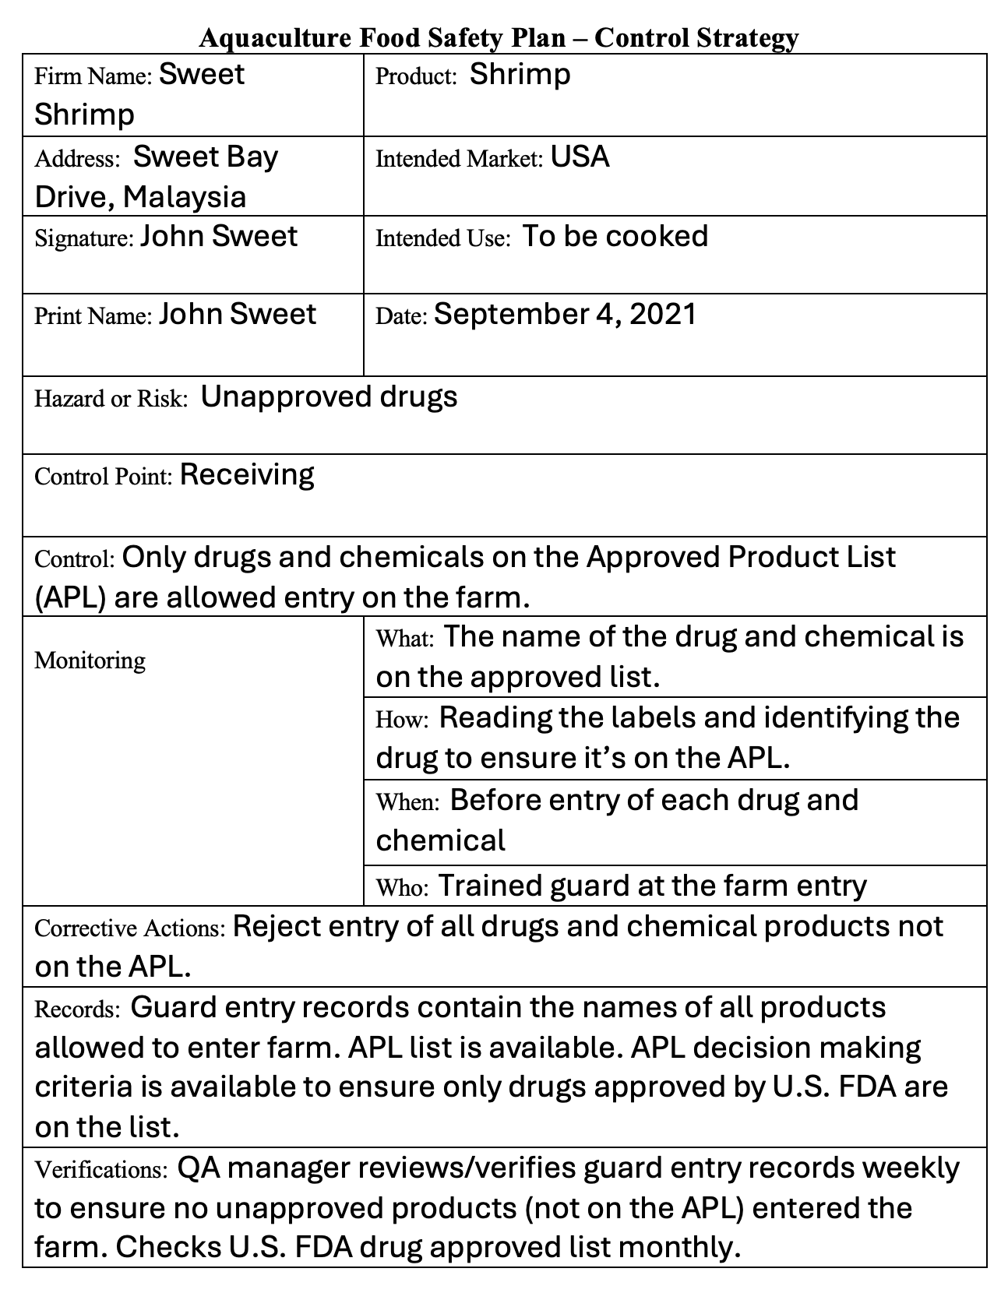
Example of a Food Safety Plan to Address Unapproved Drugs
Notes:
Example of a Food Safety Plan to Address Unapproved Drugs
Say: Here is a Food Safety Plan to address the issues found on the previous slide. The hazard identified is Unapproved Drugs. The Control is that the farm now requires all drugs and chemicals coming onto the farm to be on the Approved Product List before entry.
Walk through the plan shown on the slide in detail, row by row.
<Select Enter to advance the slide build.>

Slide 22
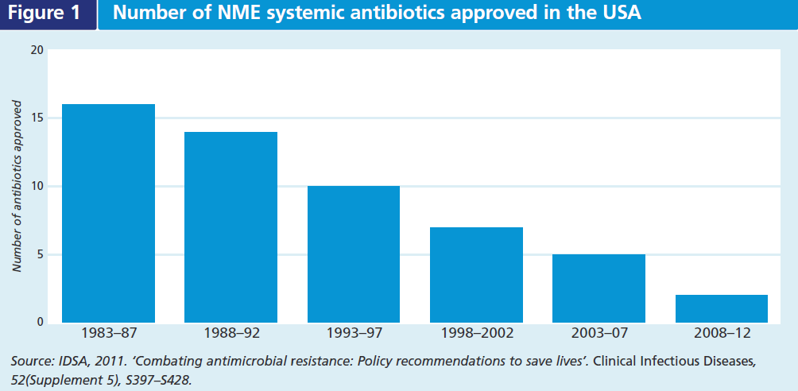
New Antibiotic Development and Approval
Administer drugs carefully
Only use antibiotics when you absolutely must
Number of new antibiotics approved
Source: IDSA, 2011. ‘Combating antimicrobial resistance: Policy recommendations to save lives’. Clinical Infectious Diseases, 52(Supplement 5), S397–S428.
Notes:
New Antibiotic Development and Approval
Say: One of the most serious public health concerns worldwide is bacteria resistance to antibiotics. At the same time the development of new antibiotics are slowing down. This slide shows the number of new antibiotics developed and approved by the U.S. FDA. Starting in 1983 on the left all the way to the right, showing 2012, the trend of developing and approving new antibiotics is going down significantly.
Therefore, as an aquaculture producer, our part is:
<Select Enter to advance the slide build.>
Say:
Administer drugs carefully
<Select Enter to advance the slide build.>
Say:
Only use antibiotics when you absolutely must

Slide 23
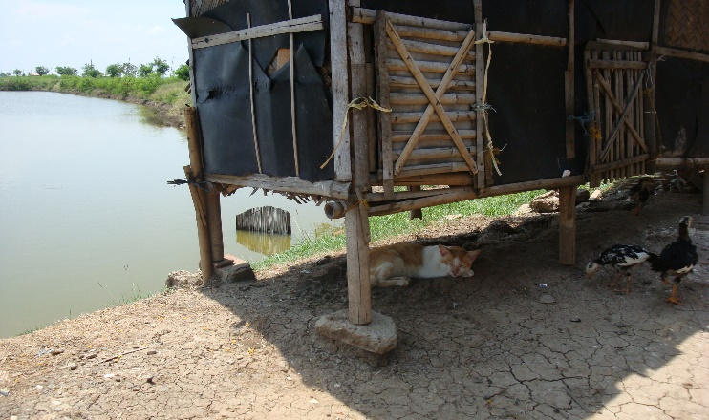
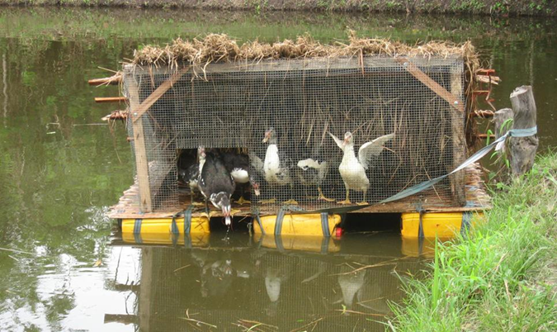
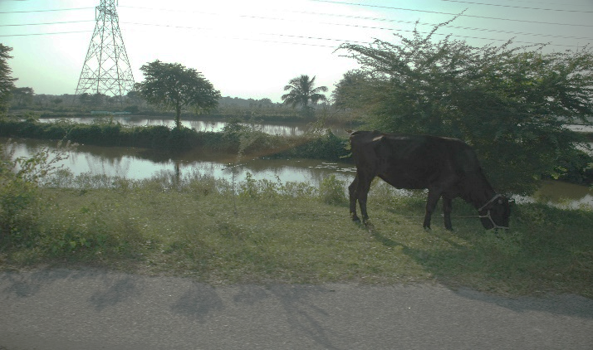
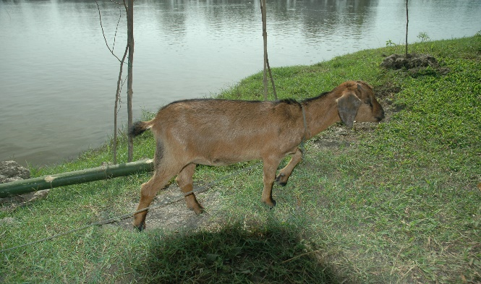
Human Pathogens
Notes:
Human Pathogens
Say: Animals are a very common reason for human pathogens found in aquaculture products. Keep animals away from the farm to resist spreading human pathogens.

Slide 24

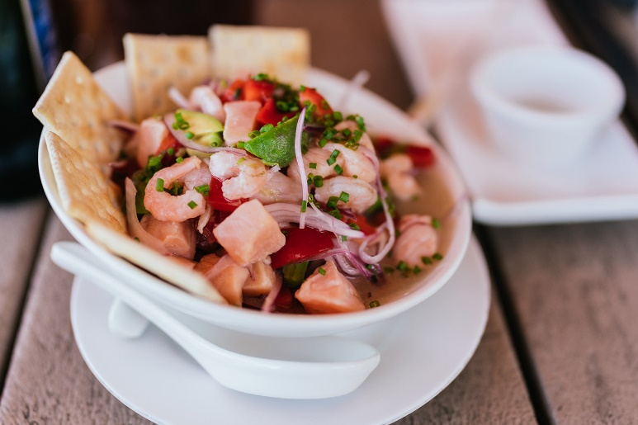
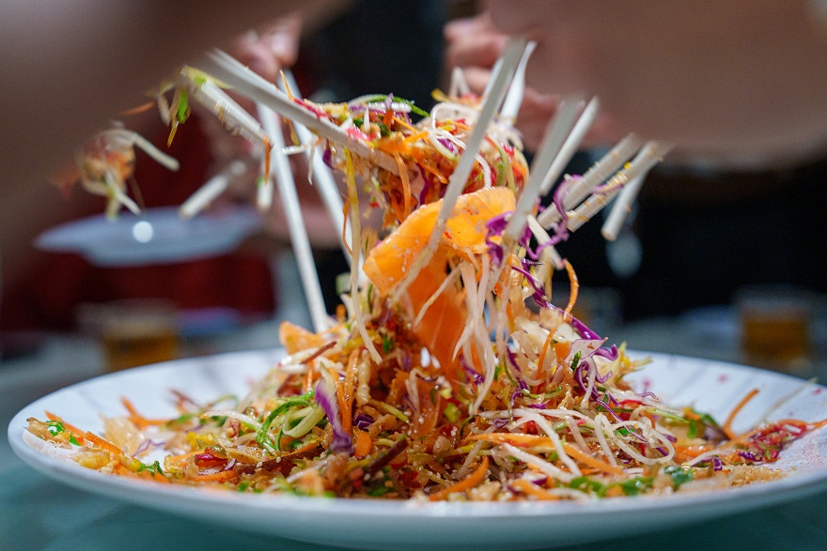

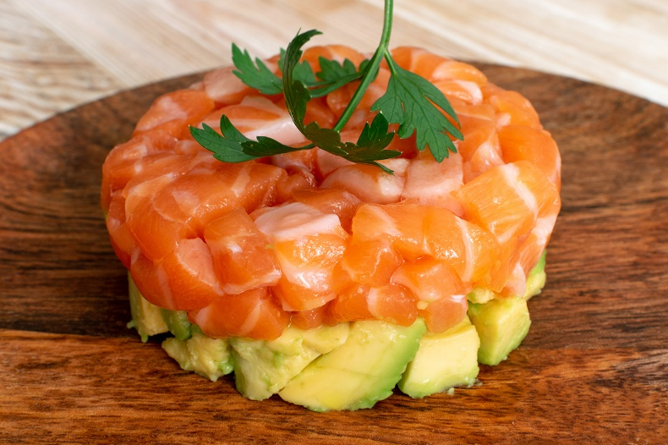
What Do You Think?
Ceviche from across North and South America
Sashimi from Japan
Poke, very common in the U.S., especially Hawaii
Tartare is a dish common in France
Yusheng from China
Notes:
What Do You Think?
Ask: Do any of these dishes look familiar? What are they? What do they have in common?
Debrief, accepting all answers as correct and emphasizing:
Sashimi from Japan
Ceviche from across North and South America
Yusheng from China
Poke, very common in the U.S., especially Hawaii
Tartare is a dish common in France
Say: All of these contain seafood and all of them use raw or undercooked seafood. These are examples of common raw seafood dishes from around the world. If your farm provides products intended to be consumed raw, preventing or eliminating the human pathogen risk should be a top priority.

Slide 25

Ice and Water: Critical to Food Safety
The farm has a list with names of the only approved ice suppliers that can be used.
List comes from their own inspection and/or Competent Authority (CA) “approved list”.
The farm documents how “approval is determined” (i.e., ice plant inspection, checks the current list of CA approved ice plants).
Staff must be trained to implement all controls.
Notes:
Ice and Water: Critical to Food Safety
Say: Another food safety risk in aquaculture products is the use of dirty unsanitary ice, water, and utensils or totes.
Review the examples of how aquaculture farms can ensure the ice and water they use contributes to food safety.

Slide 26
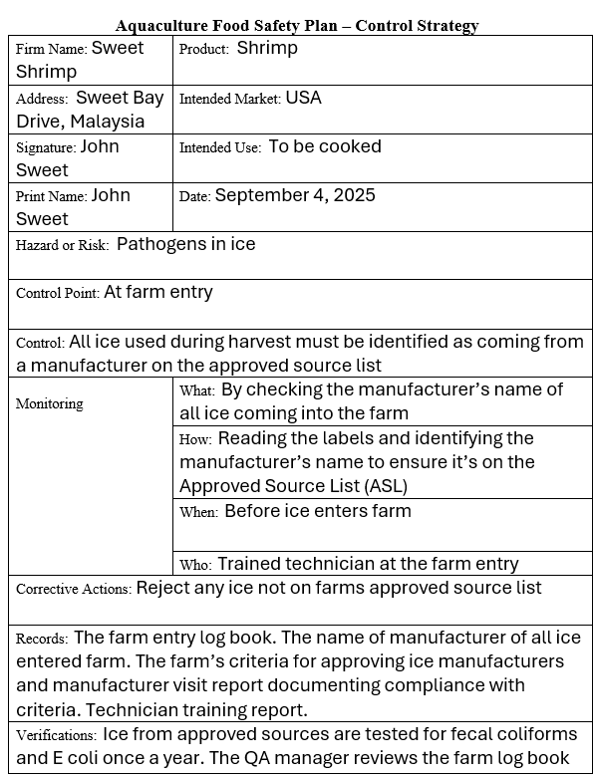
Example of a Food Safety Plan to Address Pathogens in Ice
Notes:
Example of a Food Safety Plan to Address Pathogens in Ice
Say: Here is a Food Safety Plan to address the issues found on the previous slide. The hazard identified is pathogens in ice.
Walk through the plan shown on the slide in detail, row-by-row.
<Select Enter to advance the slide build.>

Slide 27



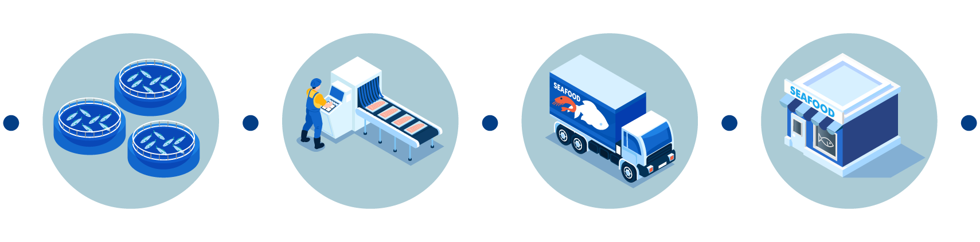
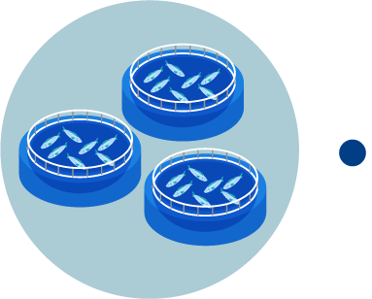
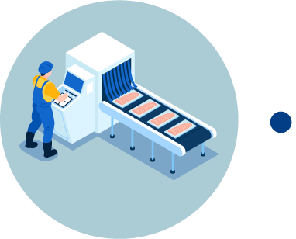

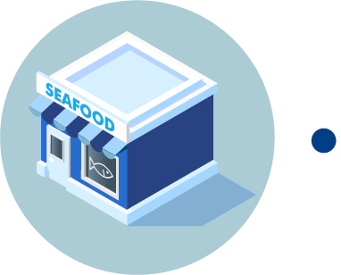
What is Traceability?
Traceability does not refer to collecting and recording a lot of product data alone.
Traceability does refer to your ability to access and track product data you have collected and recorded at any point in time, quickly, thoroughly, and on any level.
Harvested
Distributed
Processed
Sold to
Notes:
What is Traceability?
Say: There are many definitions of traceability. Traceability does not refer to product data itself. You will have data showing:
<Select Enter to advance the slide build.>
Say:
Who and where a product was harvested,
<Select Enter to advance the slide build.>
Say:
Who processed the product,
<Select Enter to advance the slide build.>
Say:
Who distributed it, and
<Select Enter to advance the slide build.>
Say:
Who the product was sold to, and so on. You must have this data to make sales.
Traceability is about the systematic ability to access data you have collected and recorded. A good system lets you access the data at any point in time along the supply chain quickly and thoroughly. It is not about having data, it’s the ability to access the data.

Slide 28
An Example
Grower B
Grower H
Grower C
Point of Service A
Distributor A
Distributor E
Distributor J
Grower I
Grower D
Grower J
Grower K
Point of Service B
Distributor B
Distributor F
Grower E
Distributor K
Distributor R
Grower L
Broker A
Distributor S
Grower M
Point of Service C
Distributor C
Distributor G
Grower A
Distributor L
Grower O
Grower F
Distributor H
Distributor M
Grower P
Point of Service D
Distributor D
Lot 112
Distributor O
Distributor U
Distributor I
Distributor P
Grower G
Notes:
An Example
Say: Recalls can be very complicated. Here is an example.
<Select Enter to advance the slide build.>
Say: Starting on the right are the producer/growers.
<Select Enter to advance the slide build.>
Say: Then, there are a variety of distributors and brokers,
<Select Enter to advance the slide build.>
Say: and finally, product ends up on the left, in the hands of the end users at the point of service—maybe it’s a seafood market or a restaurant chain.
<Select Enter to advance the slide build.>
Say: When there is an issue experienced by an end user …
<Select Enter to advance the slide build.>
Say: the repercussions can ripple back through the entire chain, creating problems for all involved.

Slide 29
The Importance of Lots
LOT 112
Raw material (shrimp)
Processed on January 9th
During morning and night shifts
Same production run (raw, headless, deveined shrimp intended for a company in the U.S.)
LOT 112
Food Safety
Notes:
The Importance of Lots
Say: Let’s look at what is considered a lot and a batch during production and how it relates to traceability.
In this example, a lot is a raw material processed on the same date and time frame and is the same production run. For example, shrimp from farm A, was processed on January 9th during two shifts – morning and night. It may also be the same production run, like raw, headless deveined shrimp intended for a company in the U.S.
Ask: If all of this is assigned the same lot number, what might happen if there is a problem?
Debrief ensuring the following point is emphasized: If all of this product has the same lot number and there is a problem associated with it, all of this may have to be recalled.

Slide 30
Using Unique Lot or Batch Numbers
BATCH
11203
BATCH
112
BATCH
11205
LOT 112
Raw material (shrimp)
Processed on January 9th
During morning and night shifts
Same production run (raw, headless, deveined shrimp intended for a company in the U.S.)
Different raw material used
BATCH
112
BATCH
11207
BATCH
112
BATCH
11209
BATCH
112
BATCH
112
BATCH
11211
BATCH
11213
BATCH
112
Notes:
Using Unique Lot or Batch Numbers
Say: To avoid this problem, differentiate the lot by stages, times, farms, pend, or grow-out ponds into batch numbers. This way if there were ever a problem that required a recall you could narrow down the affected seafood by batch.
<Select Enter to advance the slide build.>
Say: For example, instead of using one batch or lot number for all of the product, narrow it down by one or more of the following:
Different raw materials used such as Farm A, Farm B, and so on
Each pond within a farm such as pond 03, 05 and so on
This provides a much more unique identification system that allows you to potentially reduce the size of a recall. Instead of destroying the entire batch 112, you could narrow it down to a smaller segment of the product.

Slide 31
With Traceability
Grower B
Grower H
Grower C
Point of Service A
Distributor A
Distributor E
Distributor J
Grower I
Grower D
Grower J
Grower K
Point of Service B
Distributor B
Distributor F
Grower E
Distributor K
Distributor R
Grower L
Broker A
Distributor S
Grower M
Point of Service C
Distributor C
Distributor G
Grower A
Distributor L
Grower O
Grower F
Distributor H
Distributor M
Grower P
Point of Service D
Distributor D
11203
11205
Distributor O
Distributor U
Distributor I
11207
11209
Distributor P
Grower G
11211
11213
Notes:
With Traceability
Say: Here is an example of how identifying smaller batch numbers can allow just one small batch to be recalled if there is a problem. with traceability in effect. The U.S. FDA recently finalized a rule that requires traceability. You will learn more about that in the next lesson. Now, let’s compare the effect of a recall when traceability is being used appropriately. An issue happens at the end of the chain, with the end user at the point of service.
<Select Enter to advance the slide build.>
Say: Using traceability processes, the ability to track back an issue specifically, allows
<Select Enter to advance the slide build.>
Say: the ripple effect to be much smaller. Less wasted product, fewer issues for all involved.

Slide 32
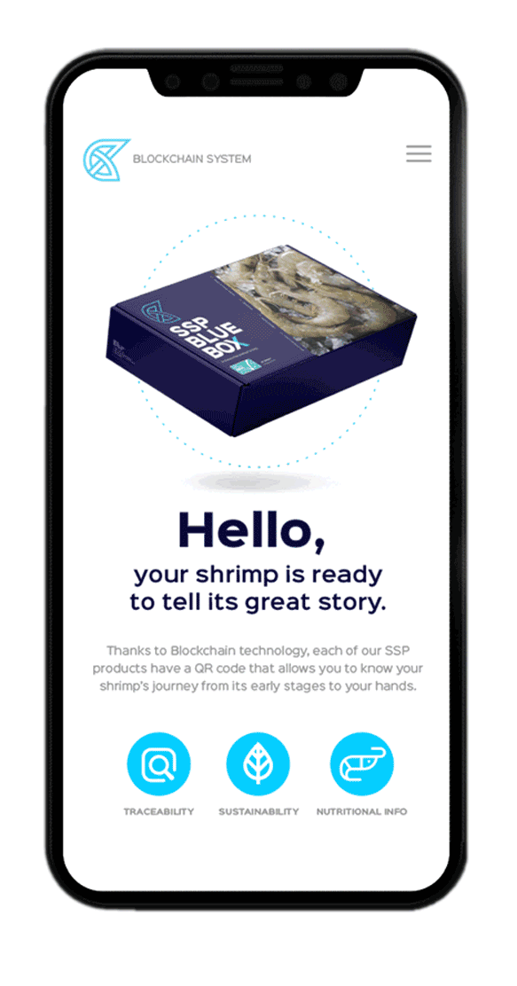
Telling Your Story
Food Safety
Notes:
Telling Your Story
Say: Having good traceability is a story that you can share with customer to build trust in your product and potentially boost sales. Customers who are familiar with your program, your practices, your well-trained staff are inclined to want your product. The transparency builds a trust level that is helpful for everyone involved.
For example, Ecuador has a QR code where consumers can access the name of the hatchery, farm, processor as well as the retail store the shrimp comes from. It’s a voluntary program, but the benefits can be significant.

Slide 33

Developing Food Safety Elements for a Food Safety Plan
60min
Identify at least two food safety risks for your farm.
Document the controls, monitoring, verification, records, etc. on the Food Safety Plan template for each risk.
Be prepared to share with the group and discuss.
Some examples:
There are chickens, dogs, or other animals on your farm.
The farm does not always know where their ice comes from or if it is “safe”.
The farm sometimes gets a Vibrio disease and must use an antibiotic every grow-out period.
Your farm is located next to a rice paddy that often uses pesticides.
There is concern in your area about arsenic in the soil.
Notes:
Developing Food Safety Elements for a Food Safety Plan
Say: In the previous sessions you identified biosecurity and BMP risks and controls, using the FSP, identify at least two food safety risks and the controls, monitoring, verification, records, etc. Use the Food Safety Plan template in your Participant Guide.
Be prepared to share with the group and discuss.
<Select Enter to advance the slide build.>
Say: Some examples of Food Safety risks to consider for your farm may include:
There are chickens, dogs, or other animals on your farm.
The farm does not always know where their ice comes from or if it is “safe”.
The farm sometimes gets a Vibrio disease and must use an antibiotic every grow-out period.
Your farm is located next to a rice paddy that often uses pesticides.
There is concern in your area about arsenic in the soil.
Divide participants into groups and allow them 60 minutes to work. Walk around monitoring the groups as they work and answering questions.
Notify the groups when there is 15 minutes remaining. Ask them to wrap up their work, take a quick break if necessary, and be prepared to share at the given time.

Slide 34
Developing Food Safety Elements for a Food Safety Plan, continued
60min
Share the food safety risks you identified.
Describe the controls, monitoring, verification, records, etc. you developed for each risk.
Ensure each member of your group speaks during your sharing.
Notes:
Developing Food Safety Elements for a Food Safety Plan, continued
Call on each group to share, eliciting sharing from each member of the group when possible.
Allow each group approximately 10 minutes to share. There is a total of one hour allotted for this part of the activity.
At the conclusion of each group’s sharing, allow the whole group to ask questions about the presentation and give the presenters time to address each question.

Slide 35
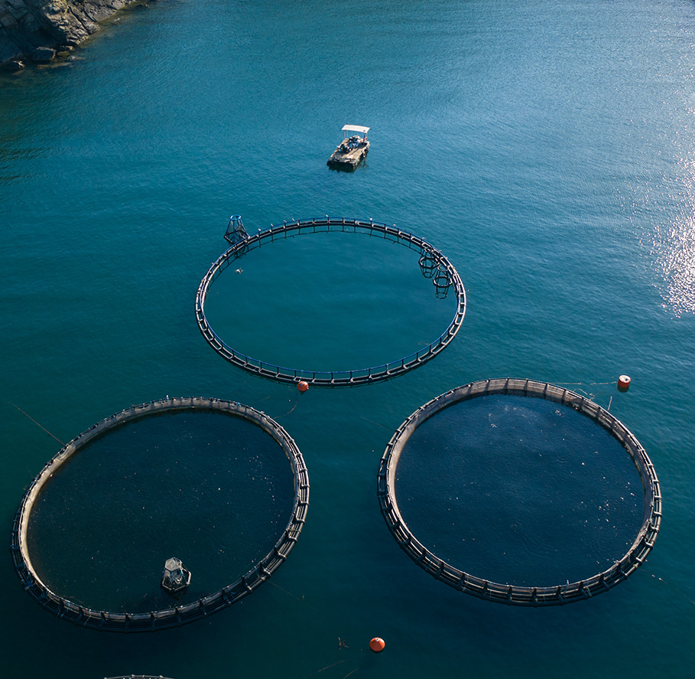
Summary
A GAqP Food Safety Plan makes a difference, even if you are already following best practices.
Do you have:
Documentation?
Evidence?
Records?
Transparency?
Can you show and tell your story to:
Bankers?
Importers?
Buyers?
Consumers?
Can you traceback to correct problems?
Notes:
Summary
Review each point on the slide one-by-one.

Slide 36
?
Notes:
Ask: What questions do you have?

