Slide 1
JIFSAN Symposium
Communication Scenario
April 5, 2016
All names, events and details in this scenario are fictional.
Any similarities to real events are coincidental.
Notes:
DAY 2: 9:15 – 9:30 a.m.

Slide 2
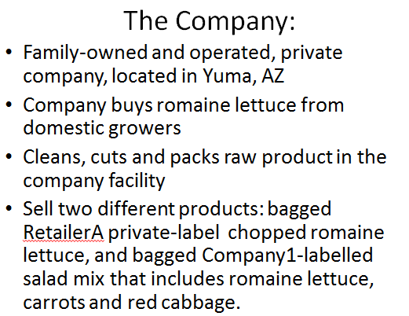
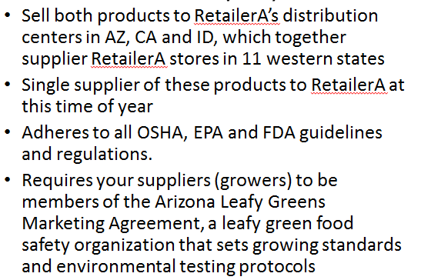
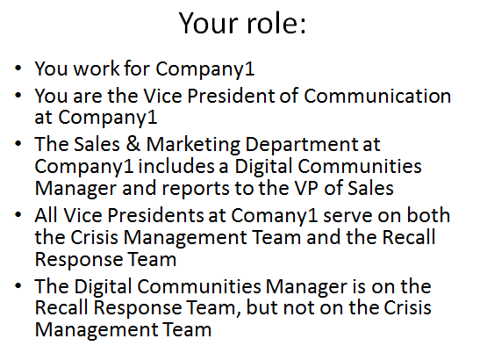
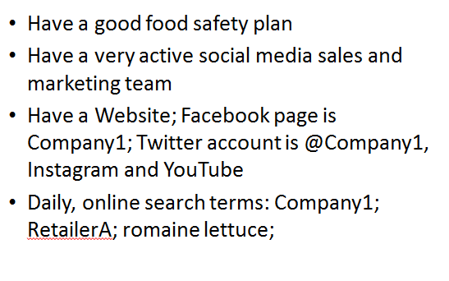
Notes:
DAY 2: 9:00 – 9:01 a.m. (1 min)
Recap of Day 1 Scenario & Discussion

Slide 3

Day 1, afternoon
The Company1 Crisis Management Team Lead calls the team into the conference room and explains:
RetailerA called today to inform the company about a recent visitor post on its Facebook Page:
Martha M.
5 hours ago · Phoenix, AZ
Bought several bags of your chopped romaine lettuce at my Phoenix, AZ RetailerA store about a week ago. I loved it – I ate a salad every night! I made a wonderful Cesar salad over the weekend, and then barfed it back up…for two days! It was terrible! I left a message for the store manager, but no one has returned my call. Wish I had kept the bag. Please take this product off the shelf so others do not succumb to the same fate!
Notes:
DAY 2: 9:01 – 9:02 p.m. (1 min)

Slide 4
RetailerA provided the Facebook Friend with Company1’s website address and the phone number listed on the website.
The rest of the team investigates the situation (reviewing food safety records, conducting product traceback and traceforward, health hazard analysis, etc.).
Identify 3 different audiences with whom the company may have to communicate and draft 3 talking points for each.
Notes:
DAY 2: 9:02 – 9:03 a.m. (1 min)
Facilitator Questions:
How was the company phone number conveyed? Verbally or in a FB reply? If verbally, can RetailerA give us this person’s phone number?
Has Company1 received any similar complaints either directly or indirectly?
What are the internal approval processes that you have to go through to be able to respond?
Who are your audiences (potential audiences). Would it have helped to have these identified in advance?
What to do?
Give receptionist a head up and remind her/him of company routing instructions
Give consumer affairs desk heads up. Tell them that you will have approved messages for them soon
Identify audiences with whom company may need to communicate re this (consumers, media, customers, employees)
Draft messaging points (for whom?) Who will approve? is legal available to review?
Draft holding statement, What are the internal approval processes that you have to go through to be able to use the messaging points and statement?
Meet with Digital Communities Manager – does VP of Sales need to be involved? Do you have to go through VP of Sales?

Slide 5
Summary of Audiences from Day 1
Talk to NOW
Prepare to talk to…just in case
External Audience: Facebook friend (consumer) – In this case RetailerA requires Company to respond w/in 24 hours.
Internal Audiences: Receptionist, Sales rep for RetailerA (maybe other sales reps), Senior leadership,
Media: Holding or Reactive statement
Health Depts.
Regulators
Broad customer group (other retailers)
Industry trade associations
Don’t have enough information. Need to investigate.

Slide 6
Summary of Talking Points from Day 1
FB Friend (consumer):
  We are taking this seriously
  Help us gather more info (understand)
  Use prepared template of questions to ask in case of adverse events (input from ins. co/legal)
  If still feel ill, consult a medical physician as you normally would
Employees
  A situation has been brought to our attention
  May receive inquiries about possible illnesses. Company is looking into it.
  Be responsive; instruct how to handle inquiries
  Use the routing protocols in the crisis communication/social media triage plans
  Don’t apologize in a way that implies wrong-doing (not enough info)
Uncertainty is always a factor, but must take all consumer claims seriously until known otherwise. Show respect. Consumers are understanding as long as they feel they are being heard/taken seriously

Slide 7
Day 2, morning
RetailerA tells Company1 that a consumer called late yesterday saying that his wife and four friends who had dinner at their house had become ill a few days after all eating a salad she made with RetailerA brand bagged, Chopped Romaine Lettuce purchased at a RetailerA store in Phoenix, AZ. The husband did not eat the salad.
RetailerA is removing all the private-label Chopped Romaine Lettuce produced by Company1 from its shelves until the issue has been cleared up
Your Digital Communities Manager has just sent you this email…
Notes:
DAY 2: 9:03 – 9:05 a.m. (2 min)

Slide 8


Day 2, morning
Just saw this on our Facebook page. How should I respond?
Thnx, Zee
Martha M.
15 mins ago · Phoenix, AZ
I ate some of your chopped romaine lettuce and became violently ill. I missed a day of work and had to pay for a doctor’s visit. Can you compensate me for any of my time or expenses?
What do you tell Zee, the Digital Communities Manager?
Notes:
DAY 2: 9:05 – 9:10 (5 min) work in partners? Groups?
How will you respond? Or not respond?
What are the internal approval processes that you have to go through to be able to respond?
Have you already decided which search terms you’ll use when monitoring?
What else, if anything, should you do? Post a statement on website? Contact other customers? Notify employees?

Slide 9
Day 2, morning
Your Digital Communities Manager sends you a jpg of the following twitter post: Now what?
Twitter Post @SusiQ
Heard bags of RetailerA-brand Chopped romaine lettuce at store in Phoenix, AZ made people sick. #baggedromaine
Notes:
DAY 2: 9:10 – 9:13 a.m. (3 min) individual for first min or so, then share with partner

Slide 10
Day 2, morning
If this were the post instead, would it change what you do?
Twitter Post @PhoenixTimes
Heard bags of RetailerA-brand Chopped romaine lettuce at store in Phoenix, AZ reportedly made people sick. #baggedromaine
Notes:
DAY 2: 9:13 – 9:15 a.m. (2 min) discuss as partners

Slide 11
Crafting the Right Message
Laura
Amy
Donna

Slide 12
Break
Day 2 10:30-10:45 a.m.

Slide 13
Scenario Messages
Review the messages that you’ve been using for the scenario
Update them based on what you’ve heard this morning
Notes:
DAY 2: 10:45-10:55 (10 min) Open dialogue with all attendees. Use flip charts to record, if available?

Slide 14
Summary of Talking Points from Day 1
FB Friend (consumer):
  We are taking this seriously
  Help us gather more info (understand)
  Use prepared template of questions to ask in case of adverse events (input from ins. co/legal)
  If still feel ill, consult a medical physician as you normally would
Employees
  A situation has been brought to our attention
  May receive inquiries about possible illnesses. Company is looking into it.
  Be responsive; instruct how to handle inquiries
  Use the routing protocols in the crisis communication/social media triage plans
  Don’t apologize in a way that implies wrong-doing (not enough info)
Uncertainty is always a factor, but must take all consumer claims seriously until known otherwise. Show respect. Consumers are understanding as long as they feel they are being heard/taken seriously

Slide 15
Day 2, morning
The Crisis Management Team assembles again. Based on the information available at this time, the team decides to issue a Class 1 recall. No pathogen has been found on the finished product, but internal testing indicates that one of the chlorine monitors for the wash water used on lines 1 and 2 on April 3 may not have been functioning properly on that one day.
The team tells you the following details for the press release:
  20lb cases, 20 units, 16 oz. bags of RetailerA-brand Chopped Romaine Lettuce, production code: 201608501, BBD: April 13, 2016, shipped to RetailerA in Arizona
  15lb cases, 10 units, 24 oz. bags of Company1-brand fresh Garden Salad Mix, production code 201608502, BBD: April 13, 2016, shipped to retailers, wholesalers in California, Texas and Michigan
Notes:
DAY 2: 10:55 – 10:57 a.m. (2 min) read and let them digest/write down the details

Slide 16
Notes:
DAY 2: 10:57-11:16 a.m. (8-9 min for them to write + 8-10 min to discuss) work in pairs
Provide FDA-based template either as hard copy or on screen
All bags have on them the company name and address and are stamped with a code that indicates the:
Julian processing date
production line
a Best by Date (BBD)

Slide 17
Day 2, morning
While the press release is in review:
Adapt the release for use on various platforms:
  Facebook
  Twitter
  Instagram
  YouTube
Notes:
DAY 2: 11:16- 11:26 a.m. (10 min) work as pairs

Slide 18
Google Alert finds a law firm’s website posting:
We are representing a woman in Texas who is suing RetailerA because contaminated romaine lettuce made her ill. She fell violently ill 10 days ago and went to doctor who diagnosed her with E. Coli. She then took several partially eaten items in her refrigerator to a lab to be tested and the romaine salad mix she purchased at RetailerA was positive for coliforms. #baggedromaine #foodpoisoning
Notes:
Day 2: 11:26 – 11:28 a.m. (2 min) the next series of slides are more to simulate the numerous and constant interruptions that one experiences as the situation constantly changes.
Does this change anything? Will you need more help with social media? With phones?

Slide 19


More Facebook postings
Benji
5 mins ago · Phoenix, AZ
Hey, I also ate lettuce at a RetailerA store and had terrible stomach cramping. How do I get my money back? #baggedromaine
David S.
12 mins ago · San Francisco, CA
Seems this is going around. I shop at a RetailerA store in San Francisco, and I ate the store brand of chopped romaine too. About three days later, I was so sick, I thought I was going to die. At first I thought it was the raw oysters I ate, but now I’m thinking it was the romaine. How do I find out? #baggedromaine
Notes:
DAY 2: 11:28 – 11:29 a.m. (1 min)

Slide 20
Twitter Post @SusiQ
I ate RetailerA chopped romaine too. Son is still not better. Taking him to the dr today. #baggedromaine
Notes:
DAY 2: 11:29 – 11:30 a.m. (1 min)

Slide 21
Fast Forward to Three Weeks Later
What are some lessons learned?
What were the most challenging aspects?
What might have you done differently?
What additional resources would you have needed?
Notes:
DAY 2: 11:43 – 11:58 a.m. (15 min) discuss as one group
Go back through slides to prompt discussion

Slide 22


Slide 23
Lunch
Day 2

