Slide 1
ERIS: supporting the early detection of food risks and issues Innovative information analysis and interpretation | Niels Lucas Luijckx

Slide 2
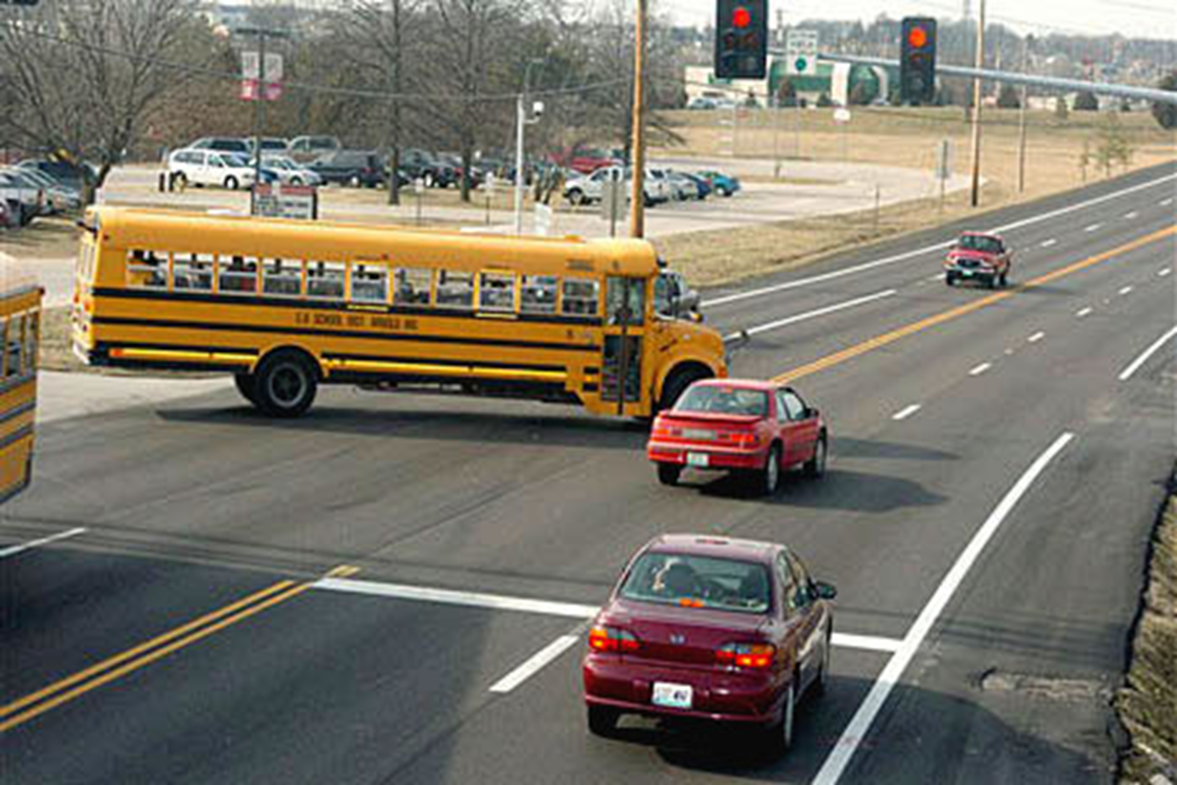
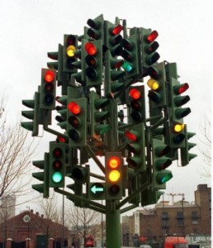



Slide 3

What is this all about…
Food risks and issues
Food Safety: hazards, exposure → risks, health effects
Food Integrity: EMA, fraud → Risk or Issue?
Issue?
An issue is the gap between your actions and stakeholder expectations (perception)!
Anything said or published around your product, fact or fiction, substantiated or not, creates an issue, potentially…..
Early detection
Any signal that has the potential of becoming or creating a hazard, risk, fraud opportunity or (thus) issue has to be ‘caught’
Information management is key , but where to start and end
It starts with a bit of philosophy….

Slide 4
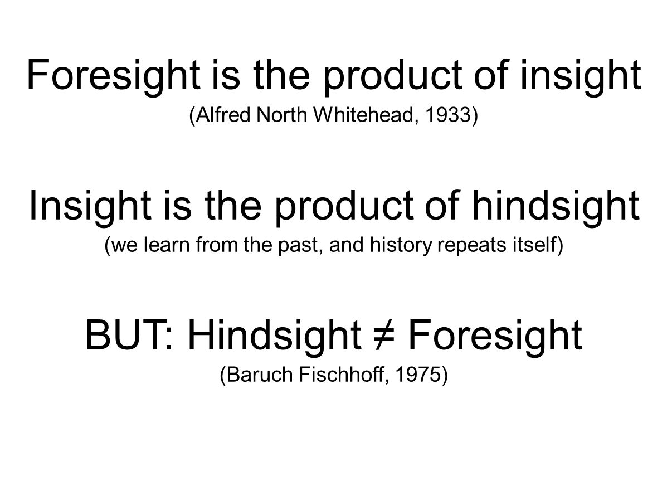
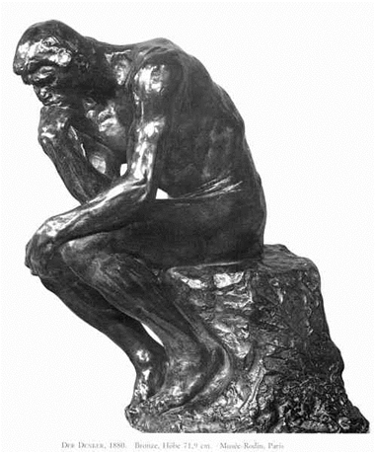
Foresight philosophy……

Slide 5


And some more ….
Hindsight Bias + Creeping Determinism → Foresight bias
Insight = hindsight + foresight + sense making (understanding reality)
What about the unpredictable → “black swan”
What about “tipping points”

Slide 6
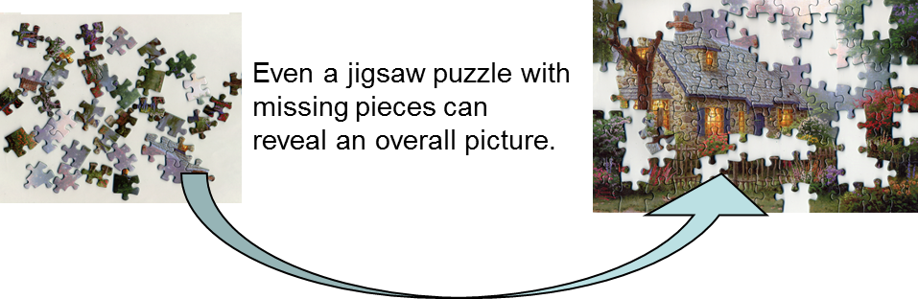
Information and interpretation
Awareness and alertness for early signals is crucial
Both in emerging issue identification and in food fraud prevention
However….
Interpreting them is a major challenge
Uncertainty is a fact even with information and data available
Making the right scenario, without over-reacting (making a justified risk management decision)

Slide 7

From hindsight to insight
Early signals:
precede food safety incidents
have generic characteristics
Often reside in science based data
…to foresight
RE-emerging issues and risks: confirming the known and forgotten
Emerging risks: new and unexpected hazards, no history
Horizon scanning: from drivers of change to a scenario
Emerging research: early awareness of research outcomes and results
There is a small to large time window to influence the emerging risk
An open search strategy is needed to identify unexpected hazards
Brug et al, 2014, Food Control 39, p 75-86

Slide 8
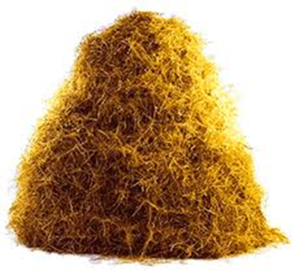
Challenges
We do not know what to look for:
so many chemicals & micro-organisms
so many food products, additives, materials, processes
Dynamic and complex food production chain
There is an information overload

Slide 9


Early signals and time to incident
PUBLIC DOMAIN
Incident
INFORMATION
SCIENCE DOMAIN
TIME
Notes:
9
9

Slide 10
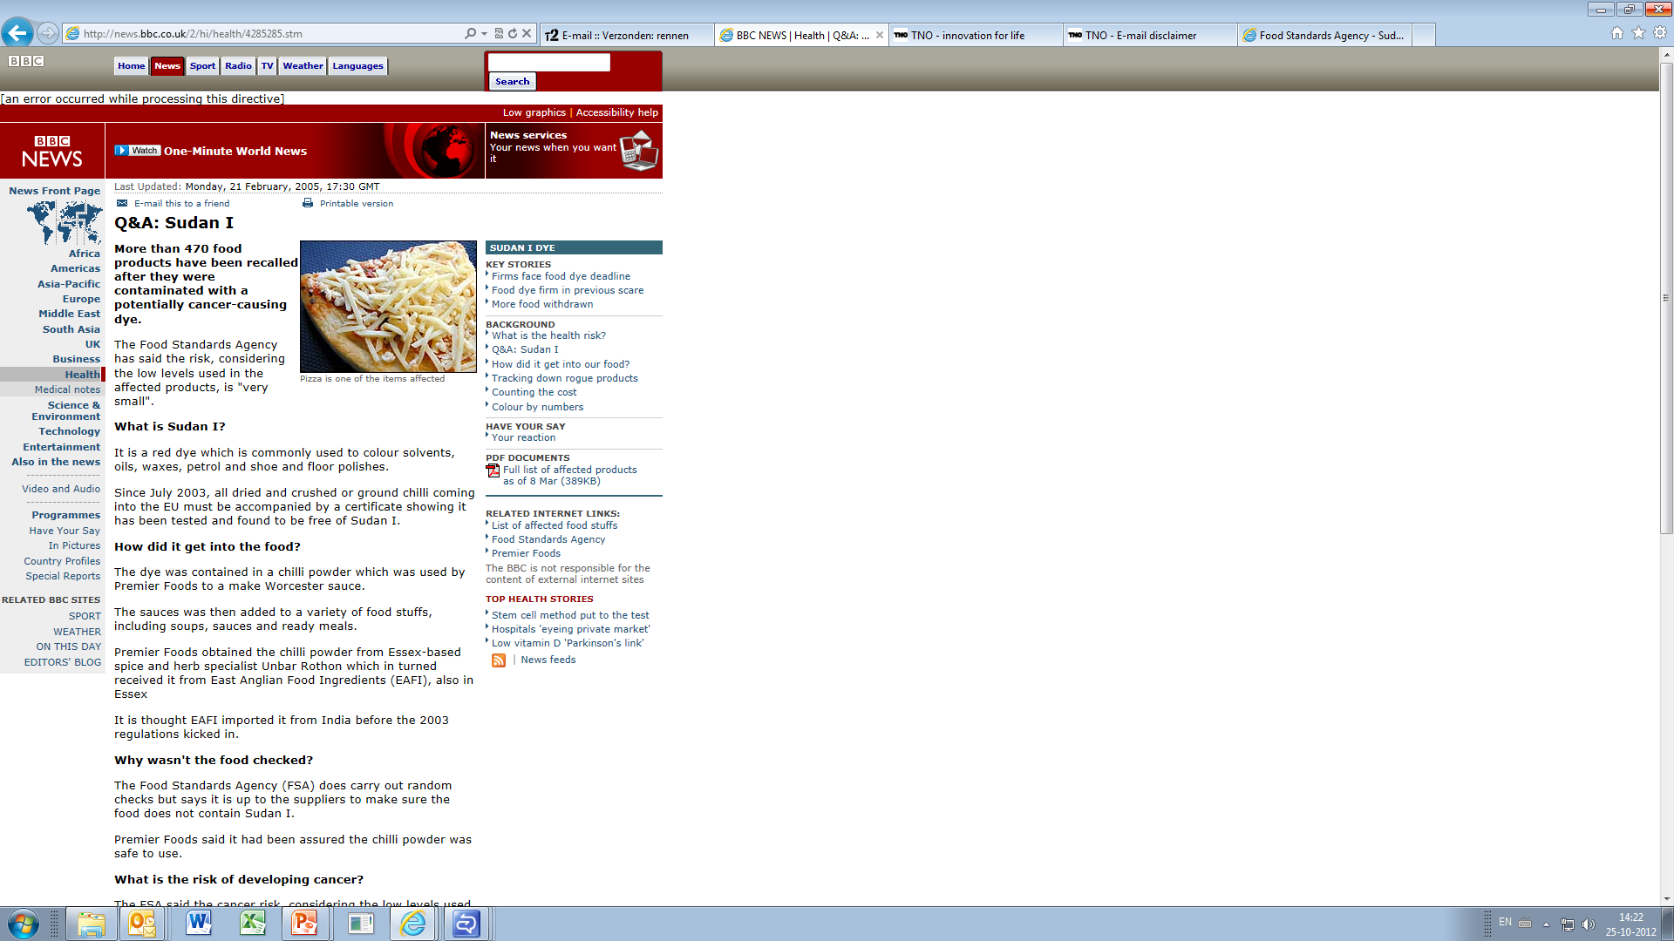
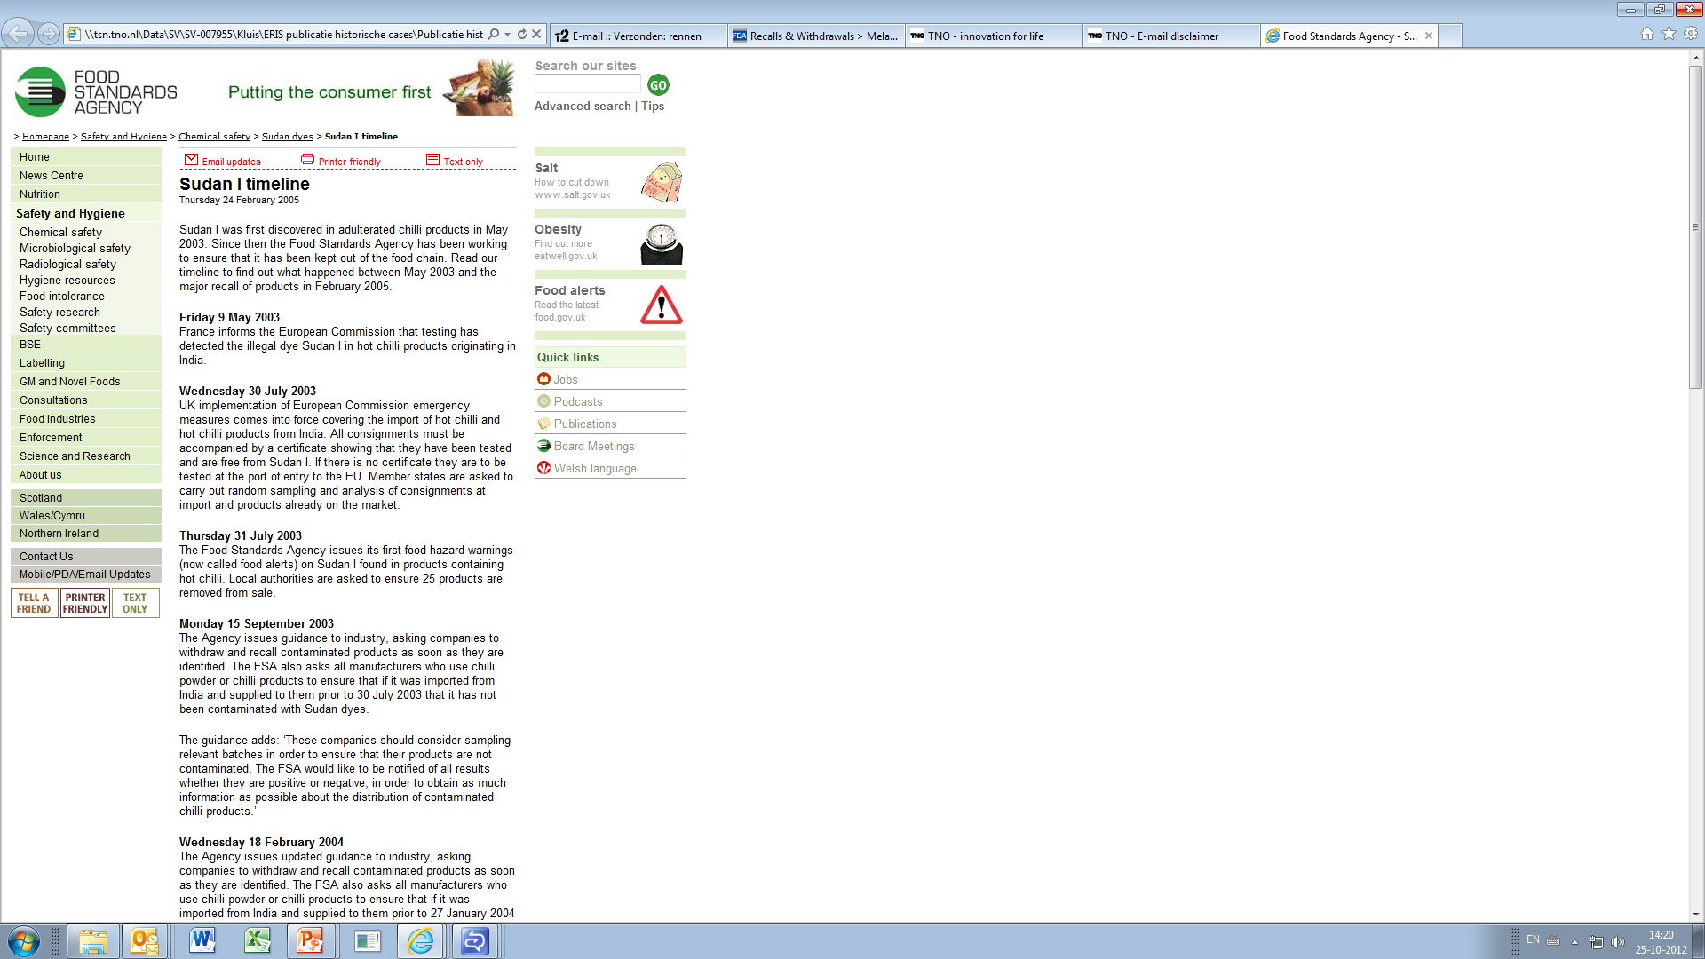
Sudan I in chilli (2005)
PUBLIC DOMAIN
SCIENCE DOMAIN
Dixit et al. 1995:
Of 2057 samples, drawn from 224 village markets from 56 districts of Uttar Pradesh, 32% contained artificial colours of which 61.6% were non permitted. In the artificially coloured eatables, 39% sweets, 85% namkins, and all the samples of powdered turmeric, as well as chilli contained non-permitted colours. Seven non-food grade dyes used include metanil yellow, orange II, sudan I, rhodamine B, Blue VRS, auramine, and Sudan III/IV.

Slide 11
Acrylamide formation during heating of food (2002)
PUBLIC DOMAIN
2002, April 24-26
Sweden, press release:
Acrylamide in French fries and
other food products
2000, June
Acrylamide in fried rat feed
1997
High acrylamide levels found in
non-exposed humans
1994, IARC
Acrylamide is a probable
carcinogen
SCIENCE DOMAIN
Notes:
11
11

Slide 12
Complex food production: “dioxin via feed in cow milk (2004)”
dioxin
monitoring
2004
Part of feed-dairy chain
feed
dairy
farm
dairy
processing
consumer
potato
peelings
Part of potato chain
potato
cleaning
potato sorting
in clay baths
potato
peeling
potato
selection
kaolin
clay
Already known in 1997
dioxin

Slide 13
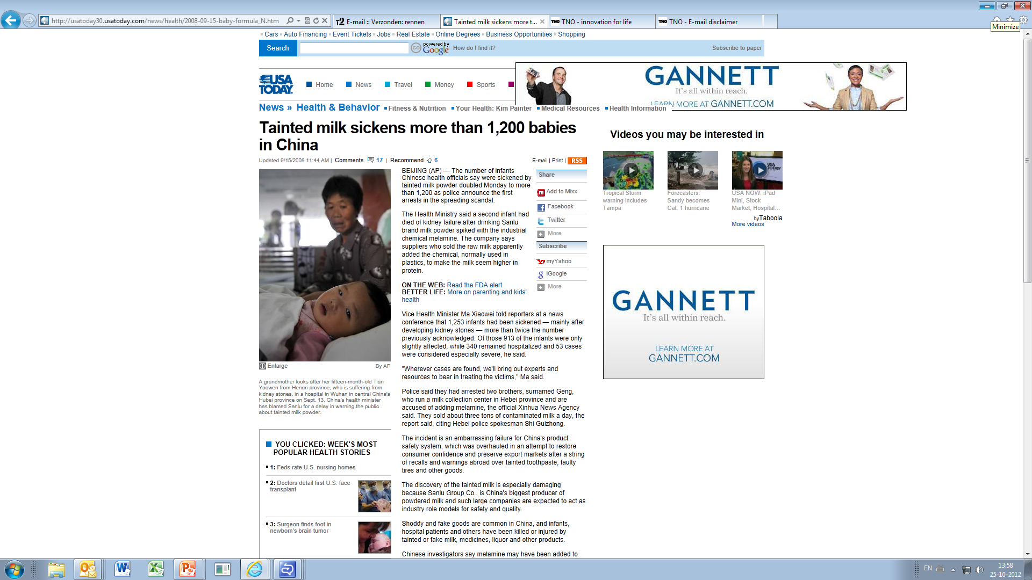
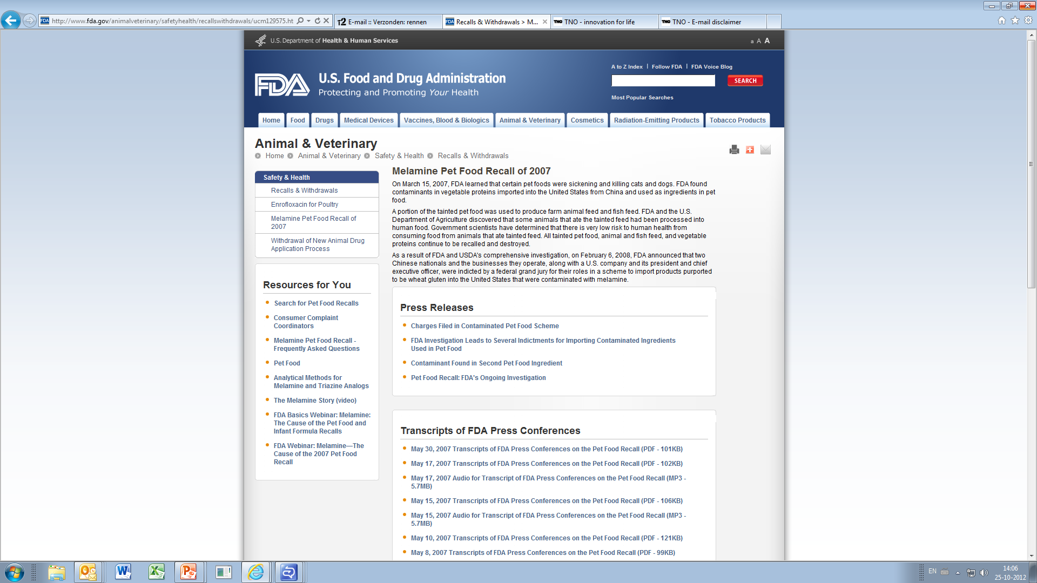
Melamine in infant formula (2008)
SEPTEMBER 2008
PUBLIC DOMAIN
MARCH 2007
Pet food incident

Slide 14
A way of thinking…….
adverse health effect
NEW?
NEW?
HAZARD
substance
food
& feed
NEW?

Slide 15
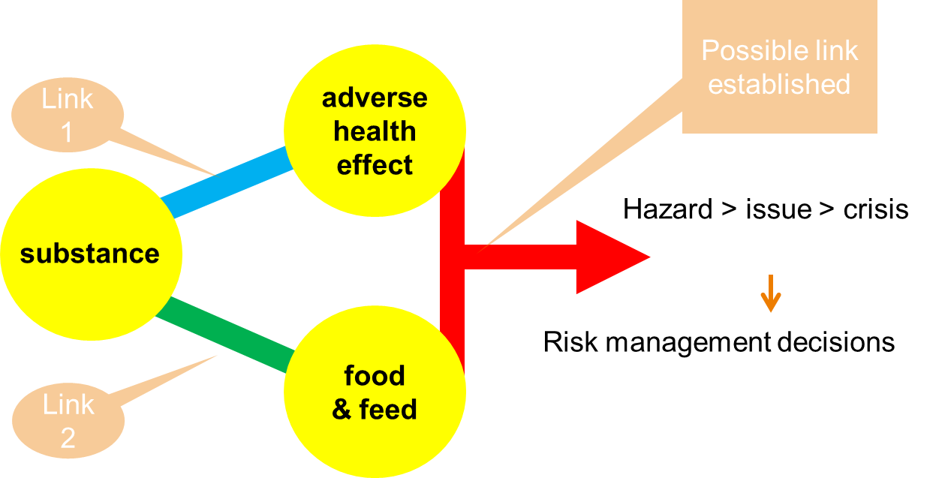
ERIs thinking
Food safety
Other domains:
Health benefits
Consumer opinion
Pharma
Fraud

Slide 16
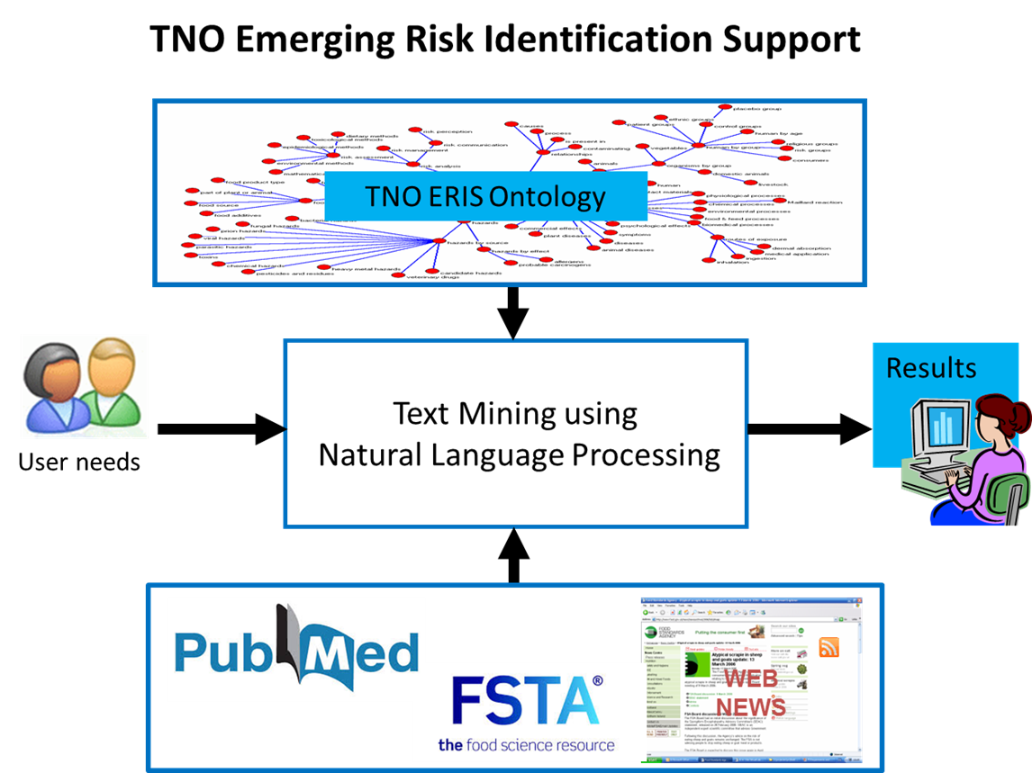
ERIs in a nutshell
System basically has three parts:
Ontology: TNO expertise and experience
Sources…..
Software to make the connection
Tailored to user needs
Finding multiple relations
(matrix search)
All results are relevant, but may require interpretation

Slide 17
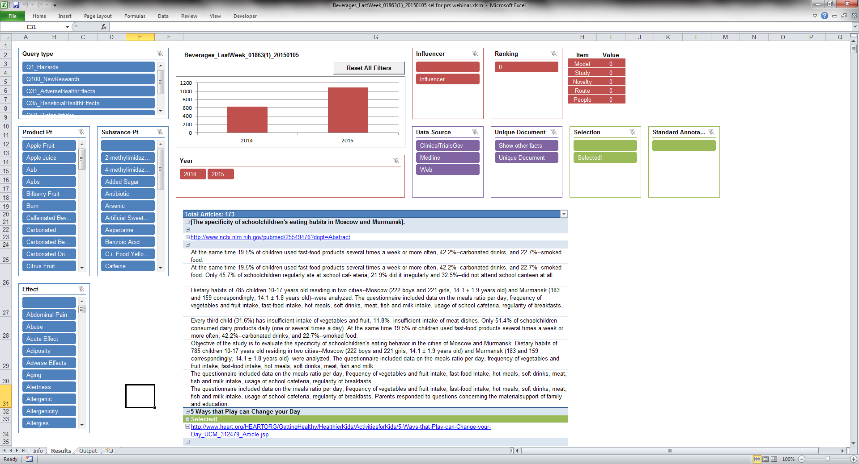
Keywords, etc
Timeline
Snippets

Slide 18
thinking model in linear form
Text mining
Product | Substance | Effect | Hyperlink
Omega-3 fat | 4-oxo-2-hexenal | Mutagen | 16294926
…. | …. | …. | ……
…. | …. | …. | ……

Slide 19
Is 4-OHE an emerging risk?
PUBLIC DOMAIN
?
SCIENCE DOMAIN
2005 – 2010 “Kasai & Kawai”:
4-OHE is generated by oxidation omega-3 fatty acids such as in fish oil.
4-OHE is mutagenic in Ames test.
2010, Long et al.
The 4-oxo derivative, 4-OHE, has the possibility of being a potent cytotoxin and biological effector as well, and subsequent study needs to be devoted to determining the extent to which 4-OHE, its adducts, or metabolites are found in vivo.

Slide 20

Some projects
Signals management for the US FDA
US FDA has a signals management process, for which they searched input information on chemical hazards.
Focus on up to 100 foods/food products/ingredients
Early Awareness of Risks for a major food company in the US
Focus on brand protection, emerging research, issues
Demonstration project for EFSA
Emerging risk identification, focus on two (fish) chains, includes environmental issues

Slide 21
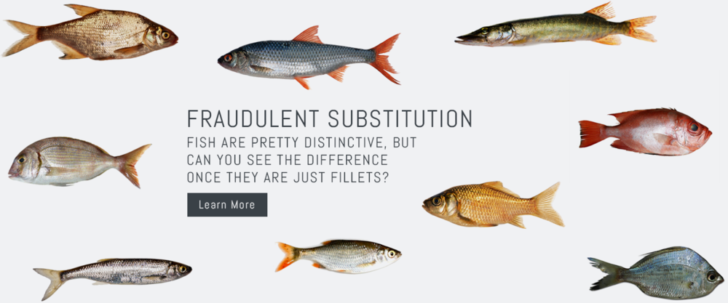
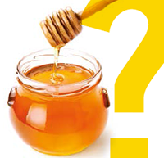
Expansions
Occupational safety and health
Immune health and immunotoxicology
Pharma -> target safety assessment
Early life nutrition
Food technology and consumer attitude
Plant (waste) substances with health benefit / novel proteins
FOOD FRAUD / EMA

Slide 22
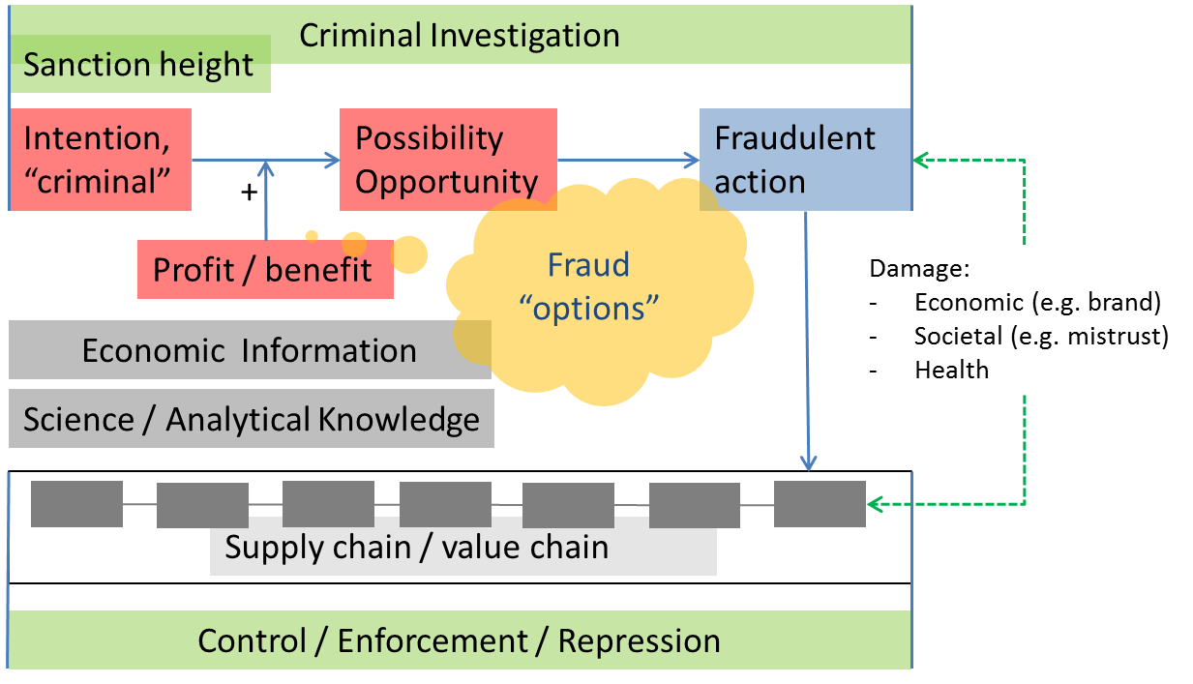
Food fraud
Adapted from SSAFE
and others
There is information:
Find it and assess

Slide 23




The FoodIntegrity project is a RTD supported by the European Commission Seventh Framework Programme Under contract 631688.
Authorities & Regulators
Integration & interpretation
Trusted third parties
Laboratories
Data warehouse
Certifying bodies
Branch organisations
Research
organisations
Production network
Data sharing in the chain:
Preventive and proactive
Reactive
Awareness and alertness
Consumer organisations

Slide 24
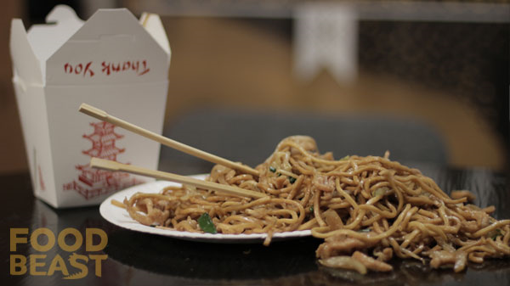
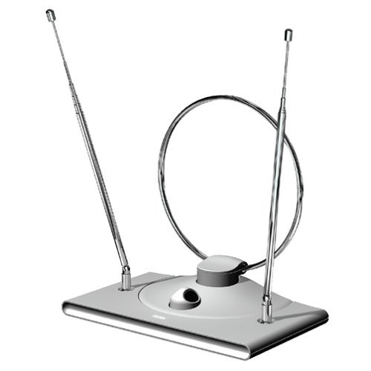
Thinking….
Whatever tool or management system or monitoring is used: NO SINGLE SOLUTION WORKS
Multisided and multi-disciplinary approach needed
Think opportunity and criminally, and OUT OF THE BOX
Keep an antenna up for signals
Be prepared to develop scenarios

Slide 25

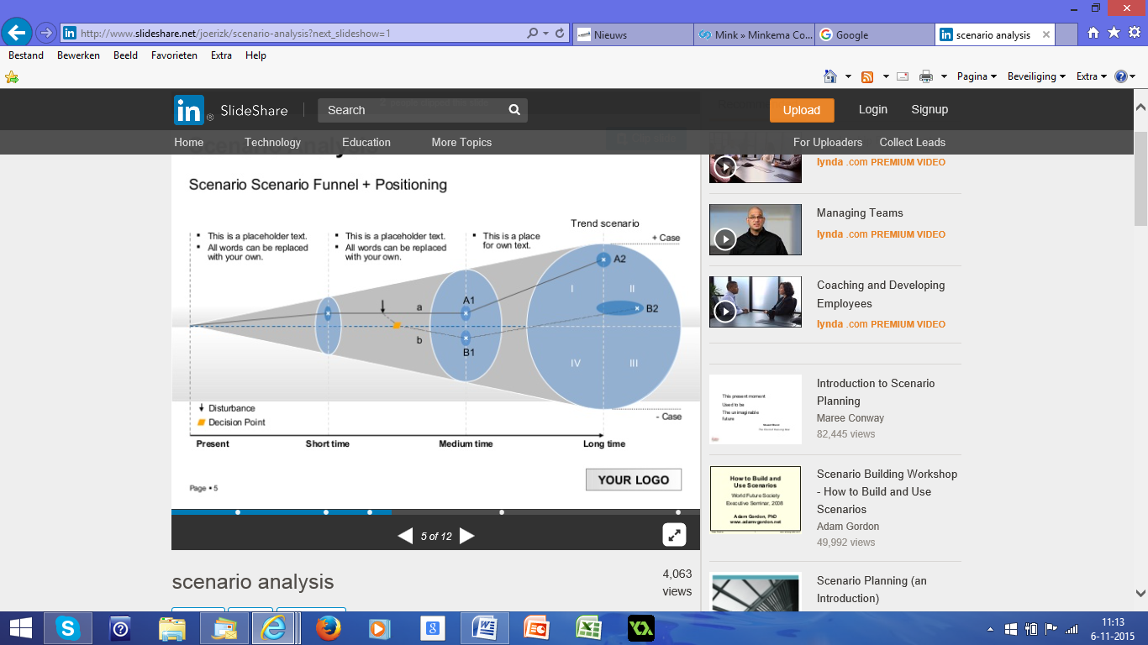
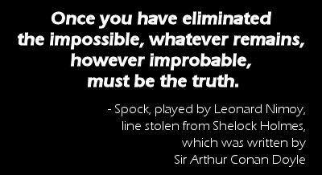
scenarios
Peoples minds are creative and able to make many associations: TRIGGER THEM
Boldly go where ……
In this case a scenario is like a funnel,
but starting at the smaller end

Slide 26
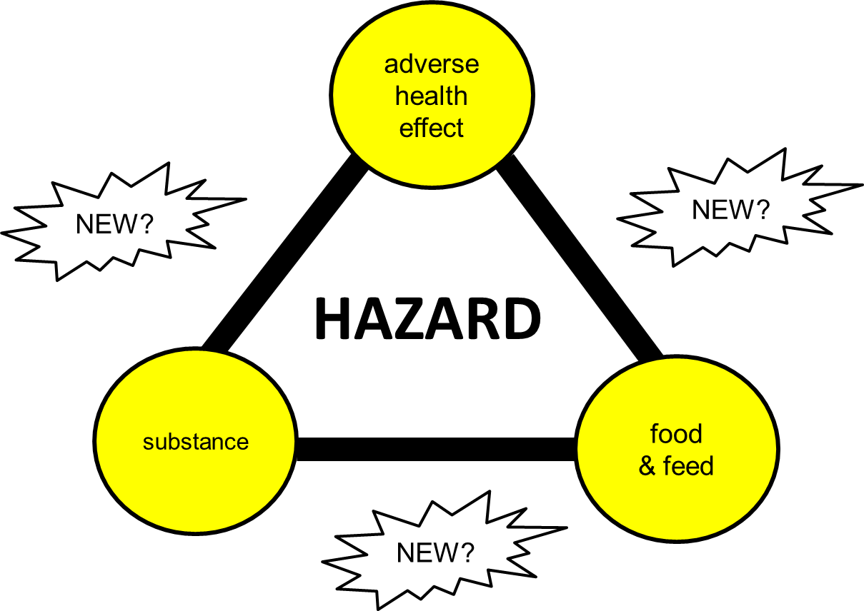

TNO Emerging Risk Identification Support
FERA – JIFSAN Symposium – June 2014
CONTACT
Niels Lucas Luijckx or
Fred van de Brug
Niels.lucasluijckx@tno.nl
fred.vandebrug@tno.nl
+31 88 86 615 - 26 or 48
www.tno.nl

Slide 27

Thank you for your attention

