Slide 1
JIFSAN Symposium
Communication Scenario
April 4, 2016
All names, events and details in this scenario are fictional.
Any similarities to real events are coincidental.
Notes:
DAY 1: 11:30-11:32 a.m. (2 min)

Slide 2
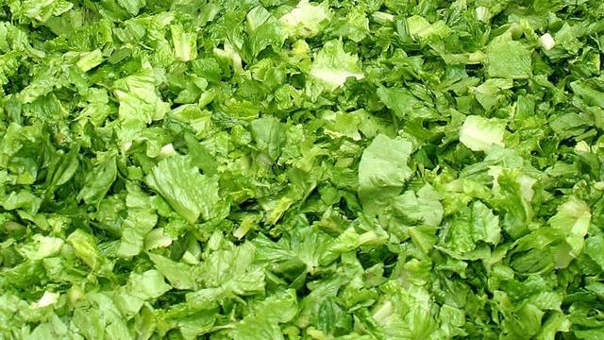
The Company:
Family-owned and operated, private company, located in Yuma, AZ
Company buys romaine lettuce from domestic growers
Cleans, cuts and packs raw product in the company facility
Sell two different products: bagged RetailerA private-label chopped romaine lettuce, and bagged Company1-labelled salad mix that includes romaine lettuce, carrots and red cabbage.
Company1
Garden Salad Mix
Romaine lettuce
Carrots
Red Cabbage
24oz.
RetailerA
Chopped Romaine Lettuce
16 oz.
Notes:
DAY 1: 11:32- 11:34 (2min)

Slide 3
The Company:
Sell both products to RetailerA’s distribution centers in AZ, CA and ID, which together supplier RetailerA stores in 11 western states
Single supplier of these products to RetailerA at this time of year
Adheres to all OSHA, EPA and FDA guidelines and regulations.
Requires your suppliers (growers) to be members of the Arizona Leafy Greens Marketing Agreement, a leafy green food safety organization that sets growing standards and environmental testing protocols
Notes:
DAY 1: 11:34- 11:36 (2min)

Slide 4
The Company:
Have a good food safety plan
Have a very active social media sales and marketing team
Have a Website; Facebook page is Company1; Twitter account is @Company1, Instagram and YouTube
Daily, online search terms: Company1; RetailerA; romaine lettuce;
Notes:
DAY 1: 11:36- 11:38 (2min)

Slide 5
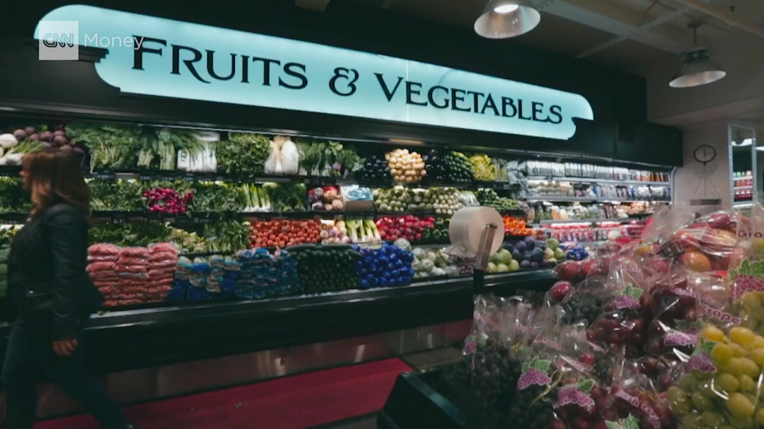
The media environment in which you operate
Notes:
DAY 1: 11:38-11:42 a.m. - Video clip (4 minutes)

Slide 6
Your role:
You work for Company1
You are the Vice President of Communication at Company1
The Sales & Marketing Department at Company1 includes a Digital Communities Manager and reports to the VP of Sales
All Vice Presidents at Comany1 serve on both the Crisis Management Team and the Recall Response Team
The Digital Communities Manager is on the Recall Response Team, but not on the Crisis Management Team
Notes:
DAY 1: 11:42- 11:44 (2min)
The scenario is designed from the company’s point of view and focuses strictly on the communication function mostly social media, but not entirely. I think we want the group to think of other audiences and channels as well.

Slide 7

Day 1, morning
The Company1 Crisis Management Team Lead calls the team into the conference room and explains:
RetailerA called today to inform the company about a recent visitor post on its Facebook Page:
Martha M.
5 hours ago · Phoenix, AZ
Bought several bags of your chopped romaine lettuce at my Phoenix, AZ RetailerA store about a week ago. I loved it – I ate a salad every night! I made a wonderful Cesar salad over the weekend, and then barfed it back up…for two days! It was terrible! I left a message for the store manager, but no one has returned my call. Wish I had kept the bag. Please take this product off the shelf so others do not succumb to the same fate!
Notes:
DAY 1: 11:44-11:46 (2 min)

Slide 8
RetailerA provided the Facebook Friend with Company1’s website address and the phone number listed on the website.
The rest of the team investigates the situation (reviewing food safety records, conducting product traceback and traceforward, health hazard analysis, etc.).
Identify 3 different audiences with whom the company may have to communicate and draft 3 talking points for each.
Notes:
DAY 1: 5:05-5:13 p.m. (8 min) work as individuals (if people finish early, ask them to partner with the person to their right and discuss)
Jot down ideas and we’ll discuss it an end of day.
Facilitator Questions:
How was the company phone number conveyed? Verbally or in a FB reply? If verbally, can RetailerA give us this person’s phone number?
Has Company1 received any similar complaints either directly or indirectly?
What are the internal approval processes that you have to go through to be able to respond?
Who are your audiences (potential audiences). Would it have helped to have these identified in advance?
What to do?
Give receptionist a head up and remind her/him of company routing instructions
Give consumer affairs desk heads up. Tell them that you will have approved messages for them soon
Identify audiences with whom company may need to communicate re this (consumers, media, customers, employees)
Draft messaging points (for whom?) Who will approve? is legal available to review?
Draft holding statement, What are the internal approval processes that you have to go through to be able to use the messaging points and statement?
Meet with Digital Communities Manager – does VP of Sales need to be involved? Do you have to go through VP of Sales?

Slide 9
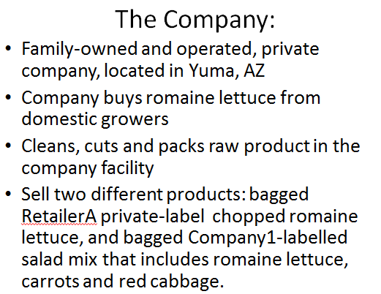
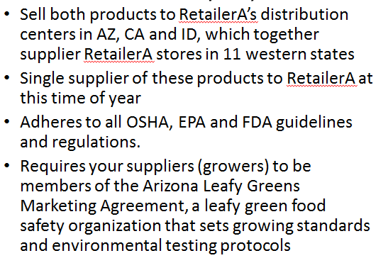
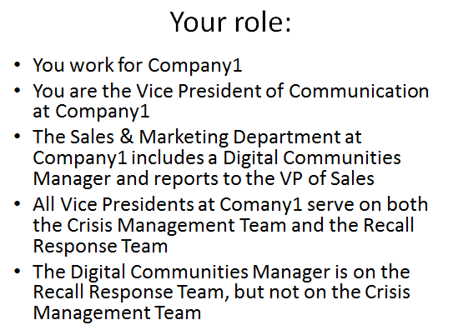
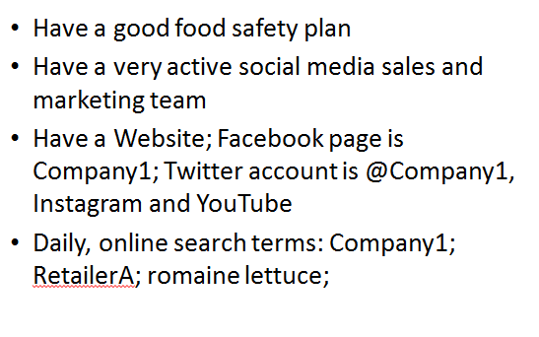
Notes:
DAY 1: 5:00 – 5:02 p.m. (2 min)

Slide 10
Lunch
Day 1

Slide 11
Notes:
DAY 1: 5:00 – 5:02 p.m. (2 min)

Slide 12
Day 1, this morning
The Company1 Crisis Management Team Lead calls the team into the conference room and explains: RetailerA called today to inform the company about a recent visitor post on its Facebook Page:
Martha M.
5 hours ago · Phoenix, AZ
Bought several bags of your chopped romaine lettuce at my Phoenix, AZ RetailerA store about a week ago. I loved it – I ate a salad every night! I made a wonderful Caesar salad over the weekend, and then barfed it back up…for two days! It was terrible! I left a message for the store manager, but no one has returned my call. Wish I had kept the bag. Please take this product off the shelf so others do not succumb to the same fate!
Notes:
DAY 1: 5:02 – 5:05 p.m. (2 min)

Slide 13
RetailerA provided the Facebook Friend with Company1’s website address and the phone number listed on the website.
The rest of the team investigates the situation (reviewing food safety records, conducting product traceback and traceforward, health hazard analysis, etc.).
Identify 3 different audiences with whom the company may have to communicate and draft 3 talking points for each.
Notes:
DAY 1: 5:05-5:13 p.m. (8 min) work as individuals (if people finish early, ask them to partner with the person to their right and discuss)
5:13 – 5:15 p.m. – instructions for tonight (think about this, be ready to discuss in the morning)
Facilitator Questions:
How was the company phone number conveyed? Verbally or in a FB reply? If verbally, can RetailerA give us this person’s phone number?
Has Company1 received any similar complaints either directly or indirectly?
What are the internal approval processes that you have to go through to be able to respond?
Who are your audiences (potential audiences). Would it have helped to have these identified in advance?
What to do?
Give receptionist a head up and remind her/him of company routing instructions
Give consumer affairs desk heads up. Tell them that you will have approved messages for them soon
Identify audiences with whom company may need to communicate re this (consumers, media, customers, employees)
Draft messaging points (for whom?) Who will approve? is legal available to review?
Draft holding statement, What are the internal approval processes that you have to go through to be able to use the messaging points and statement?
Meet with Digital Communities Manager – does VP of Sales need to be involved? Do you have to go through VP of Sales?

Slide 14
Day 1 Symposium Wrap-up
George Evancho, JIFSAN, Symposium Chair
Notes:
5:15 p.m.

