Slide 1
Are Age-old Risk Communication Principles Standing the Test of Time (and the Internet)?
William K. Hallman, Ph.D.
Professor /Chair
Department of Human Ecology
School of Environmental and Biological Sciences

Slide 2
In Short -
Yes, basic risk communication principles are standing the test of time.
Human nature has not changed
What people want to know when faced with risks and uncertainty has not changed
However, the implementation of basic risk communication principles has evolved in the era of the Internet and Social Media.

Slide 3
Principles:
Predict
Preparedness and Planning
Prevent
Perception
Purpose
Psychology
Process that is Transparent, Open, and Responsive
Participation of Stakeholders
Provide Useful, Accurate, Timely, Targeted Information
Preempt Bad Information
Put Risks in Perspective
Promote Appropriate Actions
Personal
Pre-test Messages
Plurality of Languages and Cultures
Public Monitoring
Pivot
Post-mortem

Slide 4
Overall Goal of Risk Communication:
Help people respond appropriately to risks.
What people?
With whom should we be communicating?
What risk?
Which risks are worth considering?
Who determines this?
What is the appropriate response?
Who decides?
On what basis?
The Internet and Social Media have a large influence on the answers to these questions

Slide 5
Who is our Audience?
According to 2015 Pew Research Center data:
84% of American adults use the Internet
Equal percentages of men and women
But, use differs by:
Age
Class
Race and Ethnicity
Community Location
Andrew Perrin, Maeve Duggan, “Americans’ Internet Access: 2000-2015.” Pew Research Center, June 2015

Slide 6
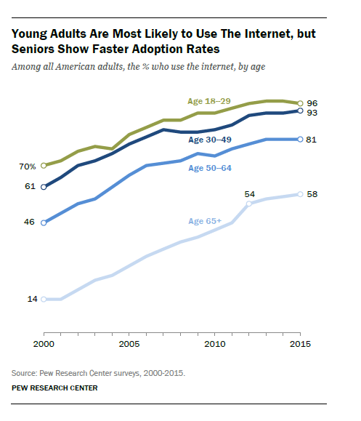
Age

Slide 7
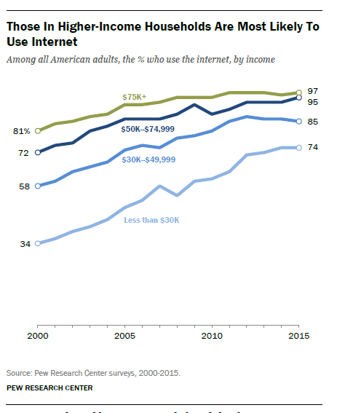
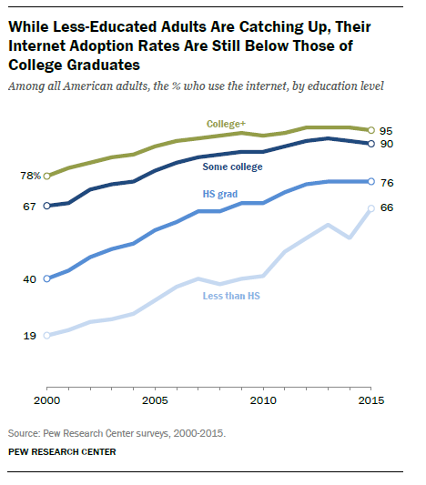
Income and Education

Slide 8
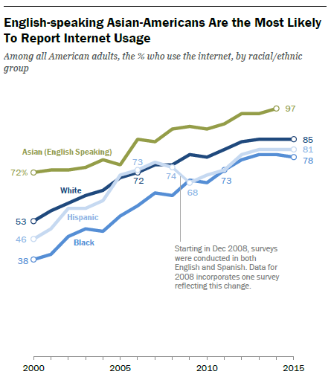
Race/Ethnicity

Slide 9
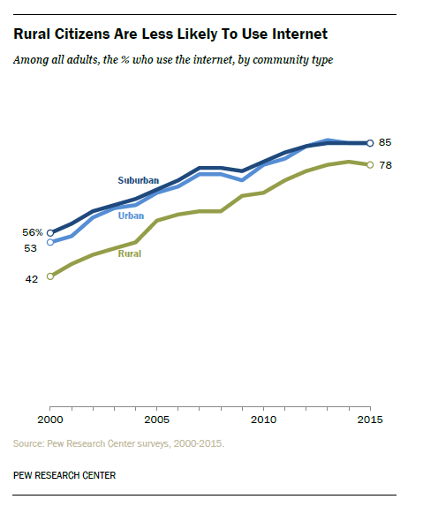
Community Location

Slide 10
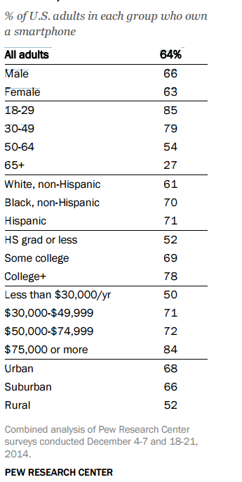

Smartphone Use
64% of Americans now have a Smartphone
Ownership highest among
Young adults
Those with Higher Incomes and Education
Those living in Urban/Suburban areas
Pew Research Center, April, 2015, “The Smartphone Difference”
Available at: http://www.pewinternet.org/2015/04/01/us-smartphone-use-in-2015/

Slide 11
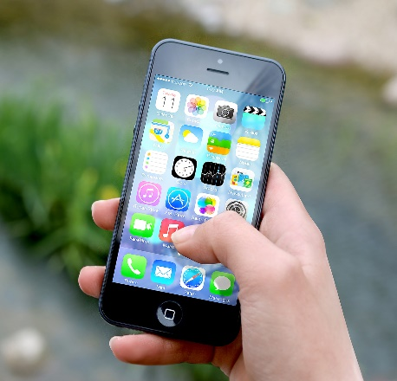
Smartphone Access of Internet Info/Services
68% of smartphone owners use their phone at least occasionally to follow along with breaking news events,
33% say that they do this “frequently.”
62% have used their phone in the past year to look up information about a health condition.
40% to look up government services or information.
30% to take a class or get educational content.
Pew Research Center, April, 2015, “The Smartphone Difference”
Available at: http://www.pewinternet.org/2015/04/01/us-smartphone-use-in-2015/

Slide 12
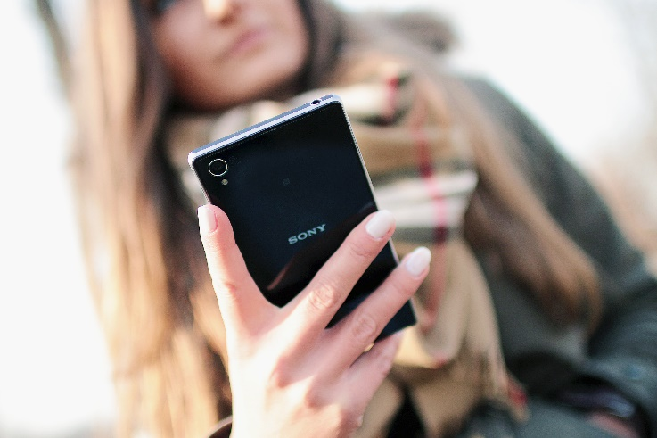
Smartphone Dependent
19% of Americans rely on their Smartphones to some degree to access online information/services
7% are “Smartphone Dependent”
Own a Smartphone
No broadband access at home
Relatively few options for getting online other than their cell phone
Most likely to be in this category:
18-29 years of age
<$30,000 income
Non-Whites
Pew Research Center, April, 2015, “The Smartphone Difference”
Available at: http://www.pewinternet.org/2015/04/01/us-smartphone-use-in-2015/

Slide 13
Internet Access is Growing
But
Traditional Media Remains Extremely Important

Slide 14
Create a Presence on / Monitoring Social Media
Not possible to have a meaningful presence everywhere
Once you create an online presence, its difficult to back away
Meaningful social media monitoring may need to be focused
Bottom line – Choosing the right platforms is important
These are constantly evolving
Focus on appropriate audience segmentation
Understand which audiences use which platforms, when, for what purposes

Slide 15
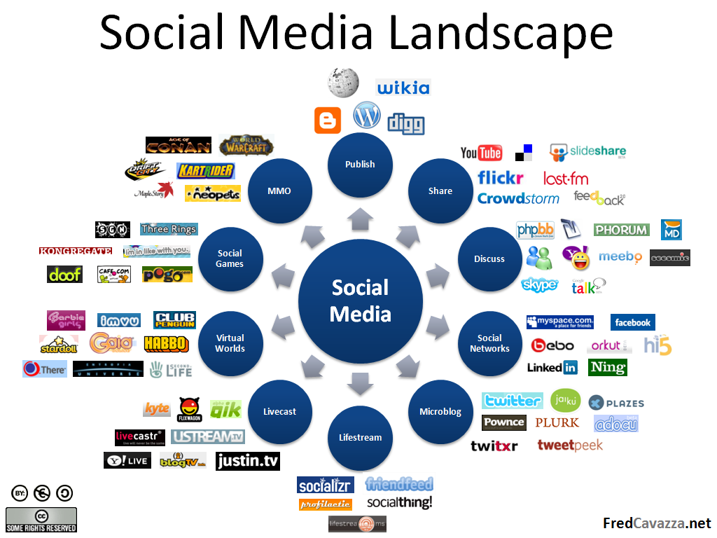

Slide 16
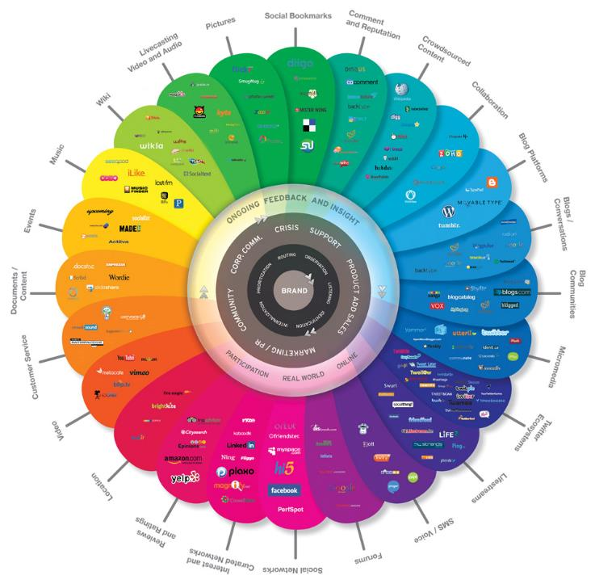
http://www.lesevangelistes.com/wp-content/uploads/2012/10/conversation-prism.jpg

Slide 17
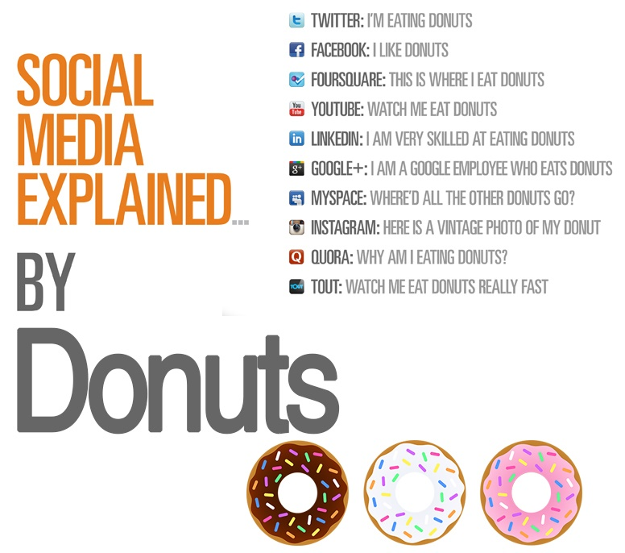
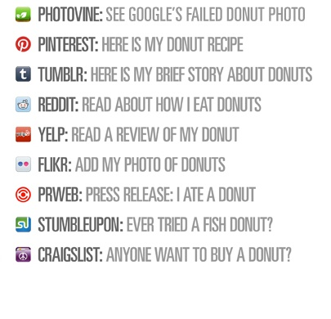

http://thedigitaldope.in/wp-content/uploads/2015/02/SMD.jpg

Slide 19
Number of Users of Social Media

Slide 20


Pop Quiz
Weibo
225 million users
Qzone
663 million users

Slide 21
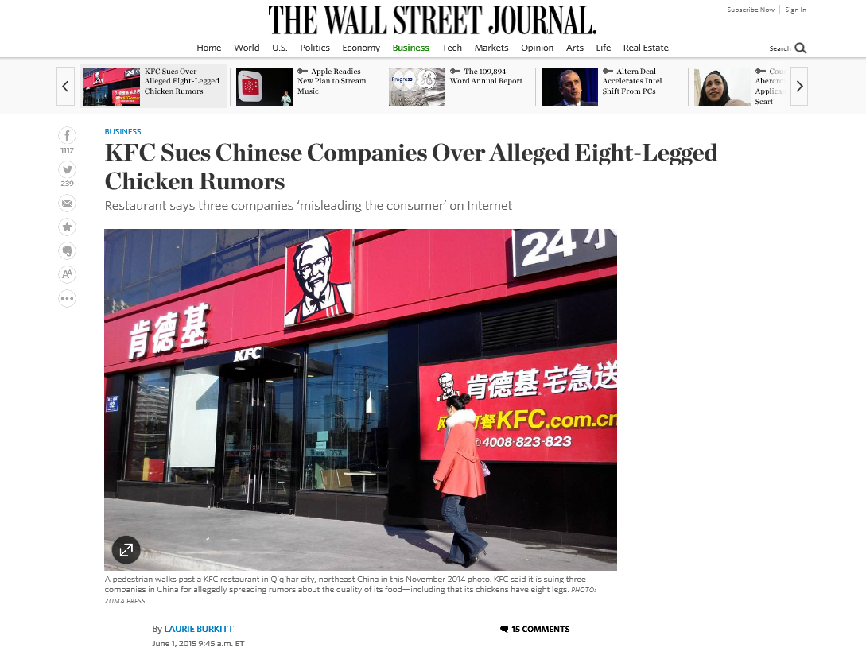

Slide 22
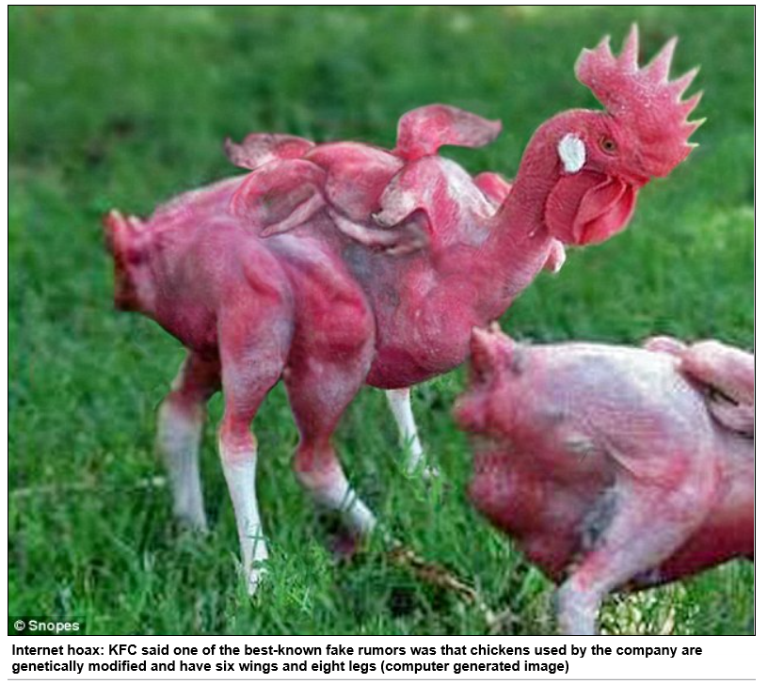

Slide 23
Our Audiences are International
When the FDA announces a product recall
People in other countries often contact their own food authorities to determine if the product is sold there.

Slide 24
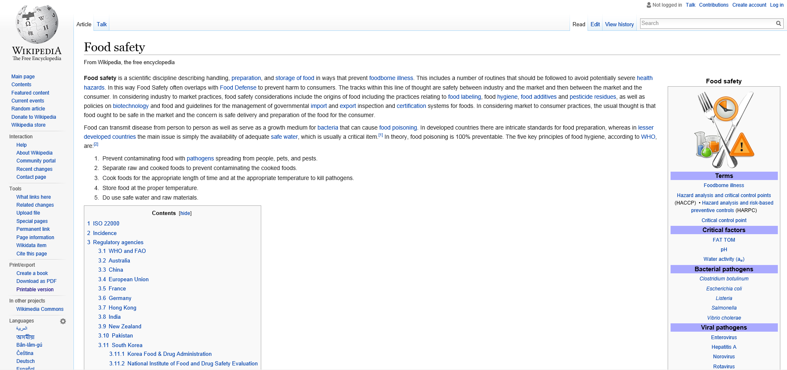
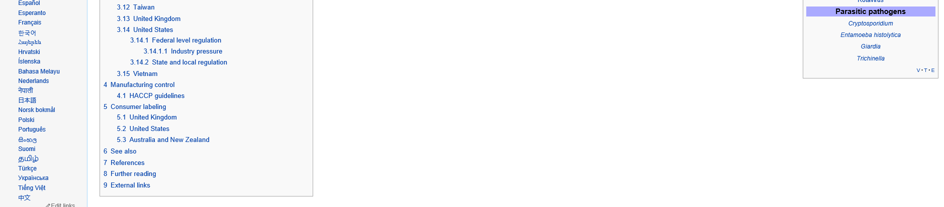

Slide 25

The Internet is an Abundant Resource

Slide 26
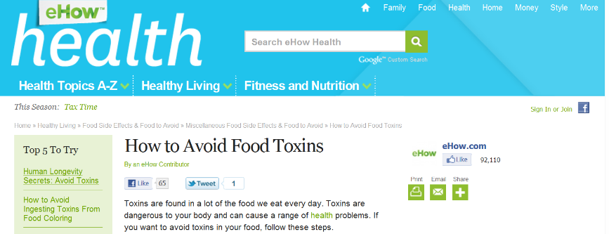
The Messages are Often Consistent

Slide 27
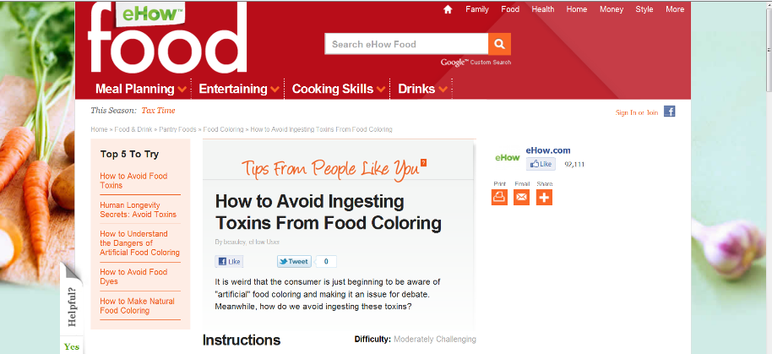
The Source of the Advice is often Hidden

Slide 28

Notes:
http://www.edetoxify.com/

Slide 29
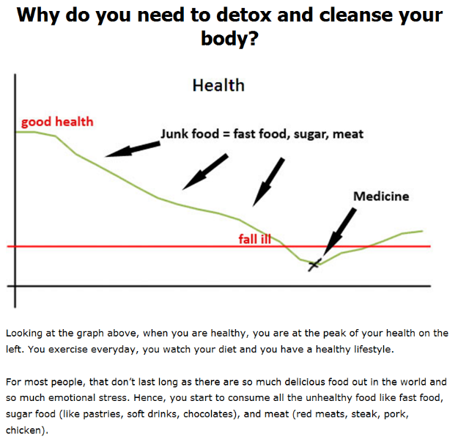
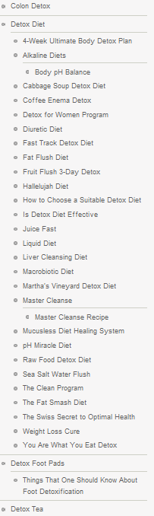

Slide 30
Too Much Information Available
The Public Depends on Curators and Interpreters of Food Safety Information
Health Professionals
Science Communicators
Government Agencies
Consumer Organizations
Authors / Journalists
Museums
Advertising
Interactions with Other People
Websites and Blogs
Social Media

Slide 31

Importance of Trust in an Era of Social Media
Trust is essential for risk communication
Many food safety risks are invisible
Bacteria
Viruses
Chemical contaminants
Information is often incomplete or uncertain
Much of the public cannot understand available information themselves

Slide 32
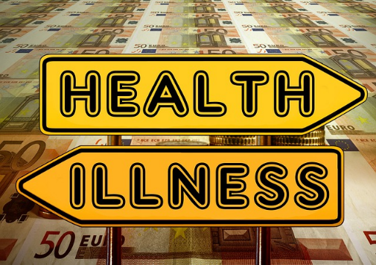
The Importance of Trust
People who distrust food safety risk messages are unlikely to believe or act upon the information.
This can have severe health, environmental, trade, and economic implications.

Slide 33
Trust Components
Credibility - The extent to which a source or institution is perceived to have the knowledge and expertise to assess, manage and communicate about a risk.
Honesty - The extent to which a source or institution conveys information about a risk in an open, truthful and transparent way.
Care - Care for the interests of the other party and that the source or institution shares the same values and concerns.
Notes:
Important components of trust include:
Credibility: Knowledge and expertise
Honesty: Being open, truthful and transparent. No history of exaggeration, denial or distortion.
Care: Shared values, no vested interests.
Risk communicators should not expect people to trust or listen to them because they are a food safety expert or in a position of authority. To increase trustworthiness, they should also actively work to demonstrate honesty, a sense of shared values and concerns, and that decisions and recommendations are aimed at protecting public health.

Slide 34
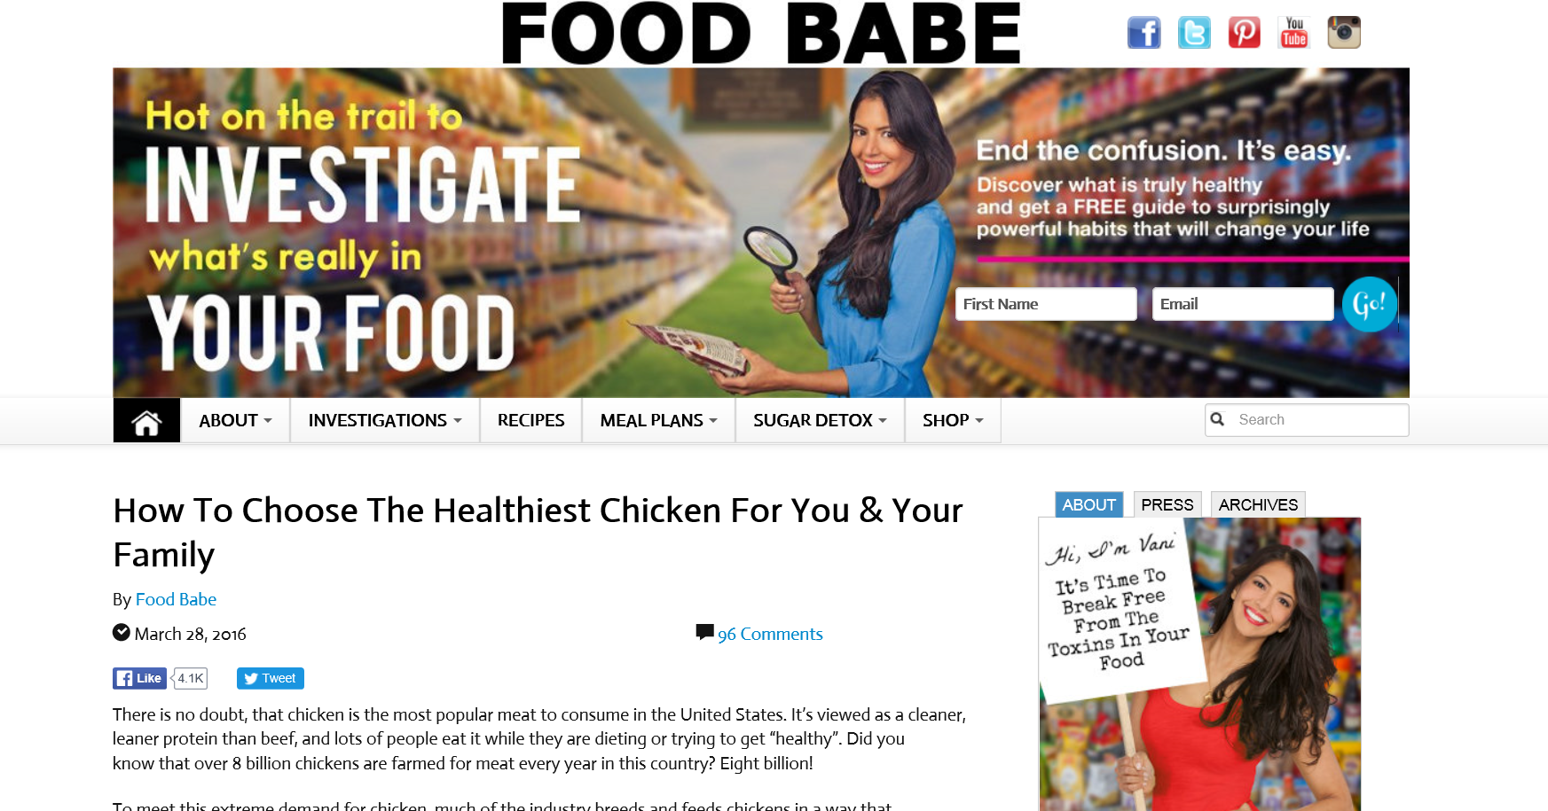
http://foodbabe.com/

Slide 35
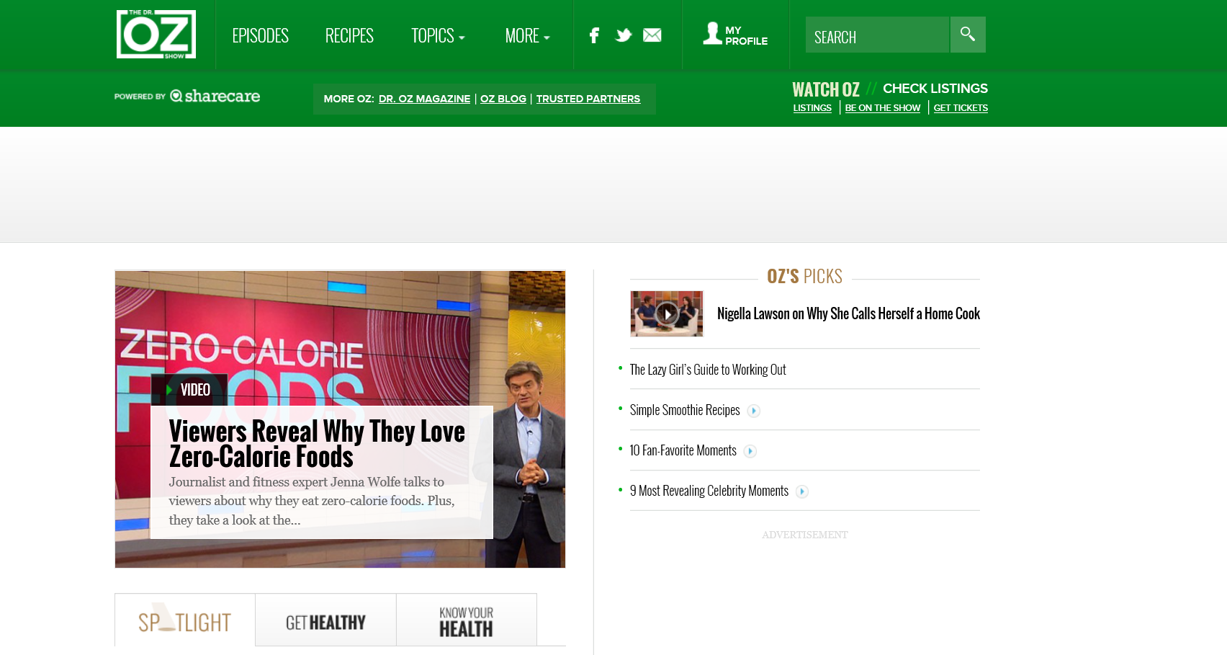

Slide 36
“Helpful Tips From Healthy Helen”
(Retired Health Professional)

Slide 37


Slide 38
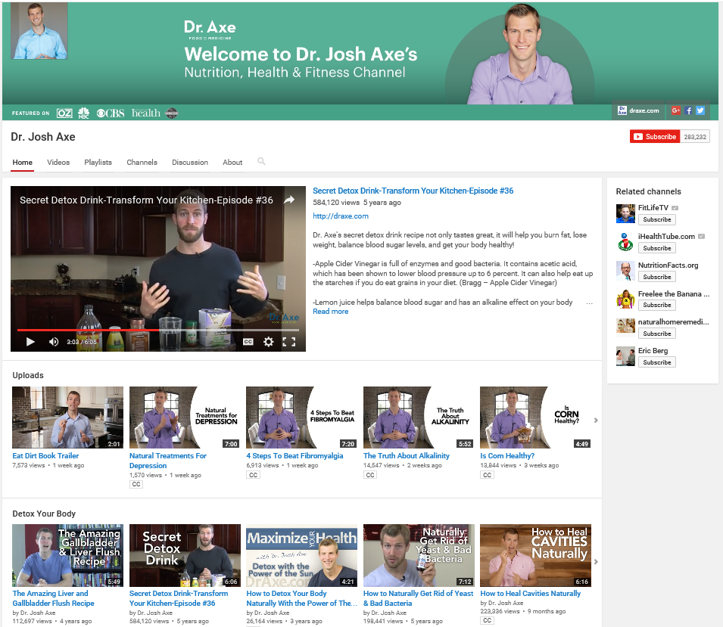

Slide 39
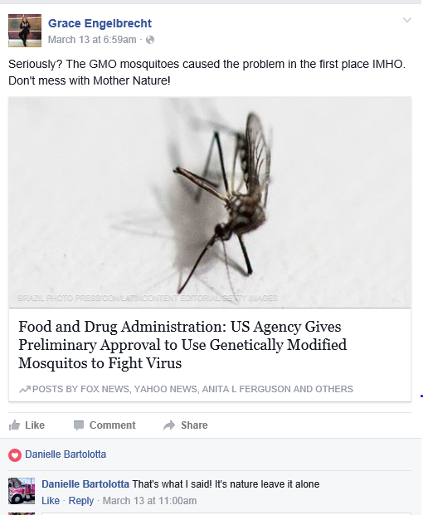

Slide 40

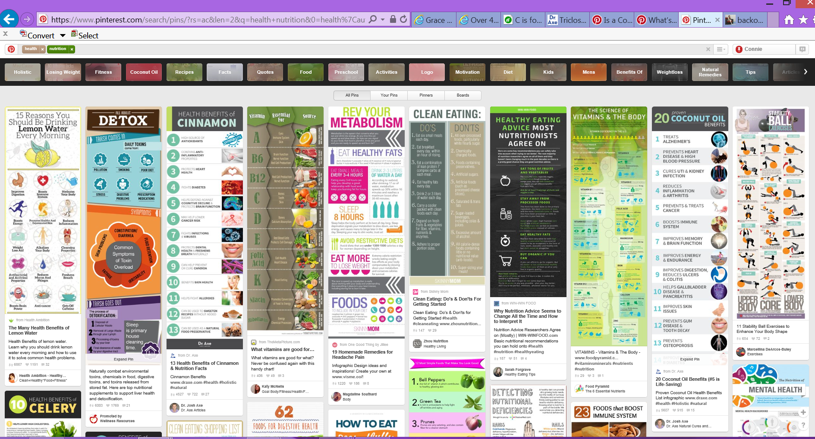

Slide 41
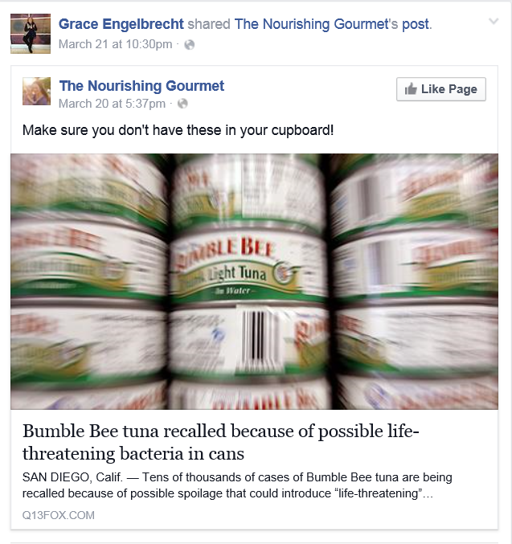

Slide 42
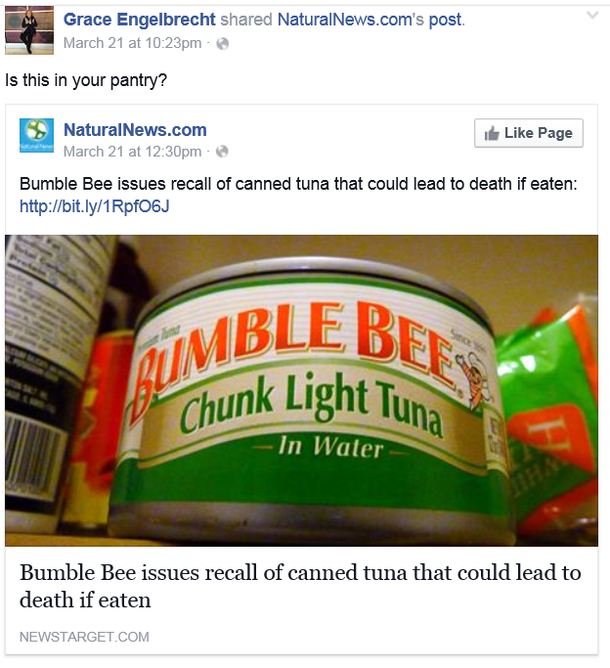

Slide 43
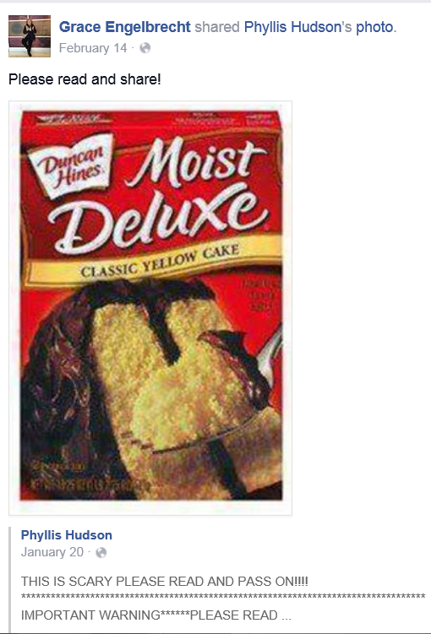
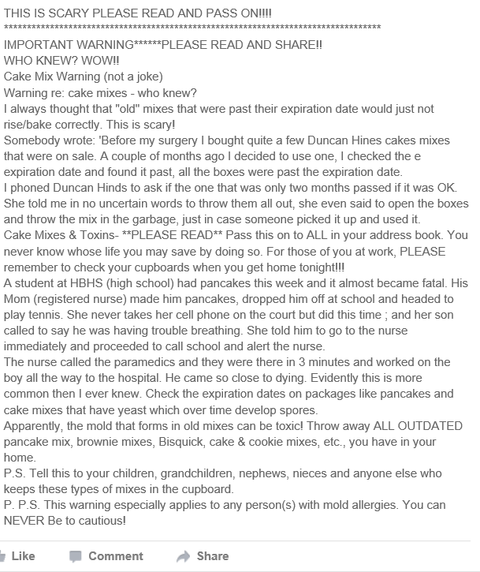

Slide 44
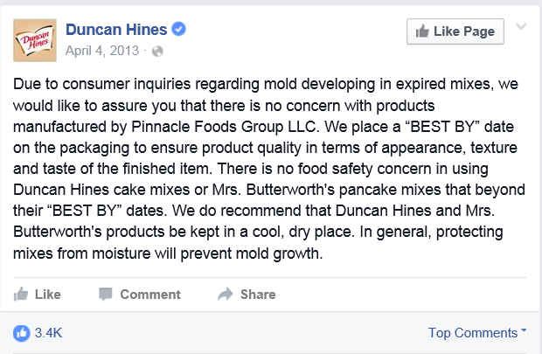

Slide 45
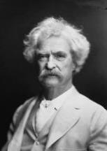
“A lie can travel halfway around the world while the truth is putting on its shoes.”
- Mark Twain

Slide 46

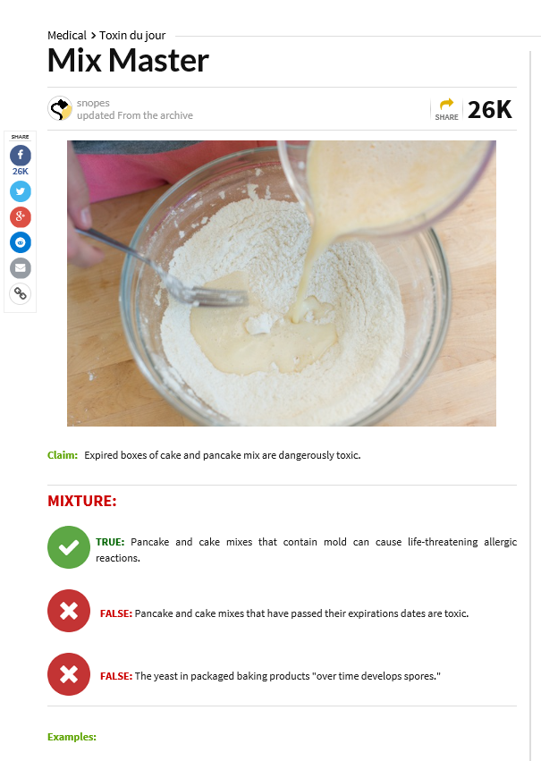

Slide 47
Intuitive Plausibility Matters

Slide 48
Beliefs about Eating GM Foods
Hallman, Cuite, Morin, 2013 Survey of 1148 American Adults

Slide 49
Influencing Mental Models

Slide 50
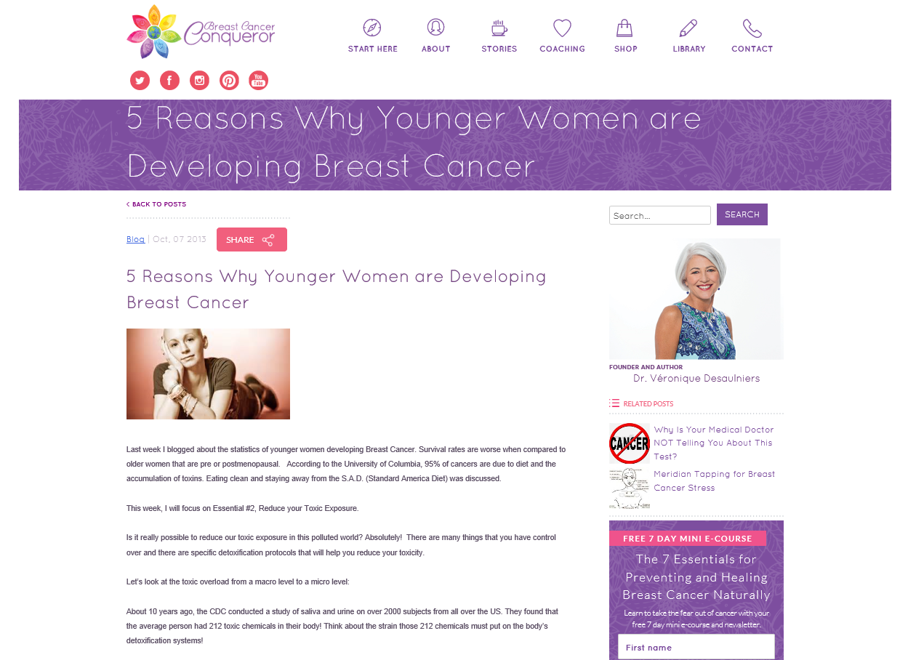
http://breastcancerconqueror.com/5-reasons-why-younger-women-are-developing-breast-cancer/

Slide 51
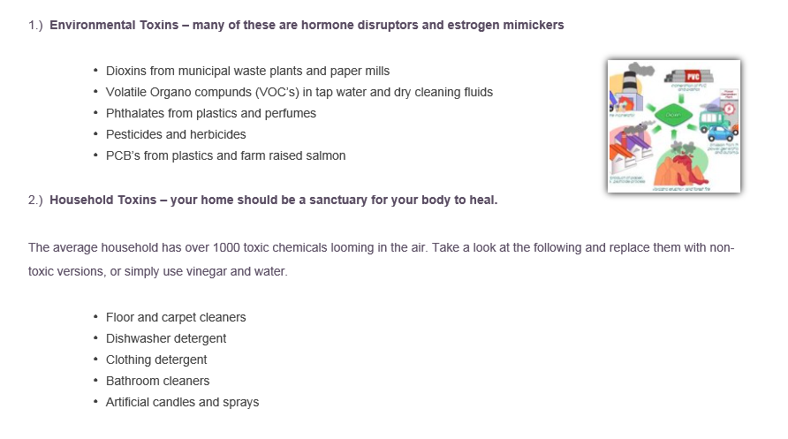

Slide 52
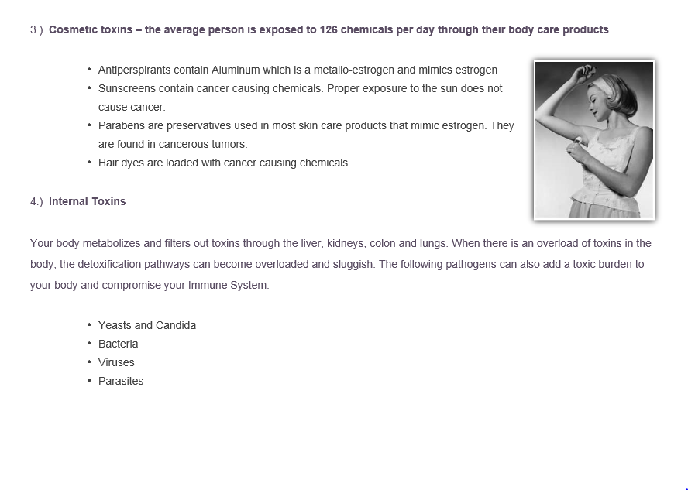

Slide 53
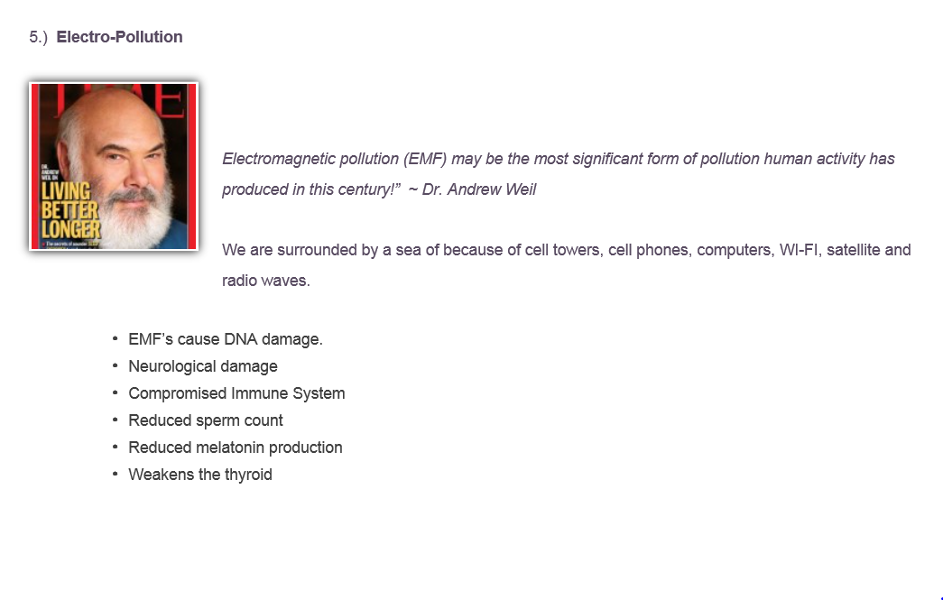

Slide 54
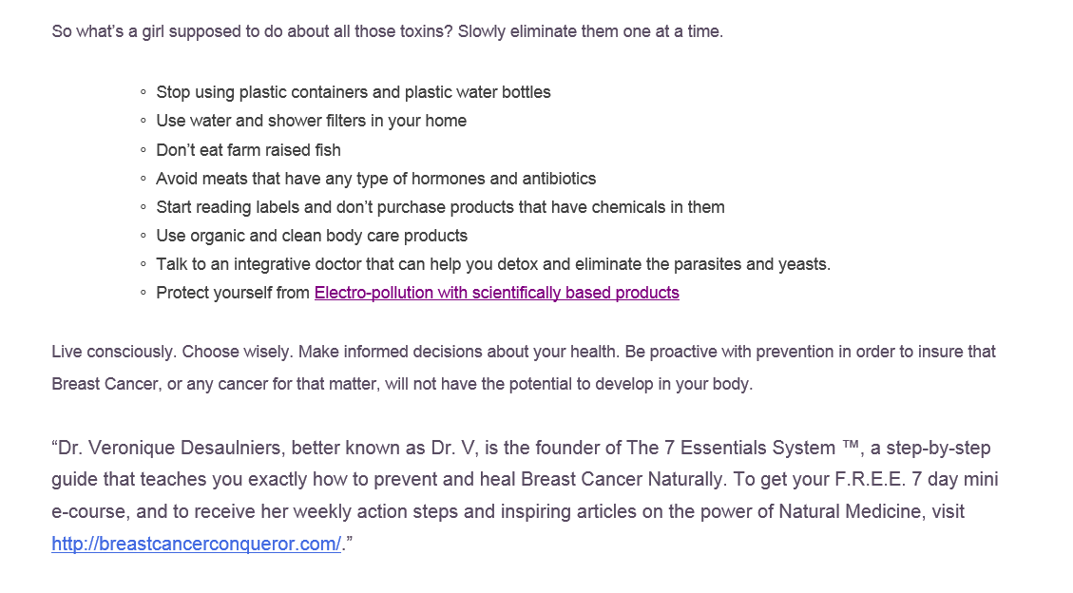

Slide 55
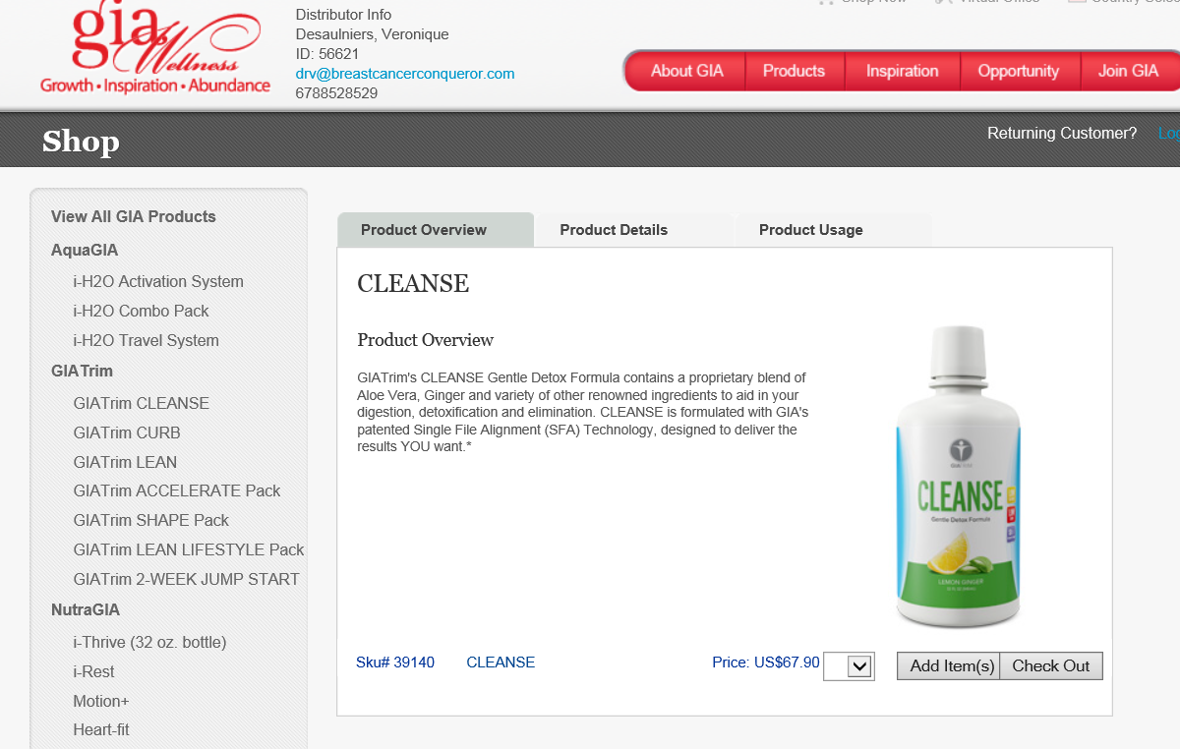

Slide 56
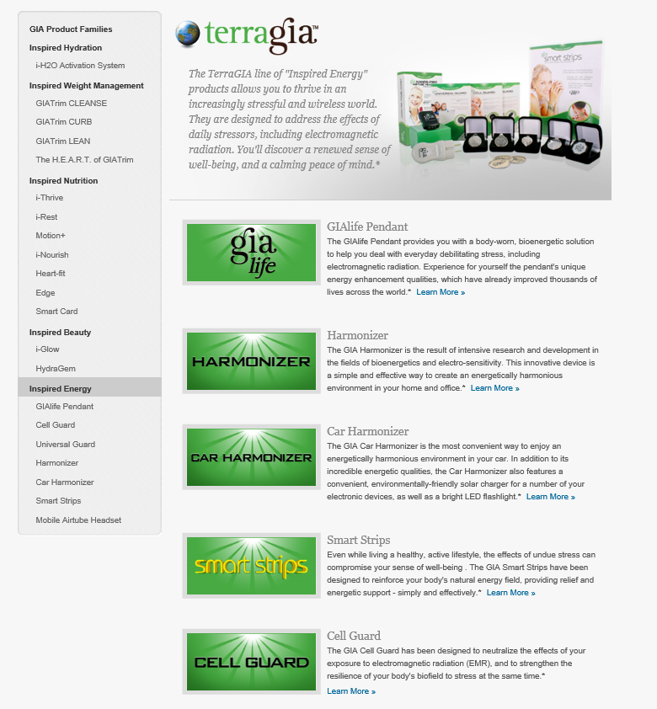

Slide 57
Have the Principles Stood the Test of Time and the Internet?
Yes,
Human nature has not changed
What people want to know when faced with risks and uncertainty has not changed
However, the implementation of basic risk communication principles has evolved in the era of the Internet and Social Media.

Slide 58
For More Information:
William K. Hallman, PhD.
Professor/Chair
Department of Human Ecology
Rutgers University
55 Dudley Road
New Brunswick, NJ 08901-8520
(848) 932-9227
Hallman@aesop.rutgers.edu
© William K. Hallman, PhD. Reproduction, distribution, and use of these materials is by permission of the author.

