Slide 1

Disseminating the Message: CDC’s Perspective
Laura Burnworth, MPH
Health Communication Specialist
Outbreak Response and Prevention Branch
JIFSAN Annual Symposium
Greenbelt, Maryland
April 5, 2016
National Center for Emerging and Zoonotic Infectious Diseases
Division of Foodborne, Waterborne, and Environmental Diseases

Slide 2

Multiple Audiences
Consumers
Reporters
Retailers and restaurants
Public health officials
Food industries
Heathcare providers

Slide 3
How does CDC communicate about outbreaks?
Public
CDC website
Social media
News media
Public Health Partners
Email lists
Conference calls
Industry Partners
Email lists
Conference calls
Healthcare
CDC website
Health Alert Network

Slide 4
CDC Website
Main communication tool used to display information about outbreak investigations
Current case count, affected states
Advice to consumers, retailers
Investigation details
Updated when we have new information to share
A final outbreak summary is posted to indicate the outbreak is over

Slide 5
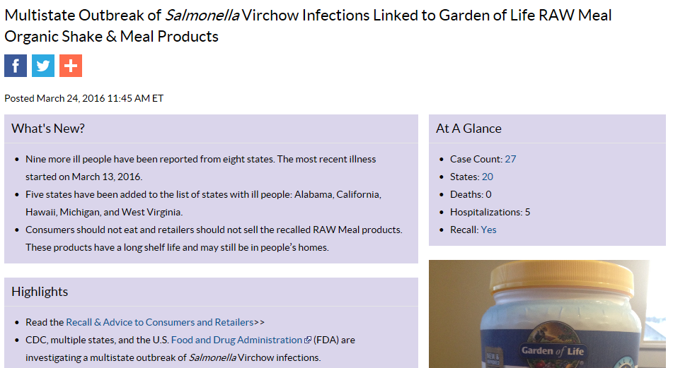
CDC Website

Slide 6
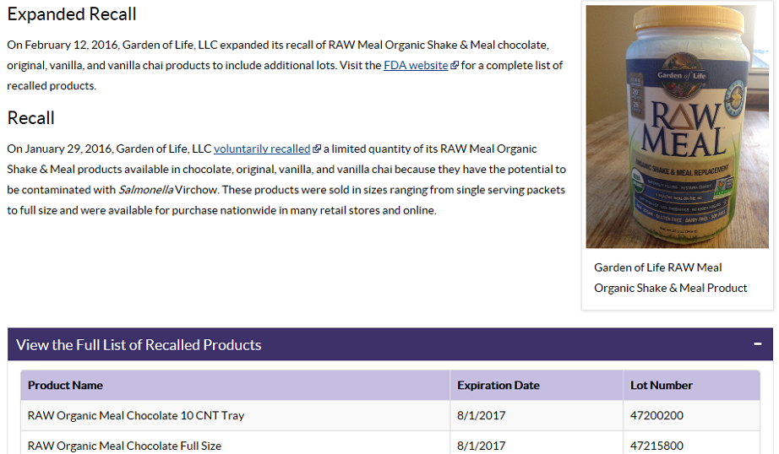
CDC Website

Slide 7
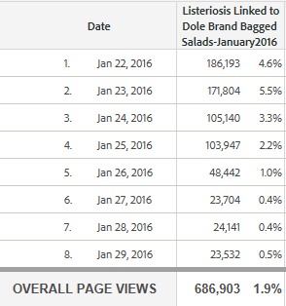
CDC Website
Web traffic continues to increase every year
2.1 million page views total in 2015
Average of 50,000 page views during an investigation
Influenced by media coverage, brand name of company involved
4 minutes average time spent on page

Slide 8
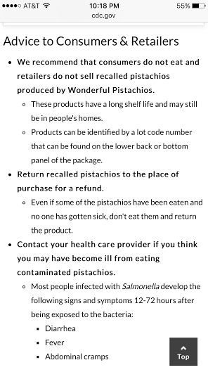
CDC Website
Search engine optimization used to increase visibility
Typically first or second search result
Keywords
CDC website now has responsive design capabilities
More people are using mobile devices to view content
Half of visitors to CDC websites are mobile users

Slide 9
Social Media
CDC Facebook and Twitter followers are represented by the general public, with some public health and media followers
Messages are used to drive traffic to the CDC outbreak webpage
Call out specific advice to consumers
Provide image of food product
Social media provides an opportunity to engage with your audience
Facebook: 4.3 average engagement rate
Twitter: 2.2 average engagement rate

Slide 10
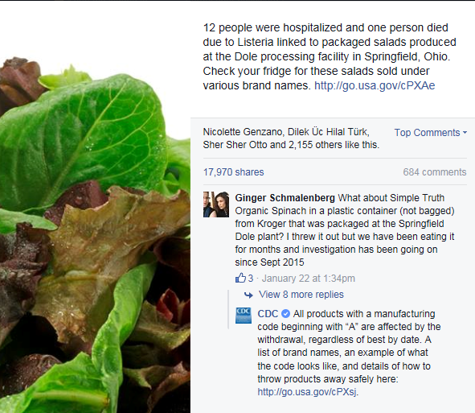
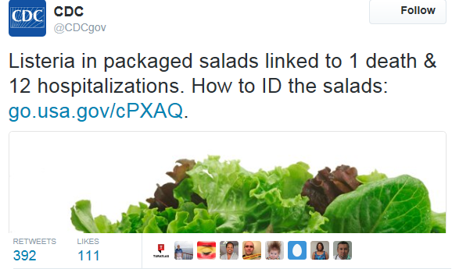
CDC can interact with consumers
Answer questions in real time
Indicate seriousness, highlight advice

Slide 11
News Media
Due to several high profile outbreaks in recent years, reporters are covering our content more frequently
News media helps us get our message out to a broader audience
Provides an opportunity for us to tell the investigative story
Use our data to make graphics for their readers
Reporters increasingly repeating what’s on the CDC website, even providing a hyperlink in their story
Less interview requests overall, especially from local outlets
Reporters interested in a bigger story want interviews

Slide 12

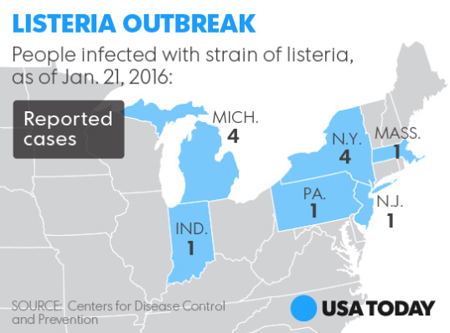
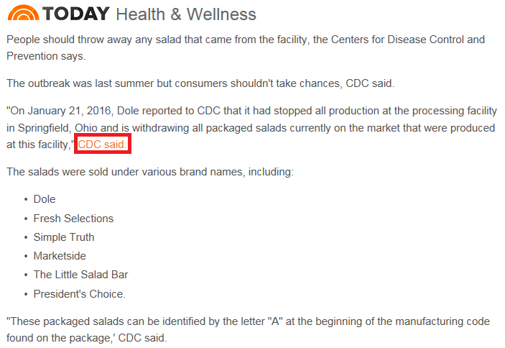

Slide 13
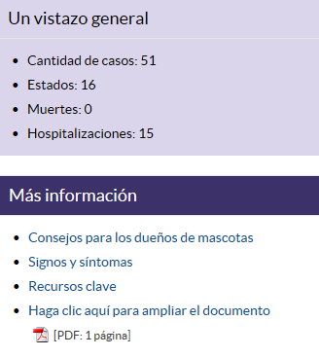
Communicating with “Hard to Reach” Consumers
CDC en Español
Translating outbreak messages when epidemiologic data identifies a disproportionate burden on non-English speaking populations
Targeting cultural media outlets
Univision
Leveraging bloggers to reach healthy
eaters

Slide 14
How does CDC communicate about outbreaks?
Public
CDC website
Social media
News media
Public Health Partners
Email lists
Conference calls
Industry Partners
Email lists
Conference calls
Healthcare
CDC website
Health Alert Network

Slide 15
Public Health Partners
Use of email listservs and conference calls to coordinate messaging and message timing
Confirmation and agreement with state partners before CDC posts an outbreak announcement
States confirm case counts and patient outcomes
Dissemination of CDC internal talking points with state Public Information Officers
Ensures message consistency, especially with difficult to answer questions

Slide 16
How does CDC communicate about outbreaks?
Public
CDC website
Social media
News media
Public Health Partners
Email lists
Conference calls
Industry Partners
Email lists
Conference calls
Healthcare
CDC website
Health Alert Network

Slide 17
Industry Partners
The food industry is a vital partner in disseminating messages to consumers during an outbreak event
Can leverage long-standing consumer trust and brand
Before a CDC outbreak announcement is posted, the implicated firm receives a copy of the content
Important for the company and public health partners to give a consistent message to consumers and media
Gives the consumer confidence in the message

Slide 18
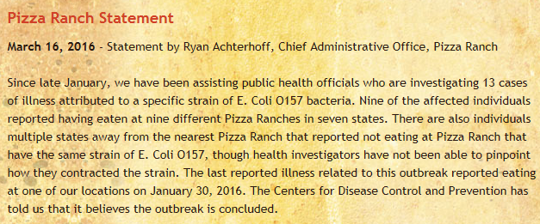
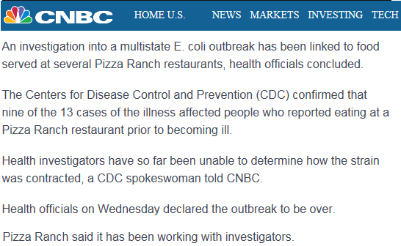
Industry Partners

Slide 19
How does CDC communicate about outbreaks?
Public
CDC website
Social media
News media
Public Health Partners
Email lists
Conference calls
Industry Partners
Email lists
Conference calls
Healthcare
CDC website
Health Alert Network

Slide 20
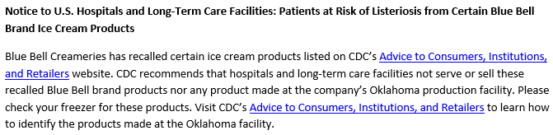
Healthcare
In certain outbreaks, healthcare professionals need targeted messaging:
Outbreaks involving Listeria
Products sent to institutional settings
High-risk group involved
Assistance with case identification

Slide 21
Be Adaptable and Flexible
In the current communications landscape, consumers of information are faced with sifting through multiple channels
As one of the channels available to the consumer, CDC is tasked with monitoring the conversation around issues its involved in, for example:
Hashtags
Media headlines and stories
Questions from the public (CDC-INFO)
Be adaptable and flexible; it’s ok to alter your message once it’s out if it helps improve accuracy and dissemination

Slide 22

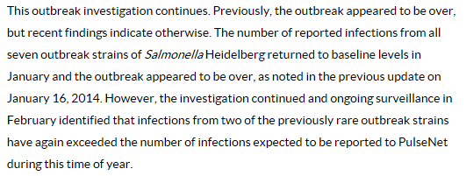
Be Adaptable and Flexible
Foster Farms chicken, January 2014
Foster Farms chicken, March 2014

Slide 23

Summary
A combination of communication strategies is needed to reach multiple audiences
Web
Social media
News media
Currently analyzing metrics to determine what influences page viewership and identify best practices or trends
Time of day, day of week
Competing headlines
Social media
Be flexible and adapt messaging as needed

Slide 24

Laura Burnworth
wmg5@cdc.gov
For more information please contact Centers for Disease Control and Prevention
1600 Clifton Road NE, Atlanta, GA 30333
Telephone: 1-800-CDC-INFO (232-4636)/TTY: 1-888-232-6348
Visit: www.cdc.gov | Contact CDC at: 1-800-CDC-INFO or www.cdc.gov/info
The findings and conclusions in this report are those of the authors and do not necessarily represent the official position of the Centers for Disease Control and Prevention.
National Center for Emerging and Zoonotic Infectious Diseases
Division Name in this space

