Slide 1
Crafting the Right Message
April 5, 2016
9:30 a.m. – 10:30 a.m.
Laura Burnworth, Centers for Disease Control and Prevention
Donna Rosenbaum, Food Safety Partners, Ltd
Amy Philpott, Watson Green LLC
Notes:
Someone gives introduction as to overall purpose and structure of this session

Slide 2

Crafting the Right Message:
CDC’s Perspective
Laura Burnworth, MPH
Health Communication Specialist
Outbreak Response and Prevention Branch
JIFSAN Annual Symposium
Greenbelt, Maryland
April 5, 2016
National Center for Emerging and Zoonotic Infectious Diseases
Division of Foodborne, Waterborne, and Environmental Diseases

Slide 3

CDC’s Role in Foodborne Outbreaks Communications
Similar to coordinating the epidemiologic investigation, CDC serves as the “spokesperson” for multistate outbreaks
Since 2006, CDC has posted over 90 foodborne outbreak announcements on its website
CDC website serves as the central hub for the latest information about the outbreak:
  Case count and states affected
  Advice to consumers and retailers
  Investigation details

Slide 4
Why does CDC communicate about outbreaks?
Specific source identified AND public can take action
Other reasons CDC may communicate include:
State health department(s) communicate
High risk group involved
Deaths, high hospitalization rate
Media interest, misinformation being circulated

Slide 5

When does CDC communicate about an outbreak?
Communication to the public may be needed at any point, or it may never be needed
  In 2015, over 220 multistate clusters (potential outbreaks) were investigated by CDC
  14 outbreaks communicated about on the CDC website
The decision about “when” typically occurs quickly
  During an investigation, evidence about what the food source is accumulates and changes, as does the need to communicate
  New information can trigger communication at any point in an investigation

Slide 6
Five Common Communication Scenarios
Examples 20 people infected with one strain of E. coli
Signal for ground beef
Company X ground beef is likely vehicle
Outbreak of E. coli infections in Ohio
Ground beef recalled for E. coli contamination
Scenario 1
Scenario 4
Scenario 5
Scenario 2
Scenario 3
Cluster of illnesses with no specific source identified
Generic food type identified as likely vehicle
Specific food product, brand identified as likely vehicle
Local outbreak, locals and/or state release press
Pathogen identified in food independent of any human illness

Slide 7
Five Common Communication Scenarios
Reasons NOT to Communicate:
Will communicating create message fatigue?
Is there no clear action step for the public?
Is there insufficient evidence?
Is the food vehicle generic in nature?
Is the outbreak over?
Reasons to Communicate:
Is the pathogen causing severe illness?
Is there a high number of cases?
Is the outbreak ongoing?
Is the food vehicle novel?
Does the product have a long shelf life?
Is a large group of people potentially exposed?
Can the public take specific actions to protect themselves?

Slide 8
Crafting the CDC Message
Once the decision is made to communicate, the process to craft a message that will be heard is complex:
  What cases and states are we including?
  What will our advice to consumers be?
  What evidence do we have linking illness to food X?
  What can we say about the ongoing investigation?
Crafting the CDC message involves input from various partners:
  State and local health and regulatory officials
  Federal regulatory agencies (FDA, USDA-FSIS)
  Food industry

Slide 9

Crafting the CDC Message
Because our goal is to prevent additional illnesses, CDC’s most important message is crafting the advice for consumers
In order for our advice to lead to action, it needs to be:
  Specific
  Clear
  Complete

Slide 10
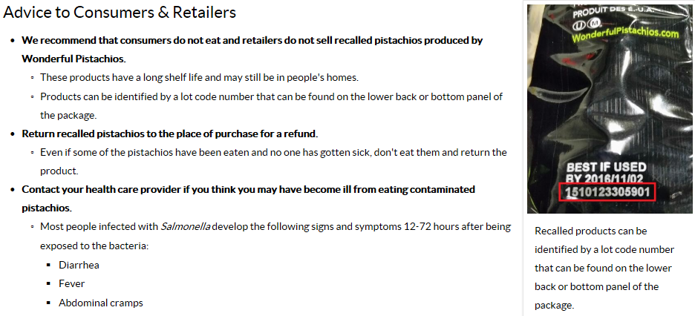
Crafting the CDC Message

Slide 11

Balancing Priorities
As the nation’s public health agency, CDC represents public health officials around the country when it communicates about an investigation
The process of posting a notice on the CDC website about a foodborne outbreak involves balancing priorities:
  Being “fast and right”
  Input from partners
  Science and plain language

Slide 12
Balancing Being “Fast and Right”
We have to balance communicating quickly but also waiting until we have enough information to issue actionable advice
Often, CDC is not the first agency to “break the news”
  We may wait to communicate until a company issues a recall so we can link to it and give specific advice about what not to eat
  A state or local health department may issue press first
Messages are reviewed at multiple levels of CDC to ensure scientific and communication principles are being applied
  A template is used to expedite the process

Slide 13
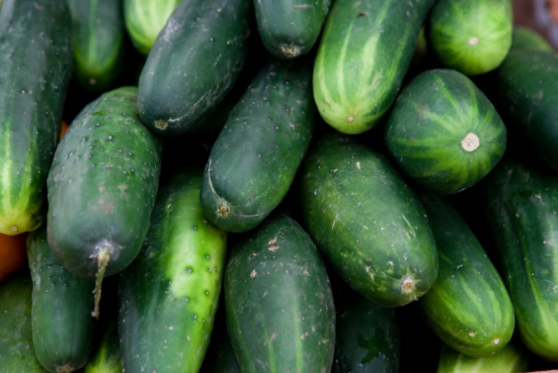
Balancing Input from Partners
State and local officials
  Case count and patient outcomes
  Product testing completed by states
Federal regulatory agencies
  Regulatory investigation
  Compliance actions
Food industry
  Details about the implicated food product

Slide 14

Balancing Science & Plain Language
CDC is a scientific agency
  Information must be scientifically accurate
Plain Writing Act of 2010
  Requires all federal agencies to write "clear government communication that the public can understand and use”
Our outbreak communications must balance being scientifically accurate and understandable

Slide 15
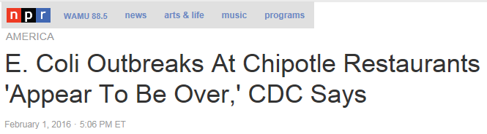
What We Say Has Impact
CDC is a trusted source of science-based health information
That means what we say and how we say it has implications
  “…is the likely source of this outbreak.”
  “The outbreak appears to be over.”
  “…closely related genetically…”
  “This investigation is ongoing.”

Slide 16
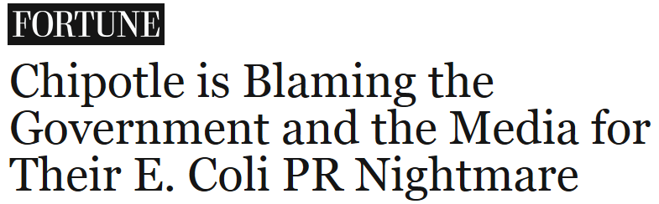
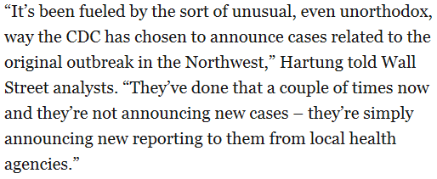
Naming Companies to Protect Public Health
It’s a general policy for CDC to identify commercial entities involved in ongoing outbreaks IF it protects public health
  Company name appears in the title of the web posting as being “linked to the outbreak”
Recently, CDC has been challenged by companies for the way in which firms are identified in outbreak web postings

Slide 17
Constantly Improving
Using social media and traditional media to make changes in real time during investigations
Making improvements to the web posting template
  “What’s New” box
  Shorter, reordered “Highlights” box
Developing focus groups for message testing
  User satisfaction with template
  Understandability of scientific content

Slide 18
Summary
Increasing demands for government to be transparent
  Message fatigue is real, but should not be a major reason to delay public communication
Decision about right time to communicate is nuanced
  Must continuously weigh evidence to make decision
Crafting messages that will be understood is complex
  Involves balancing science, input from partners
Collaboration and trust in the process are key

Slide 19

Laura Burnworth
wmg5@cdc.gov
For more information please contact Centers for Disease Control and Prevention
1600 Clifton Road NE, Atlanta, GA 30333
Telephone: 1-800-CDC-INFO (232-4636)/TTY: 1-888-232-6348
Visit: www.cdc.gov | Contact CDC at: 1-800-CDC-INFO or www.cdc.gov/info
The findings and conclusions in this report are those of the authors and do not necessarily represent the official position of the Centers for Disease Control and Prevention.
National Center for Emerging and Zoonotic Infectious Diseases
Division Name in this space

Slide 20
Message Development:
Best Practices from an Industry Perspective
Amy Philpott, apr
Watson Green LLC

Slide 21
Messages Should Address:
What happened
What the audience(s) need to do now
How/Why it happened and your role
What you are doing now
What you will do (are doing) to prevent it from happening again

Slide 22
Message Development
Don't write so that you can be understood, write so that you can't be misunderstood.
~William Howard Taft
Source: www.brainyquote.com

Slide 23
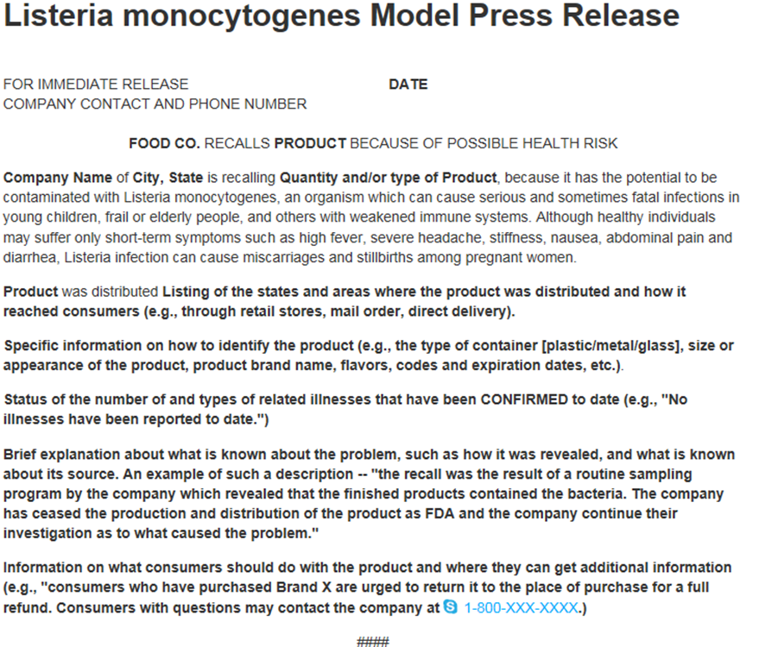


Slide 24
Message Development
“The product was distributed… (listing of the states and areas where the product was distributed, and how it reached consumers (retail, mail order, direct delivery)”
OR
The product was shipped directly to (types of customers) in (list states and areas).

Slide 25


Internal Communication Logistics
Draft/Revise
(NAMES)
Internal Approval/
Legal Review
(NAMES)
Train Staff
(NAMES)
Staff Disseminates
(NAMES)
Provide Feedback
(EVERYONE)
Notes:
Message Development Requires a Benevolent Dictatorship

Slide 26

Internal Communication Logistics
Draft/Revise
(NAMES)
Internal Approval/
Legal Review
(NAMES)
Train Staff
(NAMES)
Staff Disseminates
(NAMES)
Provide Feedback
(EVERYONE)

Slide 27
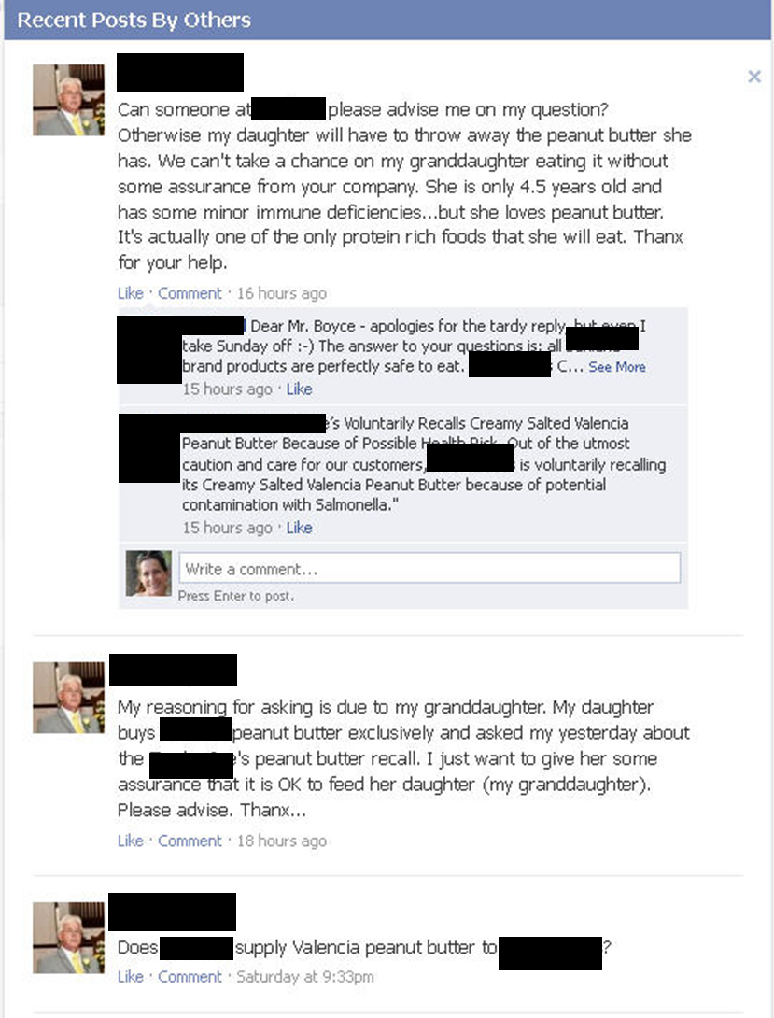
Dear Mr. Boyce – apologies for the tardy reply, but even I take Sunday off :-) The answer to your questions is: all NAME brand products are perfectly safe to eat. …..
Out of the utmost caution and care for our customers STORE is voluntarily recalling its PRODCUT because of potential contamination with Salmonella.

Slide 28
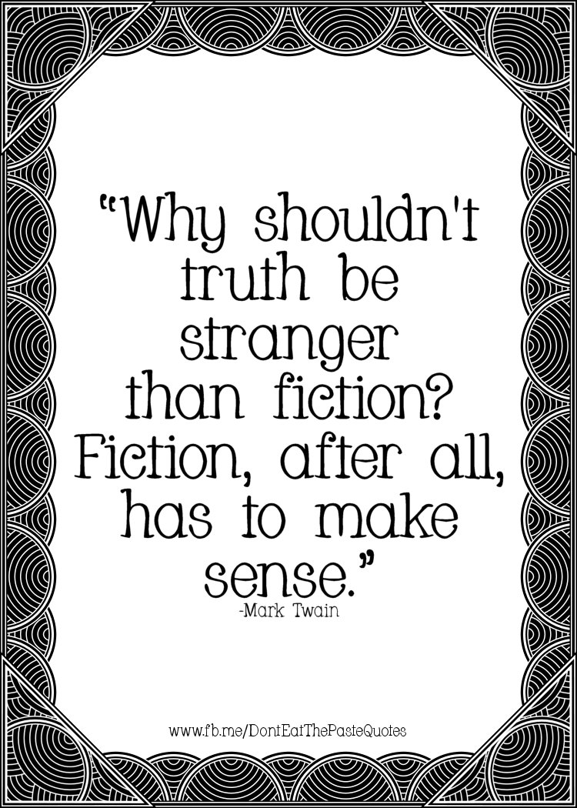
Message Development
Start with the truth
Make it make sense
Add context & feelings
End with the truth

Slide 29

Message Development
Anticipate a dialogue - watch for rabbit holes!
Identify your nightmare question(s) and address it (them).

Slide 30
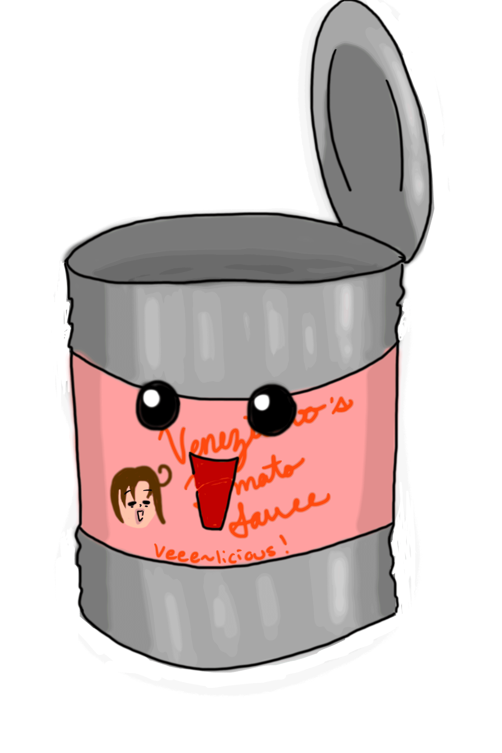
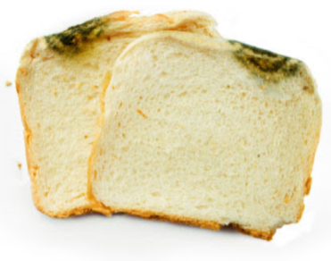
Message Development
And don’t give me some canned reply that has been vetted by a dozen lawyers!
Keep it REAL
Keep it FRESH
Keep it CONSISTENT

Slide 31
Message Development Final Tips
Resonate with intended audience
Consider how messages will be disseminated
Find a balance between legal and communication goals
Keep in mind those who will use them - different spokespersons/communicators like to have their messages in different formats:
  parenthetical; bullet points; outline format
  visual message mapping

Slide 32
Audiences
Audience | Primary Responsibility | Communication Options | Concerns

Slide 33

Message Mapping Template
proof point
Message 1
Issue or
question
proof point
proof point
Message 2
proof point
proof point
Message 3
proof point
proof point
proof point
proof point
Notes:
Concern
Action
Credibility

Slide 34
Thank you!
Amy PhilpotT, apr
Watson Green LLC
aphilpott@watsongreenllc.com
202-384-1840 (0)
703-472-6615 (c) because crises happen 24/7

Slide 35
Crafting the Right Message:
The Consumer Perspective
Donna Emanuel Rosenbaum, M.S.
Consumer Communication Specialist
Food Safety Partners, Ltd.

Slide 36
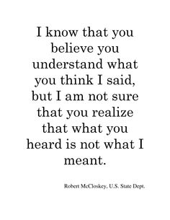

Getting it Right
It’s not what you say,
It’s what people hear.
      - Frank Luntz

Slide 37

Introduction and Overview
“Consumers are entitled to information that could affect their health and transparency helps them to make informed choices.” —Sir John Krebs (2003)
Food risks are not are not perceived in the same manner as other risks due to the much more intimate relationship we all have with food.
Every consumer has a unique relationship and attitude towards food and food safety based on their personal life history.
Better understanding your audience results in more effective food risk messaging.
Use the “Goldilocks Test”...not too simple, not too wordy, get it “Just Right”

Slide 38
Put People First
Communication is about people—a back and forth dialogue in order to attain understanding between those parties. Risk communication can often be sidelined by using risk “education” language.... I have facts to impart to you about the risk of this food and you should listen because I’ve done the science and I know best.
The Role of Transparency:
  The public is considerably more competent than what the experts give them credit for.
  Simplifying risk messages can cause the public to think authorities are lying.
  Communicating uncertainty will actually increase public trust and help it make informed choices.
  Honesty can help alleviate the stigmatization of certain commodities after food scares, especially if additional controls will be instituted.
  Honesty is just as important in non-crisis conversation as it builds the trust you may need to rely on later on
  Media amplification makes all these issues increasingly important.
Attitude & Demeanor makes or breaks good food risk communication:
  Consumers feel they are entitled to know what is in their food
  vs.
  Consumers are entitled to know what is in their food
  Non-verbal cues are as important as words used in gaining consumer trust...watch tone, cadence, facial expression
Notes:
If you have a very effective spokesperson, use video clips of them on social media instead of just clips or bullet points from a press release.....research currently being done and published soon.

Slide 39
Social Media Do’s & Don’ts
Messaging should be specific to each social media channel & platform
DO NOT use social media & Twitter as an extended RSS feed
DO talk with people, not at them
DO NOT tweet and disappear....better to spend a little time everyday than just Friday afternoon
DO pause before pushing SEND....1,000 tweets to build a reputation and 1 to trash it
DO NOT respond to trolls, pick a fight, or adopt an even slightly sarcastic tone
DO respond to anyone who had a bad experience with your company.....say sorry, ask them more about it, apologize again for not catching it sooner
DO NOT pay anyone for reviews or endorsement online without disclosing it
DO keep politics and religion away from your website and online presence
DO NOT have employees (or their relatives) pose as your consumers online
DO, DO, DO enhance your website for consumer experience....simplify your home page, give away some information in newsletters/blogs/white papers, be ready with staff to respond
EVERY POINT OF CONTACT IS A POINT FOR ENGAGEMENT
THAT EITHER HEIGHTENS THE RELATIONSHIP OR LOWERS IT!
Notes:
In internet slang, a troll is someone who posts controversial, inflammatory, irrelevant or off-topic messages on sm, with the primary intent of provoking others into an emotional response or disrupting regular topics/discussion….but do not engage, do not expose them (remember if they twee to you, only their 20 followers will see it but if you tweet back all of your will!)= giving
them a great big platform.
Don’t listen, don’t acknowledge, just go on being you
Good way to judge it as writing or about to hit send;
If you would not be proud to have it on a Billboard with your name, your picture, your phone number & company logo…DO NOT press send….can delete, take down, but chances high that someone, somewhere has it still.

Slide 40
Messaging as a Crisis Unfolds
Pre-Crisis
  Use social media to develop insight and social capital
  Monitor issues & make team-building practice drills a priority
Crisis Identified
  What you say FIRST really matters!
  Use ALL resources and methods for getting the word out
Crisis in Progress, then Winding Down
  Update information often – in government notices & your website
  If you stay silent your audience will write a story in their own minds
Crisis Follow-Up
  Declare it’s OVER loud and clear!
  Circle back internally – document, reflect, change, update, practice
Notes:
Sore point with consumers is when you do not reach out to them- they loyalty cards or a regular participant on your blog or platform

Slide 41
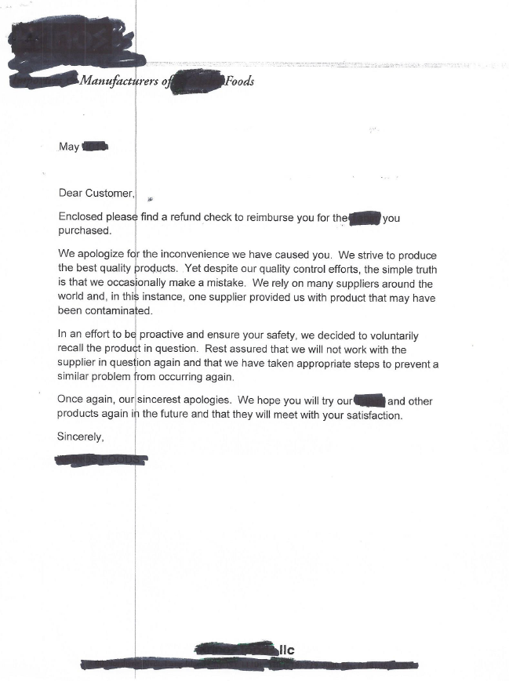
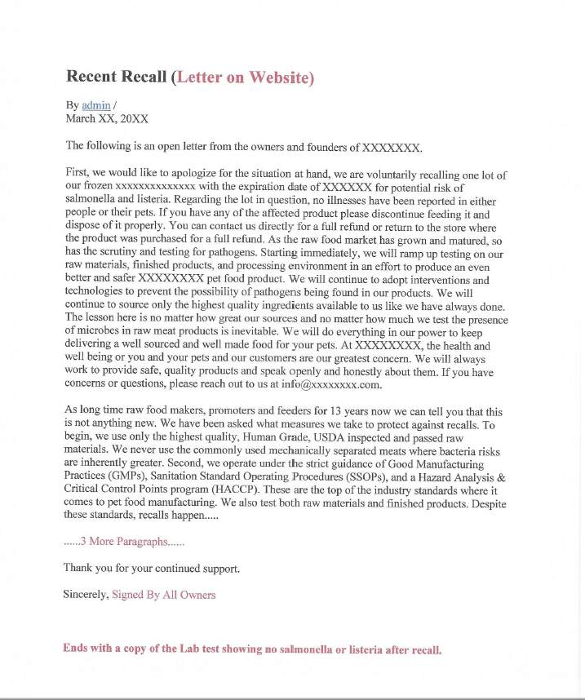
A Tale of Two Recalls
Letter 1
Letter 2
Notes:
Side by side analysis of 2 consumer letters following recall and product refunds to consumers...both within the last few years.
That is where the similarity ends.
One is from the largest company in its class that imports ethnic products and the other is from a small pet food manufacturer.
One is a short boilerplate form letter that came in the mail and the other is a long letter that was sent mail to all customers and placed prominently on their website.
You don’t have to search for it .

Slide 42
Year only- no date
Letter 1
Impersonal form letter
What efforts?
Outbreak & pathogen known before recall
Initiated after product +’s
Supplier on FDA Import Alert
What steps?
What if this letter received by someone who was ill?
From the “Company” –not a person or CEO

Slide 43
Pathogens listed
Apology first!
Letter2
Recalled quickly; no illnesses
Good, clear instructions
Honest, believable pledge,& inviting dialogue
Detailed explanation of standards & testing
Corporate accountability

Slide 44
Confusing Consumers During a Recall
  Calling it a “Voluntary” Recall
  Using “Abundance of Caution” language
  Posting Advisories vs. Recalls
  Rolling Recalls
  Tardiness in identifying all product
  Not updating illness information
  No/poor information on company website
  Not pushing the recall information out to me .....do you really care about my health?
  Multiple recalls for the same food/commodity in a short timeframe
Notes:
Words really do matter.
I want to be very clear.
Voluntary is the wrong word choice here…..hugely misleading…to consumers it means optional.
It causes consumers to not take it seriously…..as in I don’t really have to…it’s my choice..
Then combine this with abundance of caution!!!!! Double up on counterproductive. AND have people not paying attention!
Asan alternative, consider company-initiated
Another problem is when notices get tweeted and voluntary recall is at the beginning….that is sometimes all people see….

Slide 45
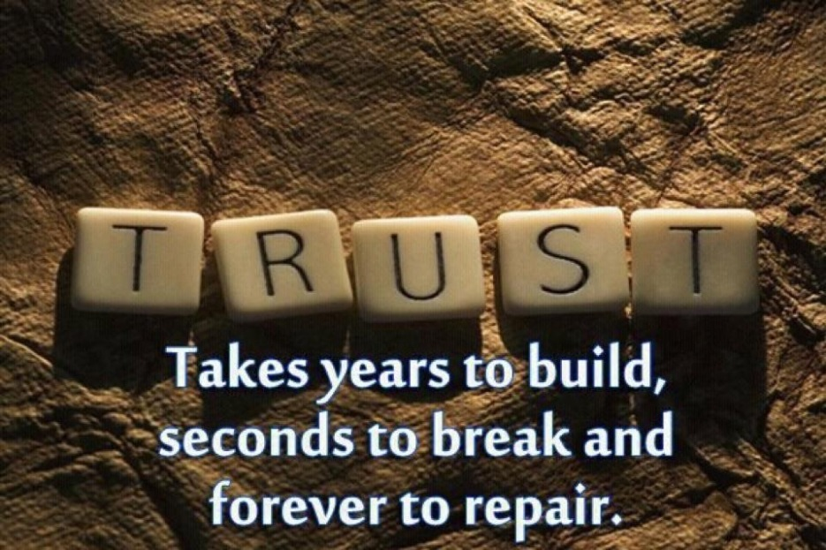
Problem Solve to Build Trust
When consumers complain or return a product, they are looking for information not compensation. A brief, honest explanation of what occurred is welcome with an invitation to discuss it further.
In the middle of a crisis, stop online push marketing, don’t send coupons, especially directly via email. This irritates consumers and sends mixed messages.

Slide 46
Twitterbugs

Slide 47
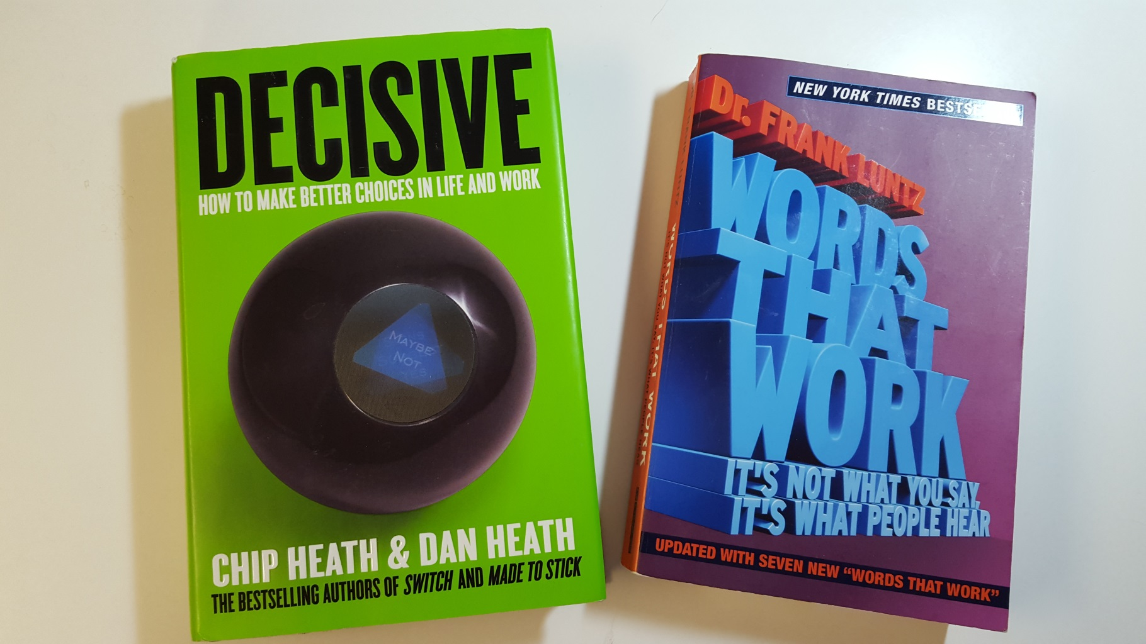
Resources
Chip Heath & Dan Heath (2013) Dr. Frank Luntz (2007)

Slide 48

Thank You!
Donna Emanuel Rosenbaum, M.S.
Food Safety Partners, Ltd.
Northbrook, IL
O: 847-715-9589
C: 847-757-5377
donna.foodsafety@gmail.com

