Slide 1
A NEW STANDARDS DEVELOPMENT PROGRAM ON Novel Foods from Alternative Protein Sources
JIFSAN-CFS³ Advisory Council Webinar
Alternative Proteins and Novel Foods
January 17, 2024
Katerina Mastovska, Ph.D.
AOAC INTERNATIONAL

Slide 2

AOAC INTERNATIONAL
In Food & Agriculture, We Set the Standard
Established in 1884
AOAC INTERNATIONAL is an independent, not-for-profit association
and voluntary consensus standards developing organization (SDO).
VISION: Global alignment for trusted analytical solutions
MISSION: Advance food safety and product integrity through standards, validated test methods, and laboratory quality programs

Slide 3
ANALYSIS OF NOVEL FOODS
WHY ARE NEW STANDARDS NEEDED FOR ANALYSIS OF NOVEL FOODS?
Lack of standardized methods for ensuring quality, safety & acceptability of novel foods
New matrices
Applicability of current analytical methods to novel matrices?
Need for matrix-specific method validation
New analytes – examples:
Allergens
Additives/bioprocessing residues
Chemical residues & contaminants
Natural toxins/antinutrients
Microbial contaminants
WHY?

Slide 4


NEW AOAC PROGRAM Development
AOAC NOVEL FOODS PROGRAM DEVELOPMENT ACTIVITIES IN 2023
NEW PROGRAM FORMATION
MARCH
AUGUST
OCTOBER
AOAC Survey
AOAC Virtual Forum

Slide 5

AOAC SURVEY Questions
BRIEF SURVEY TO GET INPUT INTO NEW PROGRAM DEVELOPMENT
Interest in the following novel food (alternative protein source) categories:
Cell-based
Fermentation-based
Insect-based
Plant-based
Other
Main challenges related to novel foods
that you would like to see addressed by AOAC INTERNATIONAL
Methods needed for testing of novel foods
to ensure their quality, safety and acceptability

Slide 6
NOVEL FOOD CATEGORIES
Interest in the following novel food (alternative protein source) categories:
Cell-based
Fermentation-based
Insect-based
Plant-based
Other

Slide 7
NOVEL FOOD CATEGORIES
Interest in the following novel food (alternative protein source) categories:
Cell-based
Fermentation-based
Insect-based
Plant-based
Other

Slide 8
Main Challenges
Regulatory framework
Terminology/definitions
Education/Acceptance
Sampling/sample sizes
Testing requirements
Safety/toxicological assessment
Unknown risks (e.g., allergens, toxins/antinutrients, pathogens)
Availability of reference materials
Protein analysis, characterization, and digestibility
Applicability of current methods to novel matrices
Matrix-specific, fit-for-purpose methods
Recognized, validated methods

Slide 9
Main Method needs
Additives
Allergens
Authenticity/Adulteration
Bioassays
Bioprocessing residues
Cell lines
Chemical contaminants & residues
GMO
Microbial contamination
Moisture and water activity
Natural toxins/antinutrients
Nutrients (other than protein/amino acids)
Organoleptic quality (flavor, texture)
Protein and amino acids
Solubility
Stability/shelf-life
PROTEIN ANALYSIS
UNIVERSAL METHOD NEED
FOR ALL NOVEL FOODS FROM ALTERNATIVE PROTEIN SOURCES

Slide 10
PROTEIN analysis
WHY IS PROTEIN ANALYSIS IMPORTANT FOR NOVEL FOODS?
ACCURATE FOOD LABELING
- Accurate determination of protein content using methods validated for novel foods
PROTEIN QUALITY
- Key differentiator for novel foods from alternative protein sources
- Protein digestibility based on amino acid content
PROTEIN AUTHENTICITY
- Verification of protein source/protein identification
PROTEIN CHARACTERIZATION
- Advanced analysis of individual proteins to support product development and innovation

Slide 11
PROTEIN analysis
METHODS VALIDATED IN NOVEL FOOD MATRICES NEEDED FOR:
ROUTINE ANALYSIS
- Total nitrogen (Kjeldahl, Dumas) or another method for crude protein determination
REFERENCE ANALYSIS
- Sum of amino acids for “true” protein determination
AUTHENTICITY ANALYSIS
- Protein source identification or identity verification
ADVANCED ANALYSIS
- Identification and quantitation of individual proteins or protein profiling

Slide 12


TOTAL nitrogen analysis
ADVANTAGES
- Well-established, relatively simple and low-cost
CHALLENGES
Inclusion of non-protein nitrogen:
Overestimation due to non-protein N-containing compounds (nitrates, chitin, free amino acids etc.)
Susceptible to adulteration
Problematic nitrogen-to-protein conversion factors for:
Composite foods with mixed protein sources (e.g., various plant-based protein ingredients)
Novel protein sources

Slide 13
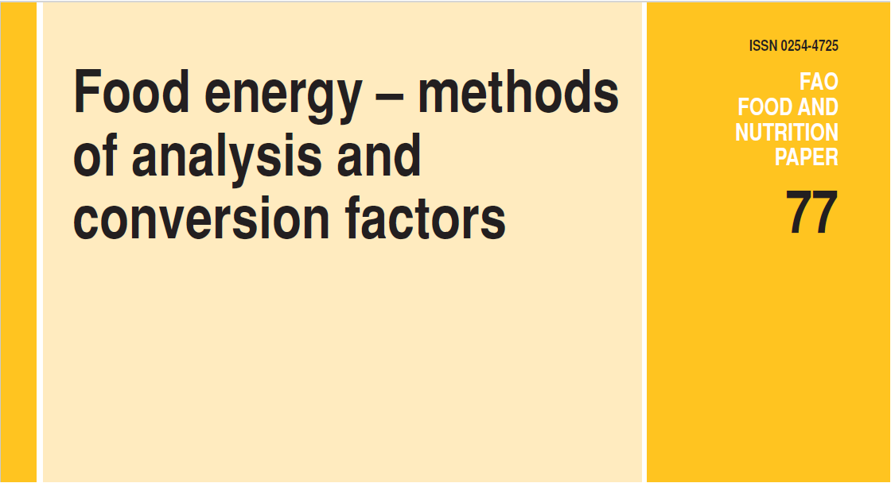

AMINO ACID ANALYSIS
FAO RECOMMENDATIONS FOR PROTEIN ANALYSIS IN FOODS
Measure protein as the sum of amino acids whenever possible
Need for consensus-based, standardized method (highlighted the lack of an AOAC official method) for determination of amino acids in foods
Use amino-acid based values for protein content whenever possible
Update food composition tables to reflect protein values based on amino acid analyses
Only amino acid analysis to be used to determine protein in:
Foods used as the sole source of nourishment, such as infant formula, or designed for special dietary conditions
Novel foods
https://www.fao.org/uploads/media/FAO_2003_Food_Energy_02.pdf
FAO (2003)

Slide 14
PROTEIN analysis
METHODS VALIDATED IN NOVEL FOOD MATRICES NEEDED FOR:
ROUTINE ANALYSIS
- Total nitrogen (Kjeldahl, Dumas) or another method for crude protein determination
REFERENCE ANALYSIS
- Sum of amino acids for “true” protein determination
AUTHENTICITY ANALYSIS
- Protein source identification or identity verification
ADVANCED ANALYSIS
- Identification and quantitation of individual proteins or protein profiling
First project of the new AOAC program

Slide 15
AOAC Program on NOVEL FOODS
FIRST PROJECT TO LAUNCH THE NEW AOAC PROGRAM:
DEVELOPMENT OF VOLUNTARY CONSENSUS STANDARD(S) FOR DETERMINATION OF TOTAL AMINO ACIDS
IN SELECTED FOOD PRODUCTS AND INGREDIENTS
Development of Standard Method Performance Requirements (SMPRs®) to serve as a basis for development of AOAC Official method(s), which could be adopted by Codex Alimentarius
Target matrices to be determined by the Advisory Panel

Slide 16


GET INVOLVED
NOVEL FOODS PROGRAM INTEREST FORM:
SUPPORT THE PROGRAM AND JOIN THE ADVISORY PANEL
GET ON THE MAILING LIST AS AN EXPERT OR FUTURE WORKING GROUP MEMBER
JOIN US AT:

Slide 17

THANK YOU FOR YOUR ATTENTION
NOVEL FOODS
INTEREST FORM
ANY QUESTIONS?
kmastovska@aoac.org

