Slide 1







Developments and Challenges in Precision Fermentation of Functional Protein Ingredients
Michael Madonna, PhD
Formerly Sr. Director of Protein Science at Shiru

Slide 2



Plant-based foods are booming, but key barriers remain
Taste & Texture
Price
Nutrition
73% of customers surveyed by Kerry Group believed that Plant-Based substitutes should mimic the taste of meat analogues
Consumers who lack interest in plant-based alternatives cited taste as the #1 reason why¹
The price of plant-based alternatives tend to come with a significant premium, between 20% and 300% of their animal counterparts²
52% of consumers say they would buy more plant-based products if they were cheaper than animal incumbants¹
43% of consumers see plant-based foods as healthier than other products¹
There are concerns about “clean label” and processing aides used to achieve the taste and texture³
1- Suzy Research Group survey, 2022
2- Giacalone et al. Understanding barriers to consumption of plant-based foods and beverages: insights from sensory and consumer science. Current Opinion in Food Science. V48, Dec 2022, 100919
3- Noguerol, et al. Green or clean? Perception of clean label plant-based products by omnivorous, vegan, vegetarian and flexitarian consumers. Food Research International, v149, Nov 2021, 110652

Slide 3
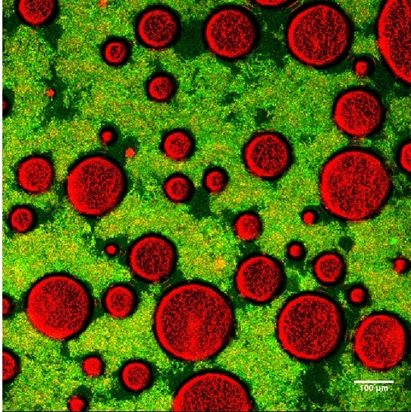

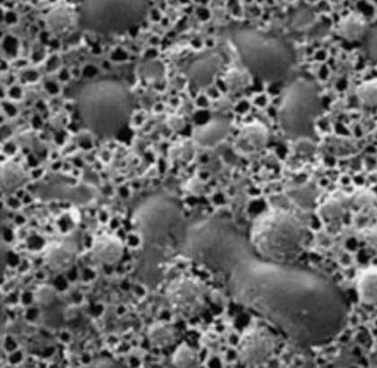

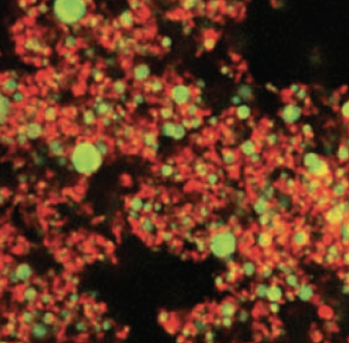
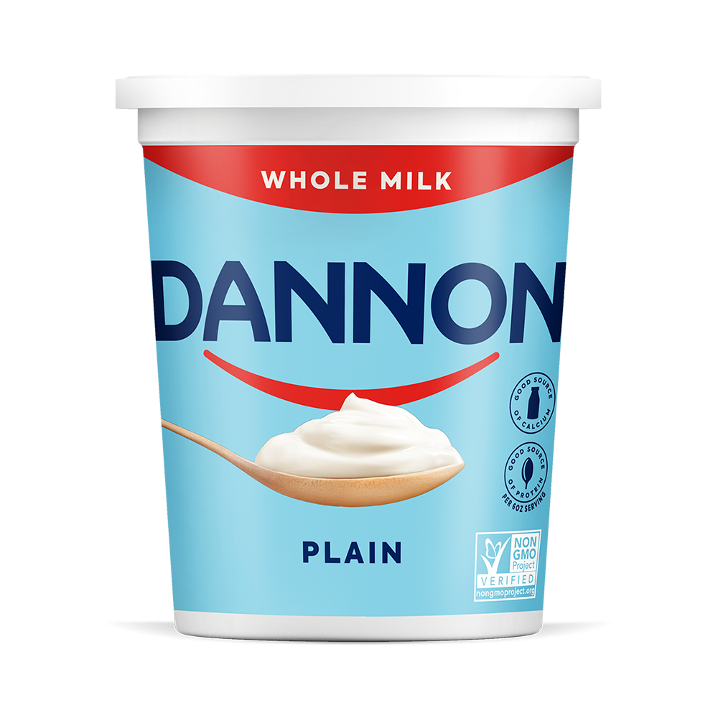
Proteins are key functional ingredients in foods
Proteins surround air bubbles to stabilize the water-air interface in foams¹
Egg proteins aggregate and create networks that become chewy gels in omlettes²
Dairy proteins stabilize oil droplets to create a creamy yogurt mouthfeel³
1- Confocal micrographs:. Jiang et al. Lactic acid bacteria as structural building blocks in non-fat whipping cream analogues. Food Hydrocolloids, v135, Feb 2023, 108137
2- Scanning electron micrograph: Kaewmanee et al. Effect of Sodium Chloride and Osmotic Dehydration on Viscoelastic Properties and Thermal-Induced Transitions of Duck Egg Yolk. Food Bioprocess Technol, 6(2), 2013
3- Confocal micrographs: Mark Auty. Microscopy tools for product innovation. Food Science and Technology, 33(4), 2019.

Slide 4
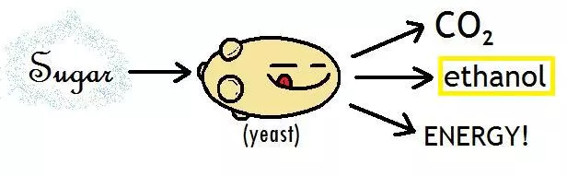











Precision Fermentation: Tiny, productive, cellular factories
Host Organism
Genetic instructions for production of a target protein are engineered into a microbial host, such as bacteria, yeast, fungi
  Controlled environment allows the host to grow and produce the desired product
  The protein is recovered and dried, typically resulting in a fluffy white powder
Historically called “recombinant expression” and has been used for decades in Biopharma
  Human insulin first produced by E.coli in 1978 (Genentech)
  Rennet was the first recombinant enzyme approved by FDA for use in foods (1990)
  Ajinomoto receives “No Questions Letter” from FDA for production of Transglutaminase by precision fermentation in 1998 (GRN No. 4)
Target Gene
Recovery & Product Formulation
Target Protein
Waste
(biomass, spent media, etc)

Slide 5
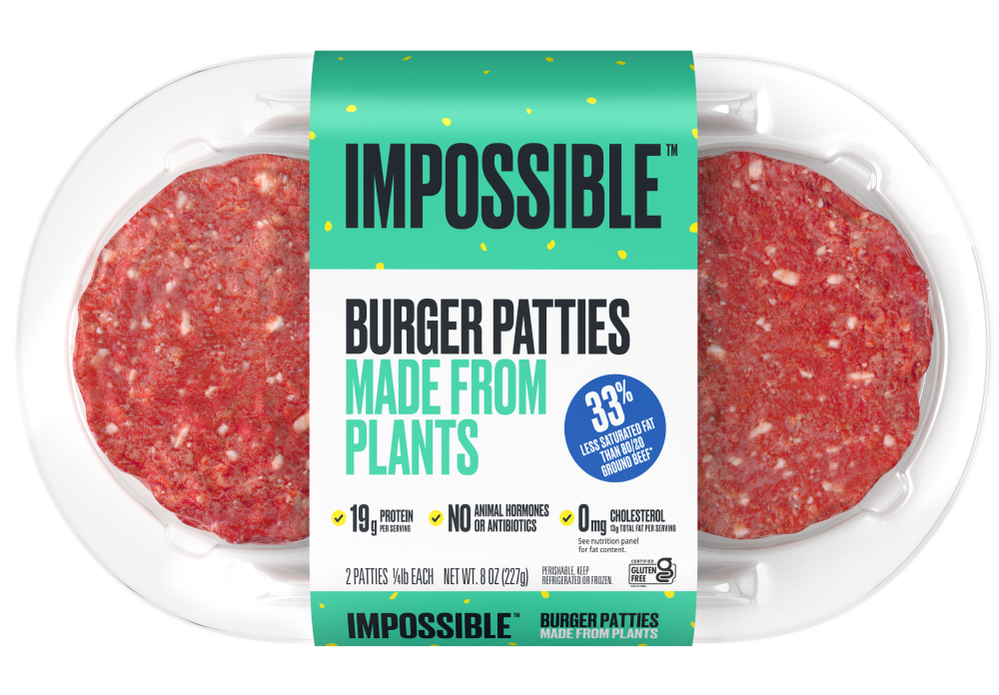
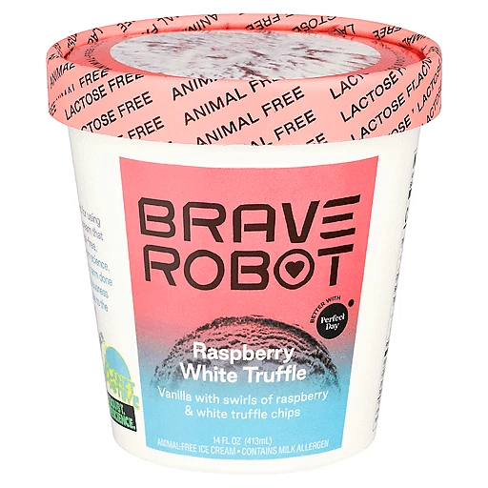
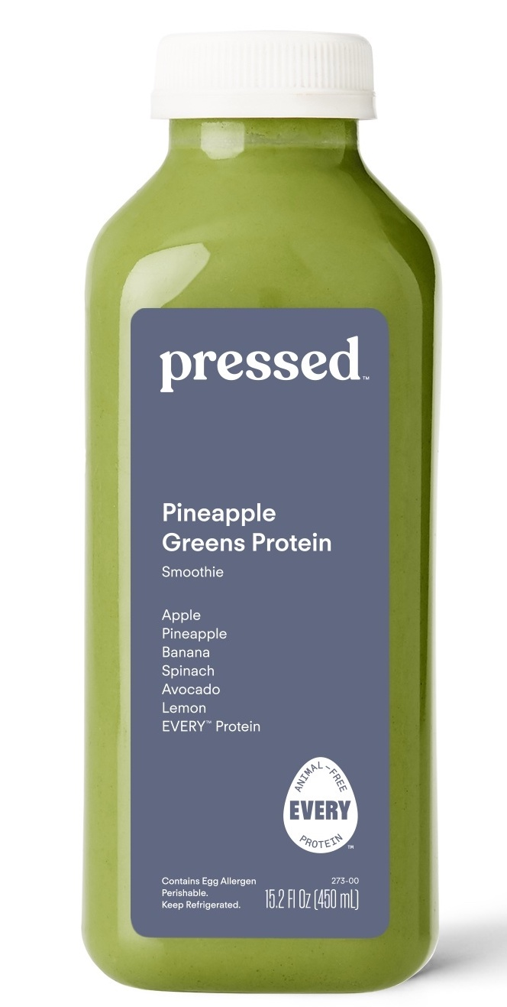
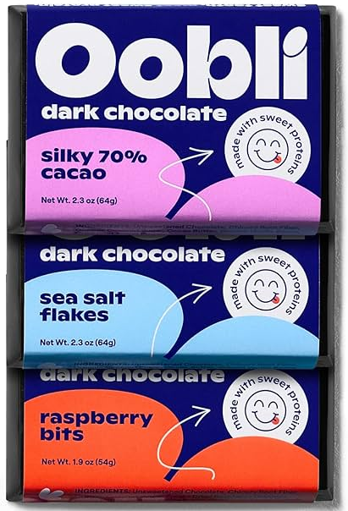

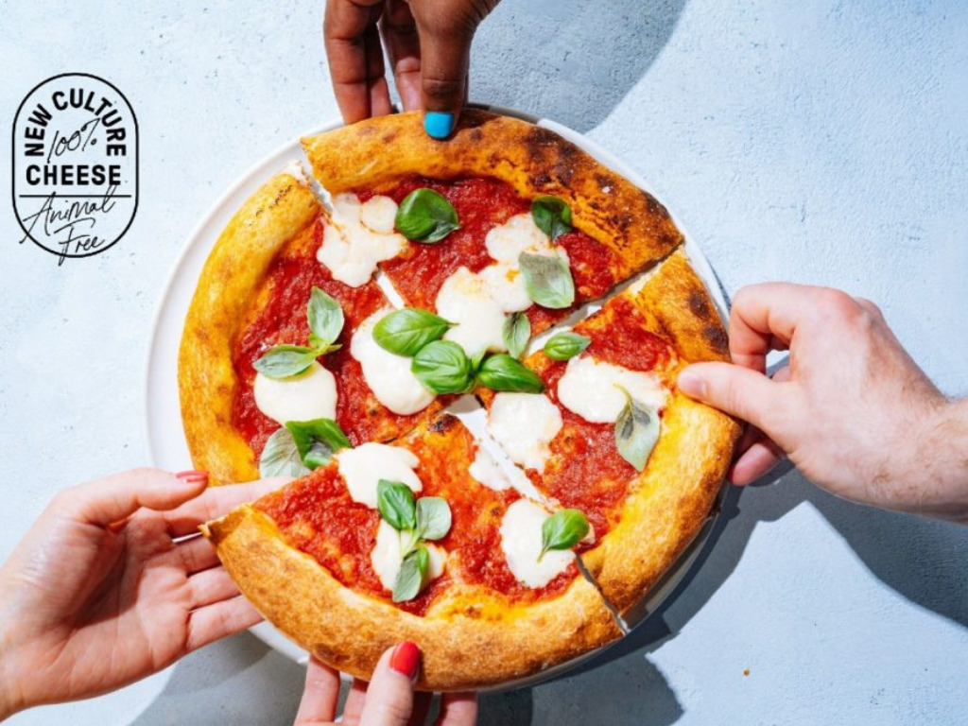
Precision fermentation products are enabling novel foods
Host Organism
Impossible Foods
Soy Leghemoglobin
2018
Perfect Day
β-Lactoglobulin
2020
Target Gene
Recovery & Product Formulation
Target Protein
Waste
(biomass, spent media, etc)
The EVERY Co
Egg white protein
2021
Oobli
Brazzein
2023
New Culture
Cow Casein
2023
Food processing enzymes are produced via precision fermentation (80% of Rennet used in cheese production)²
136 companies worldwide focused exclusively or predominantly on fermentation for alternative proteins by the end of 2022¹
$3.6B all-time investment in companies focused on fermentation for novel proteins, with $824M invested in 2022 alone
1- GFI State of the Industry Report: Fermentation (2022)
2- Johnson & Lucey. Major Technological Advances and Trends in Cheese. Journal of Dairy Science, 89 (4), 1174-1178

Slide 6
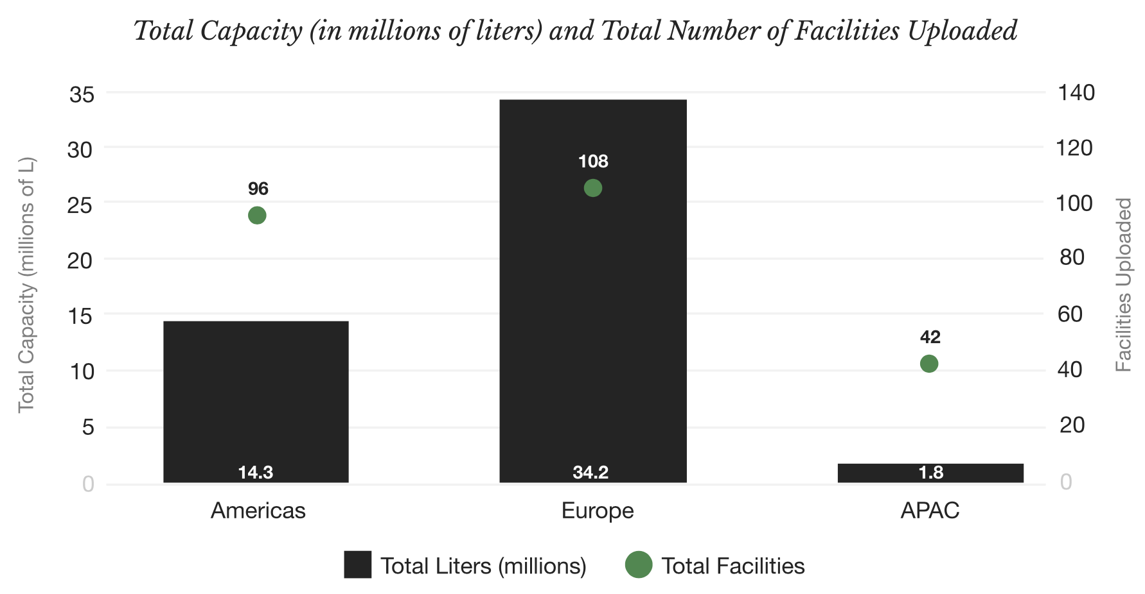
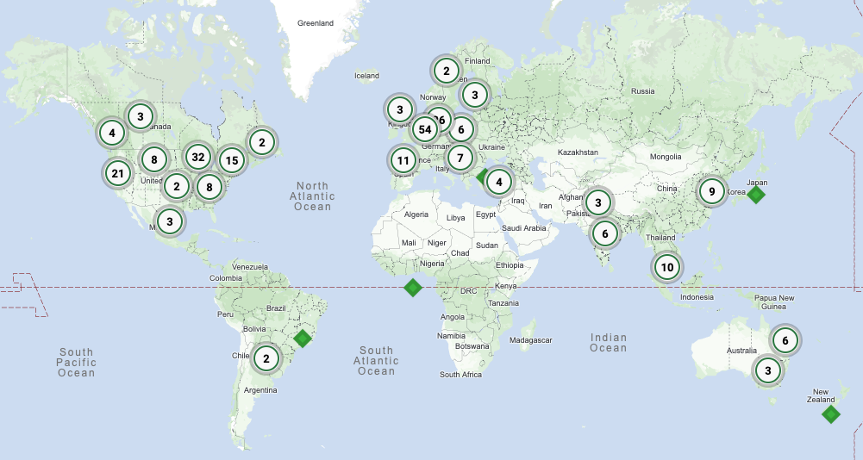
Limited capacity and high costs force deeper learnings early on
Total worldwide fermentation capacity is estimated at 50-60 million Liters, with individual bioreactor sizes ranging from 10 – 600,000L¹. Only ~10 million Liters of capacity is unreserved, with estimates of >1 billion Liters needed by 2030²
Scale-up costs force process development to be done at pre-pilot and bench scale (5 – 500L)
Sample limitations from early-stage titers (0.1-1g/L) create challenges for supporting characterization and formulation development
Identification of core analytics and safety/regulatory challenges can drive innovation
There are opportunities to leverage existing methods and technology from Biopharma to accelerate these ingredients
1- Synonym, State of Global Fermentation Report, Nov 2023
2- BCG, Food for Thought, Mar 2021
3- Map courtesy Synonym via Capacitor.bio

Slide 7


Fermentation process samples create complexity and opportunity
Filtration
Host
Lysis
Centrifuge
Chromatography
Drying
Milling
Mixing
Host cell biology drives the complexity of the purification process, and the resulting questions being asked of the material
  How much protein does it produce, and what metabolites must be removed?
  Can the host produce the protein in the desired form, or are there modifications?
  What are the control points necessary to ensure the final material is safe and functional?
Process complexity can produce a diverse set of intermediate samples that vary in composition, but need to be compared as a cohort in the context of target protein mass balance
Identification of what steps are needed to remove impurities and where protein loss occurs
The final material has a simple matrix that is flexible and can be used in a variety of ways, enabling down-sizing of a variety of assays
  Simple base composition: >70% protein, fat content <1%, ash/inorganics <10%, carbs <5%
  Homogenous, off-white powder
  Stable at room temp (dry)

Slide 8
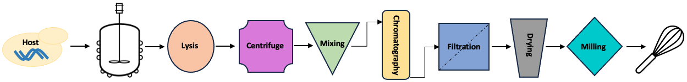
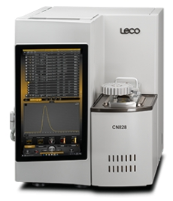
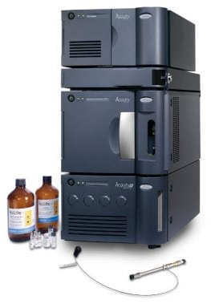

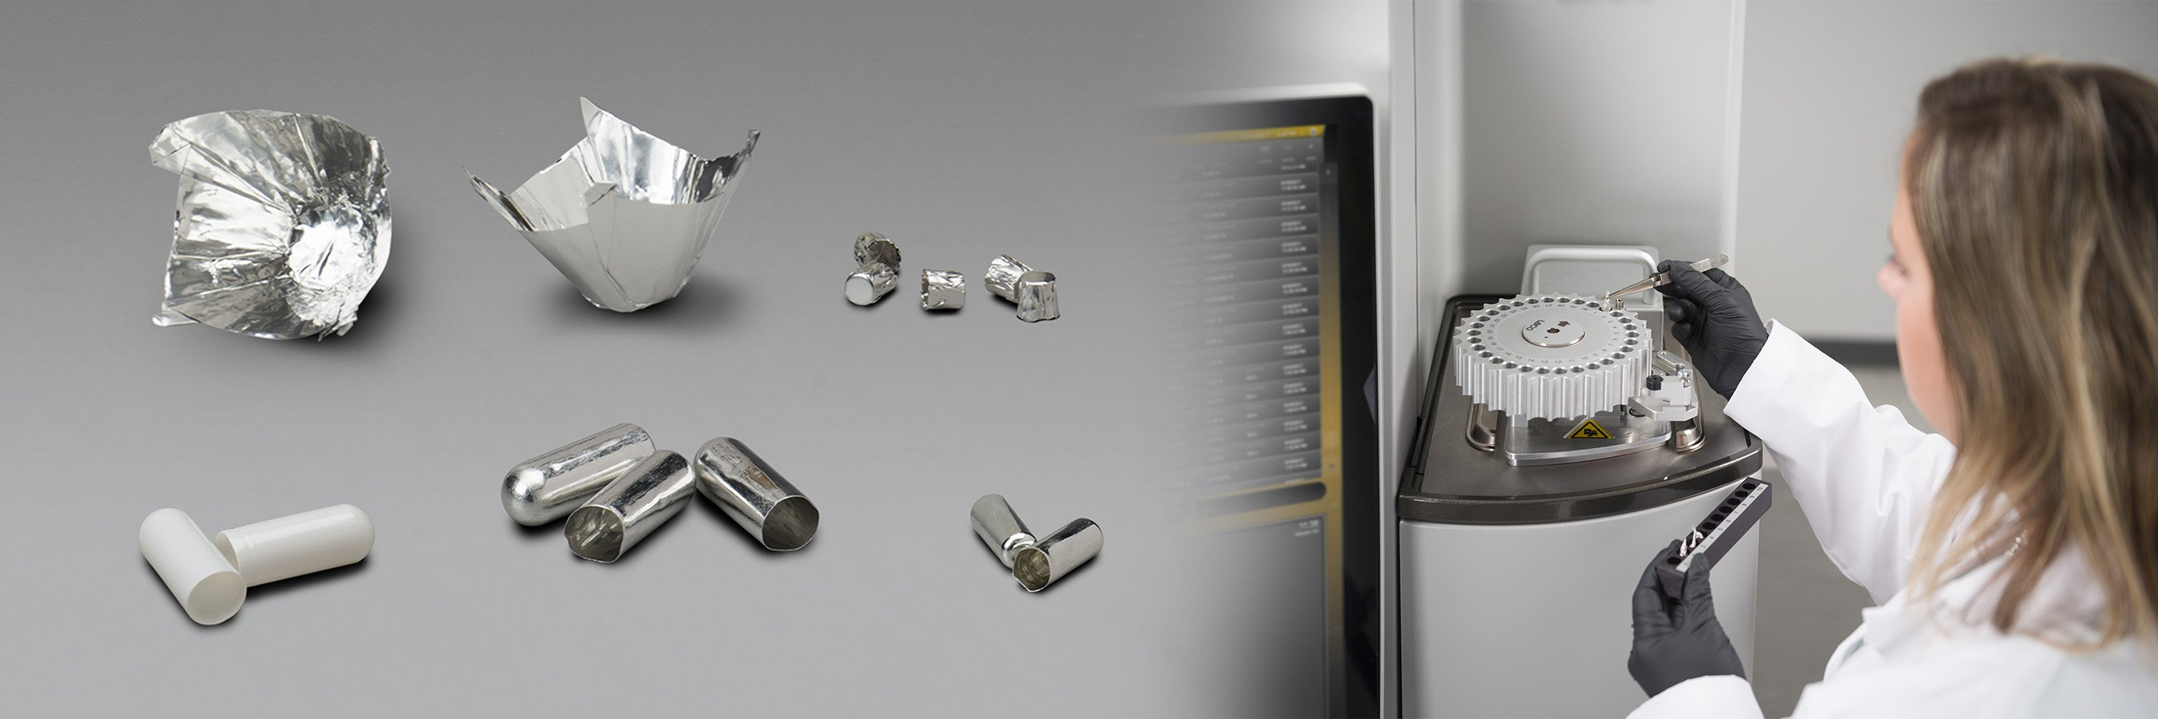
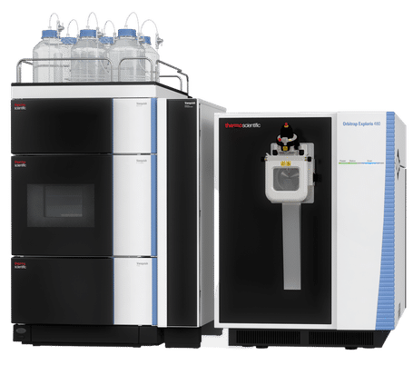
Accurate protein quant is essential to process development
Core process metrics rely on target protein tracking
  Fermentation Titer → grams of product produced per liter of fermentation volume
  Fermentation Productivity → Titer produced per hour
  Fermentation Yield → grams of product produced per gram of sugar
  Recovery → % of product obtained after purification from fermentation broth
  Purity → grams of product per 100g of final material
Existing standard methods are built for bulk protein
  Total protein by Nitrogen content (Dumas/Kjeldahl)
  Relies on a validated material specific conversion factor
  Requires understanding of potential sources of nitrogen in the sample matrix (nitrates, nitrites, ammonia, etc)
  Contract testing typically requires 10-25g
Biopharma has built tools to handle these proteins
  U/HPLC methods have been built to distinguish different proteins and impurities
  Amino Acid Analysis was recommended by FAO for protein determination in novel foods¹
  Mass Spectrometry can be used to identify a target protein in a complex matrix and quantify it
  Methods typically require 1 - 500ug sample and leverage the sequence identity of the target protein, but are more expensive
Waters UPLC
w/ AcqTag AAA Kit
Leco Nitrogen
Analyzer
Thermo Exploris
Mass Spec w/ UHPLC
Image Source: LECO Corp. online catalogue
Image Source: Waters online catalogue
Image Source: Thermo Fisher Scientific
1- FAO Food and Nutrition Paper 77, Food energy – methods of analysis and conversion factors

Slide 9
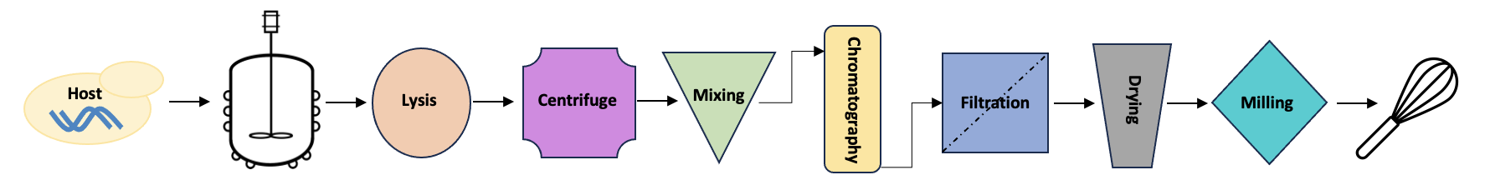
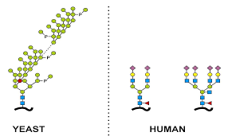
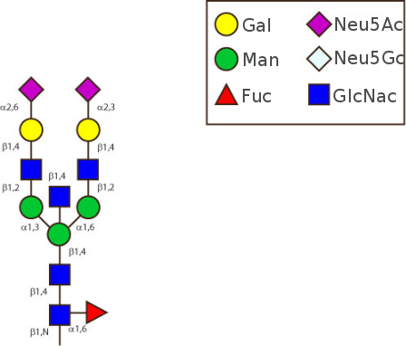
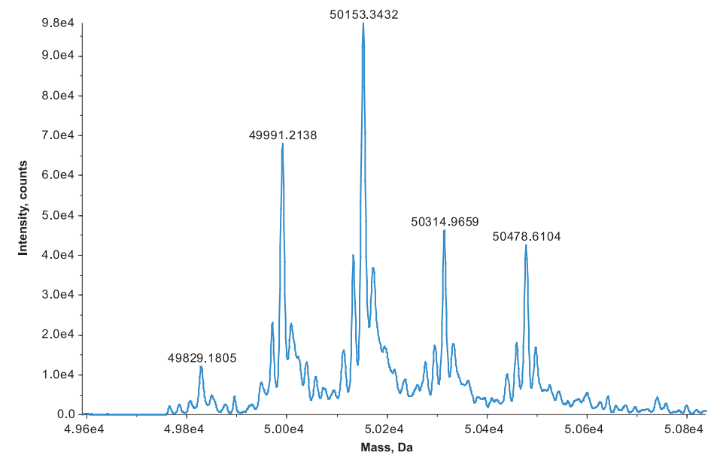
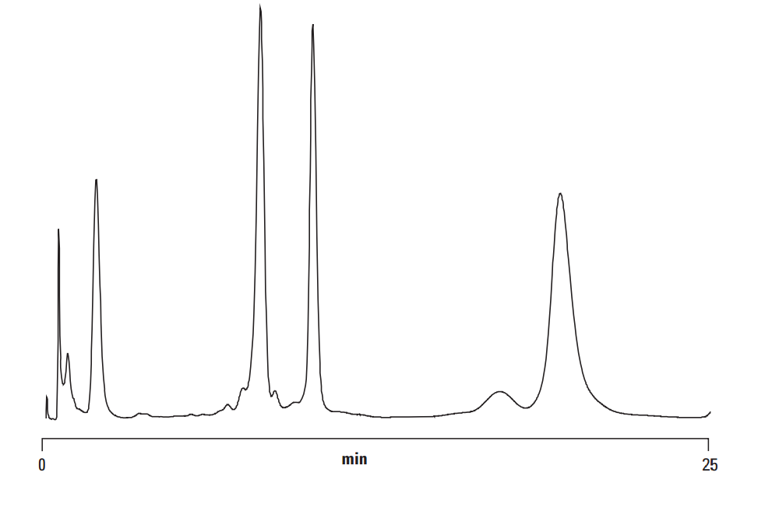
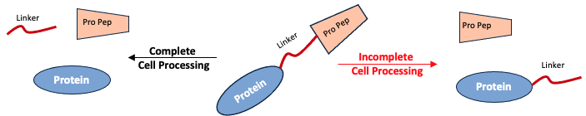
Post-translational modifications may impact function
Each process step can impact the target protein quality
  Changes in rheological properties (gelling, emulsifying, viscosifying)
  Shifts in mouthfeel (hardness, chewiness, water holding)
  Changes in flavor (increased bitterness, etc)
Host-cell biology can have the largest impact on target protein quality
  Hyperglycosylation can increase the protein mass by 2-10x
  Proteolytic activity shifts can yield either truncated or elongated products
  Misfolding in the cell (ie- scrambled disulfide connectivity) can alter the protein structure and impact food function
Biopharma has developed an extensive toolkit for PTM characterization
  Liquid chromatography, MassSpec, and capillary electrophoresis are all routinely used for therapeutic antibodies
  These tools are rarely deployed for proteins outside of biopharma or academic environments, primarily due to cost and the need for target analyte specific adjustments
Protein
Run-away
glycosylation
Protein
+162
+162
+162
+162
Image Source: Agilent Technologies application note

Slide 10

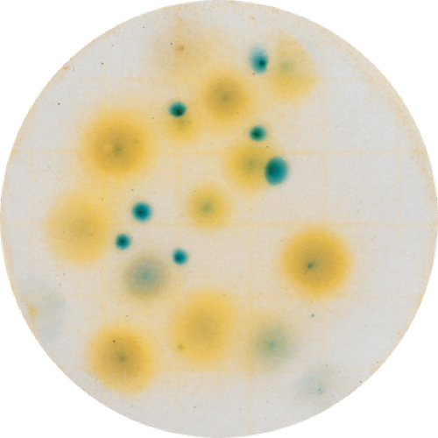
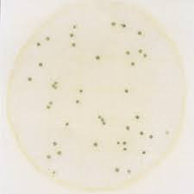

Safety & Regulatory Challenges
Bioengineered
“Food that contains genetic material that has been modified through certain laboratory techniques and for which the modification could not be obtained through conventional breeding or found in nature”
  As of Jan 1, 2022 all foods with detectable modified DNA must be labeled as Bioengineered (National Bioengineered Food Disclosure Standard)
  This is in line with similar standards in the EU
Microbial Load
  Sample limitations are a major challenge at smaller scales of production
  Host organism
  Pathogen detection (Salmonella, Listeria, etc) for food safety
  Yeast & mold for product quality
Production Organism Metabolites
Diacetyl
Host
Protein
  Host cell protein (HCP) contaminants – Are they toxic? Catalytic?
  Secondary metabolites (off-flavors, mycotoxins, etc) may impact product safety or quality
Protease
Target Protein
Target Protein
Host
Protein
Image Source: USDA
Image Source: 3M Technologies

Slide 11
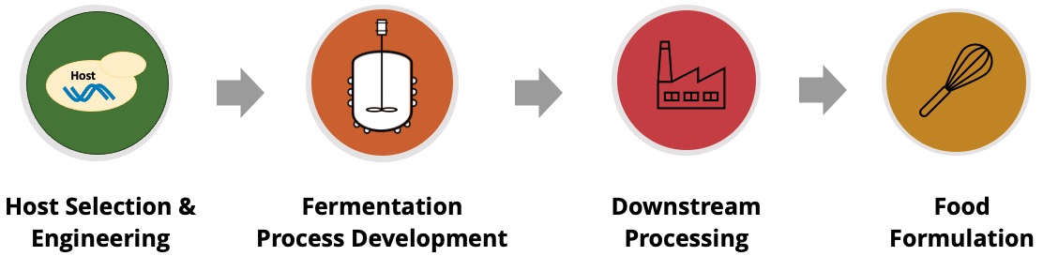
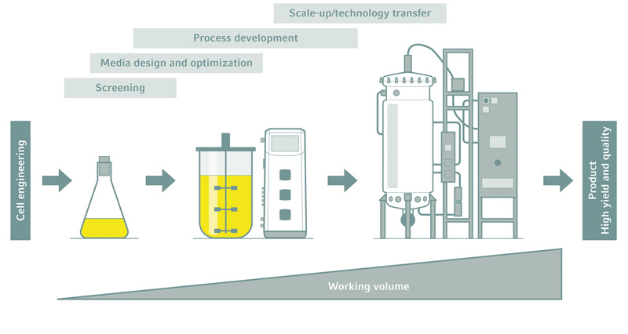
Functional proteins – take home and opportunity
These ingredients are unlocking critical sensory attributes in plant-based foods
  Delivering the sensory experience people expect removes the biggest barrier to adoption
  Enhancing flavor and texture with natural proteins also reduces the need for processing aides and texturizers that consumers don’t want to see on an ingredients label
  Commercializing these ingredients requires accelerating the development cycle and better understanding of unit economics, to reduce costs of final food products
Availability and cost of fermentation processes put added importance on bench-scale development
  The development cycle can only be accelerated if the data is there to provide learnings and enable decisions
  Sample demand for food product development and partnerships compounds this issue
  Food safety is critical. That’s the final proving ground
Process complexity demands flexible testing programs to connect data from strain to food
  Reliably measuring protein quantity and quality is a major challenge at early stages
  Understanding the sample matrix can lead to development of fit for purpose methods that require less material
  Lessons learned from biopharma and academia can drive innovation and improve access to more sophisticated technologies
$0.1k
(Flask)
$1k
(Benchtop)
$100k
(Pilot)
Image Source: Eppendorf

Slide 12
Thank You!

