Slide 1
Food Allergen Claims, Controls, and Considerations for Plant-Based and Dairy Milk Products
Melanie Downs, Ph.D.
Associate Professor
September 22, 2022
JIFSAN-CFS3 Advisory Council Webinar: Milk – A Discussion on the Nutritional, Food Safety and Consumer Preferences of Plant Based and Dairy Milk

Slide 2





Food Allergies
Quality of Life and Financial Burdens
$24.8 billion annual impact of childhood food allergy in the U.S.
Prevalence
Affects at least 3-4% of the U.S. population
  4-8% of children
  1-2% of adults
Possibly up to 10%
Sensitivity
Small amounts can cause reactions
Low mg or ppm total food protein
Severity
Reactions potentially life-threatening
Reactions are preventable
Avoidance Diets
Treatments are scarce
Strict avoidance diets

Slide 3
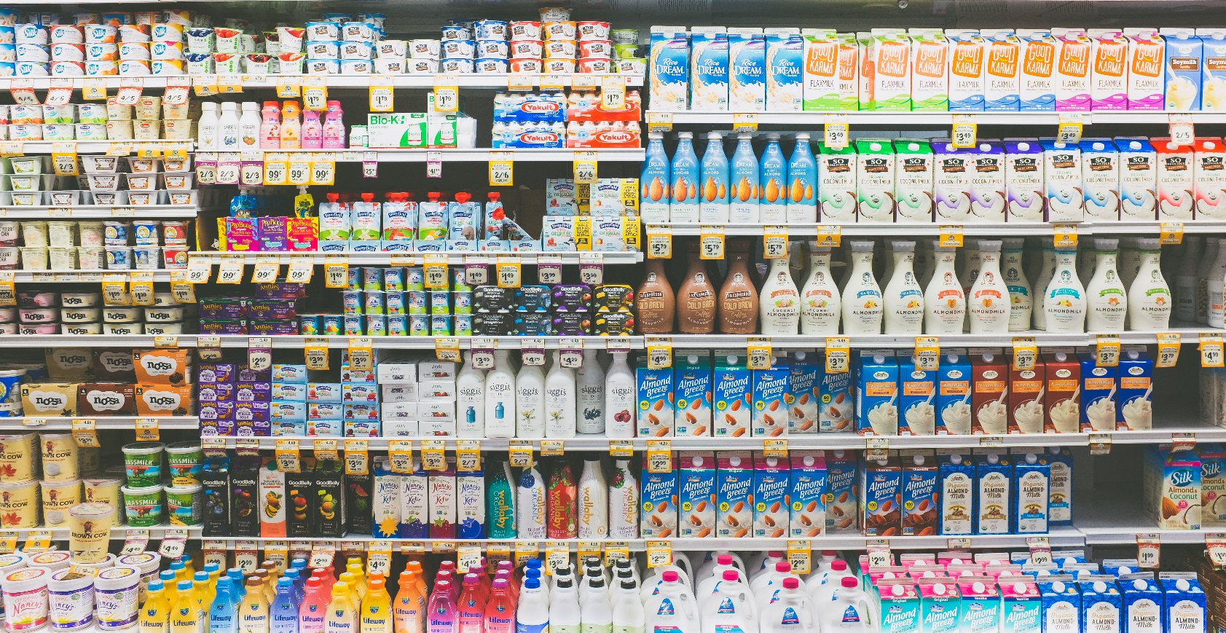
Treatment for True Food Allergies:
Specific Avoidance Diets
Allergic consumers rely on labeling to avoid allergens in packaged foods
Labeling regulations intended to provide allergic consumers with clear, accurate, and complete information

Slide 4


Food Allergen Regulations
Ingredient Labeling
Regulatory Thresholds
No established action levels
Milk
Egg
Crustacea
Fish
Peanut
Soybean
Tree nuts
Wheat
Sesame
Product Recalls
Leading cause of food recalls
Increase in allergen recalls
Food Allergen Management
U.S. FDA: Food Safety Modernization Act
CODEX: Code of Practice on Food Allergen Management

Slide 5
Allergen Considerations for Milk- and Plant-Based Beverages
Labeling
Cross-Contact

Slide 6
Beverages and Allergen Labeling
Major Allergens and Beverages
FALCPA Labeling Terminology
Milk
Eggs
Fish
Crustacean shellfish
Peanuts
Tree nuts
Soybeans
Wheat
Sesame (2023)
Must use the common name of the major food allergen for allergen declaration
“Milk” = cow’s milk
“Dairy” confusion

Slide 7
Free-From Labeling
Basics
Not specifically regulated
No standard definition
No standardization on allowable target levels so default is probably “not detected by the most sensitive analytical method in existence”
Must be truthful and not misleading
FDA Expectations?
Sampling assignment for milk in “milk-free” dark chocolate
“If a product or references to a product on a company website were to bear a dairy-free or similar claim, the FDA would expect there to be no milk allergen in the product given that consumers with milk allergy depend on the accuracy of dairy-free claims for their health.”
Similar claims: dairy-free, milk free, 100% milk free, and contains no milk
Dairy-free
Milk-free
Wheat-free
Peanut-free
Soy-free
FY18/19 Sample Collection and Analysis of Domestically Manufactured, Dairy-Free Dark Chocolate Products for Milk Allergen

Slide 8
Growing Free-From Claims
Pseudo free-from:
Allergen-free
Nut-free
Vegan
Plant-based
Allergy friendly
School safe
Broad claims:
Variable interpretations of pseudo free-from claims
Scarcity of validated analytical method to support some claims
What is meant by “allergen-free” or “nut-free”?
There are 160+ other foods that can cause allergic reactions
Hefle et al. 1996. Critical Reviews in Food Science and Nutrition 36:S69-S89

Slide 9
Potential for Emerging Food Allergens
Alternative Protein Sources
Canadian Case Series: Pea Protein
Food allergens = proteins
Introducing a new protein source may result in some number of reactions or sensitizations
High-protein products with protein concentrations/ isolates may substantially increase protein dose
6 pediatric cases
Some: no previously known pea allergy
Other allergies to tree nuts or legumes
Unexpected, systemic reactions after consuming products containing pea protein
50% of cases related to pea milk, beverages, or yogurt
Levine and Ben-Shoshan. 2019. JACI In Practice https://doi.org/10.1016/j.jaip.2019.02.010.

Slide 10
Plant-Based Beverages
Even without a label claim, the product category alone should be expected to attract milk-allergic consumers
Many milk-allergic individuals are children
Good Allergen Control is Critical

Slide 11
Hazard Identification
Product Development
Ingredient and Supply Chain Management
Ingredient Receiving, Storage, and Handling
Preventing Cross-Contact During Processing
Product Label and Packaging Controls
Hygienic Design
Food Allergen Sanitation
Validation & Verification
Allergen Detection
Effective Food Allergen Management
Training and Education

Slide 12
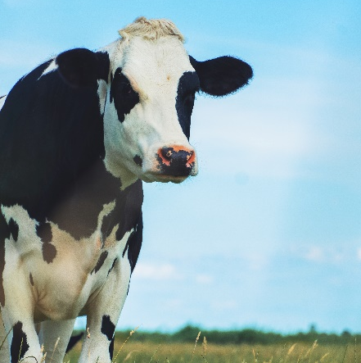
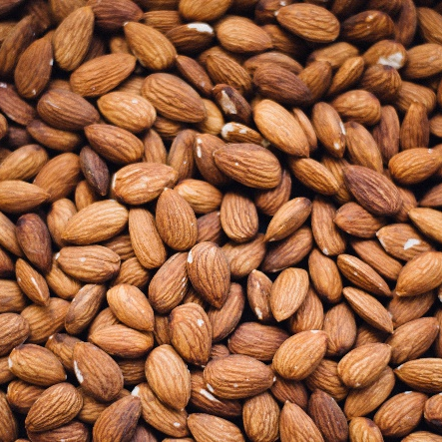
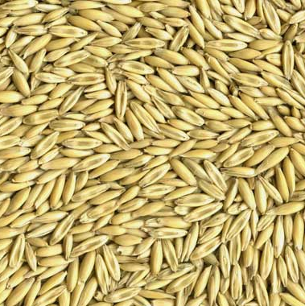
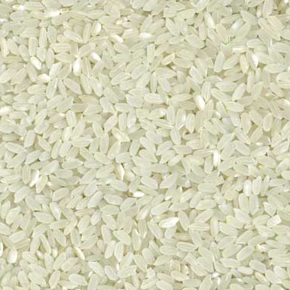
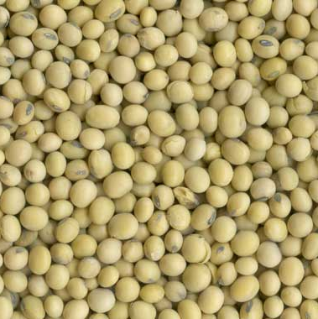
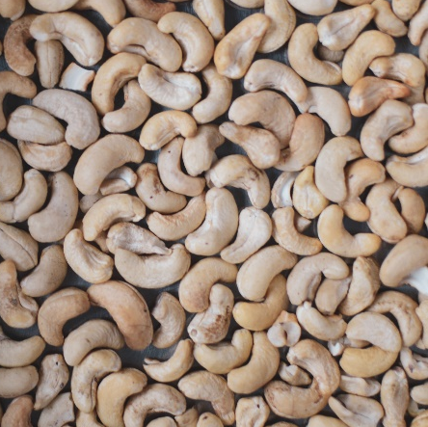
Allergen Hazard Analysis in Milk and Plant Beverages
Almost all combinations have cross-contact issues
Flavor ingredients
Commingling in raw materials (particularly for free-from claims)
  Soy is challenging
  Wheat/gluten in oats
Milk
Almond
Oat
Rice
Soy
Cashew

Slide 13

Beverages: Allergen Cross-Contact Management Considerations
Advantages
Can wet clean
Challenges
Complex scheduling
Can use CIP
UHT Effects on detection methods

Slide 14
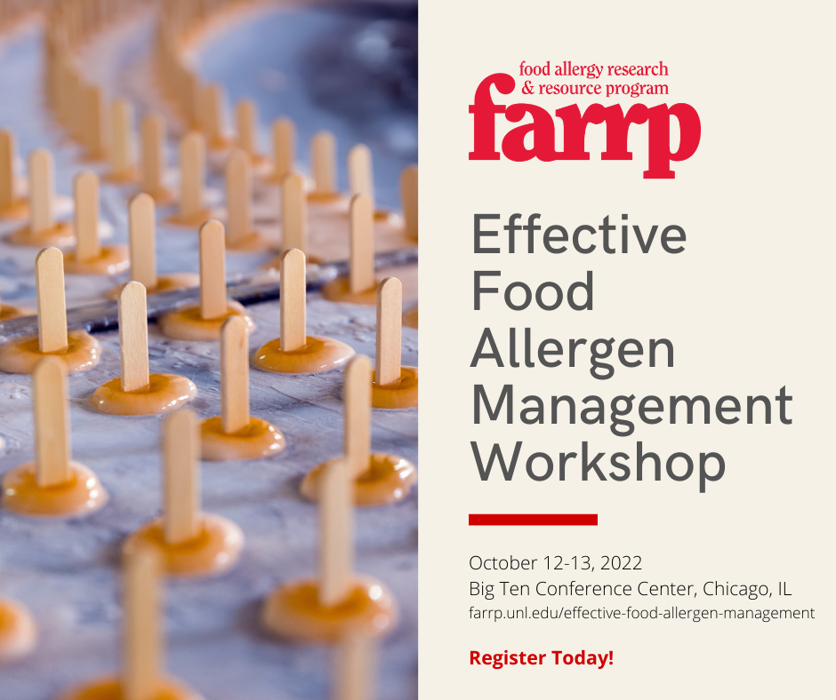
Thank you!
Questions?
mdowns2@unl.edu

